Slide 1
CLASSES

Slide 2
TypeScript Class
JavaScript does not have a concept of class like other programming languages such as Java and C#.
In ES5, you can use a constructor function and prototype inheritance to create a “class”.
ES6 allowed you to define a class which is simply syntactic sugar for creating constructor function and prototypal inheritance:
In the class syntax, the constructor is clearly defined and placed inside the class.

Slide 3
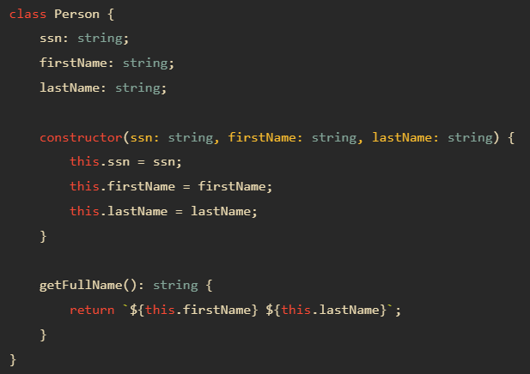
TypeScript Class
TypeScript class adds type annotations to the properties and methods of the class.

Slide 4
TypeScript Access Modifiers
Access modifiers change the visibility of the properties and methods of a class.
TypeScript provides three access modifiers:
private
protected
public

Slide 5
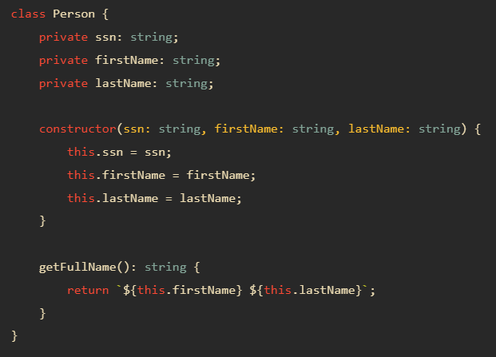

The private modifier
The private modifier limits the visibility to the same-class only.
When you add the private modifier to a property or method, you can access that property or method within the same class.
Any attempt to access private properties or methods outside the class will result in an error at compile time.

Slide 6
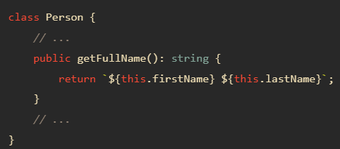
The public modifier
The public modifier allows class properties and methods to be accessible from all locations.
If you don’t specify any access modifier for properties and methods, they will take the public modifier by default.

Slide 7
The protected modifier
The protected modifier allows properties and methods of a class to be accessible within same class and within subclasses.
When a class (child class) inherits from another class (parent class), it is a subclass of the parent class.
The TypeScript compiler will issue an error if you attempt to access the protected properties or methods from anywhere else.
To add the protected modifier to a property or a method, you use the protected keyword.

Slide 8
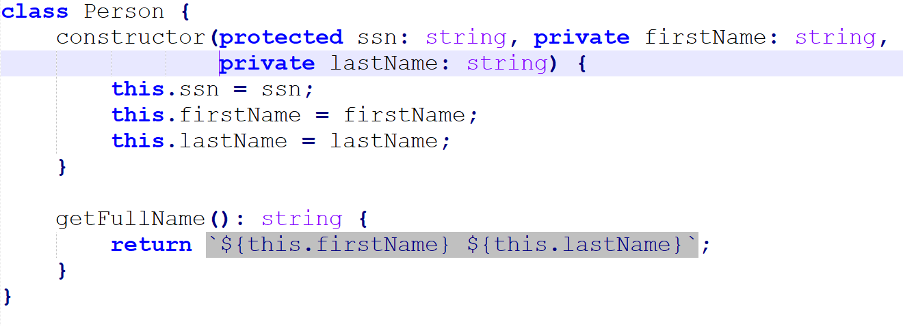
The protected modifier

Slide 9
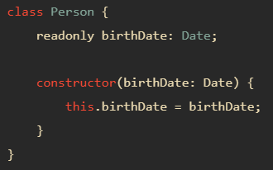

TypeScript readonly
TypeScript provides the readonly modifier that allows you to mark the properties of a class immutable.
The assignment to a readonly property can only occur in one of two places:
In the property declaration.
In the constructor of the same class.
To mark a property as immutable, you use the readonly keyword.

Slide 10
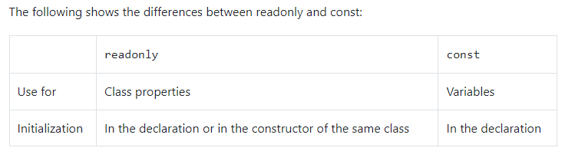
Readonly vs. const

Slide 11
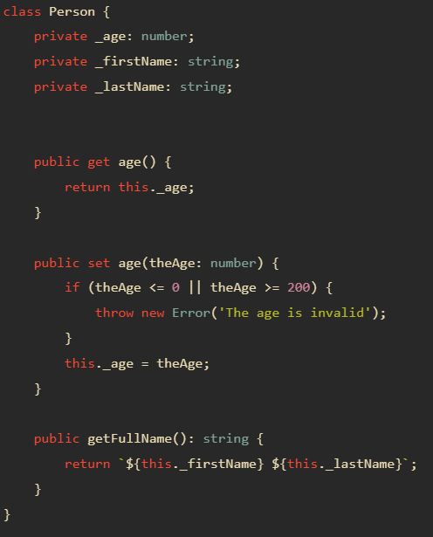
TypeScript Getters and Setters
A getter method returns the value of the property’s value. A getter is also called an accessor.
A setter method updates the property’s value. A setter is also known as a mutator.
A getter method starts with the keyword get and a setter method starts with the keyword set.

Slide 12


TypeScript Getters and Setters
The call to the setter doesn’t have parentheses like a regular method.
When you call person.age, the age setter method is invoked. If you assign an invalid age value, the setter will throw an error:

Slide 13
TypeScript Inheritance
A class can reuse the properties and methods of another class. This is called inheritance in TypeScript.
The class which inherits properties and methods is called the child class. And the class whose properties and methods are inherited is known as the parent class. These names come from the nature that children inherit genes from parents.
Inheritance allows you to reuse the functionality of an existing class without rewriting it.
JavaScript uses prototypal inheritance, not classical inheritance like Java or C#. ES6 introduces the class syntax that is simply the syntactic sugar of the prototypal inheritance. TypeScript supports inheritance like ES6.

Slide 14
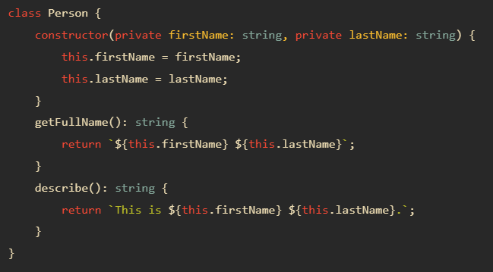

TypeScript Inheritance
To inherit a class, you use the extends keyword.
For example the following Employee class inherits the Person class:
the Employee is a child class and the Person is the parent class

Slide 15
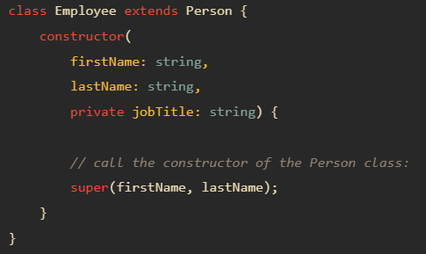
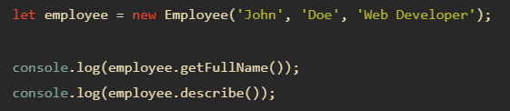
Constructor
Because the Person class has a constructor that initializes the firstName and lastName properties, you need to initialize these properties in the constructor of the Employee class by calling its parent class’ constructor.
To call the constructor of the parent class in the constructor of the child class, you use the super() syntax.
Because the Employee class inherits properties and methods of the Person class, you can call the getFullName() and describe() methods on the employee object

Slide 16
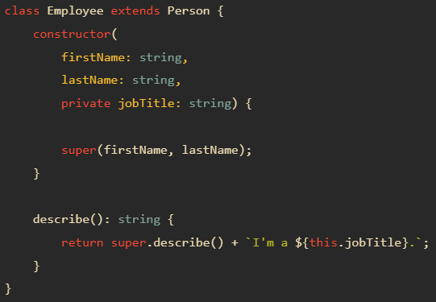

Method overriding

Slide 17
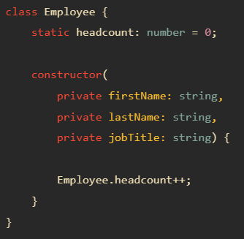
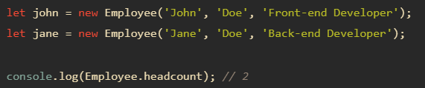
Static properties
Unlike an instance property, a static property is shared among all instances of a class.
To declare a static property, you use the static keyword.
To access a static property, you use the className.propertyName syntax.

Slide 18
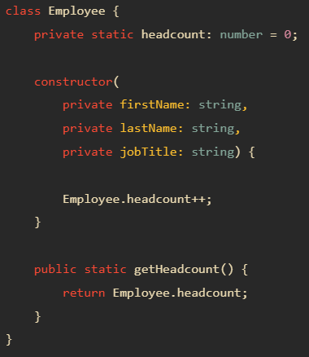
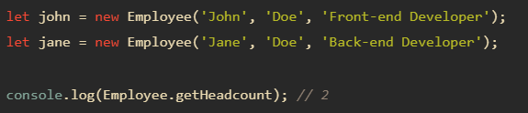
Static methods
Similar to the static property, a static method is also shared across instances of the class.
To declare a static method, you use the static keyword before the method name.
To call a static method, you use the className.staticMethod() syntax

Slide 19
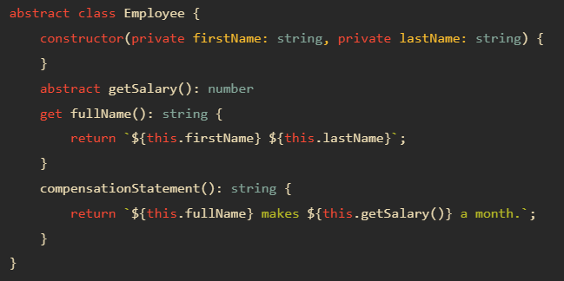
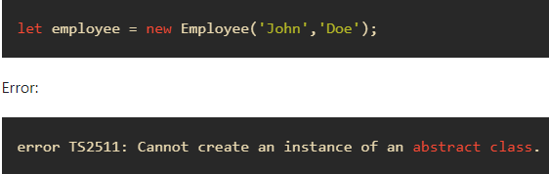
TypeScript Abstract Classes
An abstract class is typically used to define common behaviors for derived classes to extend.
Unlike a regular class, an abstract class cannot be instantiated directly.
To declare an abstract class, you use the abstract keyword

Slide 20
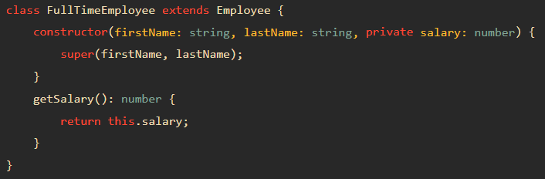
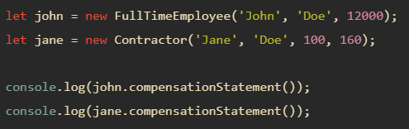
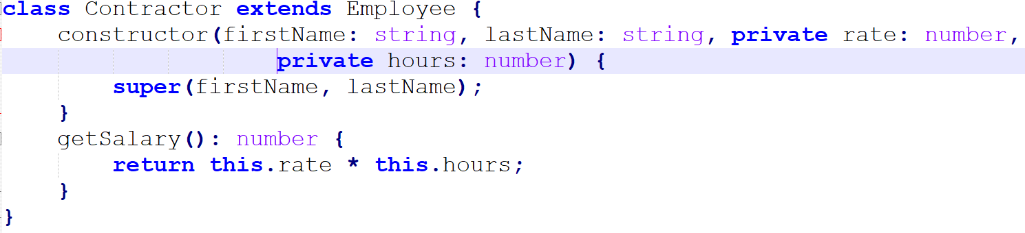
TypeScript Abstract Classes

Slide 21
TypeScript Interface

Slide 22
Interfaces
Interfaces allow us to create contracts that other classes/ objects can implement.
Interfaces are defined using the interface keyword that includes properties and methods.
We can have optional properties, marked with a "?" that do not have to be implemented.
The TypeScript compiler does not convert the interface to JavaScript.
Instead they are only used for type checking.

Slide 23
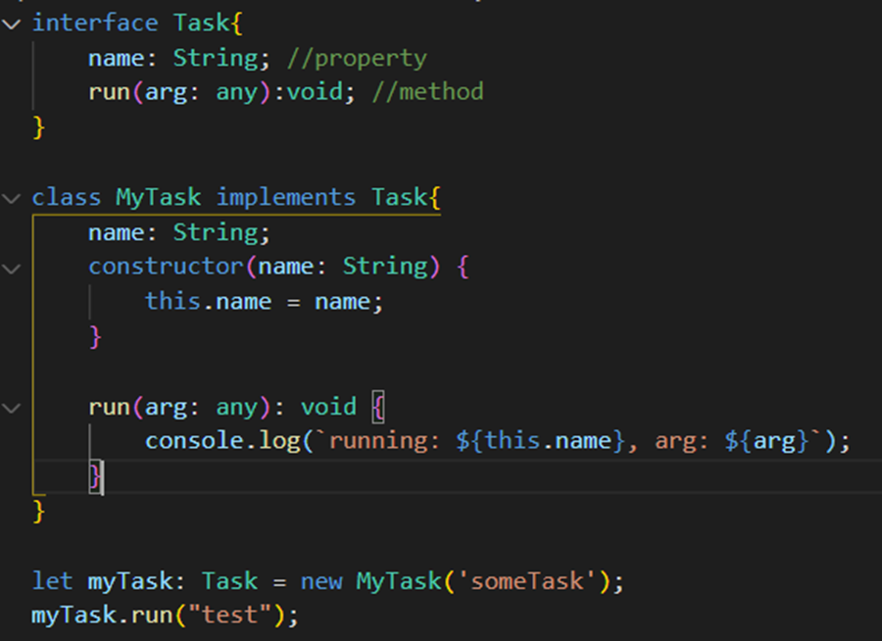
Interfaces

Slide 24
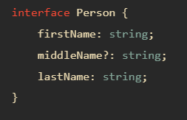
Optional properties
An interface may have optional properties.
To declare an optional property, you use the question mark (?) at the end of the property name in the declaration

Slide 25
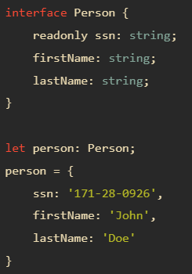
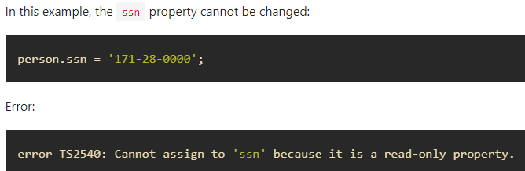
Readonly properties
If properties should be modifiable only when the object first created, you can use the readonly keyword before the name of the property

Slide 26
Interfaces
TypeScript interfaces define contracts in your code and provide explicit names for type checking.
Interfaces may have optional properties or readonly properties.
Interfaces can be used as function types.
Interfaces are typically used as class types that make a contract between unrelated classes.

Slide 27
Extending Interfaces
An interface can extend one or multiple existing interfaces.
An interface also can extend a class. If the class contains private or protected members, the interface can only be implemented by the class or subclasses of that class.

