Slide 1
GENERICS
TypeScript generics allow you to write the reusable and generalized form of functions, classes, and interfaces.

Slide 2
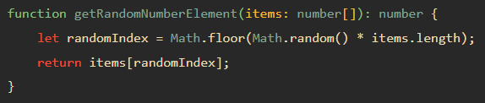

TypeScript Generics
Suppose you need to develop a function that returns a random element in an array of numbers.
The following getRandomNumberElement() function takes an array of numbers as its parameter and returns a random element from the array:
To get a random element of an array, you need to:
Find the random index first.
Get the random element based on the random index.
Assuming that you need to get a random element from an array of strings.

Slide 3
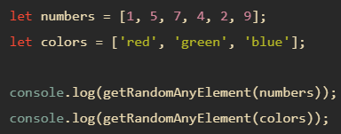
TypeScript Generics
Using the any type
One solution for this issue is to set the type of the array argument as any[].
By doing this, you need to write just one function that works with an array of any type.

Slide 4
TypeScript Generics
This solution works fine. However, it has a drawback.
It doesn’t allow you to enforce the type of the returned element. In other words, it isn’t type-safe.
A better solution to avoid code duplication while preserving the type is to use generics.

Slide 5
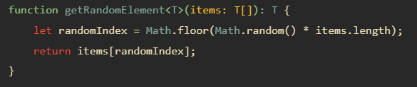
TypeScript Generics come to rescue
The following shows a generic function that returns the random element from an array of type T
This function uses type variable T. The T allows you to capture the type that is provided at the time of calling the function. Also, the function uses the T type variable as its return type.
This getRandomElement() function is generic because it can work with any data type including string, number, objects,…
By convention, we use the letter T as the type variable. However, you can freely use other letters such as A, B C, …

Slide 6

Calling a generic function
The following shows how to use the getRandomElement() with an array of numbers:
In practice, you’ll use type inference for the argument. It means that you let the TypeScript compiler set the value of T automatically based on the type of argument that you pass into, like this:
let numbers = [1, 5, 7, 4, 2, 9];
let randomEle = getRandomElement(numbers);
console.log(randomEle);
In this example, we didn’t pass the number type to the getRandomElement() explicitly. The compiler just looks at the argument and sets T to its type.

Slide 7
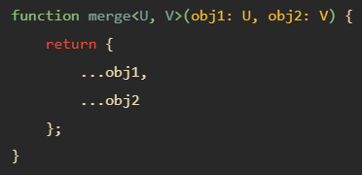
Generic functions with multiple types
The following illustrates how to develop a generic function with two type variables U and V:

Slide 8


TypeScript Generic Classes
A generic class has a generic type parameter list in an angle brackets <> that follows the name of the class:
TypeScript allows you to have multiple generic types in the type parameter list.

Slide 9


TypeScript Generic Interfaces
Like classes, interfaces also can be generic. A generic interface has generic type parameter list in an angle brackets <> following the name of the interface
This make the type parameter T visible to all members of the interface.
The type parameter list can have one or multiple types.

Slide 10
Array<Type>
Let us consider a function
function identity<Type>(arg: Type): Type {
return arg;
}
What if we want to also log the length of the argument arg to the console with each call? We might be tempted to write this:
function loggingIdentity<Type>(arg: Type): Type {
console.log(arg.length);
return arg;
}
Property 'length' does not exist on type 'Type'.

Slide 11
Array<Type>
When we do, the compiler will give us an error that we’re using the .length member of arg, but nowhere have we said that arg has this member.
Remember, we said earlier that these type variables stand in for any and all types, so someone using this function could have passed in a number instead, which does not have a .length member.
Let’s say that we’ve actually intended this function to work on arrays of Type rather than Type directly. Since we’re working with arrays, the .length member should be available. We can describe this just like we would create arrays of other types:
function loggingIdentity<Type>(arg: Type[]): Type[] {
console.log(arg.length);
return arg;
}

Slide 12
Array<Type>
You can read the type of loggingIdentity as “the generic function loggingIdentity takes a type parameter Type, and an argument arg which is an array of Types, and returns an array of Types.”
If we passed in an array of numbers, we’d get an array of numbers back out, as Type would bind to number.
This allows us to use our generic type variable Type as part of the types we’re working with, rather than the whole type, giving us greater flexibility.
We can alternatively write the sample example this way:
function loggingIdentity<Type>(arg: Array<Type>): Array<Type> {
console.log(arg.length); // Array has a .length, so no more error
return arg;
}

Slide 13
TypeScript Modules

Slide 14
TypeScript Modules
A TypeScript module can contain both declarations and code.
A module executes within its own scope, not in the global scope.
It means that when you declare variables, functions, classes, interfaces, etc., in a module, they are not visible outside the module unless you explicitly export them using export statement.
On the other hand, if you want to access variables, functions, classes, etc., from a module, you need to import them using the import statement.

Slide 15

Creating a new module
The following creates a new module called Validator.ts and declares an interface named Validator
In this module, we place the export keyword before the interface keyword to expose it to other modules.
In other words, if you do not use the export keyword, the Validator interface is private in the Validator.ts module, therefore, it cannot be used by other modules.

Slide 16
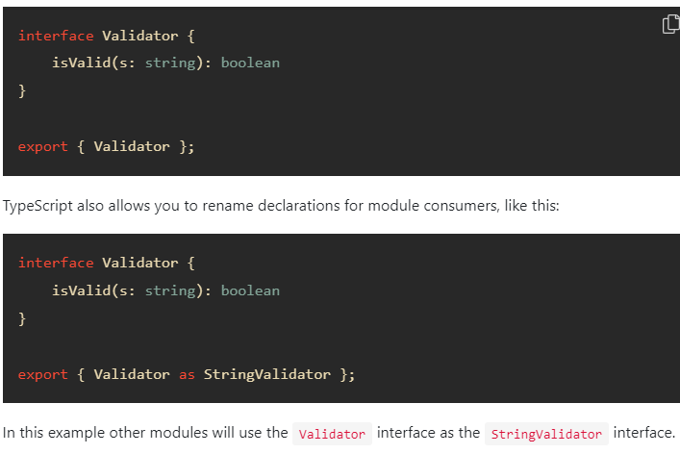
Export statements
Another way to export a declaration from a module is to use the export statement

Slide 17
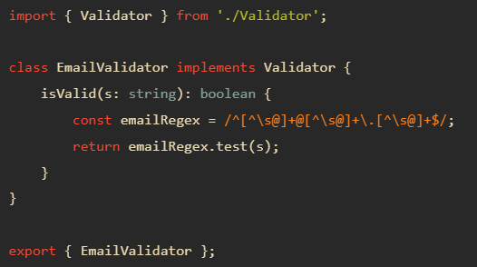

Importing a new module
To consume a module, you use the import statement.
The following creates a new module EmailValidator.ts that uses the Validator.ts module

