Slide 1
TypeScript

Slide 2

Decorators
Decorators are used to add special behaviors to a class or to members of a class.
The decorator is a function that takes in arguments and adds some annotation or metadata to the arguments in a declarative way.
A Decorator is a special kind of declaration attached to a class declaration, method, accessor, property, or parameter.
Decorators are defined in the @expression format, where expression evaluates a function that called at runtime.
Decorators can be attached to a class declaration, method, property, accessor, or parameter.
For the decorator @frozen, we write the frozen function as follows:

Slide 3
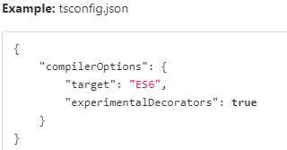
Decorators
In TypeScript, we need to enable experimental support for decorators.
In the tsconfig.json file, we set the experimentalDecorators compiler option property to true, in order to use decorators in our code.
Note: By running tsc --init command, the Typescript compiler automatically creates a tsconfig.json file in our working directory.

Slide 4
Types of Decorators
There are 4 different types of decorators:
Class decorators
Method decorators
Property decorators
Parameter decorators

Slide 5
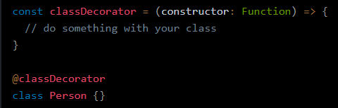
Class Decorators
A Class Decorator is used to decorate a class declaration. The class decorator receives the constructor of the class as its only argument.
The decorator can be used to observe, modify, or replace a class definition.

Slide 6
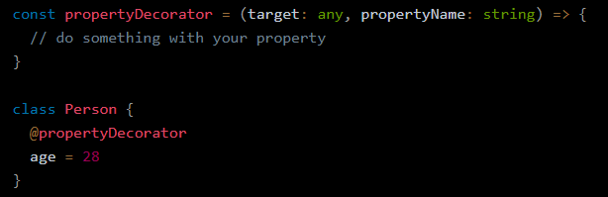
Property Decorators
A Property Decorator is used to decorate a property of a class. The property decorator receives two arguments.
The prototype of the class for an instance member OR the constructor function of the class for a static member.
The name of the property.

Slide 7
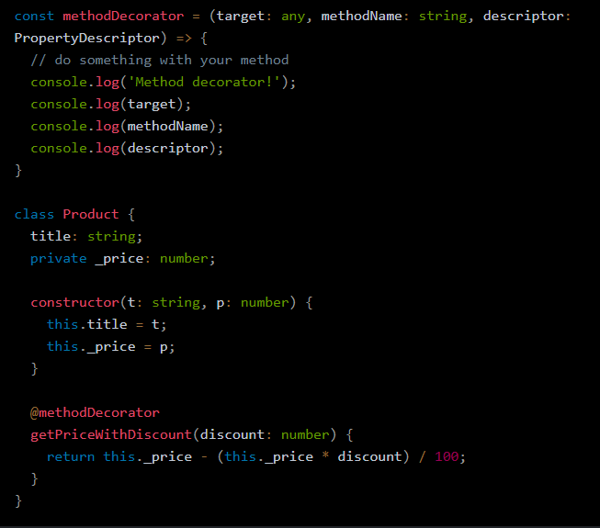
Method Decorators
A Method Decorator is used to decorate a class method.
The method decorator is applied to the Property Descriptor for that method.
The method decorator receives three arguments.
The prototype of the class for an instance member OR the constructor function of the class for a static member.
The name of the method.
The Property Descriptor for the method.

Slide 8
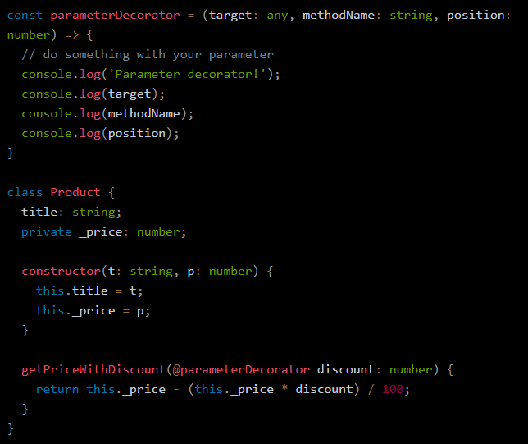
Parameter Decorators
A Parameter Decorator is is used to decorate a parameter of a class method or a class constructor.
The parameter decorator receives three arguments.
The prototype of the class for an instance member OR the constructor function of the class for a static member.
The name of the method that uses the parameter.
The index of the parameter in the function’s parameter list.

Slide 9
Accessor Decorators
An Accessor Decorator is used to decorate an accessor property of a class. The accessor decorator gets applied to the Property Descriptor for that accessor.
Since the Property Descriptor combines both the get and set accessor, all decorators for the member must be applied to one accessor, not to both of the accessors.
The accessor decorator receives three arguments.
The prototype of the class for an instance member OR the constructor function of the class for a static member.
The name of the accessor.
The Property Descriptor for the accessor.

Slide 10
TypeScript Utility Types
TypeScript comes with a large number of types that can help with some common type manipulation, usually referred to as utility types.

Slide 11
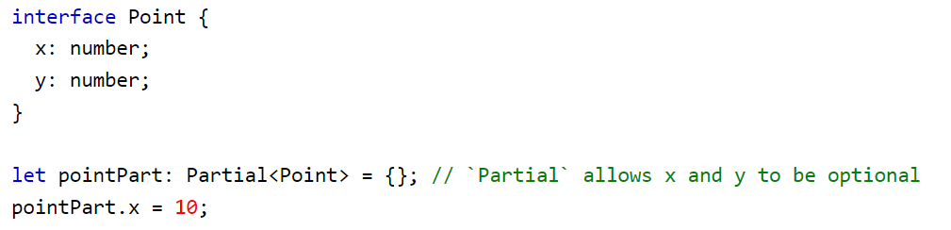
Partial
Partial changes all the properties in an object to be optional.

Slide 12
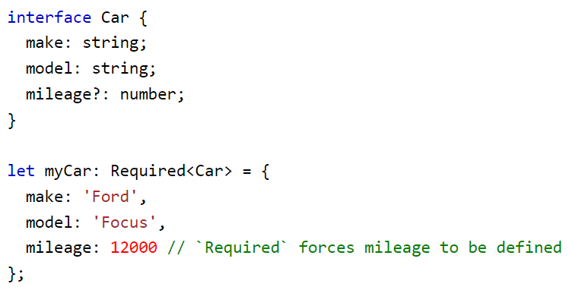
Required
Required changes all the properties in an object to be required.

Slide 13
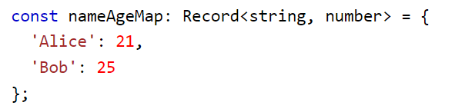
Record
Record is a shortcut to defining an object type with a specific key type and value type

Slide 14
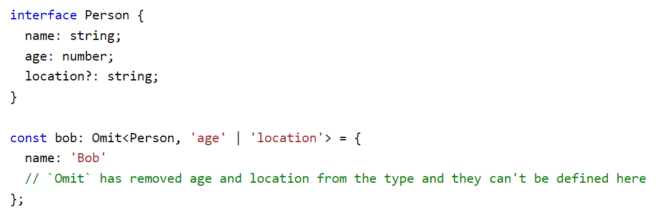
Omit
Omit removes keys from an object type.

Slide 15
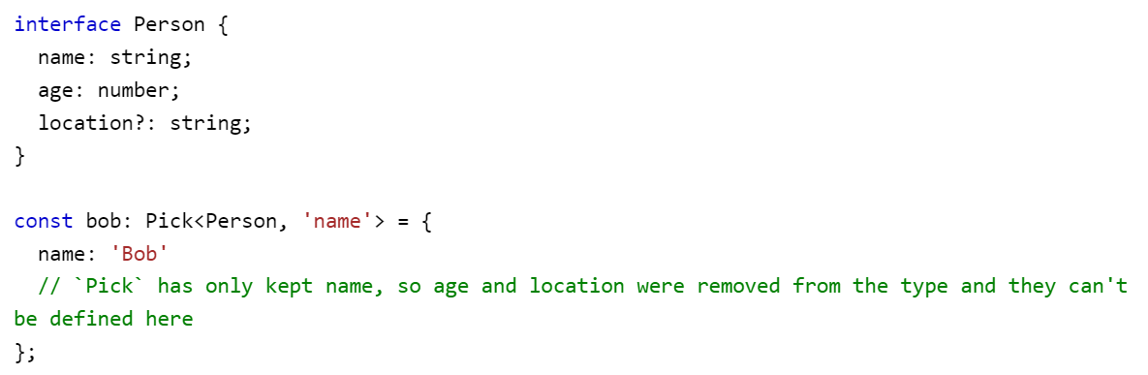
Pick
Pick removes all but the specified keys from an object type.

Slide 16
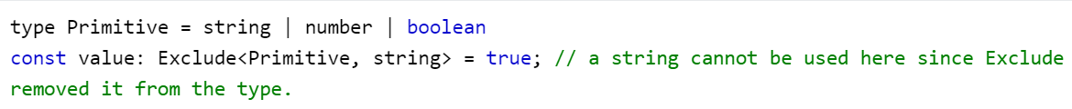
Exclude
Exclude removes types from a union.

Slide 17
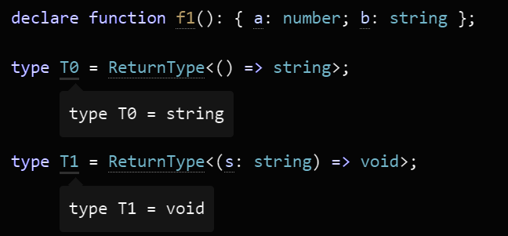
ReturnType
Constructs a type consisting of the return type of function Type.

Slide 18
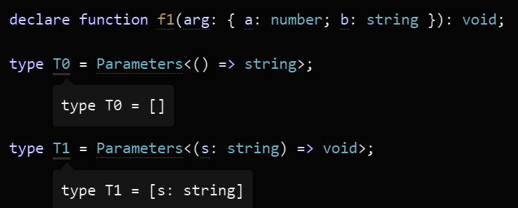
Parameters
Constructs a tuple type from the types used in the parameters of a function type Type.

Slide 19
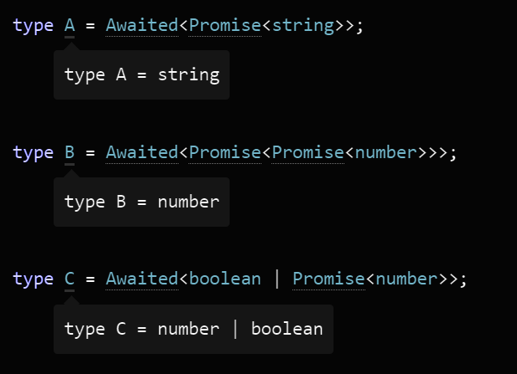
Awaited<Type>
This type is meant to model operations like await in async functions, or the .then() method on Promises - specifically, the way that they recursively unwrap Promises.

Slide 20
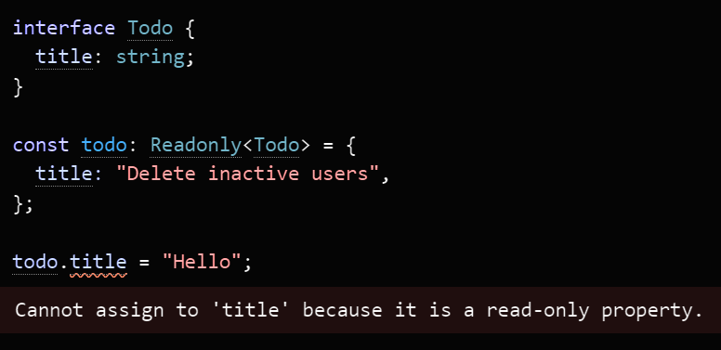
Readonly<Type>
Constructs a type with all properties of Type set to readonly, meaning the properties of the constructed type cannot be reassigned.

Slide 21
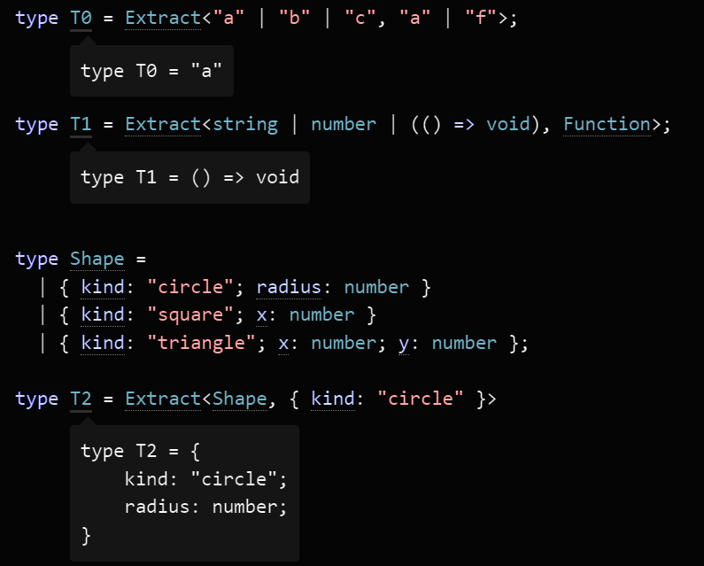
Extract<Type, Union>
Constructs a type by extracting from Type all union members that are assignable to Union.

Slide 22
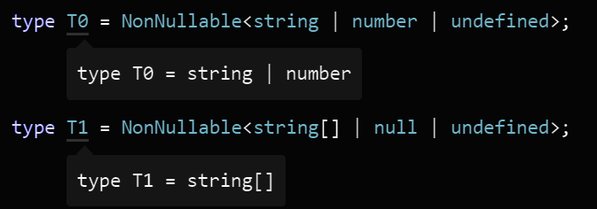
NonNullable<Type>
Constructs a type by excluding null and undefined from Type.

Slide 24
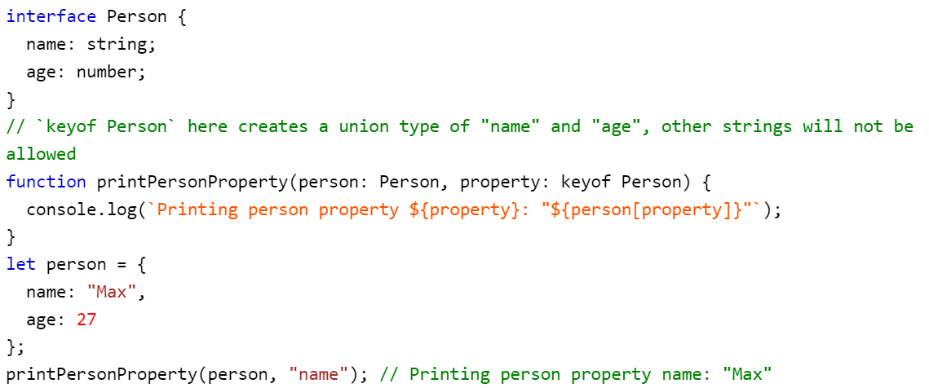
TypeScript Keyof
keyof is a keyword in TypeScript which is used to extract the key type from an object type.
When used on an object type with explicit keys, keyof creates a union type with those keys.

Slide 25
const assertions in Typescript
In Typescript 4.3, typescript introduced the const assertions. const assertions are used to tell the Typescript compiler one of the following:
Object properties are Readonly
Arrays become Readonly Tuples
A variable value should be treated as Literal Type

Slide 26
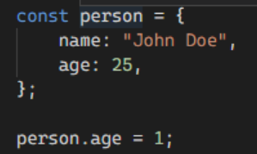
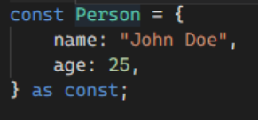
Object properties are Readonly
When you cast an object as const, the properties are marked as read-only and cannot be modified.
Its types are inferred as string and number as expected
But if we assert it as const, the inferred types for the person object are marked as read-only and cannot be modified.
If we tried to update the age field, we would get the following error: Cannot assign to 'age' because it is a read-only property

Slide 27

Arrays become Readonly Tuples
const assertions on an array allow us to mark an array as read-only Tuple i.e. content of the array in each position becomes a literal type that cannot be modified.
Typescript will infer this as an array of strings or numbers i.e. (string | number)[]:
But, if we used as const assertions, this becomes restricted to a readonly Tuple, with "john doe" in the first position and "25" in the second position. And its values cannot be modified

Slide 28
tsconfig.json

Slide 29
tsconfig.json
TypeScript compiler uses tsconfig.json to get configuration options for generating JavaScript code from TypeScript source-code.
When you uses '$ tsc' command to compile TypeScript code, compiler searches for configurations located in tsconfig.json.
The tsconfig.json is generally put in the root folder of the project.
It provides the compiler options required to compile the project.
Then use 'tsc --init' command to create tsconfig.json file in your project’s root folder.

