Slide 1
Testing Angular
Jasmine & Karma, Vitest, TestBed

Slide 2
Outline
Testing in Angular
Jasmine
Karma
Vitest
Angular Utilities - TestBed

Slide 3

Testing in Angular

Slide 4
Unit Testing in Angular
It is very easy to get started with unit testing for Angular applications
If your project was setup using the Angular CLI, everything will be ready for you to start writing tests using Jasmine as the testing framework and Karma as the test runner
Note: As of Angular 16 Karma became deprecated. In Angular 20 it was marked for removal and in Angular 21 it was replaced with Vitest as the new stable test runner.
Angular also provides utilities like TestBed and async to make testing asynchronous code, components, directives or services easier

Slide 5
Jasmine

Slide 6
Jasmine
Jasmine is a popular testing framework for creating Behavior Driven Development (BDD) unit tests
Jasmine provides utilities that can be used to run automated tests for both synchronous and asynchronous code.
Jasmine is the equivalent to ‘Junit’ + ‘AssertJ’ rolled into one.

Slide 7
Jasmine Features
Fast and low overhead with no external dependencies
Human-readable syntax using describe() and it() blocks
Available for both Node and the browser
Can be used with other languages like Python & Ruby
Does not require the DOM
Provides clean and easy way to understand syntax and also a rich, straightforward API
Built-in spy/mock system
We can use natural language to describe the tests and the expected results

Slide 8
Jasmine Functions
describe() – function used to define the test suite.
beforeEach() – setup function to run before each test
afterEach() – teardown/clean-up function to run after each test
it() – (Individual Test) – details of each test.
it() takes a string that explains the expected behavior, followed by a function which tests it.

Slide 9
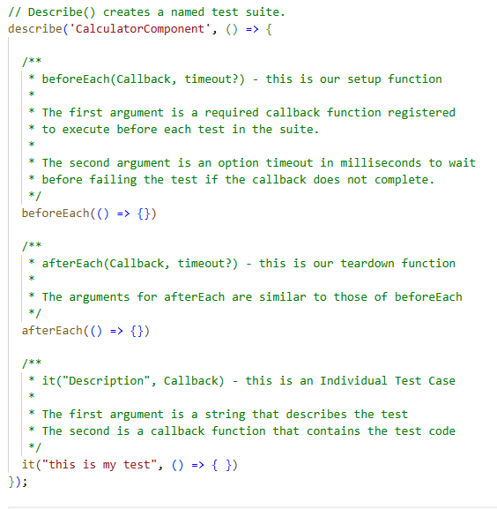
Jasmine Example

Slide 10
Jasmine Matchers (Assertions)
Within your test [it()] you can declare assertion methods, which are chained after ‘expect()’. Belo you can see the common jasmine matchers
Jamine Matcher | What is checks
toBe(value) | Strict Equality (===)
toEqual(obj) | object value contents
toBeTruthy() | Value is truthy
toBeFalsy() | Value is falsy
toBeNull | Value is null
toBeUndefined() | Value is undefined
toContain(item) | Array/string contains item
toThrow() | Function throws an error
toHaveBeenCalled() | Spy (mocking) was invoked at least once

Slide 11
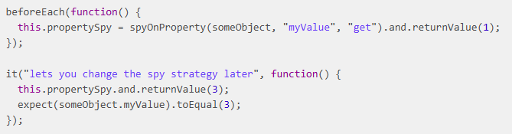
Spies – Jasmine Mocking
Spies are the Jasmine equivalent to Mockito mocks.
A spy intercepts calls to a function so you can control what it returns, verify it was called, and check what arguments it received – without executing the real implementation.

Slide 12
Karma

Slide 13
Karma
Karma is a test runner which is responsible for launching a browser, loading your compiled test files into that browser, executing them, and reporting the results back to your terminal
Karma also watches your development files for changes and re-runs the tests automatically
Karma lets us run Jasmine tests as part of a development tool chain which requires tests to be runnable and results inspectable via the command line.
When using the Angular CLI, it handles the configuration for us

Slide 14
Karma – How it Works
When you run ‘ng test’, the Angular CLI tells Karma to start
Karma launches a browser (typically Chrome Headless)
Karma compiles your TypeScript spec files using webpack
The compiled test bundle is loaded into the browser
Jasmine executes the tests inside the browser
Results are reported back to your terminal in real time
Karma watches for file changes and re-runs tests automatically

Slide 15
Karma Config
Karma is configured via a karma.conf.js file at the root of your Angular project – which is typically generated automatically when you create an Angular project using the CLI.
Reminder: Karma is not used in Angular 21+, and therefore this karma.conf.js file is not generated.
More information about the Karma config file can be founds here: https://karma-runner.github.io/6.4/config/configuration-file.html

Slide 16
Vitest

Slide 17
Vitest
As previously stated, Vitest is the modern replacement for Karma. It is a TypeScript-first test runner, which is automatically configured in new Angular Projects (created using CLI)
The workflow (use ‘ng test’ command) works the same for Karma and vitest
You can find more information about vitest here: https://vitest.dev/guide/cli.html

Slide 18
Angular Utilities - TestBed

Slide 19
Angular Utilities (TestBed)
Angular components, services, and directives are not plain TypeScript classes. They depend on Angular’s dependency injection system, its template compiler, and its change detection mechanism, so you cannot test them with Jasmine alone.
TestBed is Angular’s primary testing utility, and it creates a miniature Angular module specifically for testing – allowing you to configure components, inject services and simulate the Angular runtime in a controlled environment.
TestBed is imported from ‘@angular/core/testing’ and is either used inside your beforeEach() block to create a component to be used for each test, or can be leveraged within a test to create/access components.
Note, your ‘spec.ts’ files automatically generated by Angular include boilerplate code showcasing this.

Slide 20
The Fixture
Boilerplate test code includes the following: TestBed.configureTestingModule
This function call is used to define the environment that we want our component under test to live in, and it mostly useful if you expect to perform injection or asynchronous calls
If you need the ability to get specific information about a component configured this way, then the ComponentFixture class can be used to get a reference to the component instance being tested, as well as the component’s template.
To instantiate the component fixture we need to chain one more method onto our testbed, ‘createComponent’, and pass in the component we want to create.
Note: for tests which do not require much complexity (just the component) you can simply create the component using TestBed.createComponent()

Slide 21
The Fixture
By attaching .createComponent(Comp) to the end of our TestBed.configureTestingModule call, we are now receiving a ComponentFixture instance.
Note: Angular automatically provides the boilerplate code for this entire module configuration and component creation automatically in the generated .spec.ts files.
You’ll notice that there is typically an ‘await fixture.whenStable()’ call afterwards – this returns a promise that can be used to resume testing
Again, note that this is used for tests that may require async calls

Slide 22
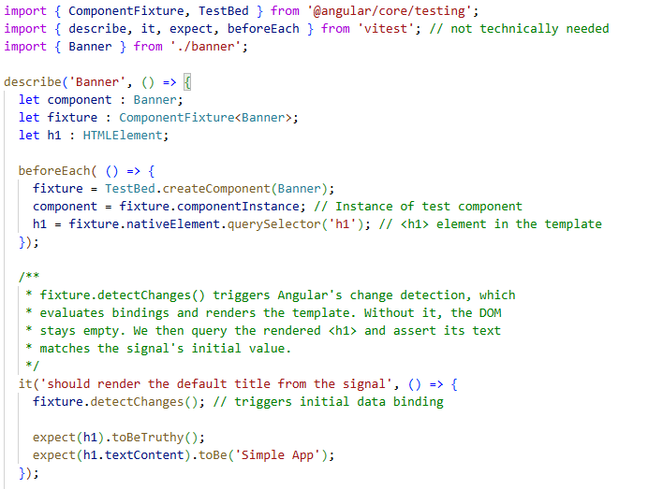
The Fixture

Slide 23
TestBed API
TestBed Method / Property | What it does
TestBed.configureTestingModule() | Defines the test Angular module
TestBed.inject(Token) | Retrieves a service from the injector
TestBed.createComponent(Comp) | Creates an instance of a component, along with its DOM fixture
Fixture.detectChanges | Triggers Angular’s change detection – causes data bindings to render
Fixture.componentInstance | Access the component class instance (properties, methods)
Fixture.nativeElement | Access the raw DOM element for querying rendered HTML
Fixture.debugElement | Access Angular’s wrapper over the DOM with extra query helpers
Fixture is the element returned from the ‘createComponent’

