Slide 1
Microservices with Spring

Slide 2
Outline
Intro to Microservices
Microservices vs Monolithic Applications
Microservice Architecture
Microservices – Considerations
Spring Cloud
Service Discovery
API Gateway
Load Balancing
Circuit Breaker Design Pattern

Slide 3

Intro to Microservices

Slide 4
What are Microservices?
Microservice Architecture (MSA) describes a way of designing software applications as suites of independently deployable services.
Each service runs its own process and communicates using lightweight mechanisms, often an HTTP resource API.
These services are built around business capabilities and independently deployable by fully automated deployment machinery
There is a bare minimum of centralized management of these services, which may be written in different programming languages and use different data storage technologies

Slide 5
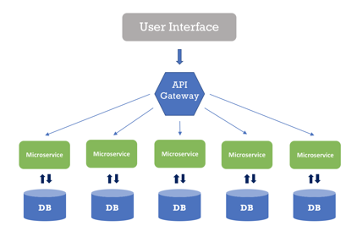
What are Microservices?
A service can generate alerts, log data, support user interfaces, handle user identification or authentication, and perform various other tasks.

Slide 6
What are Microservices?
The microservice paradigm provides development teams with a more decentralized approach for building software.
Most companies in the world – like Amazon, Netflix, Uber, Etsy, etc…, have adopted the microservices architecture for developing their applications.
Over time, these enterprises dismantled their monolithic applications and refactored them into microservice-based architectures.
This has given them scaling advantages, greater business agility, and increased profits

Slide 7
Microservices vs Monolithic Applications

Slide 8
Monolithic Applications
Monolithic applications are ones which are build as a single unit.
A typical Enterprise Application using a Monolithic structure contains three (3) major parts:
User Interface – might consist of HTML pages and JavaScript running on the user’s browser.
Server-Side application – handles incoming data (like HTTP requests), executes domain logic, retrieves and updates data from the database, and updates the user interface.
Databases – stores data on tables of an RDBMS

Slide 9
Microservices vs Monolithic
In a Monolithic structure, any minor changes in the system require building and deploying a new version of the server-side application
Over time, it’s often hard to keep a good modular structure, making it harder to manage changes that ought to only affect one module within that application
Scaling requires scaling of the entire application, rather than the parts of it that require the most resources.
These frustrations have led to the microservice architectural style, building applications as suites of services.
When services are independently deployable, and scalable, each service provides a firm module boundary.
Each service can also be developing in distinct programming languages

Slide 10
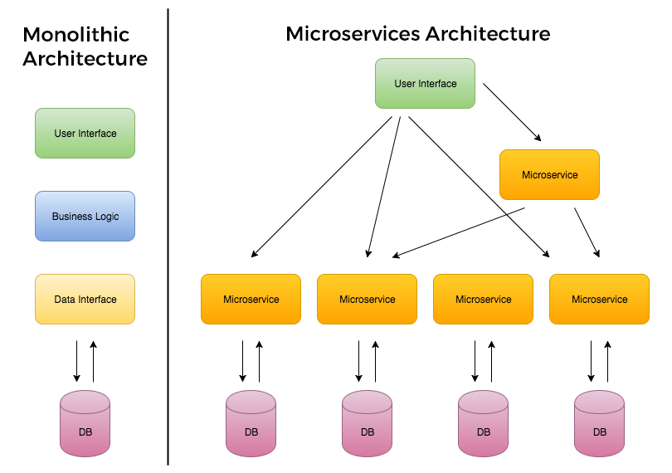
Microservices vs Monolithic

Slide 11
Microservices vs Monolithic
Services are deployed and updated independently, which gives more flexibility.
Monolithic uses a shared database.
Each microservice uses a single database. Each service can use any database system (MySQL, Oracle, NoSQL) depending on its business logic.
Monolithic applications are tightly coupled. Here, it is difficult to change technology or language or framework. MSA ensures that the services are loosely coupled, so it's easy to make changes since services are independent to each other.
Monolithic applications are more compatible with Waterfall Model.
MSA is adaptable with Agile Methodology for developing applications.

Slide 12
Microservices vs Monolithic
Monolithic | MSA
Simple to develop and deploy. | Complex and hard to develop and deploy.
Code changes affect the entire system. | Only the microservice that is changed would be affected.
One codebase and one shared database. | A codebase and database for each microservice.
Hard to scale or upgrade. | Easy to scale and upgrade.
Less expensive and faster to develop. | More expensive and takes more time to develop.
Monolithic uses a shared database. | Each microservice uses a single database. Each service can use any database system (MySQL, Oracle, NoSQL) depending on its business logic.
Monolithic applications are tightly coupled. Here, it is difficult to change technology or language or framework. | MSA ensures that the services are loosely coupled, so it's easy to make changes since services are independent to each other.
The entire system can be affected by a single error or bug. | The entire system is shielded from the error or bug on one microservice.

Slide 13
Microservice Architecture

Slide 14
Characteristics of Microservices Architecture
Microservices architecture encourages us to break our application into multiple individually deployable components
Here, a component refers to a unit of software that is independently replaceable and upgradeable
These components expose their functionality as services and serve a business purpose.
Components are loosely coupled and communicate with each other through pre-defined protocols, such as message queues, HTTP request/response models, and so on.
Services are organized based on the business capabilities, not by the technology.

Slide 15
Characteristics of Microservices Architecture
Each service has its own database, either different instances of the same database technology, or entirely independent database systems - an approach called Polyglot Persistence.
MSA provides infrastructure automation with continuous delivery and automated testing.
Any service’s failure should be in isolation.
Failure of one service should not make the whole application go down. Since services can fail, it’s important to detect the failures and, if possible, restore the service.

Slide 16
Microservices – 12 Factors
The twelve factors are architectural concerns which should be accounted for a service to be considered a ‘true’ service within a microservice architecture.
Note: not every microservice will follow all of these factors perfectly – it is more important that the ‘spirit’ of these rules are maintained in your microservices.

Slide 17
Microservices – 12 Factors
Codebase : Each microservice should have it’s own repository and independent deployment pipeline.
Dependencies : Dependencies should be explicitly declared and isolated for each service to ensures services build consistently across environments
Config : Configuration information should be stored outside of the application to allow the same service artifact to run in different environments without modification.
Backing Services : Databases, message brokers and caches should be treated as attachable resources to enable replacing infrastructure without changing application code.

Slide 18
Microservices – 12 Factors
Build, Release Run : Build, release and runtime stages should be separate so that artifacts are built once and promoted through environments consistently.
Processes : Applications are run as stateless processes to allow for horizontally scaling and easier recover from failures.
Port Binding : Services expose functionality by binding to a port which allows each microservice to run independently and communicate over HTTP or messaging
Concurrency : Scaling via process model/pods to ensure that microservices can scale horizontally to handle load

Slide 19
Microservices – 12 Factors
Disposability : Services should start quickly and shut down gracefully to enable rolling deployments, container restarts and fault tolerance.
Dev/Prod Parity : Developing, testing and production environments should be similar to reduce deployment surprises in distributed system
Logs : Logs should be treated as event streams, rather than files. Centralizing logging improves debugging across many services.
Admin Processes : Administrative tasks should be run as one-off processes, allowing safe maintenance tasks without altering the running service.

Slide 20
Microservices - Considerations

Slide 21
Challenges of Microservices Architecture
Microservice architecture is much more complex than legacy systems.
This environment becomes more complicated because teams must manage and support many moving parts. Some of the challenges that an organization faces are:
Bounded Context - The bounded context is a central pattern in Domain-Driven Design(DDD). DDD deals with large models by dividing them into different Bounded Contexts and being explicit about their interrelationships.
Bounded context defines our domain boundaries in the business context.

Slide 22
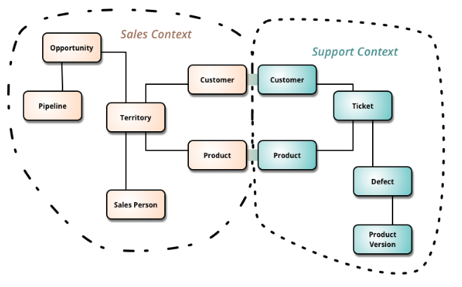
Challenges of Microservices Architecture
For example, a product in the sales context refers to an item in the process of being sold. A product in the support context refers to the item that is already sold to the customer which has some defects, so the customer contacts the support team.

Slide 23
Challenges of Microservices Architecture
Finding a root cause for problems – Distributed logic with distributed data increases the effort of finding a root cause.
Version management and cyclic dependencies between services.
Logging is distributed between services.
An issue that’s caused by one service can cause trouble elsewhere.

Slide 24
Advantages of Microservices Architecture
Microservices follow the Single Responsibility Principle.
Fault isolation: If one service crashes, it’s quite possible the rest of the application can continue to operate until that service recovers.
Microservices are language and platform independent.
Dynamic scaling: we can dynamically scale up/down the service instances whenever required.
Developers have the freedom to develop and deploy services independently.
Use of containers allowing for a quick deployment and development of the application.

Slide 25
Disadvantages of Microservices Architecture
Microservice architecture is complex.
Harder to test and monitor because of the complexity of the architecture.
Large numbers of microservices are harder to manage and secure.

Slide 26
Spring Cloud

Slide 27
Spring Cloud
Microservice architectures are the norm in modern software development
Companies develop small, self-contained, ready-to-run applications, so allow for flexibility and additional resilience to their codebase.
Spring Cloud is Spring’s solution to implementing common patterns for distributed systems and microservices architectures
Spring Cloud simplifies challenges like, service discovery, centralized configuration, load balancing, circuit breaking, and distributed messaging.

Slide 28
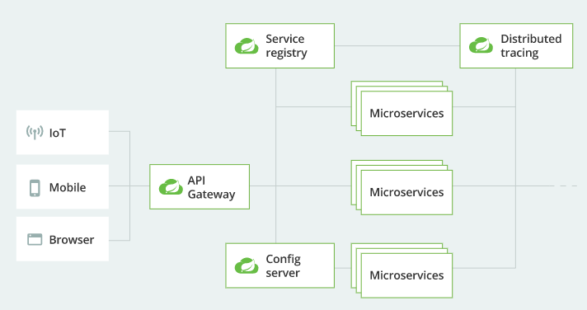
Spring Cloud

Slide 29
Service Registry

Slide 30
Service Discovery & Registries
In the cloud, applications can’t always know the exact location of other services
As such, service registries, such as HasiCorp Consul (recommended for VMs) and Kubernetes DNS (Recommended for K8s) can be leveraged.
Using these service registries, spring allows you to query endpoints by name, via HTTP API or DNS.

Slide 31
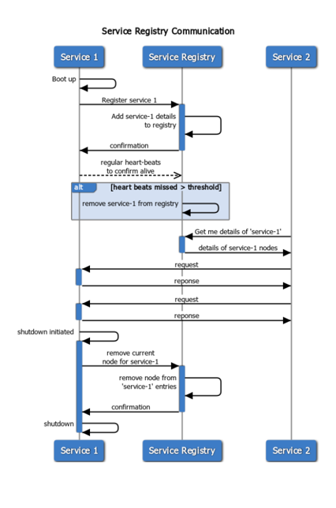
Service Registry
The service registry is a key part of Service discovery
A service registry is a database containing the network locations of service instances
It contains the currently-available instances of each service and their connection details
Services query the service registry to retrieve the details for the required microservice, then connect to it
The registry maintains a heartbeat mechanism to see if services are still up, and if not, removes them from the registry

Slide 32
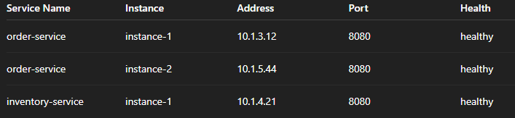
Service Registry
A service registry might store entries like this:
When a service wants to call another service, it asks the registry for available instances.
This avoid hardcoding addresses
Ex: instead of calling ‘http://10.1.4.21:8080’ you call ‘http://inventory-service’

Slide 33
Service Registry
Service registries are responsible for:
Service Registration : Register the service within the registry database for future discovery.
Service discovery Resolution : When other services query the registry, a running service instance is provided
Health monitoring : The registry checks if services are alive
Load balancing support : Multiple, registered instances of the same service can be provided to callers

Slide 34
Service Registry | Registration Models
There are two patterns used for registering services:
Self-Registration: Service instances are responsible for registering and deregistering themselves with the registry.
Ex: HashiCorp Consul
Third-party Registration: Another system known as a service registrar handles service registration or unregistering shut down/crashed services using a service registrar.
Ex: AWS ECS & Cloud Map

Slide 35
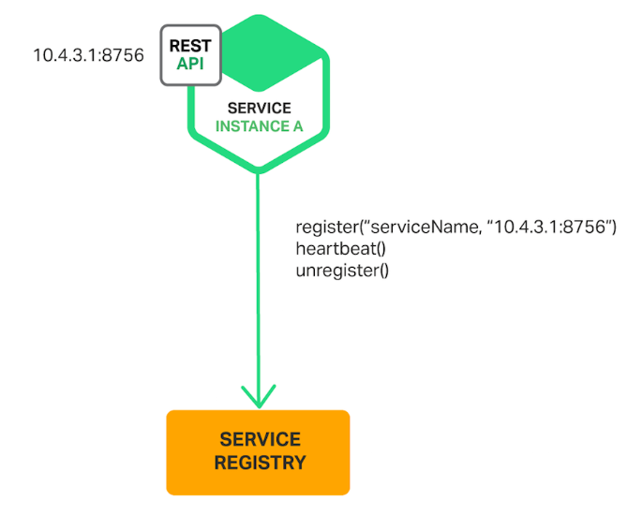
Service Registry | Self-Registration
[Benefit] Self-Registration is relatively simple and doesn’t require any other system components.
[Drawback] However, this pattern couples the service instances to the service registry, and registration code must be implemented for each programming language and framework used by your services.

Slide 36
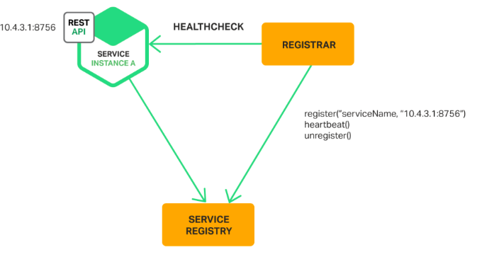
Service Registry | Third Party Registration
[Benefit] Services are decoupled from the service registry and instead the service instance registrations are handled in a centralized manner within a dedicated service
[Drawback] Unless it’s built into the deployment environment, it is yet another highly available system component that must be setup and managed.

Slide 37
Service Discovery

Slide 38
Service Discovery
As previously stated, Service Discovery solves the question: “How does one service find another service without hardcoding hostnames and ports?”
We will explore 2 options
Spring Cloud Kubernetes
HashiCorp Consul

Slide 39
Service Discovery | Kubernetes
With Spring Cloud Kubernetes, Spring can use Kubernetes itself as the discovery source,
Kubernetes Discovery Client allows you to query Kubernetes endpoints by name, where services are exposed.
Within your Spring application.yml file, you can configure Kubernetes to discover the service, Kubernetes DiscoveryClient will do the rest.
Kubernetes registers services in this way:
Pods Start
A Kubernetes Service object is created
Kubernetes tracks pod Ips
Kubernetes DNS exposes the service name
Other services query the service DNS name

Slide 40
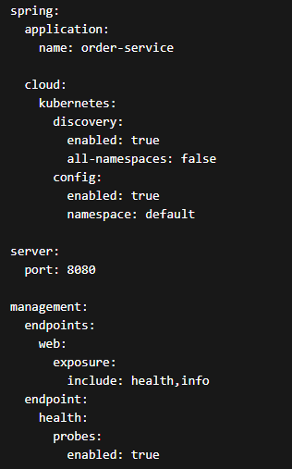
Service Discovery | Kubernetes
application.yml
spring.application.name: names the service
spring.cloud.kubernetes.discovery.enabled: turns on Kubernetes-based discovery
all-namespaces: false: limits lookup to the current namespace unless you want broader discovery
spring.cloud.kubernetes.config.enabled: allows reading config from ConfigMaps
ConfigMaps are an API object used to store non-confidential data in key-value pairs
management.endpoint.health.probes.enabled: useful for Kubernetes liveness/readiness probes

Slide 41
Service Discovery | HashiCorp Consul
HashiCorp Consul is a dedicated service registry and configuration system.
Unlike Kubernetes, services must register themselves with Consul
It is also possible to use third-party registration with consul, though self-registration is preferred
Services are maintained using a service catalog
Consul manages services in this way:
Service starts
Service registers with Consul agent
Consul stores service metadata
Other services query Consul

Slide 42
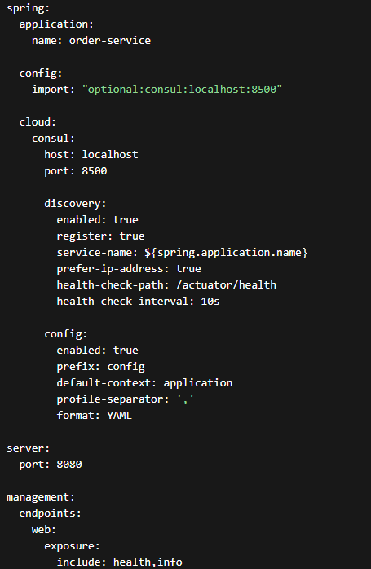
Service Discovery | HashiCorp Consul
spring.config.import: "optional:consul:localhost:8500“: tells Spring Boot to import configuration from Consul
spring.cloud.consul.host / port: point to the Consul agent
spring.cloud.consul.discovery.enabled: enables discovery
discovery.register: registers this app in Consul
service-name: sets the name other services will use
health-check-path and health-check-interval: let Consul know how to verify the service is alive
spring.cloud.consul.config.*: configures how app settings are loaded from Consul KV
management.endpoints.web.exposure: useful for health checks and meta-data (actuator)

Slide 43
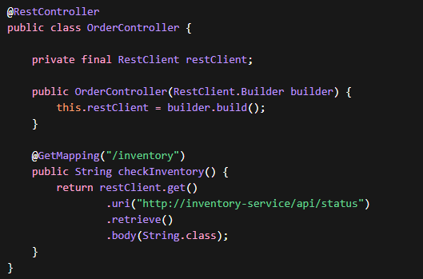
Service Discovery
For either Registry service, the spring controller might look like this:

Slide 44
Service Discovery | Patterns
There are two main service discovery design patterns (how services locate other services)
Client-Side discovery Pattern
Servier-Side discovery Pattern

Slide 45
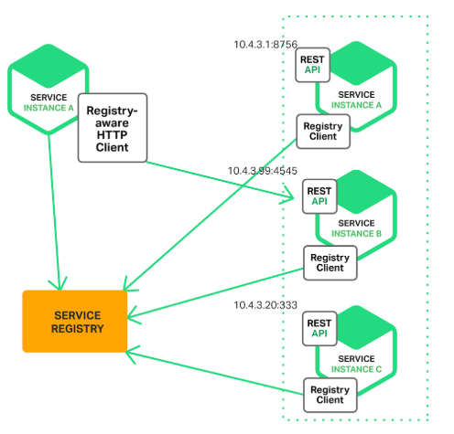
Service Discovery | Patterns
Client-Side
The client contacts a service registry, receives details for available services, and contacts one of them using a load balancing algorithm

Slide 46
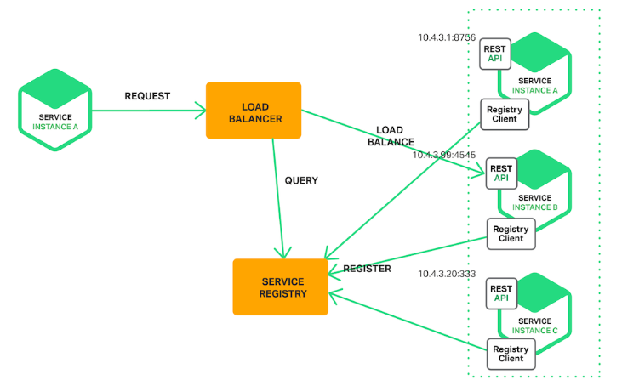
Service Discovery | Patterns
Service-Side
The client contacts a load balancer, making a request that indicates which type of service it needs.
The load balancer consults the service registry, selects the optimal service (for example, the least loaded one) and routes the request to it.

Slide 47
API Gateway

Slide 48
API Gateway
For microservices-based applications, an API Gateway acts as a single point of entry between a client and a collection of backend services.
Instead of calling services directly, clients send requests to the gateway which routes requests to the appropriate backend service

Slide 49
API Gateway
Without an API gateway…
The client must know many service addresses
Security becomes difficult to manage
It becomes difficult to enforce policies consistently
All potential microservices become exposed to the public internet, which may not be intentional or cause other security/data concerns.

Slide 50
API Gateway
With an API gateway…
Your application has a single entry point that clients use – simplifying client interactions
You can centralize security and routing policies
Authentication/authorization concerns can be centralized (once past they gateway, assume they should have access, or use auth tokens from the gateway)
Load Balancing becomes easier
Logging/Monitoring centralization
Request transformation can occur (modify headers/paths/payloads)
You can implement Rate limiting (reduces potential abuse)

Slide 51
Spring Cloud Gateway
Spring Cloud Gateway is a reactive API gateway built on WebFlex and Project Reactor.
It replaces the older Netflix Zuul Gateway within the Spring ecosystem
It provides:
Dynamic routing
Filters for request/response processing
Integration with service discovery
Support for load balancing

Slide 52
Spring Cloud Gateway
Spring Cloud Gateway works through these key concepts:
Routes: defines which requests to match and where to send them
Predicates: determines when a route should apply
i.e. based on path, methods, headers data, client host
Filters: Allows for modification of requests and/or responses
i.e. add headers, rewrite paths, rate limit requests, authenticate users

Slide 53
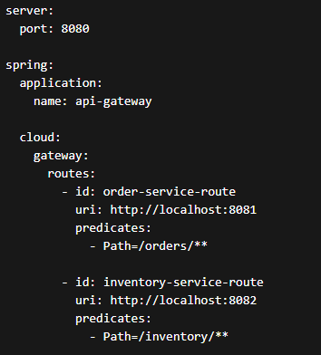

Spring Cloud Gateway | Configuration
Gateway Application.yml Example
Maven Dependency Example

Slide 54
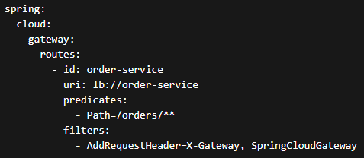
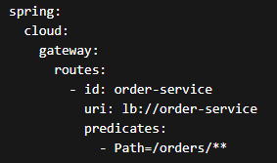
Spring Cloud Gateway | Configuration
Application.yml in Service
With filters…

Slide 55
Load Balancing

Slide 56
Load Balancing
In a microservice architecture, multiple instances of each microservice are deployed for availability and scalability.
This limits the impact of the failure of a single instance, and maintains overall system reliability.
Successfully adopting this architecture requires a load balancing mechanism
Load Balancing ensures that incoming requests are spread across all available instances, rather than overloading some and leaving others under-utilized

Slide 57
Load Balancing
A load balancer acts like a traffic cop sitting in front of our servers, and routes client requests across all servers capable of fulfilling those requests.
It does so in a manner that maximizes speed and capacity utilization and ensures that no one server is overworked.
Load balancing algorithms include: Round Robin, Least Connections, Random, Weighted Round Robin, and more…
If a single server goes down, the load balancer redirects traffic to the remaining online servers.
When a new server is added to the server group, the load balancer automatically starts sending requests to it.

Slide 58
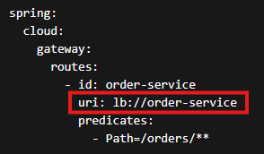
Load Balancing with Spring Cloud
Spring Cloud LoadBalancer (included as a dependency with Spring Cloud starters) is the modern in-built solution.
We have already seen an example of this in the previous examples.
There ‘lb://’ prefix of the service route allows the LoadBalancer to find and select an instance of order service using it’s load balancing algorithm (by default, Spring Cloud default to ‘Round Robin’)

Slide 59
Circuit Breaker Design Pattern

Slide 60
Circuit Breaker Pattern
Services sometimes collaborate when handling requests
When one service synchronously invokes another, there is always the possibility tat the other service is unavailable, or it is exhibiting such high latency that it’s essentially unusable
Precious resources, such as threads, might be consumed in the caller, while waiting for the other service to respond.
This might lead to resource exhaustion, which would make the calling service unable to handle other requests

Slide 61
Circuit Breaker Pattern
The failure of one service can also potentially cascade to other services throughout the application
To prevent a network or service failure from cascading to other services, we us the circuit breaker pattern when building microservice applications
A circuit breaker wraps a function call with a monitor, where the monitor will be tracking potential failures.
If the service is in the failed stage, the circuit will send the error message without make a call.
If the service is up, then the breaker forwards the call to the needed service.

Slide 62
Circuit Breaker Pattern
The circuit breaker has 3 distinct states –
Closed State - When service is up and running, the circuit breaker remains in the closed state and all calls pass through to the services.
Open State - When the number of failures exceeds a predetermined threshold the breaker trips, and it goes into the Open state. In the OPEN state the circuit breaker returns an error for all calls to the service without making the calls to the Supplier Microservice.
Half-Open State - The circuit breaker makes a trial call to the failed service periodically to check if it has recovered. If the call to the service times out, the circuit breaker remains in the Open state. If the call returns successfully, then the circuit switches to the closed state.

Slide 63
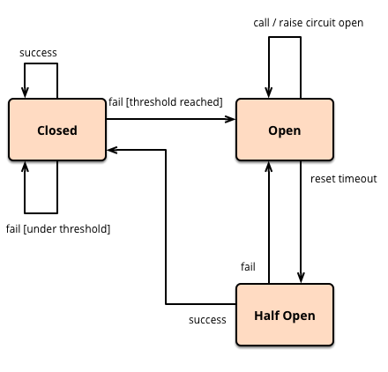
Circuit Breaker Pattern

Slide 64

Spring Circuit Breaker | Resilience4J
Spring Cloud leverages Resilience4J as the default Circuit Breaker implementation.

Slide 65
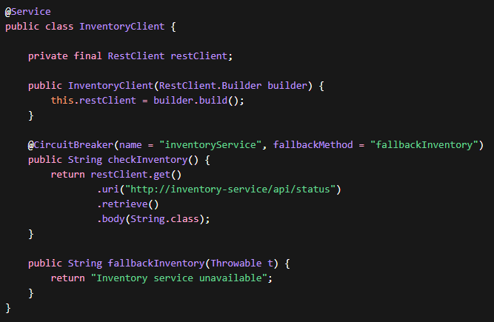
Spring Circuit Breaker | Resilience4J
In this example, if the inventory-service times out, throws an error or otherwise becomes unavailable, the circuit breaker opens, and calls the indicated fallback method “fallbackInventory”
This method, as seen, simply returns a message, stating that the inventory service is unavailabl

Slide 66
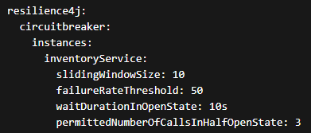
Spring Circuit Breaker | Resilience4J
You can configure your circuit breaker in the application.yml
Property | Description
slidingWindowSize | Number of requests used to evaluate failure rate
failureRateThreshold | % of failures before circuit opens
waitDurationInOpenState | Time before retry attempts
permittedNumberOfCallsInHalfOpenState | Number of requests allowed in half-open state

