Slide 1
Angular

Slide 2
Outline
Angular Introduction
Angular Version History
Angular CLI – Installation & Config
Angular Components
@NgModule
Angular Directives
Signals
Services & Dependency Injection
Data Binding
Pipes
Routing & Route Guards
Pub-sub design patterns
RxJS – observables
Subjects
httpclient

Slide 3

Angular Introduction

Slide 4
Angular Introduction
Angular is a TypeScript based open-source framework used to development dynamic web applications
Angular is a Single Page Application (SPA) framework. An SPA is a web application that fits on a single page.
All our code (JavaScript, HTML, CSS) is retrieved with a single page load. Navigation between pages is performed without refreshing the whole page.
SPA uses AJAX and HTML5 to build responsive web applications
Examples of single-page apps – Gmail, Google Maps, Facebook, X, Trello, etc…
Frameworks like AngularJS, Angular, Ember.js, ExtJS, Knockout.js, Meteor.js, React and Vue.js uses SPA principles to create a web application

Slide 5
Advantages of SPA
Fast and responsive – SPAs update only the required content instead of the entire page for each request to the server. The HTML/CSS/Scripts are only loaded once throughout the lifespan of an application. Only data is transmitted back and forth. This significantly improves the website’s speed.
Cashing capabilities – SPA sends a request to the server and caches all received data locally. Then it can reuse this data and work even offline. If a user has poor connectivity, local data can be synchronized with the server when the connection allows.
SPA provides a pleasant user experience on desktops as well as on mobile phones, since it only changes the content and not the page.

Slide 6
Disadvantages of SPA
Doesn’t perform well with SEO (search engine optimization)
Security – SPAs are less secure towards Cross-site scripting (XSS) attacks
While overall performance is better, more data is frontloaded which can make the first page load a little slower

Slide 7
Features of Angular
CROSS PLATFORM
Progressive Web Apps
Use modern web platform capabilities to deliver app-like experiences. High performance, offline, and zero-step installation
Native
Build native mobile apps with strategies from Cordova, Ionic, or NativeScript
Desktop
Create desktop-installed apps across Mac, Windows, and Linux using the same angular methods you’ve learned for the web, plus the ability to access native OS APIs

Slide 8
Features of Angular
SPEED AND PERFORMANCE
Code Generation
Angular turns your templates into code that's highly optimized for today's JavaScript virtual machines, giving you all the benefits of hand-written code with the productivity of a framework.
Universal
Serve the first view of your application on Node.js®, .NET, PHP, and other servers for near-instant rendering in just HTML and CSS. Also paves the way for sites that optimize for SEO.
Code Splitting
Angular apps load quickly with the new Component Router, which delivers automatic code-splitting so users only load code required to render the view they request.

Slide 9
Features of Angular
PRODUCTIVITY
Templates
Quickly create UI views with simple and powerful template syntax
Angular CLI
Command line tools: start building fast, add components and tests, then instantly deploy
IDEs
Get intelligent code completion, instant errors, and other feedback in popular editors and IDEs

Slide 10
Angular
Angular uses the TypeScript language, which has features like:
Static Typing
Object-oriented Programming basedon classes
Support for reactive programming using RxJS

Slide 11
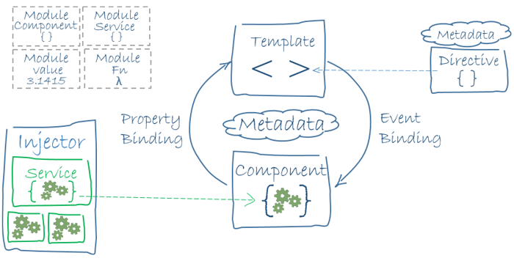
Angular – Building Blocks
The main building blocks of Angular are modules, components, templates, metadata, data binding, directives, services, and dependency injection.

Slide 12
Angular Version History

Slide 13
Angular Version History with Release Dates
AngularJS (Angular 1) - October 20 2010
Angular 2 - September 14 2016
Angular 4 - March 23, 2017
Angular 5 - November 1, 2017
Angular 6 - May 4, 2018
Angular 7 - October 18, 2018
Angular 8 - May 28, 2019
Angular 9 - February 6, 2020
Angular 10 - June 24, 2020
Angular 11 - November 11, 2020
Angular 12 - May 12, 2021
Angular 13 - November 3, 2021
Angular 14 - June 2, 2022
Angular 15 - November 16, 2022
Angular 16 - May 3, 2023
Angular 17 - November 8, 2023
Angular 18 - May 22, 2024
Angular 19 - November 19, 2024
Angular 20 - May 28, 2025
Angular 21 - November 19, 2025
Angular 22 – Expected May, 2026
The observant amongst you may notice that “Angular 3” is missing. This is not a mistake.
Version 3 was skipped due to a version mismatch between the @angular/core, @angular/compiler, and @angular/router libraries — the router package had already reached v3.x, so skipping to version 4 kept all packages aligned.
Note: Angular is commonly referred to as “Angular 2+” or by its version number to distance the modern framework from the original AngularJS

Slide 14
AngularJS vs Angular
AngularJS is a JavaScript-based open-source front-end web framework. It doesn’t support the features of a server-side programming language, nor dynamic loading of the page.
Angular is a complete rewrite of AngularJS. AngularJS was completely based on controllers and scopes whereas, Angular uses a component hierarchy as its main architecture

Slide 15
Angular CLI – Installation & Config

Slide 16
Angular CLI
The Angular CLI is a command-line interface for Angular that helps us to get started with creating an Angular application
The Angular CLI takes care of the configuration and initialization of various libraries
It also allows us to add components, directives, services, etc… to already existing Angular applications

Slide 17
Installing Angular CLI
Before installing Angular CLI, make sure your development environment include Node.js and an npm package manager.
Run the command ‘npm install –g @angular/cli’ in your terminal to install Angular CLI using npm.
Note: You can verify your Angular installation using the command: ‘ng version’
Run the CLI command ‘ng new my-app’ to create a new angular app with the name my-app.
The Angular CLI includes a server so that we can easily build and serve your app locally.
First, go to the my-app workspace folder and Launch the sever by using the CLI command ‘ng serve’
If your application builds with no issues, you can navigate to ‘http://localhost:4200’ on your local system to view your running application.
You can run the ‘ng serve’ command with the optional ‘--open’ property, which will serve, then open the app after it has finished loading ng serve --open

Slide 18
Angular File Structure
The node_modules folder includes all downloaded dependencies and provides npm packages to the entire workspace
The src folder contains the source files which give information about application logic, data, and other assets
The app folder contains the initial component files
app.component.ts – this TypeScript file represents the logic for the app’s root component (AppComponent). Each component should have it’s own .ts file.
app.component.html – this HTML file is used to define the HTML template associated with the component (in this case AppComponent)
app.component.css – this CSS file is used to define the base CSS stylesheet for the component (in this case AppComponent)
app.component.spec.ts – this TypeScript file (and all others generated with ‘spec.ts.’ Naming contention) is used to define unit tests for the component (in this case AppComponent)

Slide 19
Angular File Structure
The public folder contains a favicon.ico icon used for the application bookmark
index.html – The main HTML page that is served when someone visits your site. The CLI automatically adds all JavaScript and CSS files when building your app, so you typically don’t need to add any <script> or <link> tags here manually
main.ts – The main entry point for an application. Compiles the application with the JIT compiler and bootstraps the application’s root module (AppModule) to run in the browser
angular.json – configuration file for angular CLI configuration defaults for all projects in the orkspace.

Slide 20
Angular Components

Slide 21
Angular Components
Components are the basic building blocks in the Angular application
Components contain the data & UI logic that defines the view and behavior of the web application
Components in Angular are defined using an @Component decorator
This decorator includes a selector, template, style, and other properties, and it specifies the metadata required to process the component

Slide 22
Angular Components
Angular application can (and should) have multiple components.
Each component handles a small part of the UI
These components work together to produce the complete user interface of the application
Recall that we looked at these files:
app.component.ts – this TypeScript file represents the logic for the app’s root component (AppComponent). Each component should have it’s own .ts file.
app.component.html – this HTML file is used to define the HTML template associated with the component (in this case AppComponent)
app.component.css – this CSS file is used to define the base CSS stylesheet for the component (in this case AppComponent)

Slide 23
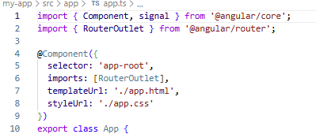
App.component.ts
Let’s examine the @Component decorator in more detail:
selector – A CSS selector that tells Angular to create and insert an instance of this component wherever it finds the corresponding tag (see index.html)
imports – defines the component’s dependencies in an array. Note the module imports at the top of the file
templateUrl – Defines the address of the HTML file whose code is used by this template. Note, you can provide in-line html as well.
styleUrl – Defines the address of the CSS stylesheet used to style the HTML view (the template)
Note: ‘styleUrl’ can be replace with ‘styleUrls’ which allows you to define an array of css files for the component

Slide 24
Creating Angular Components
To create a new Angular component, use the command ‘ng generate component <component_name>’ in your console
Note: a shorthand of this command is: ng g c <component_name>
After using this command, you should see a new folder containing 4 files:
<component-name>.component.html
<component-name>.component.spec.ts
<component-name>.component.ts
<component-name>.component.css

Slide 25
Component Lifecycle Hooks
Angular creates a component; renders it; creates and renders its children; checks it when it’s data-bound properties change; and destroys it before removing it from the DOM.
These events are called “Lifecycle Hooks”
These Lifecycle hooks have eight different function calls which correspond to the lifecycle event.
Every angular component has a life cycle event carried out in 2 different phases – one linked to the component itself and the other linked to the children of that component.

Slide 26
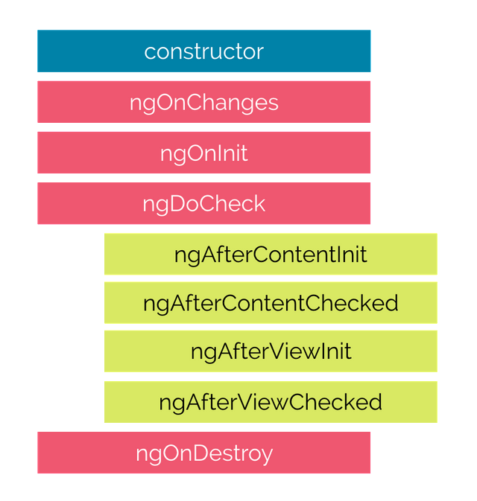
Component Lifecycle Hooks

Slide 27
Eight* Lifecycle Hooks
constructor() – The constructor of the component class gets executed first, before the execution of any other lifecycle hook events. If we need to inject any dependencies into the component, then the constructor is the best place to do so. Note, this is technically a standard TypeScript/JavaScript function and not an Angular-specific hook.
ngOnChanges() – Runs every time an input/output binding value changes. This runs before ngOnInit on the first pass, but only fires at all if the component has at least one Input property.
ngOnInit() – Runs after angular has initialized all the component’s inputs with their initial values. It initializes the component after Angular first displays the data-bound properties
ngDoCheck() – Runs very frequently and allows you to manually check for state changes outside of Angular’s normal change detection. Also called after the ngOnChanges() method.

Slide 28
Eight* Lifecycle Hooks
ngAfterContentInit() – invoked once after Angular performs any content projection into the component’s view
ngAfterContentChecked() – Invoked after each time Angular checks for content projected into the component. It is run after ngAfterContentInit() and every subsequent ngDoCheck().
ngAfterViewInit() – Runs once after all the children in the component’s own template have been initialized.
ngAfterViewChecked() – Runs after each time Angular checks for the content projected into the component. If is called after ngAfterViewInit() and every subsequent ngAfterContentChecked()
ngOnDestroy() – Invoked just before Angular destroys the component. This hook is useful to unsubscribe from observables and detach event handlers to avoid memory leaks.

Slide 29
Data Binding

Slide 30
Data Binding
In Angular, Data binding provides the communication between a component and the DOM
It is a technique used to bind the data from an HTML template to a Component class or from a Component class to an HTML template.
Angular allows both one-way data binding and two-way data binding

Slide 31
One-Way Data Binding
One-way data binding allows us to manipulate the views through the models.
If we make any changes in the class, it gets reflected in the template.
In Angular, One-way data binding is achieved through:
Interpolation or String Interpolation
Property binding
Event binding

Slide 32
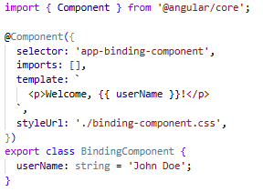
String Interpolation
In String Interpolation, we bind the data from a TypeScript class to the template by using the expression in double curly braces.
It is one-way from component class to the template.
For example: {{ data }}

Slide 33
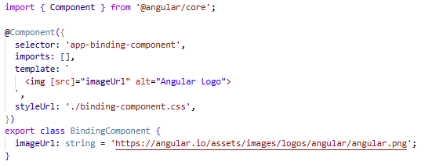
Property Binding
Property Binding allows us to bind values to the attributes of HTML elements.
Whenever the value of the component changes, Angular updates the element attribute in the template.
It’s also a one-way binding from class to template

Slide 34
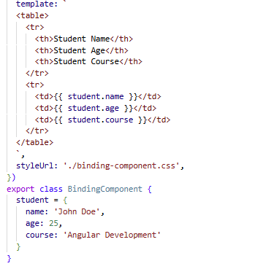
Property Binding
String interpolation and property binding are somewhat interchangeable.
If we need to set element properties to non-string data values, we must use Property binding, not string interpolation.
For instance, property Binding can be used to bind an object

Slide 35
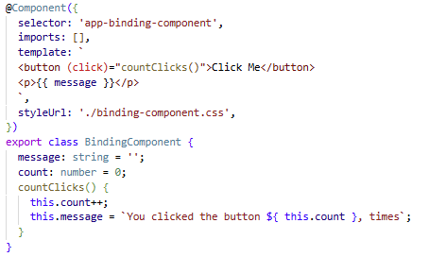
Event Binding
Event binding allows us to bind DOM events, such as keystrokes, button clicks, mouse overs, touches, etc… to a function in the component.
It is one-way from template to the component class

Slide 36
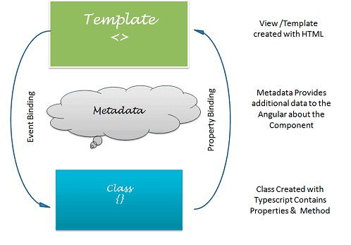
Two-Way Data Binding
In one-way data binding, any changes in the template are not reflected in the component class
To solve this, Angular provides two-way data binding.
Two-way data binding is achieved by combining property binding and event binding together.

Slide 37
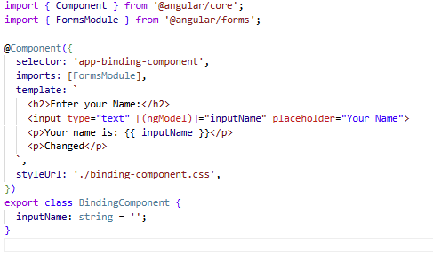
Two-Way Data Binding
In one-way data binding, any changes in the template are not reflected in the component class
To solve this, Angular provides two-way data binding.
Two-way data binding is achieved by combining property binding and event binding together.

Slide 38
@NgModule

Slide 39
@NgModule
Older version of Angular (prior to Angular 14) consisted of one or more modules created using the @NgModule decorator.
These modules acted as containers to group related components, services, directives and pipes – allowing developers to establish clear boundaries for related code and helping manage complexity.
Modern Angular applications (like the ones we will create) instead use Standalone components.
Standalone components simplify the application structure, reduce boilerplate code, and enhance the flexibility of organizing and structuring applications.
You may find yourself working on an older Angular codebase, so it is worth understanding Modules.
You can find more information here: https://angular.dev/guide/ngmodules/overview

Slide 40
@NgModule
NgModules are TypeScript classes decorated with the @NgModule decorator, imported from the @angular/core package.
NgModule takes metadata and describes how to compile a component’s template, and how to create an injector at runtime.
It identifies the module’s on components, directives, and pipes and makes them public through the export property which can be used by external components.

Slide 41
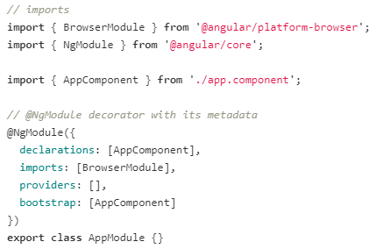
@NgModule
declarations – contains a list of components, directives, and pipes, which belong to this module. Entities may only exist in one module. If Angular detects any component, directive or pipe in more than one NgModule, it reports an error.
imports – contains a list of modules, which are used by the component templates in this module reference
exports – list of components in this module which are made available to other components and NgModules
providers – the list of service providers (Angular Services) that the application needs
bootstrap – contains the root component of the application

Slide 42
Angular Directives

Slide 43
Types of Directives
There are tree types of Directives in Angular:
Component Directives – Component directives alter the details of how the component should be processed, instantiated, and used at runtime.
Attribute Directives – Attribute directives are used to change the look and behavior of the DOM elements
Structural Directives – Structural directives are used to manipulate and change the structure of te DOM elements

Slide 44
Component Directives
Component Directives
Component directives are the most common type of directive – in fact, every Angular component (any TypeScript class decorated with the ‘@Component’ decorator) is a Component Directive.
This directive tells Angular 3 key things:
Selector
Template
Styles

Slide 45
Attribute Directives
Attribute Directives are used to change the look and behavior of the DOM elements.
There are two built-in attribute directives:
ngClass
ngStyle

Slide 46
ngClass Directive
The ngClass directive is used for adding or removing the CSS classes on an HTML element.
It allows us to apply CSS classes dynamically based on expression evaluation.
To use NgClass, you must add it to the component’s imports list:
import {NgClass} from ‘@angular/common’; @Component({ imports: [NgClass] })
The syntax for ngClass is:
<some-element [ngClass]=“value”>…</some-element>
The value for the ngClass can be:
a string
an array
an expression
an object in which keys are CSS classes and the values are expressions tat evaluate to true or false.

Slide 47
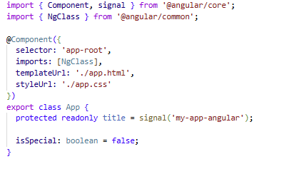

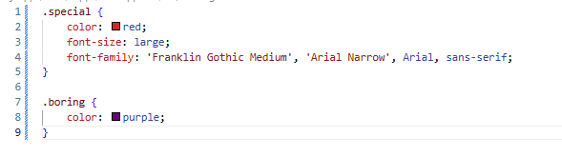
ngClass Directive
app.component.ts
app.html
app.css

Slide 48
ngStyle Directive
The ngStyle directive allows us to dynamically change the style of HTML elements based on the expression.
To use NgStyle, you must add it to the component’s imports list:
import {NgStyle} from ‘@angular/common’; @Component({ imports: [NgStyle] })
The syntax is:
<some-element [ngStyle=“objExp”>…</some-element>

Slide 49
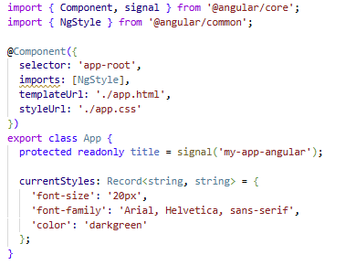
ngStyle Directive
app.component.ts
app.html

Slide 50
Structural Directives
Structural Directives
Structural directives are used for adding, removing, or manipulating DOM elements.
Structural directives start with an asterisk (*) followed by a directive name.
There are three built-in structural directives; however, they are deprecated as of Angular 20 (very recent) – we will examine these, and their replacements
ngIf – Replace by ‘ @if ’
ngFor – Replaced by ‘ @for ’
ngSwitch – Replaced by ‘ @switch ’

Slide 51
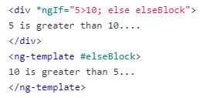
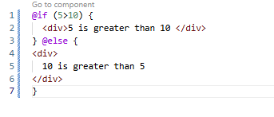
Structural Directives – ngIf
ngIf allows you tube add or remove DOM elements based on a Boolean expression.
Instead, use the ‘@if’ conditional block in your template.
Note: ‘@else if’ and ‘@else’ can be used as well

Slide 52
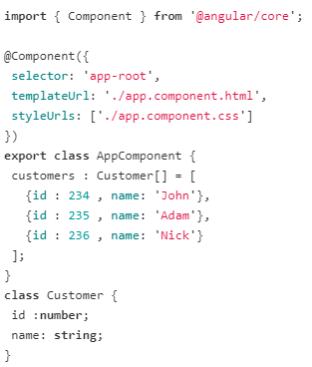

Structural Directives - ngFor
ngFor directive is used to repeat a part of the HTML template, once per each item from an iterable list.

Slide 53
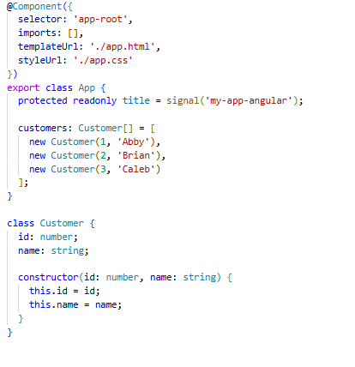
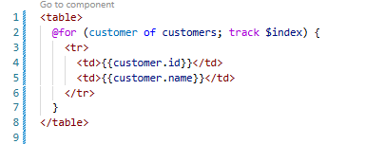
Structural Directives - ngFor
‘@for’ block replaces the ngFor directive
Note: your for statement must include a ‘track’ expression using the ‘track’ keyword For Angular to maintain the relationship between the data and the DOM nodes on te page.

Slide 54
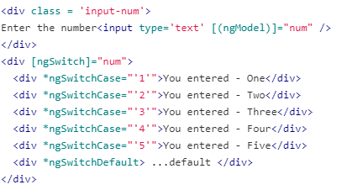
Structural Directives - ngSwitch
ngSwitch uses a set of cooperating directives, ngSwitch, ngSwitchCase and NgSwitchDefault
NgSwitch controls the behavior of the other two

Slide 55
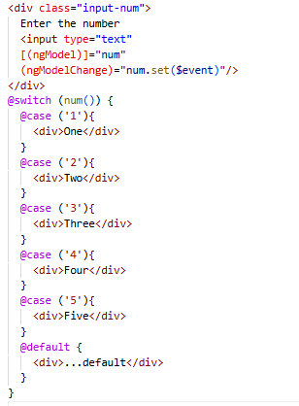
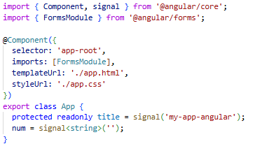
Structural Directives - ngSwitch
@switch replaces the ngSwitch and cooperating directives.
Note that @switch does not have ‘fallthrough’ so you do not need break or return statements in the block.
To apply multiple conditions to the same block, you may include consecutive @case statements

Slide 56

<ng-template>
Custom structural directives can be used with the <ng-template> element.
Note: we will not create any other directives
Additionally, <ng-template> is designed to hold other structural directives template code.
Keep in mind the use of <ng-template> with @if, @for, and @switch is not required for modern Angular

Slide 57
Custom Directives
To create your own custom directives, use the CLI command: ng generate directive <directive_name>
After the directive is created, you should see a TypeScript file of the same, or similar name
Within your directive, you can apply styles.

Slide 58
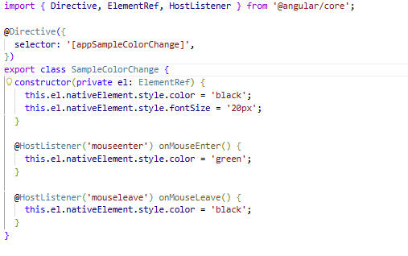


Custom Directive Example
sample-color-change.ts
app.ts - imports
app.html

Slide 59
Signals

Slide 60
Signals
A signal is a wrapper around a value that notifies interested consumers when that value changes. Signals contain any value, be it primitive to complex data structures.
You can read a signal’s value by calling it’s getter function, which allows Angular to track where the signal is used.
The goal of signals is to give developers an easy-to-use reactive primitive that can be used to build application in a reactive style; allowing the framework to optimize rendering updates.
Signals were introduced in Angular 16, and by Angular 19 and 20 became fully stabilized in the Signals API.

Slide 61
Signal Types
There are three Core signal types:
signal() – A writable signal. You create it wit an initial value, and update it using .set() or .update()
computed() – A read-only signal derived from other signals. It recalculates automatically when its dependencies change.
effect() – Runs a side effect (such as logging or an API call) whenever a signal it depends on changes.

Slide 62
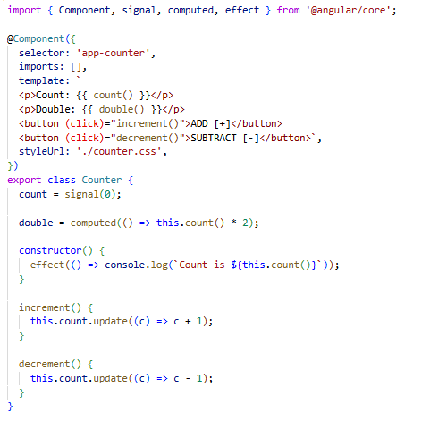
Signal - Example

Slide 63
Services & Dependency Injection

Slide 64
Services
Service are used to organize and share business logic, models, data, or functions with different components of an Angular application
An Angular service is a singleton instance that can be injected into multiple components, where the component utilizes the functions defined in a service class
This allows us to reuse the code

Slide 65
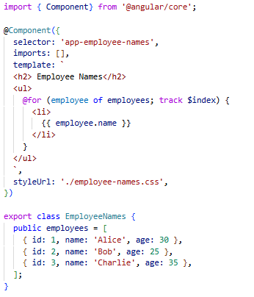
Services
Consider this code
We want to declare an array of Employee objects and display the name in a template.

Slide 66
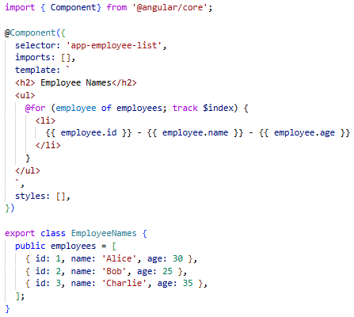
Services
Now, we create another component to display other employee information
Note, we could be processing the data in some other way – this example is simplified to illustrate the advantage of services.

Slide 67
Services
Between our components, we are repeating the same employees object code.
Also, the component is only responsible for controlling the view’s logic, but in our case, it is also responsible for creating data (the employees)
As such, components can delegate these tasks to services.
A service is a class that is used to share data across the multiple components, to implement the application logic and for external communication

Slide 68
Services
In Angular, service files are created with a “…service.ts” naming convention.
In the service class, we have provide functionality details which can later be injected into components.
We use a Dependency Injection framework to inject the service into components in our application.
We can create a service using the command: ng generate service <service-name>
(shorthand is ‘ng g s’)

Slide 69
Dependency Injection
Dependency Injection (DI) is a design pattern
It allows a class to receive its dependencies from external sources, rather than creating them itself
Angular supports DI with a Dependency Injection Framework
A DI framework uses an Injector where we register all those dependencies to be managed.
The Injector is responsible for creating service instances and injecting them into components
Note: dependencies are typically services, though you can make other components injectable.
To make a service injectable you can use the ‘Injectable’ decorator on your class.
In your other components, you can use the ‘inject()’ method to inject those dependencies.

Slide 70
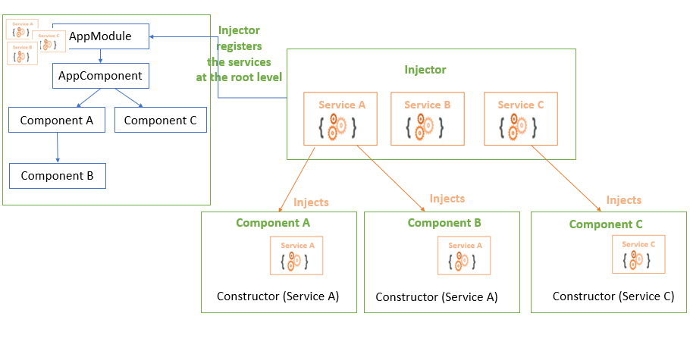
Using a Service

Slide 71
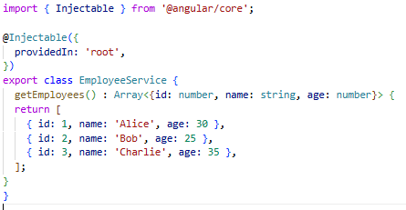
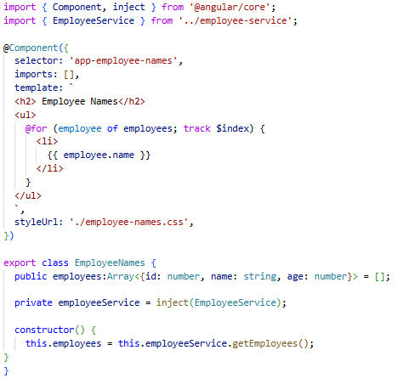
Using a Service
employee-service.ts
employee-names.ts

Slide 72
Pipes

Slide 73
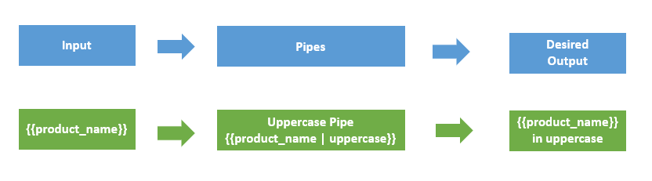
Pipes
Pipes are special operators which can be used in template expressions that allow you to transform data declaratively in your template.
Pipes provide a way to transform values in an Angular template.
Pipes are used with a Pipe ‘|’ Character, and take integers, strings, arrays, and date as input and returns a desired formatted output which can be displayed in the browser.
Syntax: {{ value_expression | pipe_name:parameter(s) }}

Slide 74
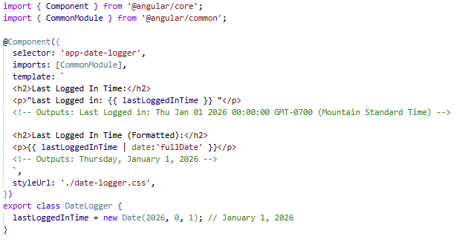
Pipes
There are many built-in Pipes, which can be leveraged using the CommonModule from ‘@angular/common’.
A list of built-in pipes can be found here: https://angular.dev/guide/templates/pipes#built-in-pipes

Slide 75
Parameterizing a Pipe
Some Pipes accepts any number of optional parameters to fine-tune their output.
To add parameters to a pipe, follow the pipe name with a colon ( : ), and then the parameter value.
Review the Angular documentation to see the options available for the Pipes you are using

Slide 76
Chaining Pipes
You can chain pipes together in effective combinations as well

Slide 77
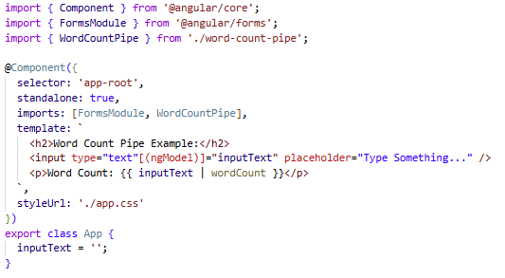
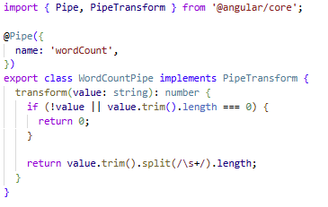
Custom Pipes
You can create custom pipes using the command ‘ng generate pipe <pipe-name>’
Shorthand: ‘ng g p <pipe-name>’
The following examples creates a pipe which counts the number of words in the associated value expression string

Slide 78
Routing & Route Guards

Slide 79
Routing
In Single Page Applications, only one page is requested from the server, and it provides multiple views dynamically, rather than loading the new pages from the server.
The Router mechanism in Angular provides a way to navigate from one view to another view in the application.
Routing in Angular is comprised of three primary parts:
Routes: define which component displays when a user visits a specific URL
Outlets: are placeholders in your templates that dynamically load and render components based on the active route.
Links: provide a way for users to navigate between different routes in your application without triggering a full page reload.

Slide 80
Routing
Angular provides a RouterModule that has the necessary service providers and directives for navigating through application views.
The router defines navigation of views on a single page and interprets URL links to determine which views to create or destroy, and which components to load or unload.
A routing component imports the Router module, and its template contains a RouterOutlet element, were it can display views produced by the router.

Slide 81
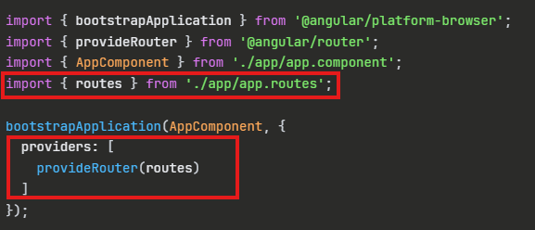
Routing
When generating a new Angular app, you should have been given a file named ‘app.routes.ts’.
Note: if you don’t have this file, you can generate the file yourself. Typically, the router file includes ‘routes’ as a naming convention.
If you need to create your own router file, you will need to register your routes in your Application’s bootstrapping (main.ts)
Angular automatically provides this bootstrapping in your app.config.ts

Slide 82
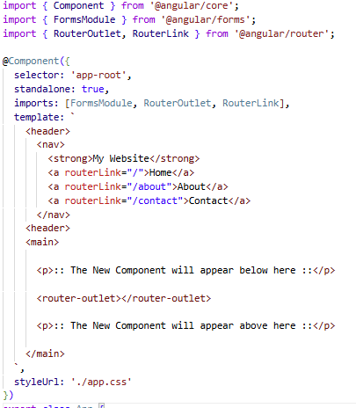
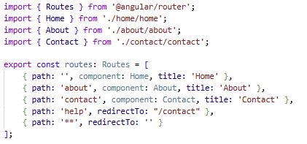
Routing
app.ts
routes.ts

Slide 83
Route Guards
A Route Guard is a function that controls whether a user is allowed to navigate to a route.
Note: In previous version of Angular (before Angular 14) Route Guards were class-based
Before Angular renders the target component, it runs the guard function – if the guard returns true, navigation proceeds, if it returns false, navigation is blocked and the user can be redirected elsewhere.
These are four types of route guards:
CanActivate (CanActivateFn)
CanActivateChild (CanActivateChildFn)
CanDeactivate (CanDeactivateFn)
CanMatch (CanMatchFn)

Slide 84
Route Guards
CanActivate (CanActivateFn) – used to determine whether a use can access a route. This is most commonly used for authentication and authorization.
CanActivateChild (CanActivateChildFn) – used to determine whether a use can access child routes of a particular parent. This is useful when you want to protect an entire section of nested routes. In other words – CanActivateChild runs for all children. This can be used to show basic site features, but hide member-only components.
CanDeactivate (CanDeactivateFn) – determines whether a user can leave a route. A common scenario is preventing navigation away from unsaved forms
CanMatch (CanMatchFn) – determines hether a route can be matched during path matching. Unlike other guards, rejection falls through to try other matching routes, instead of blocking navigation entirely. This can be useful for feature flags, A/B testing, or conditional route loading

Slide 85
Route Guards
You can generate a guard using the command ‘ng generate guard <guard-name>’
In the generated ‘guard.ts’ you can specify the functionality used to determine the result of the guard.
After creating the route guard, we import the guard to our routes.ts and reference the guard to our route.

Slide 86
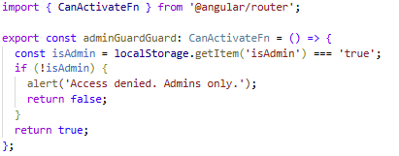
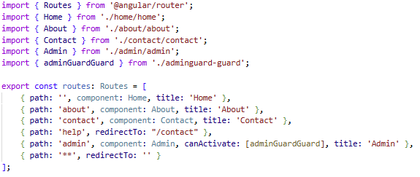
Routing
route-guard.ts
routes.ts

Slide 87
RxJS – Promises, Observables & Subjects

Slide 88
Promises
Promises are a JavaScript object which represents a single, eventual future value
In other words, it allows JavaScript to say “I don’t have this value yet, but I promise to give it to you when I do.”
A promise represents the eventual result of an asynchronous operation.
It can be one of these three states:
Pending: The initial state, neither fulfilled nor rejected
Fulfilled: The operation completed successfully, and the promise has a value.
Rejected: The operation failed, and the promise has a reason for the failure (an error)

Slide 89
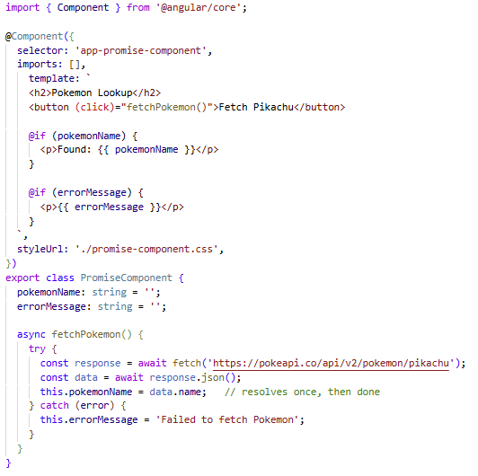
Promises
Promises are best suited for operations that can happen once and complete, such as fetching data from an API, reading a file, or submitting a form.

Slide 90
Observables
Observables provide support for passing messages between parts of your application
We can use observables for event handling, asynchronous programming, and handling multiple values.
The observer pattern is similar to the publisher/subscriber design pattern
Observables define a function for publishing values, but it is not executed until a consumer subscribes to it.
The subscribed consumer then receives notifications until the function completes, or until they unsubscribe.

Slide 91
Observables
An observable can deliver multiple values of any type (literals, messages, or events)
The API for receiving values in the same whether the values are delivered synchronously or asynchronously, and the setup and the logic are both handled by the observable.
Note: We’ll only concentrate on subscribing to consume values, and when done, unsubscribing
The observer subscribes to the observable to receive the value
The unsubscribe() method is called to stop receiving notifications.

Slide 92
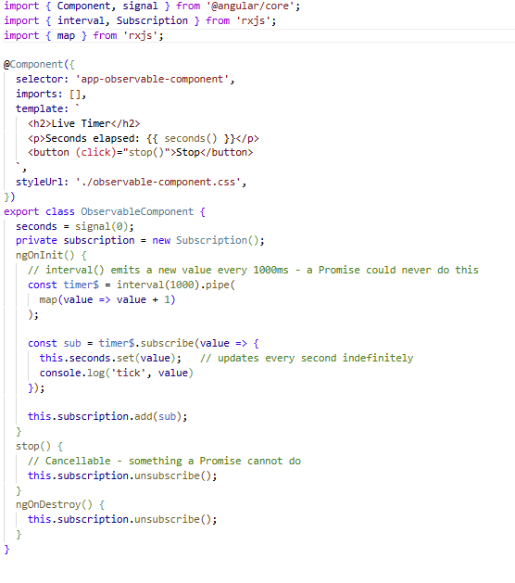
Observables

Slide 93
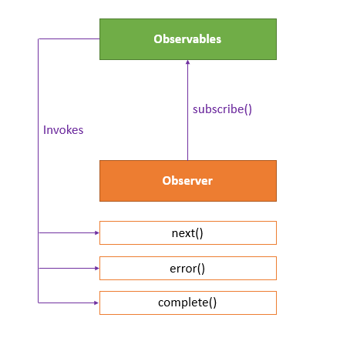
Observables

Slide 94
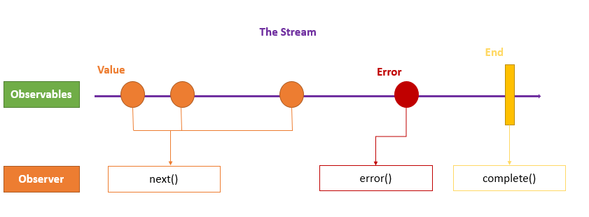
Observables
The observer defines three callback methods – next(), error(), and complete()
The observables invokes the next() callback whenever the values arrives in the stream.
It passes the value as the argument to the next callback
If an error occurs, then the error callback is invoked.
It invokes the complete() callback when the stream completes.

Slide 95
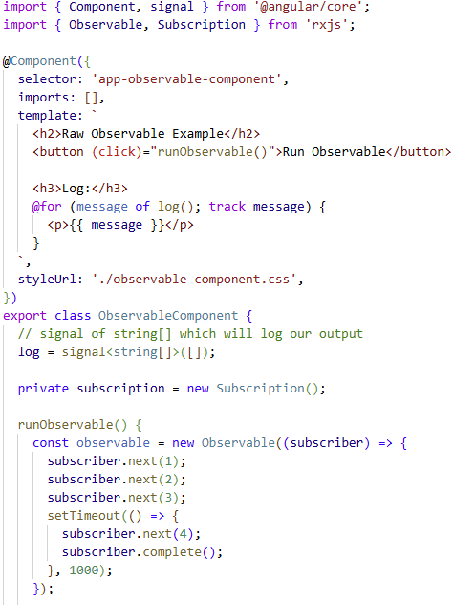
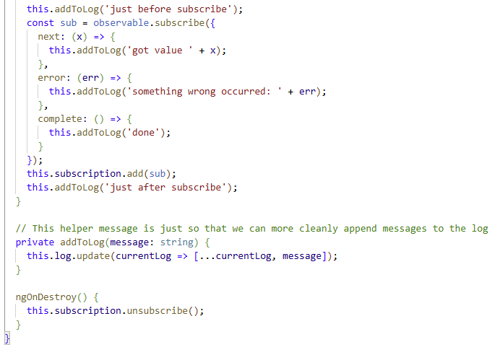
Observables

Slide 96
Observables
An Observable is like a promise, but far more powerful. While a Promises emits a single value and completes, an Observable can emit multiple values over time
This means, when handling an HTTP request, we can use a Promise to manage a single response for the same request, but if we expect multiple responses to the same request, ten we must use an Observable.
Observables are provided by RxJS and are the foundation of how Angular handles Asynchronous data

Slide 97
RxJS - Subjects
Reactive Extensions for JavaScript (RxJS) is a framework for reactive programming using observables that makes it easier to write asynchronous code.
An RxJS subject is a special type of Observable that allows values to be multi-casted to many Observers.
By default, an RxJS Observable is unicast, i.e. each subscribed observer has an independency execution of the Observable, whereas multi-cast means that the Observable execution is shared my multiple Observers.

Slide 98
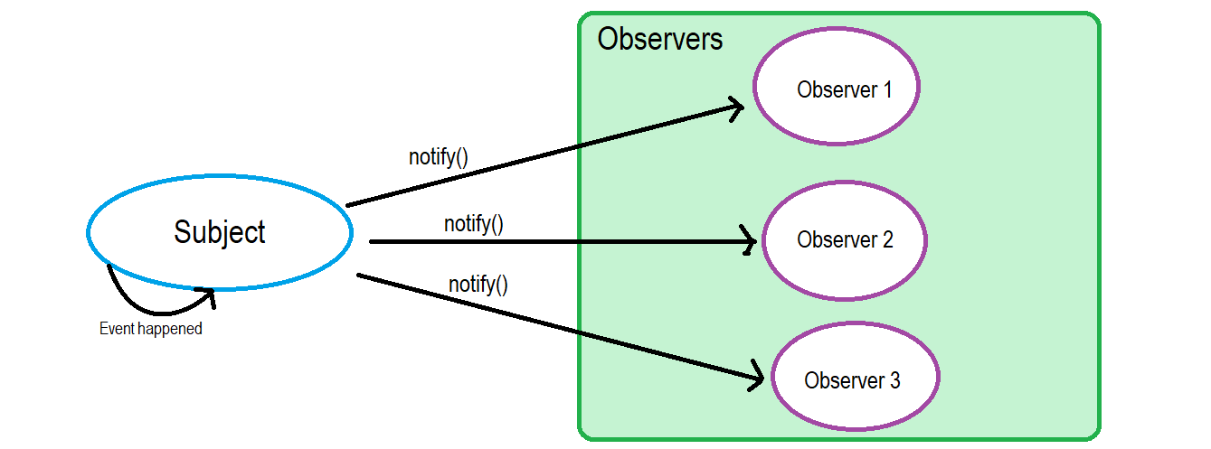
RxJS - Subjects

Slide 99
RxJS – Subject Variants
If you subscribe to the Subject after a value has been emitted, you will not receive that previous value.
Note that you can always use a basic subject; however, basic subjects have “no memory”.
There are three variants of Subjects, which have mechanisms that allow you to obtain previous values:
Behavior Subject
Replay Subject
Async Subject

Slide 100
RxJS – Subject Variants
Behavior Subject
Used to temporarily store the current data value of any observer declared before it
BehaviorSubject requires an initial values and always holds the most recent value.
Any new subscribers immediately receives the current value upon subscribing
These are best used for tracking current state, such as login status, cart count, selected theme, or user profile – anything where a new subscriber needs to know the current state immediately

Slide 101
RxJS – Subject Variants
Replay Subject
Provides an option to choose how many values we want to emit from the last observer.
This subject stores, and then passes the last specified option values to the new observer.
Replay subjects are useful for chat message history, activity logs, or any scenario where a late subscriber needs context from recent past events

Slide 102
RxJS – Subject Variants
Async Subject
Async Subjects emit the last value to observers when the sequence is completed
This means that an AsyncSubject only emits the very last value, and only does so when the subject completes. Any values emitted before completion are ignored by subscribers.
Async Subjects are best used for long-running calculations, file uploads, or any operation where intermediate values are irrelevant and only the final result matters.

Slide 103
Pub-sub design patterns

Slide 104
Publisher/Subscriber Design Pattern
The Publisher/Subscriber design pattern describes the flow of messages between applications, devices, or services
A message is published by Publishers to a Channel that will be consumed by all Subscribers monitoring that channel.
When the Publisher pushes messages to a channel (live-feed data streams), the subscribers who subscribed to this channel are immediately notified.
Any publisher may also be a subscriber.
Messages can be text, sensor data, audio, video, or other digital content.

Slide 105
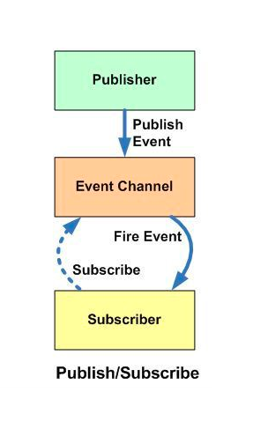
Publisher/Subscriber Design Pattern
The Sub-Sub pattern is usually implemented in an asynchronous way.
In the Observer pattern, the observers are aware of the observable, but in Pub-Sub pattern, publishers and subscribers don’t need to know each other.
They simply communicate with the help of message queues.

Slide 106
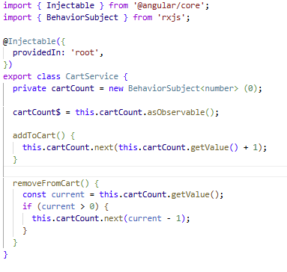
Pub-Sub | Example
First, create a Service which acts as a message broker.
It sits between the publishers and subscribers
The ‘BehaviorSubject’ from rxjs holds the current value AND emits the value to new subscribers.
Note: BehaviorSubject emits the last value to new subscribers, which means it initialize the cart count (seen later) immediately.

Slide 107
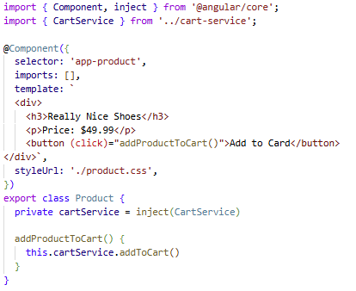
Pub-Sub | Example
Next, create the publisher. This component will publish events by calling the service.
Note: this component has knowledge of who is listening.
You can see the broadcasted event in the ‘addProductToCart()’ function.

Slide 108
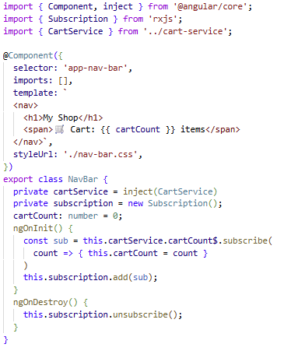
Pub-Sub | Example
Finally, create the subscriber.
In this case, the nav bar subscribes to the cart updates (see ‘cartCount$’).
In response, the nav-bar component updates it’s cartCount field to match the updated value
ngOnInit() is used to subscribe the to event before the component is made visible
ngOnDestroy is used to unsubscribe from the event to prevent memory leaks.

Slide 109
httpclient

Slide 110
HTTP Client
Most Front-End applications need to communicate with a server over the HTTP protocol to enable the ability to download or upload data and access other back-end services.
Angular provides a simplified client HTTP API for Angular applications, the HttpClient service class in ‘@angular/common/http’
The Angular HttpClient offers testability features, typed request and response objects, request and response interception, Observable APIs, and streamlined error handling

Slide 111
HTTP Client
HttpClient supposed all standard Http methods – Get, Post, Put, Delete, and returns RxJS Observables, meaning the data arrives asynchronously and your component can react to it when it is ready.
The recommended pattern is to never call HttpClient directly from a component. Instead, calls should live inside a dedicated service, keeping your components lean and your API logic reusable and easier to test.

Slide 112
HTTP Client | Example
Backend Simulator:
Install & Run Json-Server
npm install –g json-server
json-server –watch ./backend/database.json
This will be (port 3000)
App Data:
employee-model.ts
employee-service.ts
employee-portal.ts
BootStrapping Update:
main.ts (register ‘provideHttpClient()’to application bootstrap, and include ‘withFetchAPI()’)
add employee-portal component to root app component

Slide 113
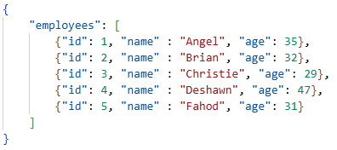
HTTP Client | Example
We’re going to leverage JSON-Server to simulate our backend.
The backend data will be represented by a json file that contains information
Create a new file in your project named ‘database.json’ and populate it with your data:

Slide 114
HTTP Client | Example
[NOTE: YOU ARE NOT REQUIRED TO DO THIS FOR YOUR PROJECTS – This is to simulate a backend]
Install & Run Json-Server by running the following commands:
npm install –g json-server
npx json-server <path-to-json-file>
Ex: json-server ./backend/database.json
This will be (port 3000)

Slide 115
HTTP Client | Example
Next, we’ll create the following three files to represent our application:
employee-model.ts – a simple model to represent our data to render to screen
employee-service.ts – a simple service to ping our ‘backend’
employee-portal.ts – a component used to view our data

Slide 116
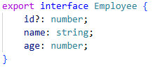
HTTP Client | Example Employee Model
We just create a file in our project root called ‘employee-model.ts’
Then we add the following code:
Note: we make this an interface because it is more memory efficient for out application.
The ‘id’ field is optional (?) because our app will supply the IDs (this might be done in your own backend)

Slide 117


HTTP Client | Example Employee Service

Slide 118

HTTP Client | Example Employee Portal

Slide 119

HTTP Client | Example Employee Portal

Slide 120

HTTP Client | Example Employee Portal

Slide 121

HTTP Client | Example Employee Portal

Slide 122

HTTP Client | Example
BootStrapping Update:
main.ts (register ‘provideHttpClient()’to application bootstrap, and include ‘withFetch()’)
Note: You may need to add this to app.config.ts instead of main.ts

Slide 123
HTTP Client | Example
Add your component (app-employee-portal) to your AppComponent, then start your angular app to view your page.

