Slide 1
Cloud Computing

Slide 2
Outline
What is Cloud Computing?
Advantages of Cloud Computing
Cloud Computing Models
Cloud Computing Deployment Methods

Slide 3
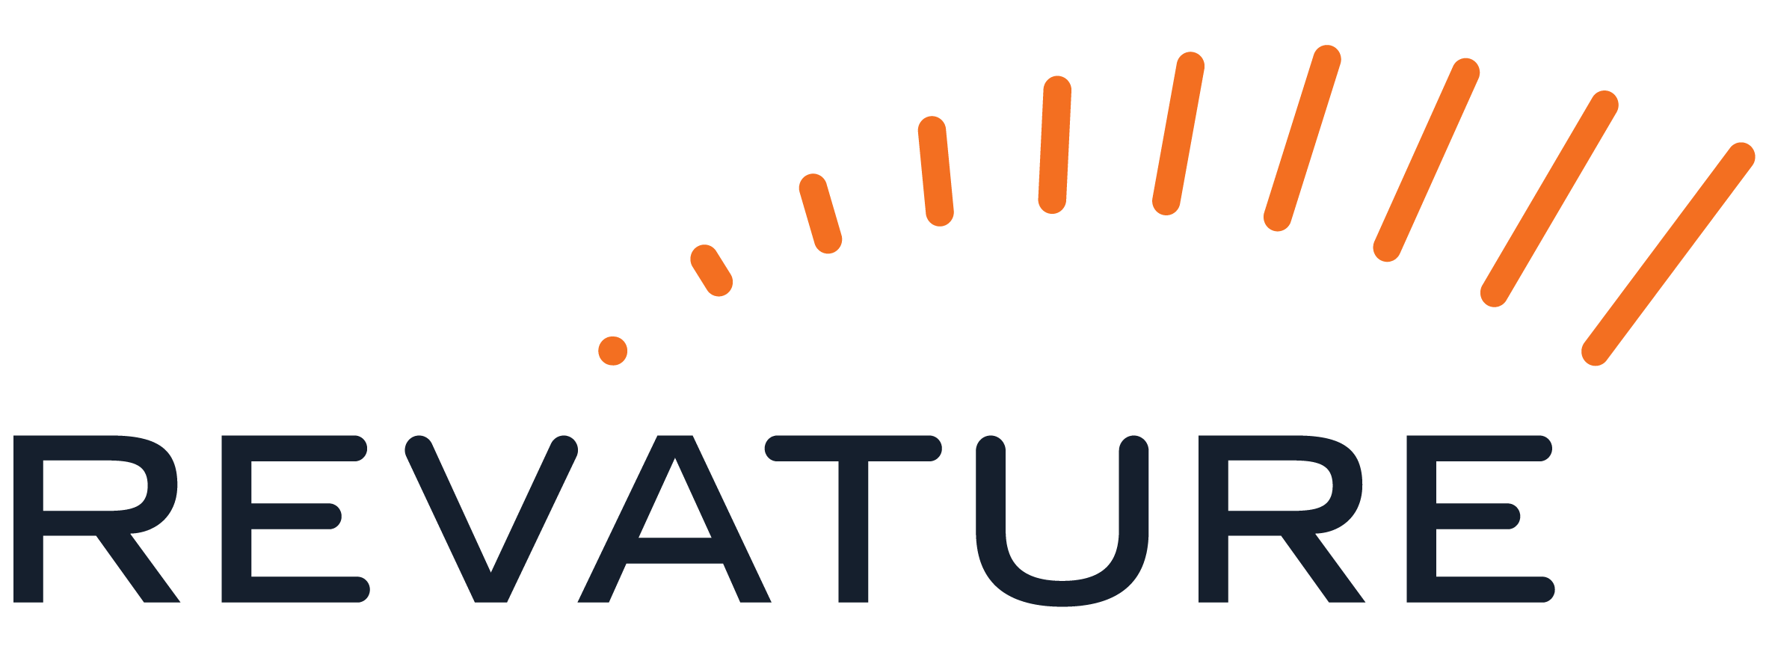
What is Cloud Computing?

Slide 4
What is Cloud Computing?
Cloud computing is on-demand delivery of compute power, database storage, applications and other IT resources through a cloud services platform
Cloud computing uses “pay-as-you-go” pricing models.
Cloud computing provides a simple way to access servers, storage, databases and a broad set of application services over the internet.

Slide 5
Advantages of Cloud Computing

Slide 6
6 Advantages of Cloud Computing
Trade capital expense for variable expense
Benefit from massive economies of scale
Stop guessing about capacity
Increase speed and agility
Eliminate overhead cost of maintaining data centers
Go global in minutes

Slide 7
Cloud Computing Models

Slide 8
3 Models of Cloud Computing
Infrastructure as a Service (IaaS)
Infrastructure as a Service is a self-service model for managing remote data center infrastructures. Cloud venders offers IaaS in the form of data centers
Platform as a Service (PaaS)
Platform as a Service allows organizations to build, run and manage applications without the IT infrastructure. This make it easier and faster to develop, test and deploy applications
Software as a Service (SaaS)
Software as a Service replaces the traditional on-device software with software that is licensed on a subscription basis. It is centrally hosted in the cloud.

Slide 9
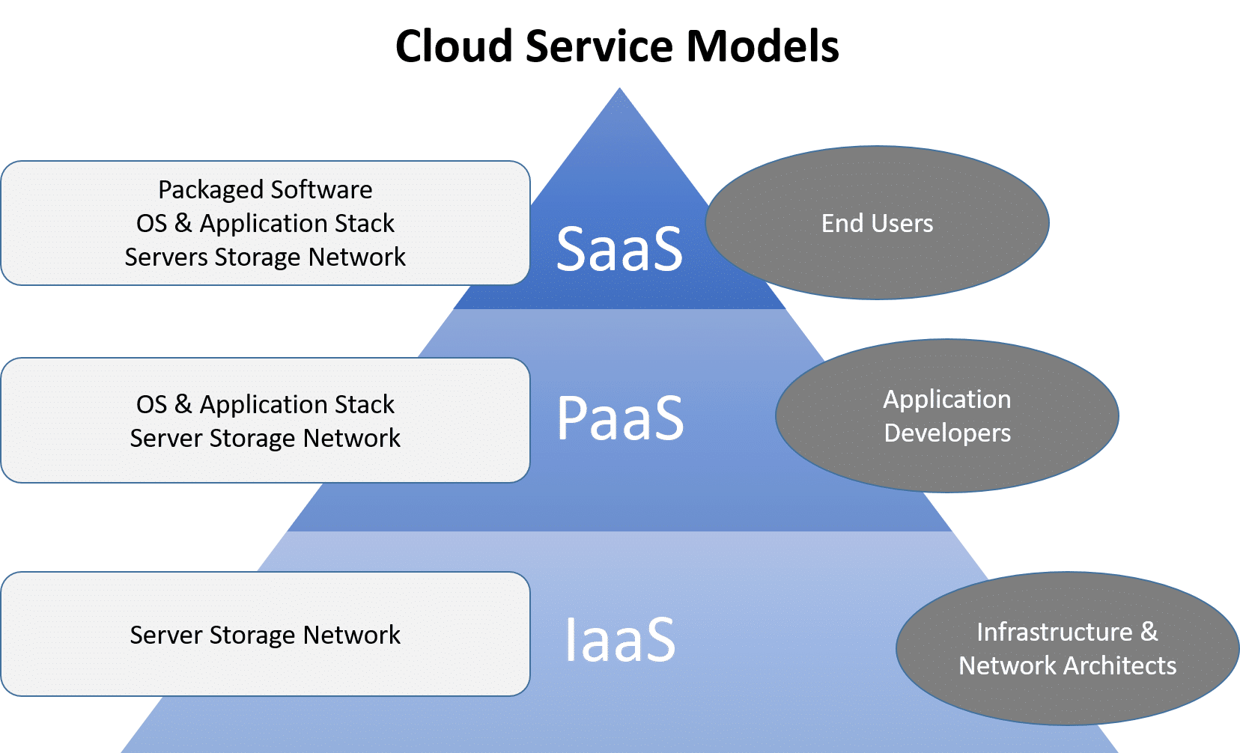
Service Models

Slide 10
Cloud Computing Deployment Methods

Slide 11
Cloud Computing Deployment Methods
Private | Hybrid | Public
Cloud computer model in which an enterprise uses proprietary architecture and runs cloud servers within in own data center | Cloud computing model that includes a mix of on-premises, private cloud services with orchestration between the two platforms | Cloud computing model in which a third-party provider makes compute resources available to the general public over the internet., with public cloud, enterprises do not have to setup and maintain their own cloud servers in house.
Single-tenant architecture On-premises hardware Direct control of underlying cloud infrastructure | Cloud bursting capabilities Benefits of both public and private environments | Multi-tenant architecture Pay-as-you-go pricing model
HPE, VMware, Dell EMC, IBM/Red Hat, Microsoft, OpenStack | A combination of both public and private cloud providers | AWS, Microsoft Azure, Google Cloud

Slide 12
Private Cloud
Private cloud services are delivered from a business’ data center to internal users
With a private cloud, an organization builds and maintains its own underlying cloud infrastructure
This model offers the versatility and convenience of the cloud, while preserving the management, control and security common to local data centers.
Internal users might or might not be billed for services through IT chargeback.
Common private cloud technologies and vendors include VMware and OpenStack

Slide 13
Public Cloud
In the public cloud model, a third-party cloud service provider (CSP) delivers the cloud server over the internet
Public cloud services are sold on demand, typically by the minute or hour, though long-term commitments are available for many services
Customers only pay for the central processing unit cycles, storage or bandwidth they consume
Leading public CSPs include: AWS, Microsoft Azure, IBM, Google Cloud Platform (GCP), Oracle and Tencent.

Slide 14
Hybrid Cloud
A hybrid cloud is a combination of public cloud services and an on-premises private cloud, with orchestration and automation between the two.
Companies can run mission-critical workloads or sensitive application on the private cloud and use the public cloud to handle workload bursts or spikes in demand.
The goal of a hybrid cloud is to create a unified, automated, scalable environment that takes advantage of all that a public cloud infrastructure can provide, while maintaining control over mission-critical data.

