Slide 1
Google Cloud Platform

Slide 2
Outline
What is GCP?
Regions & Zones
Service Overview
Managed Instance Groups
Access Management
Firewall Rules
Compute Engine
VMI
App Engine
Block Storage
Cloud SQL
Cloud Storage
GCP Run Functions
GCP Cloud Monitoring
GCP Pub/Sub

Slide 3
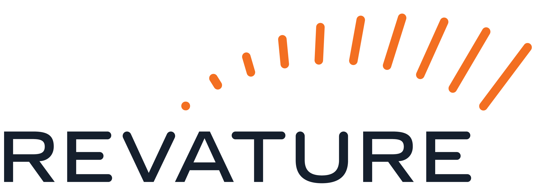
What is GCP?

Slide 4
Google Cloud Platform – Intro
Google Cloud Platform (GCP) is Google suite of cloud computing services that runs on the same infrastructure google uses internally for products like Gmail, YouTube, and Google Search.
Competes with Amazon Web Services and Microsoft Azure
Service Models Available:
IaaS
PaaS
SaaS
Pay-as-you-go-pricing
Global Infrastructure

Slide 5
Google Cloud Platform - Advantages
Network Performance: Google owns one of the world’s largest networks, providing exceptional speed between regions
Data Analytics: BigQuery and data processing tools are industry-leading
Machine Learning: Advanced AI/ML services (Vertex AI, TensorFlow)
Live Migration: VMs can be migrated between hosts without downtime
Pricing Flexibility: Per-second billing (not per-hour), automatic sustained-use discounts.

Slide 6
GCP - Projects
Projects are the base-level organizing entity in GCP
Every resource belongs to exactly one project
Each project has:
Project ID: Globally unique, immutable identifier
Project Name: Human-readable, can be changed
Project Number: Auto-generated numeric identifier
Billing, quotas, and permissions are managed at the project level
Think of projects like isolated workspaces or Maven modules

Slide 7
Regions and Zones

Slide 8
Regions and Zones - Regions
GCP infrastructure is organized into regions and zones to provide geographic distribution, fault tolerance and lo latency
Regions:
Physical geographic locations
ex: us-central1, europe-west1
Each regions is completely independent
Contains 3 or more zones
Choose regions based on:
Latency: Deployment close to your users
Cost: Pricing varies by region
Compliance: Data residency requirements
Service availability: Service availability

Slide 9
Regions and Zones - Zones
Zones:
Isolated locations within a region
Named with region + letter.
Ex: us-central1-a, us-central1-b
Each zone runs on independent power, cooling and networking
Failure Domain: a zone failure doesn’t affect other zones
Designed to protect against datacenter-level failures
Resources in the same zone have lowest latency between them
Zones contain the physical infrastructure that runs services such as Compute Engine and GKE

Slide 10
Regions and Zones – Architecture
Multi-Zone
Running your application in more than one zone (usually in the same region)
Ex: us-central1-a and us-central1-b
If one zone goes down, your other zone(s) can still serve users
Cheaper, lower latency, but more vulnerable
Multi-Region
Running your application in more than one region
Ex: us-central1 and us-east1
If an entire region goes down (natural disaster, major networking issues, etc…), your application can still server users (albeit with some latency)
More expensive, higher latency, but more resilient

Slide 11
Service Overview

Slide 12
Accessing Resources through services
In cloud computing, what you might be used to thinking of as software and hardware products become services.
These services provide access to the underlying resources.
The list of available Google Cloud services is long, and it keeps growing.
When you develop your website or web app on Google Cloud, you mix and match these services into combinations that provide the infrastructure you need; and, then add your code to enable the scenarios you want to build.

Slide 13
GCP Services
GCP offers 100+ services across various categories. Some key services include:
Service Category | Services (Examples)
Compute | -Compute Engine -Google Kubernetes Engine
Storage & Databases | -Cloud Storage -Cloud SQL
Networking | -Virtual Private Cloud -Cloud Load Balancing
Big Data & Analytics | -BigQuery -Pub/Sub
Management & Monitoring | -Cloud Monitoring -Cloud Logging

Slide 14
Interacting with Services
Google Cloud console (Web UI)
Browser-based dashboard where you can click through menus to create, configure and manage GCP resources
Command-Line interface
Using terminal commands (such as gcloud tool) to manage GCP resources from your Computer
Client libraries
Programming libraries (Java, Python, Node.js) that let your application code directly call GCP services through APIs

Slide 15
Autoscaled Managed Instance Groups (MIGs)

Slide 16
Managed Instance Groups
Managed Instance Groups (MIGs) allow you to operate and manage multiple, identical Virtual Machines (VMs) as a single entity.
They provide:
Automatic repairing failed VMs
Regional (multi-zone) deployment
Load Balancing
Automated Updates

Slide 17
Access Management

Slide 18
Access Management | IAM
Identity and Access Management (IAM)
IAM involves 3 components, which essentially answer who can access what resources where:
[WHO] - Principles
Users (you)
Groups
service accounts (identify for apps)
domains
[WHAT] - Roles: Collections of permissions
Basic Roles:
Viewer (read-only), Editor (modify many things), Owner (full control)
Predefined Roles (pre-determined by google)
Custom Roles (specific permissions)
[WHERE] - Resources: The Google Cloud Resources you want to let the principle access
Most Google Cloud Services have their own resources (for instance Compute Engine has resources like ‘instances’)
You grant roles on a resource
Granting a principle a role means that the principle can use the permissions in that role to access the resource.
Notes:
Predefined role example: instance admin

Slide 19
Access Management | IAM Policies
You grant roles to principles using allow policies
An allow policy is a YAML or JSON object that is attached to a Google Cloud resource.
Each policy contains a list of role bindings that associate IAM roles with the principles who are grated those roles.
When an authenticated principle attempts to access a resource, IAM checks the resource’s allow policy to determine whether the principles has the required permissions
If the principle is in a role binding that includes a role with the required permissions, they are allowed access.
Note: There are also ‘Deny Policies’ which prevent principles from using certain permissions, even if they’re granted a role with that permission
Notes:
Predefined role example: instance admin

Slide 20
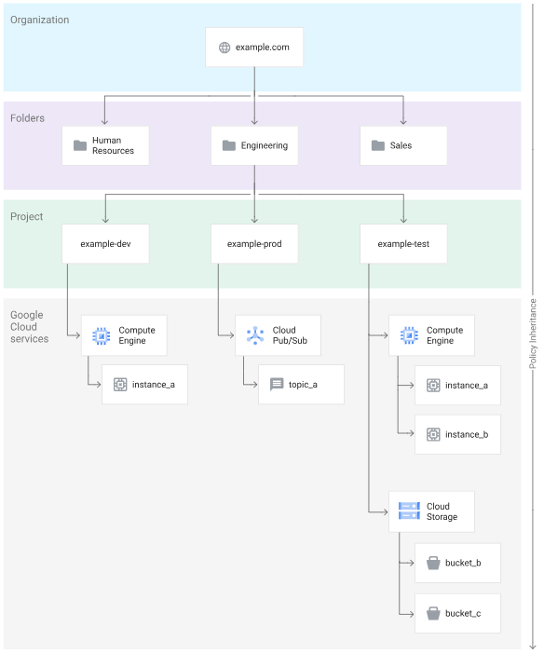
Access Management | Policy Inheritance
Google cloud has container resources – such as projects, folders, and organizations, which allow you to organize resources in a resource hierarchy.
The hierarchy is shown in this image (Org > Folders > Projects > Resources)
If you set an allow policy on a container resource, then the policy also applies to all resources in that container.
Notes:
Predefined role example: instance admin

Slide 21
Access Management | ACM
Access Context Manager (ACM) is a security service that enables ‘Attribute-Based Access Control (ABAC).
Adds contextual conditions to IAM permissions, for instance: access based on device IP or user identity, rather than permissions for the entire network
Allows organizations to define access levels and service perimeters to enforce Zero Trust policies across GCP resources.
Notes:
Predefined role example: instance admin

Slide 22
Access Management | ACM Components
Key Components of ACM are:
Access Policies
Organization-wide container for:
Access Levels
Service Perimeters (sandboxes of resources that can exchange data freely within a perimeter)
Supports:
Organization-level policies
Scopes (delegated) policies at folder/project level
Uses ‘etag’ versioning to prevent policy-overwrite conflicts
Access Levels
Used to define trust tiers and decide whether a request is allowed
Two Types: Basic Access Level & Custom Access Level
Basic Access Level
Based on predefined request attributes (IP address, device characteristics, user identity)
Conditions combined via AND (all conditions true) or NOR (no conditions true)
Custom Access Levels
Use a subset of CEL (Common Expression Language)
More flexible, can incorporate third-party data
Notes:
Predefined role example: instance admin

Slide 23
Access Management | ACM Benefits
Traditional perimeter security (ex: firewalls) are ineffective for:
Mobile workforces
Bring-your-own-devices
Cloud-native environments
ACM supports a BeyondCorp model
BeyondCorp is Google’s implementation of the Zero Trust Model.
Access depends on context, not the network alone
Reduces privileged network exposure
Notes:
Predefined role example: instance admin

Slide 24
Firewall Rules

Slide 25
Firewall Rules
Firewall rules are security controls that determine what network traffic is allowed to reach your virtual machines or leave from them.
You can configure rules based on the Direction of Traffic
Ingress (Incoming)
Traffic coming into your VM from external sources i.e. user accessing your website.
Default: DENY ALL
Egress (Outgoing)
Traffic going out of your VM to external destinations, i.e. your application calling an external API
Default: ALLOW ALL
Firewall Rules are “stateful” meaning if you allow incoming traffic, the response is automatically allowed back out.
Rules have a priority which determines when they are evaluated (lower number = higher priority)
The first matching rule is applied
If no rules match, the default (deny for ingress or allow for egress) applies.

Slide 26
Compute Engine

Slide 27
Compute Engine
Compute Engine is GCP’s IaaS Offering.
It provides Virtual Machines (VMs) that run in Google’s Data centers
i.e. You are renting a computer in Google data center that you can access remotely and control
With Compute Engine, you can create and run instances on Google infrastructure
Instances are single virtual machines with a complete OS, CPU, memory, disk and network interface.
Instances act list a physical computer; but, exist as software.
GCP Compute allows for on-demand, scalable computing resources.
Typically used when you require more control over the computing environment
Offers seamless connectivity with other Google Cloud Services

Slide 28
Advantages of Compute Engine
No hardware to buy: no upfront costs for servers
Scalability: Create 1 VM or 1000 in minutes
Pay-as-you-go: only pay for hat you use (per-second billing)
Global infrastructure: Deploy VMs worldwide, close to your users
Flexibility: Choose exact CPU, RAM, disk size you need
Live migration: Google can move your VM to different hardware without downtime (during maintenance)

Slide 29
Compute Engine – Structure
Disks (Storage)
Boot Disk
Contains OS
Created automatically when you create a VM
Can be deleted with VM or kept separate
Additional Data Disk
Optional disks to allow more storage
Persistence
Persistent disks: data survives VM deletion
Local SSDs: Data is lost when VM stops (temporary, but very fast)
IP Addresses
Internal IP (Private)
Always automatically assigned
Free
Other VMs in the same network can reach this IP
External IP (Public)
Optional
Allows internet to reach your VM
Ephemeral: Changes when VM restarts (free while VM running)
Static: Permanent, reserved IP (small charge, even when not in use)

Slide 30
Preemptible (Spot VMs)
Preemptible VMs (older version) and Spot VMs are cheaper alternatives (up to 90% off).
These are excess Compute engine capacity.
Google can stop or delete them at any time (usually with a short warning)
No availability guarantee
Useful for:
Batch processing jobs
Data analysis
Fault-tolerant applications
Do NOT use them for:
Databases (data loss risk)
Web servers servicing live traffic
Long-running processes that can’t be interrupted

Slide 31
Pricing
Billed Components
Compute (CPU/RAM): Per-second billing (minimum 1 minute)
Disk Storage: Per GB per month
Network Egress: Data leaving GCP (ingress is free)
External IP: Small charge for static IPs
Licensing: Windows and some OS require additional fees
Cost Optimization
Right-size: Don't over-provision resources
Use Spot VMs: For fault-tolerant workloads (up to 90% savings)
Committed Use Discounts: Commit to 1 or 3 years (50+% savings)
Sustained Use Discounts: Automatic discounts for VMs running >25% of month
Stop VMs when not needed: Development VMs overnight/weekends
Use preemptible for batch: Instead of running 24/7

Slide 32
When to Use Compute Engine
Use Compute Engine when:
Need full control over OS
Running legacy applications
Custom networking requirements
Applications that need GPU
Need specific software licenses
Don’t use Compute Engine when:
Just need to run containers
instead use Cloud Run it is simpler and serverless
Just need a managed database
instead use Cloud SQL for no VM management
Need serverless functions
Instead use Cloud Functions
Running standard web apps
Consider using App Engine for a fully managed tool

Slide 33
Virtual Machine Images

Slide 34
Virtual Machine Images
A Virtual machine image is a template or snapshot of a complete VM disk that contains:
Operations system
Pre-installed software
Configuration files
Application code
Google provides some ready to use instances which are maintained with regular security patches.
Alternatively, you can create images from your own configured VMs with your specific software stack.

Slide 35
Why VMIs?
Virtual Machine Images provide the following advantages:
Rapid Deployment (create identical web servers in minutes)
Consistency: Every VM has the same configuration
Disaster recovery: Restore VMs quickly from images
Version Control: Keep different versions of your setup

Slide 36
App Engine

Slide 37
App Engine
Google Cloud App Engine is a fully managed, serverless application platform with simple administration.
App Engine is a hardware agnostic platform for development which lets you easily deploy your projects into the larger Google cloud ecosystem.
You write your code in one of the supported languages, and this PaaS (platform-as-a-service) will handle the rest.
When your code is ready, you simply tell GCP to deploy it to their data centers, and make use of all the features GCP has to offer.

Slide 38
App Engine | Serverless
If an application is reachable on a network, it can’t be serverless – this is true of apps in GCP
When we say “serverless” with respect to app engine, we don’t mean “no servers”. Instead, it means, we are abstracted away from those concerns.
We don’t need to worry about the server hardware – where it is located, how much power it has, etc… GCP handles all of this.
If we are getting little to no traffic, GCP will scale down resources, and if we get more, the resources will scale up – our costs decrease or increase with respect to those changes.

Slide 39
App Engine | Supported Languages
App Engine supports a few common languages natively, meaning we will find a fully supported development environment with many tool we are familiar with:
GO
PHP
Java
Python
Node (JS)
.NET (C#)
Ruby

Slide 40
App Engine | Environments
Each App Engine project uses one (or both) of the following environments: standard, and flexible
Standard
Used for natively supported languages (see previous slide)
Best for apps which require rapid scaling
This environment can scale down to 0 (no cost) resources, and scale up to handle traffic as it comes.
Best for handling sudden extreme changes in traffic
Flexible
Runs applications in Docker containers.
Supports any language and framework which can run in a docker container.
Scales slower, and cannot scale down to 0, only down to minimum of one running container
Adding more instances will take minutes, as opposed to seconds

Slide 41
App Engine | How does it work?
Where App Engine ends, and the rest of GCP services begin is a little hard to define.
App Engine allows us to deploy applications, but where do they go?
Application work can be handled by a few difference services, including GCP Cloud Compute. Front ends can be deployed to Firebase (another Google Product).
Is App Engine scaling our apps up and down or some other service?
App Engine is doing this!
Scaling is what these cloud platforms are all about! – GCP will scale these resources based on traffic and/or work being done.
GCP will perform both vertical and/or horizontal scaling, depending on the needs of the application.
There is some overlap with over services, and App Engine represents an entry point into the wider GCP ecosystem.

Slide 42
App Engine | What Else?
Load Balancing
If scaling horizontally (adding additional instances to take some workload) – load balancing is performed to split traffic among those instances.
GCP spins up more VMs or Containers to handle routing traffic between the whole set.
Fault Tolerance
If an instance goes down for whatever reason, we re-balance traffic on the remaining instances.
Now with the increases traffic load on the instances, GCP scales up more instances to replace any that crashed.
The benchmark for measuring application availability is measured in terms of “nines” – for instance, a benchmark for high availability might be “five nines” or otherwise 99.999%
More…
Split traffic to perform A/B Testing
Monitor Application Performance & Debug issues
GCP offers a suite of security features, including SSL (secure socket layer) certificates for hosted sites

Slide 43
Block Storage

Slide 44
Block Storage (Persistent Disks)
Block storage provides virtual hard drives for your VMs. In GCP these are called persistent disks
Key Characteristics:
Persistent: Data survives even when VM is stopped or deleted
Independent: Exists separately from VMs, can be detached and moved
Durable: Data is automatically replicated for protection
Resizable: Can increase size without downtime

Slide 45
Types
Boot Disk:
Contains the operating system
Every VM must have one
Created automatically when you create a VM
Data Disk (Additional Disks):
Optional, for storing application data
Can attach multiple data disks to one VM
Can detach and move to different VMs
Example: One disk for OS, another for database files
Zonal vs Regional Disks:
Zonal: Stored in one zone (standard)
Regional: Replicated across two zones in a region (high availability)
Regional costs the same but survives zone failures

Slide 46
Cloud SQL

Slide 47
Cloud SQL
Cloud SQL is a fully managed relational database service managed by Google, you can just use the database.
Google handles:
Backups: Daily automatic backups
Updates: Security patches and version updates
Replication: Data is replicated for safety
Scaling: Can increase CPU/memory with a few clicks
High Availability: Automatic failover if hardware fails
Monitoring: Built-in performance monitoring
Supports:
MySQL
PostgreSQL
SQL Server

Slide 48
Cloud SQL – Key Features
High Availability:
Can configure with automatic failover
If primary database fails, standby takes over automatically
Minimal downtime
Backups:
Automatic daily backups (you choose the time)
Point-in-time recovery (restore to any second in last 7 days)
Manual backups available anytime
Connection Methods:
Public IP: Connect from anywhere (less secure)
Private IP: Connect only from your VPC (more secure, recommended)
Cloud SQL Proxy: Secure tunnel for connections
Instance Tiers:
Shared-core (db-f1-micro, db-g1-small): Low cost, for development/testing
Dedicated-core (db-n1-standard-X): Production workloads, dedicated resources

Slide 49
Cloud Storage

Slide 50
Cloud Storage
Cloud Storage is object storage for files and unstructured data.
Store any type of file (images, videos, backups, logs) and access from anywhere
Key Concepts:
Buckets:
Containers that hold your files
Must have globally unique names
Created in a specific location (region, multi-region)
Example: my-app-images, backup-bucket-2024
Objects:
Individual files stored in buckets
Can be any size (up to 5TB per object)
Each object has a unique name (key) within the bucket
Examples: photos/vacation.jpg, logs/2024-01-22.log
Not a File System:
No folders (but can simulate with naming: folder/subfolder/file.txt)
No mounting to VMs like a disk
Access via API, not file system commands
Each object is standalone

Slide 51
Cloud Storage – Storage Classes
Storage Classes offer Trade-offs in Cost vs how often data is accessed
Storage Class | Storage Cost | Access Fee | Use for
Standard | Highest | Lowest | Active website content, streaming videos
Nearline | Moderate | Low | Data backup, disaster recovery
Coldline | Low | Moderate | Long-term backup, archived data
Archive | Lowest | Highest | Regulatory archives

Slide 52
Cloud Storage – Key Features
Durability:
99.999999999% (“eleven nines”) durability
Your data is replicated multiple times
Virtually impossible to lose data
Availability:
Multi-region: 99.95% availability (stored across multiple regions)
Regional: 99.9% availability (stored in one region)
Dual-region: 99.95% availability (stored in two specific regions)
Versioning:
Keep multiple versions of same object
Can restore previous versions
Protects against accidental deletion or overwrites
Access Control:
Bucket-level: Control who can access entire bucket
Object-level: Control access to individual files
Public or Private: Can make objects publicly accessible or require authentication
Signed URLs: Temporary access to private objects
Lifecycle Management:
Automatically move objects to cheaper storage classes over time
Example: After 30 days, move from Standard to Nearline
Can auto-delete old objects

Slide 53
GCP Cloud Run Functions

Slide 54
GCP | Cloud Run Functions
Cloud Run is a fully managed application platform for running containers, code, or functions on Google’s scalable infrastructure
It supports any language via your own container images, or source-based deployment (GO, Node.js, Python, Java, .NET, Ruby)
Supports 3 ways to run code:
Cloud Run Services: Best for handling HTTP requests and events
Cloud Run Jobs: Best for one-off or batch work that runs to completion
Cloud Run Worker Pools: Best for continuous, background, non-HTTP workloads (queue consumers)

Slide 55
GCP Cloud Monitoring

Slide 56
GCP | Cloud Monitoring
Cloud Monitoring helps you understand the health, performance and behavior of your applications and Google Cloud Services.
It automatically collects system metrics and lets you add your own metrics.
Key Capabilities:
Incidents & Notifications: Create alert policies
Proactive Monitoring & Validation: Test availability, performance & consistency of services, apps, web pages and more
Data Visualization: Provides google-managed dashboards or creation of custom dashboards
Data Collection & Storage: Collects & stores a variety of metrics including: system data, external metrics, user defined metrics and more
Query Languages: Metrics can be obtained using Queries through console, API and CLIs
Multi-Project Monitoring: Metrics can be scoped to monitor multiple projects

Slide 57
GCP Pub/Sub

Slide 58
GCP | Pub/Sub
Google Cloud Pub/Sub is a fully managed, real-time messaging service that allows you to send and receive messages between independency applications
It is an asynchronous, scalable messaging services which decouples produces and consumers.
Core Concepts:
Publisher: Sends events to Pub/Sub
Topic: named channel/resources where publishes send messages
Message: The data transmitted
Subscriber: Receives messages from a subscription
Subscribers may push messages to a configured HTTPS endpoint, and pull from Pub/Sub to retrieve messages on demand.

Slide 59
GCP | Pub/Sub
Event Sources
Any system or service that generates events
This is the publisher – it detects a state change and emits a structured message to a topic
Event Bus
The routing backbone. This is the infrastructure that receives events from sources and routes them to the right consumers
Pub/Sub itself acts as the event bus.
Pipe
A pipe is a configured routing rule which connects an event source to a destination via event bus.

