Slide 1
Docker

Slide 2
Outline
Intro to Docker
Virtualization – Containers & VMs
Docker Architecture

Slide 3
Intro to Docker

Slide 4
What is Docker?
Open-source project that automates the deployment of software applications inside containers
Provides an additional layer of abstraction and automation of OS-level virtualization on linux
i.e. Docker is a tool that allows developers, system admins, etc…to deploy their applications in a sandbox (called containers) which run on a host operating system (i.e. linux)

Slide 5
What is Docker?
The key benefit of Docker is that it allows users to package an application with all of its dependencies into a standardized unit for software development
Unlike virtual machines, containers do not have high overhead and hence enable more efficient usage of the underlying system and resources.

Slide 6
Virtualization – Containers & VMs

Slide 7
Containers
A container is a mechanism for packaging an application (or limited number of processes) with its dependencies so that it runs in its own isolated sandbox.
Containerization help to ensure that application or set of processes can run reliably, regardless of the host environment.
The container shouldn’t be able to modify or interact with anything it doesn’t need and, changes in the container should not affect the host or other containers (and vice versa)

Slide 8
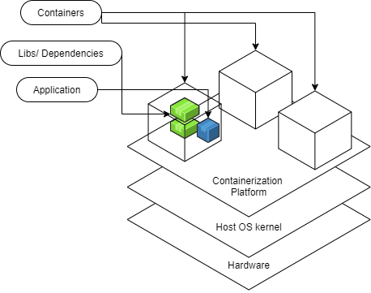
Containers

Slide 9
Containers
Containers are built from images (templates for the container)
They are run on an engine (the host OS), i.e. docker engine
They are ideally stateless
Any state needed to persist for an application should be stored in a way that is essentially ‘detachable’ from the actual container. i.e. kept in a separate volume.
Volumes are docker’s mechanism to store data outside a container on the host machine. Containers can read and rite to the volume while running, but data lives beyond the life of the container
Containers are a lightweight form of Virtualization, each container is isolated from the others and from the host, meaning they have their own filesystem, processes, and network.

Slide 10
Containers | Benefits
Secure
Isolation & Virtualization keeps your containerized apps more secure
Standardized, thus Portable
Similar to Java’s idea of ‘write once – run anywhere’
Lightweight
Shares the host operating system’s kernel
Flexible and Loosely Coupled
Scalable
Easy to spin up, and due to lightweight nature, they can be scaled up quickly

Slide 11
Virtual Machines
Virtual Machines simulate a physical server so that multiple “servers” can run on a single machine
They virtualize the entire supporting operating system
For instance, Using a virtual machine, your host computer could be windows based, and you could run a linux OS and an application on top of it
Virtual machines are enabled by hypervisors, software that coordinates between multiple VMs and interfaces with underlying infrastructure
Note: Some hypervisors interact directly with the hardware, while others run on top of the underlying OS

Slide 12
Containers
Containers bundle together applications with their supporting libraries & dependencies, allowing them to run isolated from one another
Containers share the underlying OS kernel, and are much more lightweight than virtual machines
Containers provide their processes a virtualized view of the underlying recourses.
Processes within a container only see a particular version of their environment and have limited access to resources – isolating them from the rest of the processes running on a given host.
Containerization is enabled by an engine running on the host, i.e. Docker engine.

Slide 13
Containers vs Virtual Machines
VMs and Containers both provide the ability to isolate processes, but they do so at different levels.
Concept | Virtual Machine | Container
What is virtualized? | Entire OS | Application with its Libraries & Dependencies
How is it enabled? | Using a Hypervisor | With a Container Engine
Can run its own apps? | Yes | Yes
Startup Time | Minutes | Milliseconds

Slide 14
Containers vs Virtual Machines
Containers are faster, more memory efficient and portable than Virtual Machines; however, they are reliant on the OS of the host machine.
Typically, VMs and Containers are used together in cloud computing
i.e. you create a virtual machine on a cloud server, then run containers using that VM.

Slide 15
Docker Architecture

Slide 16
Docker Architecture
Docker adheres to a client-server architecture.
The client allows you to run commands and interact with the docker objects, managed by the docker daemon.
This architecture translates into these primary components that allow you to run and interact with ‘Dockerized’ applications:
Docker Daemon
Rest API
Docker CLI client
Docker Registries
Docker Objects

Slide 17
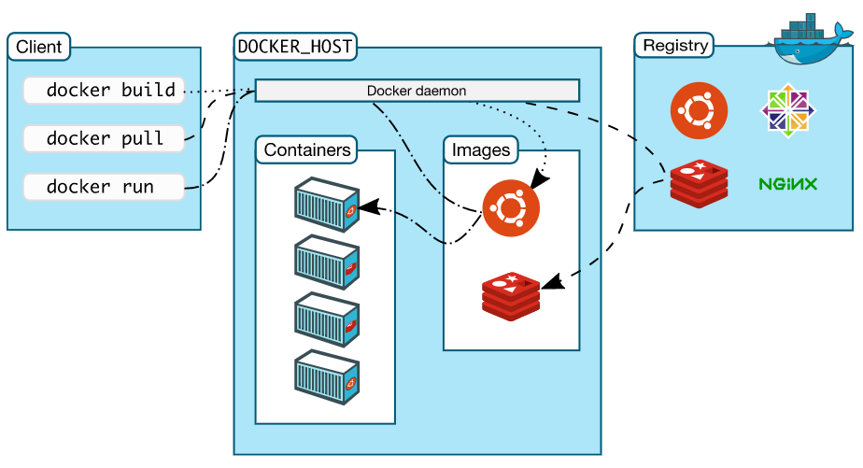
Docker Architecture

Slide 18
Docker Architecture
The client includes commands that manage docker containers
The host is the computer on which the docker daemon runs
The docker daemon is responsible for managing docker objects (containers and images)
The registry is an additional (optional) component that provides a centralized place to share docker images
The REST API (not shown in image) acts as the connection point for the client and the docker daemon.

Slide 19
Docker CLI Client
Docker CLI
The command line interface in what Docker developers typically use for interactions with the Docker daemon
There is also a GUI available for some OS
Docker CLI commands use the ‘docker’ preface
The CLI client may be on the same host machine as the docker daemon with which it communicates, but that is not required.

Slide 20
Docker Daemon
The Docker Daemon
Long running process on the docker host that does all the heavy lifting of managing Docker objects
Those objects include containers, images and more
The docker daemon is at the core of running dockerized applications.
Can communicate with other docker daemons (docker swarm)
REST API
The underlying commands used by CLI and other applications to interact with the Docker daemon
Wen you run a ‘docker’ command using the CLI, it translates into an HTTP request which talks to the docker Daemon

Slide 21
Docker Daemon
Docker Registries
Docker registries provide a centralized place to store images, allowing you to easily share images between docker hosts
Docker Hub is a public registry (think maven repo) that hosts can use to pull images from and push images to by default.
Docker Objects
Building blocks that are managed by Docker Daemon
Most fundamental objects are images and containers
Images: Templates used to create containers, detailing dependencies and processes.
Containers: runnable instances of outlined processes which contains its dependencies

Slide 22
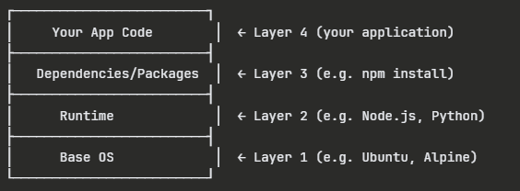
Docker Images
Docker Images are read-only, self-contained packages that act as blueprints for a container
Docker Images are built in layers, wit each layer representing discrete commands or instructions
Images are defined within a dockerfile that defines what is needed for the images.
Images are also named and tagged with a version
Each image has a unique id

Slide 23
Docker Images
There are many docker images available for use on DockerHub (such as an image that already has Node): https://hub.docker.com/
If you need to define your own image, you create a simple text file named ‘Dockerfile’ (no extension) in your project directory.
This file contains instructions, using docker commands.
A reference of dockerfile commands can be found in the docker documentation: https://docs.docker.com/reference/dockerfile/

Slide 24
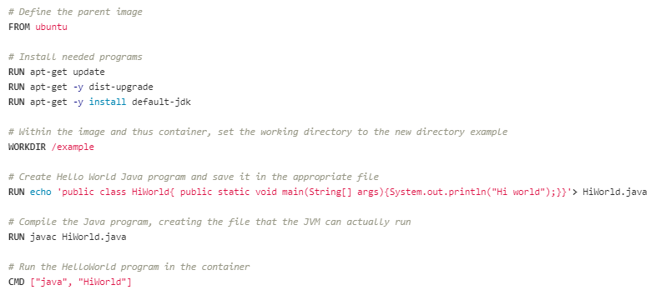
Docker Images | Example

Slide 25
Docker Container
Docker containers are isolated, runnable instances built from a docker image.
The image lays out everything the processes which run in the container will need
The docker daemon manages the containers.
The docker engine allows docker containers to be standardized and very portable

Slide 26
Docker Container | states
Created
The container has been initialized, but not yet started
Restarting
The container is in the process of stopping and starting again
Running
The container is up and actively executing processes
Paused
Container’s processes have been temporarily frozen, but not stopped (everything is suspended mid-execution)
Exited
The container has finished running and stopped
Dead
The container is in a broken, unrecoverable state

Slide 27
Docker Volumes
Typically, the goal is to have containers exist as stateless (or mostly stateless)
However, if you need information to remain hen a container stops, you can use a Docker Volume
Volumes are managed using the CLI and the Docker API
Volumes facilitate:
Sharing data between different containers
Decoupling of host and container
Storing data remotely
Moving data between hosts or backing up data between hosts
Volumes are also helpful because they allow docker to keep the containers slim by saving data in the volume, rather than the writable layer that disappears with the container

Slide 28
Docker Workflow Overview
Install Docker
Write a dockerfile (if building a custom image) or identify an existing image on a registry
Use CLI commands to send instructions to Docker Daemon
Docker Daemon pulls images from registry or creates image (depending on instructions given)
Use CLI to run processes
Configure volumes if app needs persistent storage
Stop/remove containers when done
Docker best Practices: https://docs.docker.com/build/building/best-practices/

