Slide 1
Jenkins

Slide 2
Outline
Introduction to Jenkins
Jenkins Workflow
Jenkins Job
Jenkins Pipeline

Slide 3
Introduction to Jenkins

Slide 4
Jenkins
Jenkins is an open-source automation server that facilitates software projects’ continuous integration and delivery
It provides a framework for automating applications’ building, testing, and deployment, enabling teams to streamline their software development processes.
With Jenkins, developers can set up a pipeline defining the steps required to build, test, and deploy their applications.
These steps can include tasks like compiling source code, running unit tests, packaging the application, deploying it to a staging environment for further testing, and finally deploying it to production

Slide 5
Jenkins
Jenkins supports integration with various version control systems, such as Git, subversion, and mercurial.
Allows tools to automatically trigger builds and tests whenever changes are pushed to the repository.
It also integrates with a wide range of tools and technologies, including build tools, testing frameworks, and deployment platforms
Jenkins provides a web-based interfaces that allows users to configure and manage their build pipelines and monitor the status of builds
Jenkins offers a vast ecosystem of plugins, which extend its functionality and allow integration with additional tools and services

Slide 6
Jenkins Features
Automation: Automates repetitive tasks such as builds, tests and deployments
Extensibility: over 1800 plugins to integrate with various tools like Docker, Kubernetes, Selenium and Git
Technology Agnostic: Supports multiple programming languages and tech stacks, like Java, Python and more
Ease of Setup: Provides a user-friendly web-based GUI for configuration
Controller-Agent Architecture: Enables distributed builds for improved performance and scalability.

Slide 7
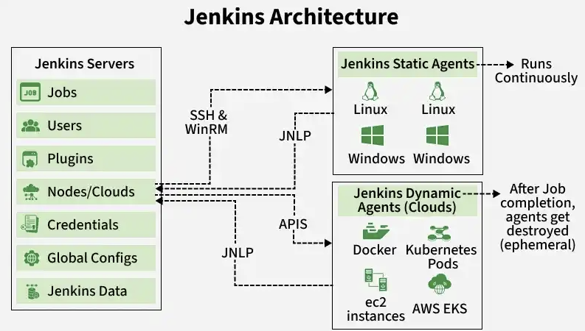
Jenkins Features

Slide 8
Jenkins Architecture
Jenkins Controller:
Serves as a central system for managing a Jenkins instance, often referred to as its ‘heart’.
Oversees agents and their connections, determining the tasks they should perform
Controller also loads plugins and ensures that jobs run in the correct sequence
Jenkins Agent:
Machine that performs tasks, like running scripts, executing tests, etc…
Tasks are assigned by the controller
Each agent has its own setup (OS, software and/or hardware).
Two type of agents:
Permanent Agents: Always ready and connected to Jenkins
Ephemeral Agents: Temporary, started when needed, and shut down when done
Jenkins Node
Term used in Jenkins 2.0
Any system that can run Jenkins jobs (building, testing, etc…)
Nodes are used by Controllers and Agents & sometimes the terms are used interchangeably

Slide 9
Benefits of Jenkins
Continuous Integration: Jenkins facilitates CI by automatically building and testing software whenever changes are made to the codebase.
Automated Testing: Jenkins allows the integration of automated testing frameworks into the build process which can execute unit tests, integration tests and other tests.
Continuous Delivery and/or Deployment: Jenkins enables (CD – both kinds) by automating the steps involved in packaging, deploying and releasing software.
Build & Release Management: Jenkins provides a centralized platform for managing build configurations, artifacts and release versions.
Scalability and Flexibility: Jenkins is highly scalable and can support projects of different sizes and complexity.
Community & Ecosystem: Jenkins has a large active community
Open-source & Cost Effective: Jenkins is open-source, so it is feely available for use and can be customized to fit project requirements.

Slide 10
Jenkins Workflow

Slide 11
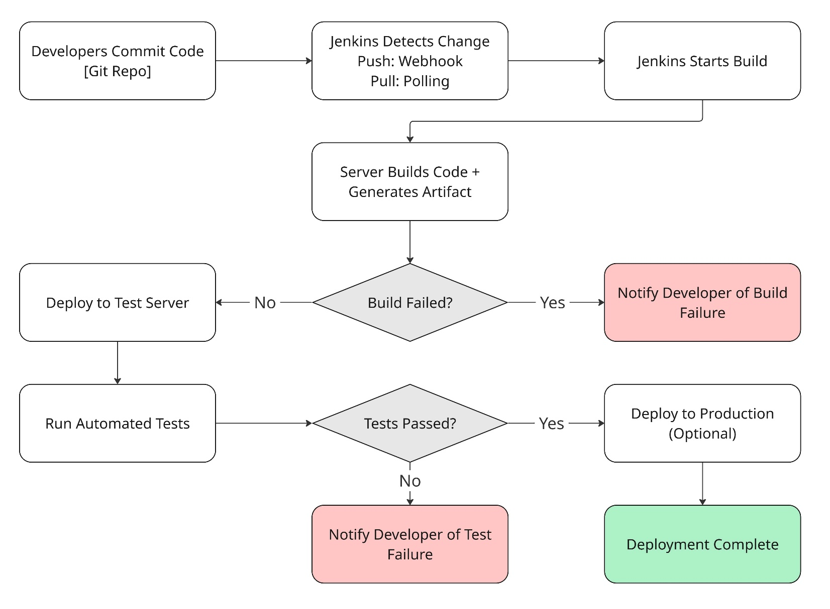
Jenkins Workflow

Slide 12
Jenkins Workflow
Developers modify source code, committing changes to the repository and Jenkins creates a new build in order to handle the new Git Commit
Jenkins can build a new job based on different triggers such as from code commits or on a configured schedule.
The build server builds the code and generates an artifact, if the build fails, the developer receives an alert
Jenkins deploys the build application/executable to the test server, which can execute continuous, automated tests
Developers receive alerts if their changes impact functionality (failing tests)
Jenkins may optionally deploy the changes to the production server if the code has no issues

Slide 13
Jenkins Job

Slide 14
Jenkins Job
Jenkins Jobs (also called projects) are a given set of tasks that runs sequentially as defined by the user
Any automation implemented in Jenkins is a Jenkins Job
These jobs are a significant part of Jenkins’ build process
We can create and build Jenkins jobs to test our application or project
With a Jenkins Job, you can clone source code from version control, like Git, compile the code, and run unit tests based on your requirements.

Slide 15
Types of Jobs
Job Type | Description
Freestyle Project | This is the central and the most widely used feature in Jenkins. It is an available Jenkins build job offering multiple operations. Using this option, you can build and run pipelines or scripts seamlessly.
Maven Project | If your work involves managing and building projects containing POM files, you prefer using Maven Project to build jobs in Jenkins. On choosing this option, Jenkins, by default, will pick the POM files, make configurations, and run builds.
Pipeline | Freestyle Project is often not a good option to create Jenkins Jobs. Therefore, Pipeline is the best option. Use the option Pipeline for creating Jenkins Jobs, especially when working on long-running activities.
Multi-configuration Project | If you are working on a project requiring multiple configurations, you prefer to use the Multi-configuration Project option. This option allows for making multiple configurations for testing in multiple environments.
GitHub Organization | If you click on this option, it scans the User's GitHub account for all repositories. And then, it matches markers as defined.

Slide 16
Jenkins Build
Jenkins Builds are a single execution of a job (we build the app to run the job)
Builds can be triggered via:
Source code changes
Scheduled times
Manual Triggers by the user
External systems (webhooks) or APIs (Webhooks notify Jenkins of events, such as a GIT pushes, pull requests or merged code)
Each build requires a configured trigger to execute

Slide 17
Jenkins Pipeline

Slide 18
Jenkins Pipeline
Jenkins Pipeline is a suite of plugins which support the implementation and integration of Continuous delivery into Jenkins
i.e. A pipeline is the complete configuration of tools and resources for Jenkins to automatically create builds and execute jobs for CI/CD/CD to occur.
Jenkins pipeline allows you to define your entire build, test and deployment process in a file called a jenkinsfile.
This means, instead of configuring jobs manually through the Jenkins UI, a pipeline lets you express your software delivery workflow as a script, making it version-able, reviewable, and auditable, like an application.
Jenkins has an extensible automation server to crate easy and complicated transport pipelines as code through pipeline DSL

Slide 19
How do Continuous Delivery Pipelines Work?
Each task or event in a Jenkins pipeline depends, in some way, on at least one other job or event
A CD pipeline automates the journey of software from Version Control to users by chaining together these sequence of automated steps
Source trigger (ex, code is committed)
Build – application is compiled
Test – unit, integration, e2e, etc…
Package – artifacts are build & versioned
Deploy – artifact is deployed to staging or production environment
Verify – Post-deployment smoke tests, or health checks confirm success

Slide 20
Why Pipelines
Reusable: Jenkins Pipeline is developed using code, allowing numerous people to change and run the pipeline process
Durable: The pipeline will be immediately resumed if your server must restart for some reason
Flexible: The pipeline process can be stopped, and you can instruct it to not restart until the user provides input
Parallelism: Jenkins pipelines assist with large projects – it’s possible to use pipelines in a loop and perform numerous jobs
Auditable: Every run is logged, so you always know what ran and when

Slide 21
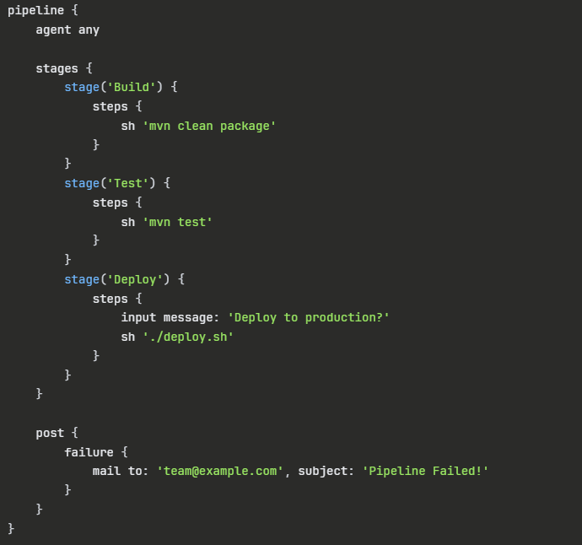
Jenkins Pipeline
Pipeline
Contains all the instructions required for the complete construction procedure
Stage
An assembly of pipeline steps (a.k.a. stage block)
Contains the procedures for build, test, and deployment
Most pipeline processes are represented by a stage block
Step
A single job that completes a particular procedure at a specific time
There may be several steps in a stage and there are many steps in a pipeline
Note: This example showcases a declarative pipeline syntax

Slide 22
Pipeline Syntax
JenkinsFiles can be defined using one of two styles:
Declarative: A straightforward, structured method. It as a preconfigured hierarchy that is used to build Jenkins pipelines. It gives you the capacity to easily and plainly handle every facet of a pipeline
Scripted: A lightweight executor helps the Jenkins controller run Jenkins pipeline syntax. The pipeline is transformed into atomic commands with a minimal number of resources.

Slide 23
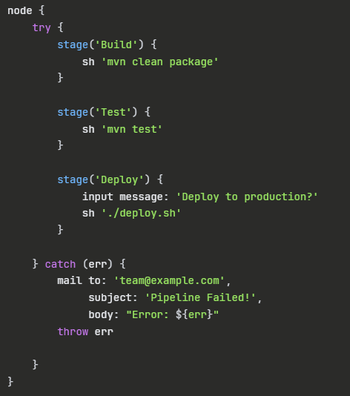
Scripted Pipeline Syntax

Slide 24
Pipeline Syntax
Both Declarative and Scripted pipeline use ‘stage’ as a common keyword.
“Pipeline”, “Agent”, “Step” are specific declarative syntax
“node” is specific to scripted syntax
Note that ‘node’ fills the role for pipeline, and to an extent, ‘agent’ as well.
‘Node’ defines both, the top-level block for all work to run, and defines where the pipeline will run.

Slide 25
Pipeline Syntax | Comparison

