Slide 1


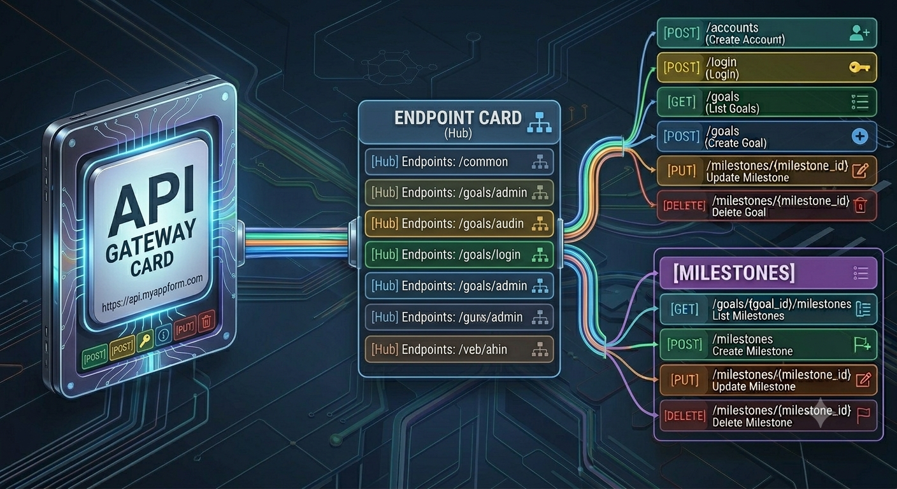
Goal
Tracker
Ariyan Shaikh

Slide 2


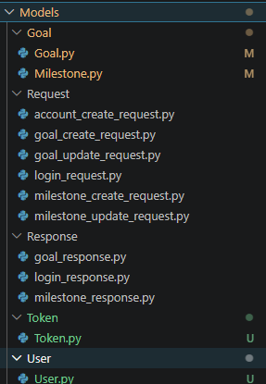
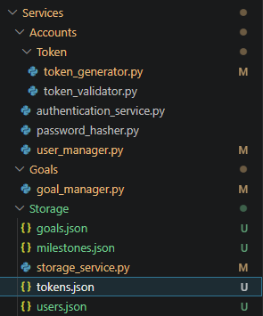
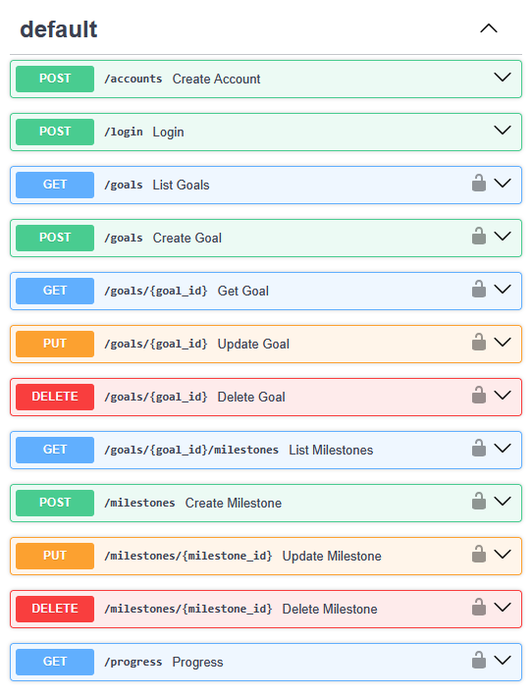
Project Structure

Slide 3

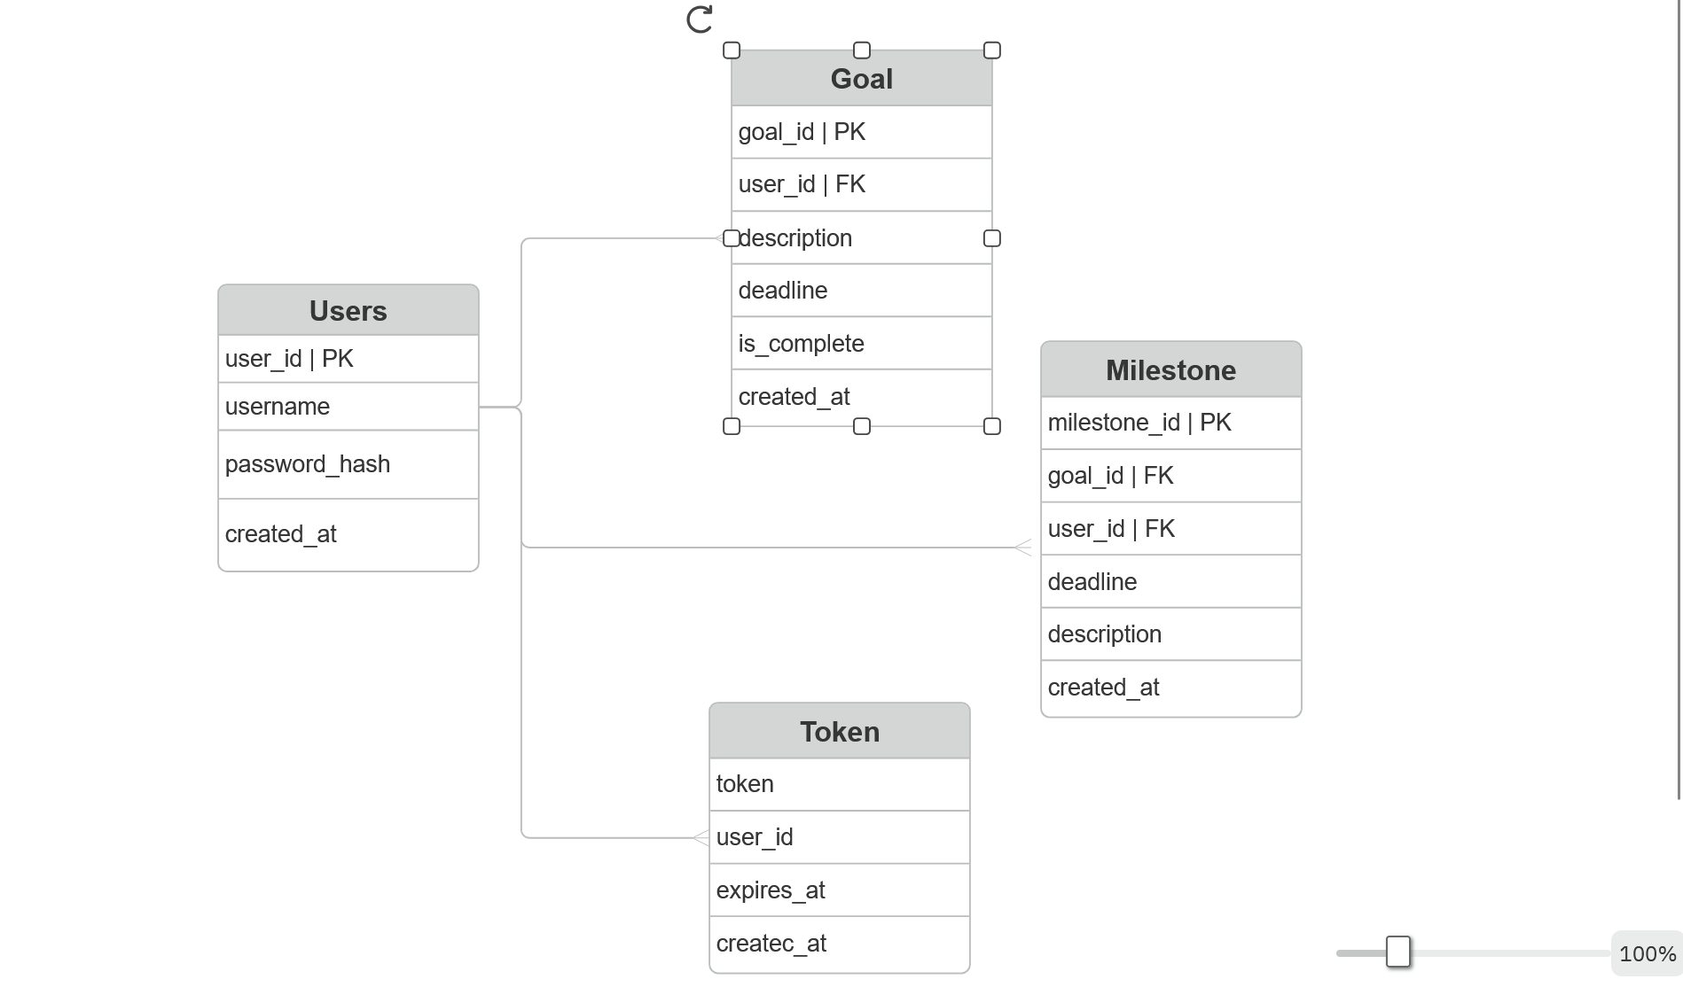
Entities!

Slide 4
5 minute demonstration

Slide 5


Production version
Use faster language.
Use db instead of json files.
Use JWT for authentication.

