Slide 1
SQL Data Tools

Slide 2
Outline
Built-in Functions
Joins
Set Operations
Sub-Queries
Views
Indexes

Slide 3

Built-in Functions

Slide 4
Aggregate Functions
Aggregate Functions: perform an operation across all the rows of a given query and return a single result.
AVG()
COUNT()
MAX()
MIN()
SUM()

Slide 5
Scalar Functions
Scalar Functions: Perform an operation on a single value and return a single value as well.
Scalar functions should, therefore, be used with queries that return a single result.
String Functions:
TRIM()
LOWER()
UPPER()
https://www.postgresql.org/docs/10/functions-string.html
Math Functions:
FLOOR()
ROUND()
ABS()
https://www.postgresql.org/docs/10/functions-math.html

Slide 6
Joins

Slide 7
Joins
Joins are used to combine columns from one (self-join) or more tables based on the values of common columns between the related tables.
The common columns are typically the primary key of the first table and the foreign key column of the second table.
Different SQL dialects support different types of joins

Slide 8
Joins
Equi joins
It is a simple sql join condition which uses the equal sign as the comparison operator.
Two types of equi joins are ‘Outer Join’ and ‘Inner Join’.
Inner Join (a.k.a. ‘natural’ join)
All the rows returned by the sql query satisfy the sql join condition specified.
Outer Join
This sql join returns all rows from both tables which satisfy the join condition along with rows which do not satisfy the join condition from one of the tables.
Full, Left and Right joins are all considered types of outer joins
Non equi joins (a.k.a. theta joins)
It is a sql join condition which makes use of some comparison operator other than the equal sign (e.g. “>”, “<”, “>=”, “<=”)

Slide 9
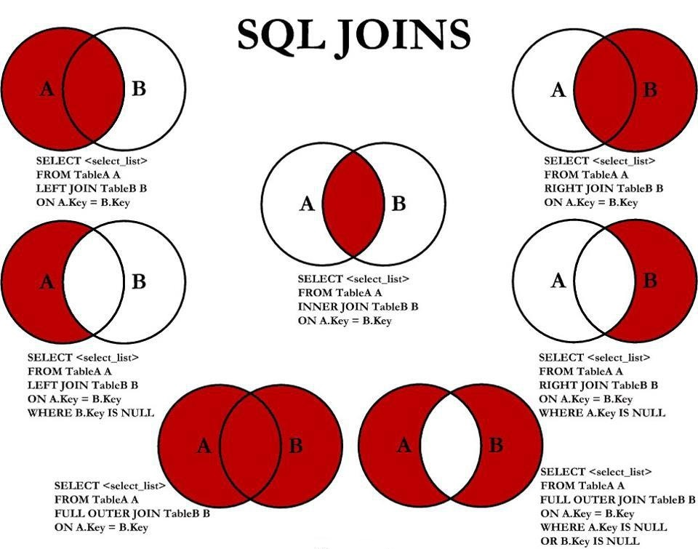
Joins

Slide 10
Set Operations

Slide 11
Set Operations
Set operations are used to manipulate two result sets, or the results of two select statements.
PostgreSQL supports the UNION, INTERSECT and EXCEPT operations.
We can optionally use the ALL keyword with a set operation to select all duplicate values.
query1 UNION [optional ALL] query2
query1 INTERSECT [optional ALL] query2
query1 EXCEPT [optional ALL] query2

Slide 12
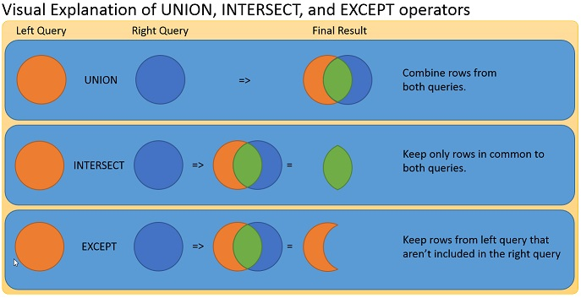
Unions

Slide 13
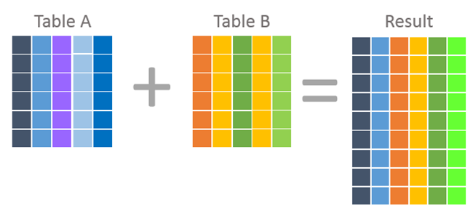
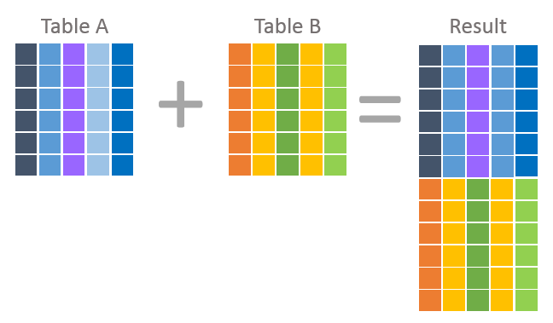
Joins vs Unions
Join statements will return a result which combines columns from each table
Unions will return a result which combines rows from each table

Slide 14
Sub Queries

Slide 15
Sub Queries
As its name implies, a subquery is a query that is nested inside of a SELECT, INSERT, UPDATE or DELETE statement, or inside of another subquery.
EX:
SELECT
column_name
FROM
table_name
WHERE
column > (SELECT
avg(column_name)
FROM
table_name
);

Slide 16
Views

Slide 17
VIEWS
A view is a named, virtual table based on the result-set of an SQL Query. They provide an interface through which to access your underlying tables.
The Syntax to create a view is:
CREATE [ OR REPLACE ] VIEW view_name AS
SELECT col_1, col_2, etc…
FROM table_name
WHERE condition;
After creation, you can query from the view, as you would another table:
SELECT * FROM view_name;
View are useful when you want to access some filtered data frequently these frequently.
You can DROP and modify (using CREATE OR REPLACE) existing views as needed.

Slide 18
VIEWS (example)
CREATE OR REPLACE VIEW high_salaries AS
SELECT emp_name, emp_salary FROM examples.employees
WHERE emp_salary > (SELECT avg(emp_salary) FROM examples.employees);
SELECT * FROM high_salaries;

Slide 19
Indexes

Slide 20
Indexes
An index is a separate data structure your RDBMS maintains alongside a table to allow rows to be located faster, without scanning every row (a sequential scan)
Indexes are most valuable on large tables, and on columns used frequently in WHERE, JOIN and ORDER BY clauses
A clustered index determines the physical order rows are stored on disk
A table can only have one clustered index since rows can only be physically ordered one way
In PostgreSQL, clustering is applied with the CLUSTER command and is not automatically maintained, meaning it must be re-run periodically on write-active tables
A non-clustered index is a separate structure storing indexed values with pointers back to the actual rows
The physical storage order of the table is unaffected
A table can have many non-clustered indexes, each optimizing a different query pattern.
Every index adds overhead to INSERT, UPDATE and DELETE operations, since the index must be kept in sync with the table on every write.
PostgreSQL uses the keywords ‘EXPLAIN ANALYZE’ to verify and diagnose index usage.

