Slide 1
Node.js

Slide 2
Outline
Node.js and NPM
Installation of Node
Package.json and Webpack

Slide 3

Node.js and NPM

Slide 4
Node.js
Node.js is an open-source, cross-platform run-time environment built on Chrome’s V8 JavaScript engine.
Node.js is used to execute JavaScript code outside of a web browser.
It provides a library of various JavaScript modules, which simplifies the development of web applications.
Global companies, like Netflix, Facebook, Walmart, Linkedin, Uber, etc… use node.js for building their applications.
It has helped companies create various applications like social media apps, video and text chat engines, real-time tracking apps, online games, and collaboration tools.

Slide 5
Node Package Manager - NPM
Node Package Manager (NPM) is a package manager for JavaScript
It is the default package manager for the JavaScript runtime environment – Node.js
Npm consists of three (3) components:
The website – the website discovers packages, sets up profiles, and manages access to public or private packages
The Command Line Interface (CLI) – The CLI runs from a terminal and allows us to interact with npm.
The registry – The registry is a public database of JavaScript packages comprised of software and metadata.

Slide 6
Why Node and NPM?
We use Node.js and npm as tools for building Angular or React apps.
Angular is a front-end framework used to create a web application, and is written in Typescript.
React is a JavaScript library used to build user interfaces.
The browser only understands JavaScript code, so we need to compile Typescript (.ts files) into plain JavaScript (.js files)
Technically this is actually “Transpilation”, we are converting from Typescript to JavaScript, not a lower-level computer readable code.

Slide 7
Installing Node

Slide 8
Node Installation
Download Node.js from https://nodejs.org/en/download and install it.
To check the version, run the following commands in your terminal (gitbash or powershell):
node -v
npm -v

Slide 9
Package.json and Webpack

Slide 10
Package.json file
All npm packages contain a file, usually in the project root, called package.json
This file is used to give information to npm that allows it to identify the project as well as handle the project’s dependencies.
Note: using a framework (like angular) or build tool (like vite for react) will automatically generate this file for you. (In addition to other config files specific to that framework/library)
This file contains metadata relevant to the project, such as the project description, the version of the project, license information, etc…
Node.js generates a package.json file by running the ‘npm init’ command in the terminal
The generated package.json file contains a name, version, description, main (entry point), any scripts, the author, and license type of our project.

Slide 11
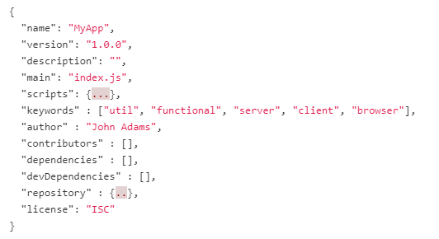
Package.json file - example

Slide 12
Package.json file dependencies
The dependencies section in the package.json file is essential for running applications
It contains a list of packages or modules installed using npm that are required to run the project
The devDependencies section in the package.json file is used only for developing applications
It contains a list of packages or modules that are required only for development.
These packages are installed only on the developer’s machine and will not be run for a production build.

Slide 13
Webpack
In a simple web application, you may use JavaScript files that are added into HTML pages via <script> tags.
For each user request, the browser loads these bunch of script files inside the HTML page.
This is inefficient as it reduces the page speed since the browser requests each script file separately.
This can be solved by bundling several files together into one file to be downloaded by the browser in one single request.
Module bundlers are used to bundle a group of JavaScript modules with their dependencies and merge them into a single file in the correct order, which can be executed by the browser.

Slide 14
Webpack
Webpack is a powerful static module bundler for JavaScript application that packages all modules in our application into a bundle and serves it to the browser.
Webpack builds a dependency graph when it processes the application.
It starts from a list of modules defined in its config file (webpack.config.js) and recursively build a dependency graph that includes every module our application needs, then packages all of those modules into a small bundle that can be loaded by the browser.

