Slide 1
TypeScript

Slide 2
Outline
Introduction to TypeScript
TypeScript Config
TypeScript Variables & Datatypes
Advanced Types
Casting Variables
Classes & Inheritance
Generics
TypeScript Interfaces
TypeScript Modules
TypeScript Decorators
TypeScript Utility Types

Slide 3

Introduction to TypeScript

Slide 4
TypeScript
TypeScript is a typed superset of JavaScript
It is an open-source and object-oriented programming language that support classes, interfaces, inheritance, modules, etc…
Developed by Microsoft
Can be used to manipulate the DOM for adding or removing elements, similar to JavaScript
It is portable across browsers, devices, and operating systems.
It supports strong typing or static typing (unlike JavaScript)
TypeScript files are saved with a .ts extension and then transpiled back into JavaScript using the TypeScript compiler.
After transpiled, the JavaScript code can run on any JavaScript runtime environment (e.g.: Node.js)

Slide 5
TypeScript Setup
You can install Typescript using NPM
After installing NPM, run:
npm install –g typescript
To verify the installation, and check your version, you can run ‘tsc -v’ in your terminal
To compile TypeScript code, run the ‘tsc’ command, followed by the name of the file you are compiling:
tsc hello.ts
After compilation, the typescript compiler creates a JavaScript file with the same name (hello.js)
The resultant JavaScript file can be run in your browser, or with node ( ‘node hello.js’ )

Slide 6
TypeScript Configuration

Slide 7
TypeScript Config
A ‘tsconfig.json’ file is used to define configurations for your TypeScript project.
To create the configuration file, use ‘tsc --init'
Configurations for your TypeScript compiler will be placed in a “compilerOptions” object.
Common configuration options include:
rootDir: defines directory of typescript files
outDir: defines directory of transpiled js files.
target: version of js the typescript compiler will generate (ES2016 should support all common browsers)
removeComments: tells compiler to remove any comments we add to compiled js code
noEmitOnError: prevents compiler from generating js files if an error is present in TypeScript code
You can find more information on config options here: https://www.typescriptlang.org/tsconfig/

Slide 8
TypeScript Variables & Datatypes

Slide 9
Variable Declaration in TypeScript
TypeScript variables also follow JavaScript variable naming conventions
Similar to JavaScript, we use var, let, and const keywords to declare variables.
Since TypeScript is a strongly typed programming language, we specify the type when we declare a variable
Note: TypeScript can infer the type of your variable without a type annotation, if you initialize the variable with some value, based on the type of the value assigned.
The Syntax for declaring a variable in TypeScript:
let/var/const [identifier] : [type] = value;
let myString : string = 'This is my String'
console.log(myString)
myString = 5; // Error: Type ‘number’ not assignable to type ‘string’

Slide 10
TypeScript Datatypes
Boolean
The boolean type is used to represent true or false values
let isEmpty: boolean = false;
Number
The number type is used to store decimal, hexadecimal, binary and octal literals
let a: number = 6;
let b: number = 0xf00d; //hexadecimal
let c: number = 0b1010; //binary
let d: number = 0o744; //octal

Slide 11
TypeScript Datatypes
String
TypeScript uses the string type to represent text characters enclosed within double quotes or single quotes.
let color: string = “yellow”;
color = “blue”;
You can also declare template literals, which can span multiple lines, and have embedded expressions using backticks ( ` )
let fullName: string = ‘Bob Bobberson’;
let age: number = 37;
let greeting: string = “Hello, my name is ${fullName} I am ${age} years old. It is great to meet you!`

Slide 12
TypeScript Datatypes
Undefined and Null
In TypeScript, both undefined and null have their own types, named ‘undefined’ and ‘null’, respectively
By default, null and undefined are subtypes of all other types
let u: undefined = undefined;
let n: null = null;
Any
We may need to describe a type of a variable that we do not know when we are writing an application.
Although this is not encouraged, we can do so using the ‘any’ type:
let someValue: any = 14; someValue = “maybe a string instead” someValue = false

Slide 13
TypeScript Datatypes
void
In TypeScript, the void type is used as the return type of functions that do not return a value
function sayHello(): void { console.log(“Hello!”); }
Declaring variables of type void is not useful, because we can then only assign an undefined value to them.

Slide 14
TypeScript Datatypes
Arrays
Like JavaScript, TypeScript allows you to work with arrays of values.
We can use the type of the elements followed by square braces, or use a generic array type for declaring the Array type.
let list: number[] = [1, 2, 3];
let list: Array<number> = [1, 2, 3];
let list: any[] = [1, "two", 3];

Slide 15
TypeScript Datatypes
Tuples
TypeScript introduced a new type called ‘Tuple’, which is an array with a fixed number of elements, whose types are known.
To declare a tuple, you use square brackets, and state the datatype of each element in the tuple.
let user: [number, string] = [1, “John”];
You can access elements of a Tuple in the same manner as an array
user[0]; // returns 1
user[1]; // returns “John”
Typically, tuples are best with fewer elements, oftentimes, 2 elements representing a key-value pair.
Note, you can also declare Arrays of Tuples:
let employees: [number, string][] employees = [[1, ‘Amber’], [2, ‘Blake’], [3, ‘Chirag’]];

Slide 16
TypeScript Datatypes
Enum
The Enum datatype in TypeScript represents a related list of named constants
Enums may be assigned a numeric or string value
You can assign different values to each Enum.
Note: If you assign a string value to one enum constant, you must explicitly assign a value to all enums
By default, Enums are given a value of 0, 1, 2, etc… (think, Array Index)
To declare an Enum, you use the ‘enum’ keyword, followed by curly braces which contain a comma, separated list of named Enums.
After creating an Enum, you may use it as a type.
You can access an enum, using the Enum name with a dot operator followed by the constant.
enum Color { Red, Green, Blue }; let c: Color = Color.Blue; enum Size { Small = “s”, Medium = “m”, Large = “l” }

Slide 17
Advanced Types

Slide 18
TypeScript Datatypes
Never
The ‘never’ type represents a type of values that never occur.
It is most often used for functions that always throws an exception, or one that never returns.
Note, although you can assign a variable the never type, it is not very useful.
let n : never
n = undefined as never;
n = null as never;

Slide 19
TypeScript Datatypes
Type Alias
Can be used to define custom types. The Syntax is similar to that of an Object, but, allows for the reuse of the structure later in the code.
type Point = {
x: number;
y: number;
};

Slide 20
TypeScript Datatypes
Union
The Union type allows you to specify that a variable or function parameter may by more than one type.
Union types can be declared using a single vertical pipe ( ‘|’ )
let weight: number | string; weight = 10; weight = ‘10kg’;
When using Union types, you should employee a technique known as ‘Narrowing’, wherein you narrow functionality based on the typeof the variable.
function kgToLbs(weight: number | string): number {
let calcWeight: number;
if (typeof weight === "number")
calcWeight = weight;
else
calcWeight = parseInt(weight);
return calcWeight * 2.20462;
}

Slide 21
TypeScript Datatypes
Literal Types
In TypeScript, the ‘Literal’ type allows you to limit the values you can assign to a variable.
The syntax is similar a Union Type (single vertical pipe), but instead of declaring potential types for the variable, you declare values.
type Amount = 1 | 2 | 3; let quantity:Amount = 1; quantity = 5; // throws an error
You may use literal types with strings, numbers and other types.

Slide 22
Casting Variables

Slide 23
Type Casting
Type Casting (also called a type assertion) tells typescript to treat a value as a specific type, overriding TypeScript’s own inferred type.
Type casting does not convert or transform the value at runtime – it is purely a compile-time instruction.
The underlying JavaScript value is completely unchanged.

Slide 24
Casting TypeScript Variables
In TypeScript, you can represent Types as another type (if applicable) using two methods:
As keyword
let x: any = ‘hello’ console.log( (x as string).toUpperCase());
Angle Brackets
let x: any = ‘hello’ console.log( (<string> x).toUpperCase() );

Slide 25
TypeScript Classes & Inheritance

Slide 26
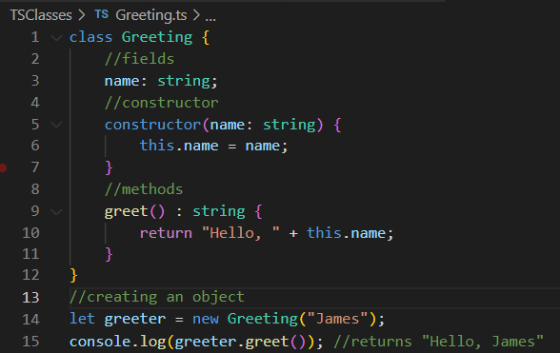
TypeScript Classes
The ‘class’ keyword is used to declare a class in typescript
An instance of the class can be created using the ‘new’ Keyword

Slide 27
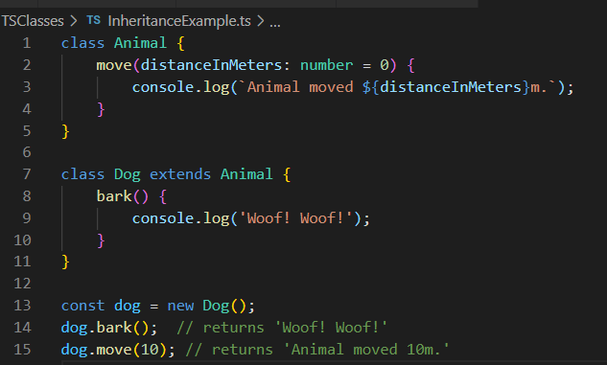
Inheritance in TypeScript
Inheritance hierarchies can be established using the ‘extends’ keyword, similar to other object-oriented programming languages.

Slide 28
TypeScript Access Modifiers
public - In TypeScript, each member is public by default. We can still mark a member public explicitly.
private - We can mark a member as private that cannot be visible outside of the class.
protected - If a member marked as protected, then the member can be accessed only by its containing class and deriving classes.

Slide 29
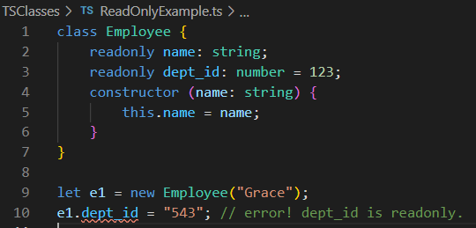
readonly modifier
We can make properties accessible but immutable by using the ‘readonly’ keyword.
readonly properties must be initialized at their declaration or in the constructor

Slide 30
keyof operator
The keyof operator produces a type representing all the property names (keys) of a given object type.
The result of keyof is a union of string literal types – one for each key on the object type
keyof is commonly used to write functions that access a property of an object safely.
It restricts the allowed key names to only those that actually exist on the object.
Compile-time only construct – it does not exist in the compile JavaScript

Slide 31
as const
as const is a type assertion that tells TypeScript to infer the most specific, literal type possible for a value, rather than widening it to a general type.
Without as const, TypeScript widens literals to their general type: a string literal like “active” becomes string, and a number literal like 5 becomes number.
With as const applied to an object, every property becomes readonly, and each property’s value
as const is especially useful for defining a fixed, known set of values (similar to an enum)
Because as const makes values readonly, attempting to reassign or mutate them afterward will cause a compile-time error.

Slide 32
TypeScript Interfaces

Slide 33
TypeScript Interfaces
Interfaces allow us to create contracts that other classes / objects can implement.
Interfaces are defined using the interface keyword that includes properties and methods.
We can have optional properties, marked with a "?" that do not have to be implemented.
The TypeScript compiler does not convert the interface to JavaScript.
Instead they are only used for type checking.

Slide 34
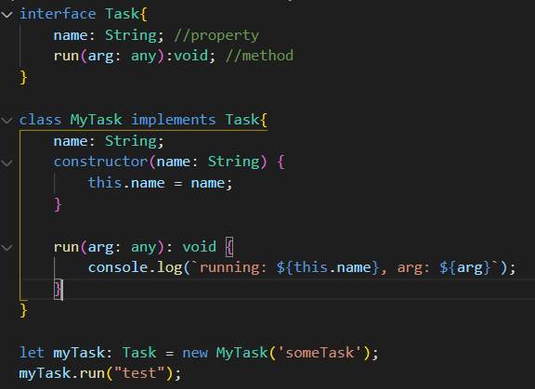
TypeScript Interfaces

Slide 35
Classes vs Interfaces vs Type Alias
Class | Interface | Type Alias
Acts as blueprints to create objects | Defines contracts regarding functionality of objects | Creates named types for any kind of type
Created using the ‘class’ keyword. | Created using the ‘interface’ keyword. | Created using the ‘type’ keyword
Can extend one class Can implement multiple Interfaces | Can extend multiple interfaces | Cannot extend directly, but can combine types using intersections ( single & operator)
Used when you need instances, behavior and OOP patterns | Used when defining object contracts, APIs or other functionality | Used when you need flexible support for unions, intersections, primitives, tuples or advanced type composition.

Slide 36
Generics

Slide 37
TypeScript Interfaces
Generics allow a function, interface or class to work with multiple types while still preserving type safety, instead of using any
A generic type is written using angle brackets with a placeholder letter, most commonly ‘T’ ( <T> )
Generics can have multiple placeholders, separated with a comma ( <T, U> )
The specific type used for the generic placeholder is inferred automatically by TypeScript based the argument passed in.
Generics can be used with functions, interfaces and classes.

Slide 38
Type Guards

Slide 39
Type Guards
Type Guards are runtime checks that narrow the type of a variable within a certain scope.
They allow you to understand and enforce types safely and more precisely.
There are many strategies for implementing Type Guards:
typeof : using the typeof operator, TypeScript can perform actions in conditional blocks knowing the value is the matching type
instanceof : using instanceof operator with an object can safely reference class fields/interface methods, etc…
in: the in operator can be used with objects that don’t share a common class, to check for the existence of a field or method.

Slide 40
TypeScript Modules

Slide 41
Modules
In TypeScript (and JavaScript), code we write is globally scoped by default.
Modules are entities which allows for organization and management of larger codebases.
All variables, classes, and functions declared in a module are not accessible outside the module.
A module is created using the export keyword and used in another module using the import keyword.

Slide 42
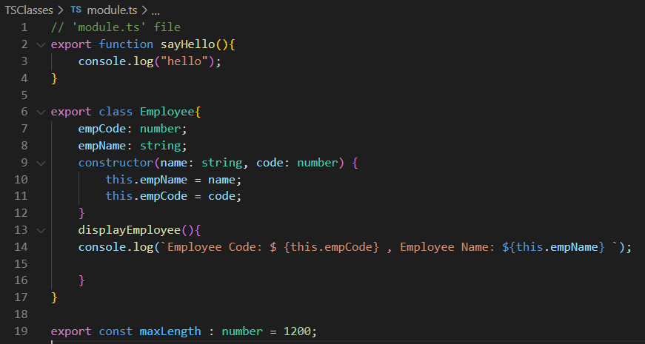
Modules
To export a class, function or variable, add the export keyword at the beginning.

Slide 43
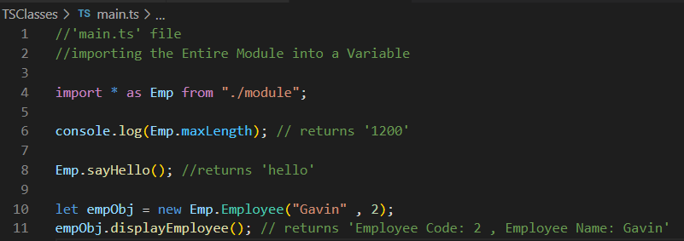
Modules
The syntax for importing a module is:
import { <export_name> } from “file path”
Note: You can list multiple named imports from a single file path by comma-separating the list
e.g. import Employee from “./myFolder/module”
Note: you should include the file extension in your import statement

Slide 44
TypeScript Decorators

Slide 45

TypeScript Decorator
A Decorator is a special kind of declaration attached to a class declaration, method, accessor, property, or parameter.
They are used as a mechanism for adding metadata information to source code and/or providing some functionality.
Decorators are used with the @expression format, where ‘expression’ evaluates a function that called at runtime.
Note: Most often, you will use built-in decorators, rather than creating your own.
For the decorator @frozen, we write the frozen function as follows:

Slide 46
TypeScript Decorator
There are 4 different types of decorators:
Class decorators
Method decorators
Property decorators
Parameter decorators
Note: you are not expected to create your own decorators – just know what they are

Slide 47
TypeScript Utility Types

Slide 48
Utility Types
Utility Types are built-in generic types provided by TypeScript that transform an existing type into a new one, without needing to manually rewrite that type from scratch
Utility types are especially useful for reusing an existing type in a slightly different form, such as making all it’s properties optional, required or read-only
Utility types work by taking an existing type as an input (often written as UtilityType<SomeType>)
This produces a new, related type as the output.
Since Utility types are built into TypeScript itself, they require no additional setup or imports to use.

Slide 49
Utility Types Reference
Utility Type | Description
Partial<Type> | Makes all properties of Type optional
Required<Type> | Makes all properties of Type required (opposite of Partial)
Readonly<Type> | Makes all properties of Type read-only
Record<Keys, Type> | Builds an object type with a specific set of keys, all mapped to the same value type
Pick<Type, Keys> | Creates a new type containing only the specified keys from Type
Omit<Type, Keys> | Creates a new type containing all properties of Type except the specified keys
Exclude<UnionType, ExcludedMembers> | Removes specific members from a union type
Extract<UnionType, Members> | Keeps only the specified members from a union type
ReturnType<FunctionType> | Extracts the return type of a given function type
Parameters<FunctionType> | Extracts the parameter types of a given function type as a tuple.
More information about Utility Types can be found here: TypeScript: Documentation - Utility Types

