Slide 1
HTML & HTTP Intro

Slide 2
Outline
Intro to HTML
HTTP Intro & HTML Forms
HTML Multimedia

Slide 3

Introduction to HTML

Slide 4
HTML Intro
HTML stands for Hypertext Markup Language.
It is a markup language for creating web pages and applications
Note: Markup languages are ‘structural formatting’ languages, which present context to the text in the document to dictate how it should be displayed, or otherwise interpreted.
Markup languages are most commonly used for web pages or configuration file
HTML contains a particular syntax, named elements and attributes.
Web browsers parse the elements and their attributes to determine how to render content of the webpage.

Slide 5
HTML, CSS, and JavaScript
HTML sets the structure of web pages.
CSS sets the style/appearance of web pages
JavaScript implements interactive functionality of a web page.

Slide 6
HTML Resources
HTML is one of the simplest languages to learn and test.
You can write HTML code in any text editor
You can run HTML code in any web browser
See these resources:
https://www.w3schools.com/html/
https://developer.mozilla.org/en-US/docs/Web/HTML

Slide 7
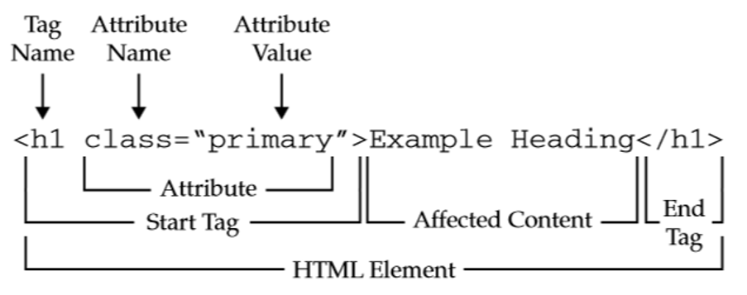
HTML Elements
HTML elements are denoted with tags.
A tag is enclosed within angle brackets:
Ex: <div>
Most elements have closing tags, which define the end of the element. These closing tags are denoted using a backslash:
The closing “div” tag looks like this: </div>
The content between the open the closing tags are known as the HTML element content.

Slide 8
HTML Elements
Some elements are ‘self-closing’. Meaning the element does not have content or a closing tag
Self-closing tags can be represented using the ‘closing tag’ syntax - <tag-name />
i.e. <tag />
These elements typically represent some functionality or meta-data but not related to its own rendered content.
For instance, the <br> element is used to indicate a ‘line break’, moving any following text to the next line on the webpage.

Slide 9
Mandatory Elements
Every HTML page must have these 5 elements to be “valid”:
<!DOCTYPE>
<html>
<head>
<title>
<body>
Technically, these were only required in HTML4. HTML5 allows <html>, <head>, and <body> to be omitted under certain conditions, but this can break some tools and introduces ambiguity.

Slide 10
Common HTML Elements
HTML Element | Description
<p> | Paragraph – displays text
<div> | Division – common element to section content – useful for controlling styling
<br> | Line break – self-closing element used to display text on the following line
<a> | Anchor – used with ‘href’ attribute to link to some other resource
<ol> | Ordered list – used with <li> to create a numbered list of items
<ul> | Unordered list – used with <li> to create a bulleted list of items
<li> | List Item – nested within <ol> or <ul>. Indicates a single item in a list
<table> | Table – represents a 2D (rows and columns) tabular data set. Used with <thead>, <tbody>, <tr> and <td>
<thead> | Table head – indicates the “head” (first row) of a table. Should encapsulate multiple <td> elements.
<tbody> | Table body – encapsulates the rows (<tr>) of a table
<tr> | Table row – represents a row of a table. Should encapsulate multiple <td> elements
<td> | Table data – represents a single value in a table row (including thead)
A full list of HTML Elements can be found here: HTML elements reference - HTML | MDN

Slide 11
HTML Attributes
HTML elements can also have attributes defined within the tag.
Attributes are key/value pairs that give metadata about the tag, which provide important context to the web browser.
Note: the ‘key’ of an attribute represents the actual attribute and the ‘value’ represents the meta-data information of that attribute.
An example of an attribute is the ‘href’ attribute of <a> (anchor) elements. This attribute provides the source of a link.
<a href=“https://www.google.com”>Go to Google</a>
Most attributes are context sensitive, meaning that using the same attribute in the wrong HTML element will either have no effect, or may even cause confusions/errors in your program.

Slide 12
Common HTML Attributes
Some attributes are usable by every HTML element
id=“value” : used to give a unique ID to a single element
class=“value” : used to group elements for styling or scripting purposes. Can have multiple values separated by spaces
style=“key:value;” : used to set styling directly on an element. Can have multiple key:value pairs, separated by semicolons (;)
href=“value” : used to indicate the resource associated with a link (<a> element).
See this link for more information about attributes: HTML attribute reference - HTML | MDN

Slide 13
HTTP Intro & HTML Forms

Slide 14
How the Internet Works
Browsers and servers generally do not keep “open connections” to each other.
Browser → Request → Server
Browser ← Response ← Server
Connection is closed
HTTP is a protocol. It defines how communication happens.
Other protocols: FTP, SMTP, HTTPS, Telnet
Browser sends HTTP request to URL.
HTTP request arrives at server.
Server finds requested resource (page, file, or program). Server may forward request to program
Server returns requested resource in HTTP response
Browser renders (draws) response to screen, or downloads file

Slide 15
Types of HTTP Request
Two flavors: GET and POST
Technically also PUT, DELETE, OPTION, TRACE, and more, but these are only used by applications, not browsers.
Also called “HTTP methods”.
GET requests:
Used to “retrieve” data from the server
Parameters will be included in the URL after ‘?’
Whenever an HTTP request is generated from typing a URL into an address bar, or clicking a link, it’s a GET request.
URLs typically have a character limit depending on browser and server settings. Generally < 2000 characters is safe

Slide 16
Types of HTTP Request Cont.
POST requests:
Used to send data to a server
Parameters are only in the “body” of the request, do not appear in URL
Data is sent as key-value pairs
HTTP POST requests typically have a maximum size depending on the server configuration (~2-10 MB)
What if I need to send a bigger file?
Multipart POST requests: used to break data up across multiple requests to respect size limits.
Server must be configured to accept multipart requests.

Slide 17
HTML Forms
An HTML form is a section of an html document that contains controls, such as text fields, password fields, checkboxes, radio buttons, etc… which are used to collect information from a user.
When ‘submitted’ the collected information is submitted to a web server, as a request, and the server will provide a response
To create a form, you use the ‘form’ tag

Slide 18
HTML Forms and HTTP Methods
The method attribute of the <form> element determines the HTTP request used to send form data (GET or POST)
GET:
Form data will appear in the URL
http://website.com/destination?key1=value1;key2=...
Subject to URL length limits
DO NOT USE FOR CONFIDENTIAL INFORMATION
POST:
Form data will be in HTTP request body, and thus hidden
The name attribute of an <input> element becomes the name of the key for the value. The value is the value of the input.

Slide 19
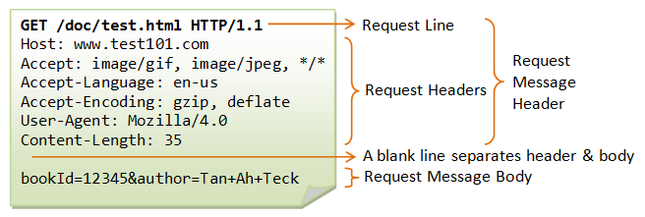
Structure of HTTP Requests
HTTP Requests have a head (filled with “headers”) and a body www.test101.com/doc/test.html?bookId=12345&author=Tan+Ah+Teck
Request Line: method, path, protocol
“Accept” headers: What types of data can be in the response. Restrictive. No match: no response/404.

Slide 20
HTML Form Elements
HTML Element | Description
<form> | Represents the section containing interactive controls for submitting information (a web form)
<button> | An interactive element that can be clicked on to perform an action (such as form submission, or calling a javascript function)
<label> | Represents a caption for an item in a web form
<input> | Incredibly versatile elements. Used with a variety of attributes and other elements to create different, complex information gathering mechanisms for a form
<select> | Represents a control element that provides a menu of options. Used with the <option> element
<option> | Represents a single item within a <select>, <optgroup> or <datalist> element. Can be used with the ‘value’ attribute to bind representative data to the option element display text
<textarea> | Represents a multi-line, plain text area where users can provide free-form text.
More information of Form element can be found here: <form>: The Form element - HTML | MDN
Additionally, see the ‘input’ element reference here: <input>: The HTML Input element - HTML | MDN

Slide 21
HTML Multimedia

Slide 22
HTML Multimedia Elements
HTML Element | Description
<audio> | Used to embed sound content in an HTML document. The audio source is represented using the ‘src’ (source) attribute or a nested <source> element.
<img> | Embeds an image into a document. The image source is represented using the ‘src’ (source) attribute.
<picture> | Embeds an image into a document, and provides a bit more flexibility than just the <img> element. Can contain multiple image sources with nested <source> elements and a single <img>.
<video> | Embeds a video player which supports video playback. The video source is represented using the ‘src’ (source) attribute, or a nested <source> element
<embed> | Used to embed external content (content from other webpages) at a specified point in the html document.
<iframe> | Represents a nested browsing context (i.e. another HTML page) within the current HTML document.
<source> | Self-closing element which specifies one or more media resources for a <picture>, <audio> or <video> element.
More information of Multi-media elements can be found in the following links:
HTML elements reference - Image & Multimedia | HTML elements reference - Embedded Content

