Slide 1
Spring Data

Slide 2
Outline
Spring Data Overview
Entity Mapping Basics
JpaRepository vs CrudRepository
Query Methods & Property Expressions
Transactions

Slide 3

Spring Data Overview

Slide 4
Spring Data
Spring Data is a broader spring project focused on simplifying data access
Provides a consistent, familiar programming model across many different kinds of data stores
Not just relational databases
Typically, when working with any data store, there is a fair amount of repetitive, boilerplate code that is needed (opening connections, mapping results to objects, etc…)
Spring Data addresses this by providing a family of related sub-projects, each targeting a specific data store.

Slide 5
Spring Data | Sub Projects
Spring Data JPA
Sub-project designed for relational databases.
Accessed through JPA/Hibernate
Spring Data MongoDB
Sub-project designed for MongoDB document-based NoSQL database
Spring Data Redis
Sub-project designed for Redis, a key-value NoSQL store
Spring Data Cassandra
Sub-project designed to work with Cassandra, a distributed NoSQL database
The core idea shared across all of these sub-projects is the repository pattern
Rather than writing manual data-access code, a developer defines a simple interface and Spring Data automatically provides a working implementation at runtime.

Slide 6
Spring Data | JPA, Hibernate, Spring Data JPA
To truly understand Spring Data JPA, you should understand three distinct layers:
JPA (Jakarta Persistence API)
Formally the Java Persistence API
A specification that defines a standard set of interfaces, annotations and rules for how Java objects should be mapped to a relation database.
This is known as Object-Relational Mapping – ORM
JPA contains no actual working code, it is the spec.
Hibernate
The most widely used implementation of the JPA spec.
Hibernate does the actual real work
Translates annotated Java object into SQL
Executes SQL against your Database
Maps Database ResultSet back into Java Objects
Spring Data JPA
A Layer build on top of JPA/Hibernate
Adds Spring’s repository abstraction so that a developer rarely needs to interact with JPA’s own lower-level API directly (like EntityManager)
Maven Import: spring-boot-starter-data-jpa
Note: for a specific SQL database, you will still need to add a Maven dependency for the specific database driver.

Slide 7
Entity Mapping Basics

Slide 8
Entity Mapping
An Entity is a plain Java class that has been mapped (using JPA annotations) onto a relational database table.
Every row in that table becomes, conceptually, one instance of that class
The ‘Entity’ is your model class
Every JPA entity requires a no-argument constructor
This is part of the JPA specification requirement
Mapping an Entity to a database table is performed through the use of various JPA annotations.

Slide 9
Entity Mapping | Annotations
Method | Annotated Entity | Description
@Entity | Class | Placed on a class to mark it as a JPA entity. This tells Hibernate the class should be tracked and persisted as part of the application’s data layer.
@Table(name=“…”) @Table(… schema=“…”) | Class | Specified which database table the entity maps to. ‘name’ is optional if the class name matches the table name exactly. ‘schema’ can be defined in the application.properties instead
@Id | Field – Primary Key | Marks exactly one field as the entity’s primary key. Every entity must have one.
@GeneratedValue | Field – Primary Key | Used alongside @Id when the database itself is responsible for generating the ID value (e.g. SERIAL columns in Postgres)
@Column(name=“…”) | Field | Maps an individual field to a specific database column. The ‘name’ is optional if the field name already matches the column name.

Slide 10
JPA vs CRUD Repository

Slide 11
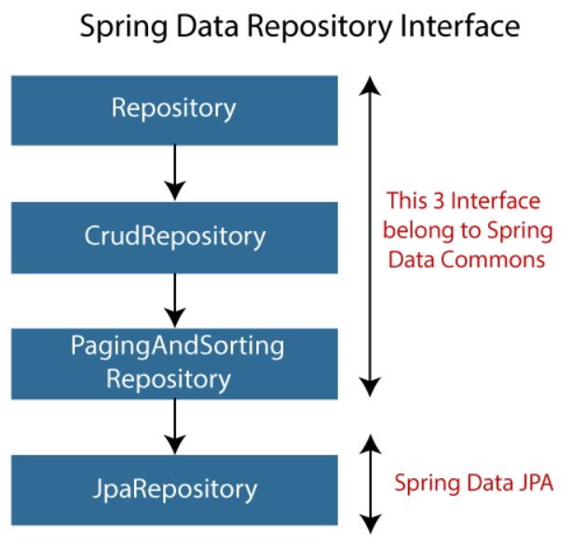
JPA vs Crud Repositories
Spring Data’s repository abstraction is organized as a hierarchy of interfaces
Repository<T, ID>: root marker interface. It defines no methods of its own. It just identifies something as a Spring Data repository.
CrudRepository<T, ID>: Adds basic set of CRUD operations
save(), findById(), findAll(), count(), etc…
PagingAndSortingRepository<T, ID>: adds findAll(Pageable) and findAll(Sort) method on top of Crud Repository, allowing for paged and sorted results without writing any query logic by hand.
JpaRepository<T, ID>: Adds JPA-specific and relational-database-specific conveniences beyond basic CRUD, including:
Batch operations (e.g. saveAll())
flush(): force pending changes to be written to the database immediately
Built-in support for pagination and sorting (from PagingAndSortingRepository)

Slide 12
Spring Data Repository Methods
Repository | Method | Description
CrudRepository | save(S entity) | Saves a given entity. Inserts if new, updates if it already exists
CrudRepository | saveAll(Iterable<S> entities) | Saves multiple entities in one call
CrudRepository | findById(ID id) | Retrieves an entity by its ID, returned as an Optional
CrudRepository | existsById(ID id) | Returns true/false for whether an entity with the given ID exists
CrudRepository | findAll() | Retrieves every entity of this type
CrudRepository | findAllById(Iterable<ID> ids) | Retrieves all entities matching the given collection of IDs
PagingAndSortingRepository | findAll(Sort sort) | Retrieves all entities, sorted according to the given Sort
PagingAndSortingRepository | findAll(Pageable pageable) | Retrieves entities one page at a time, per the given Pageable (page number, size, and optional sort)

Slide 13
Spring Data Repository Methods
Repository | Method | Description
JpaRepository | findAll() (overridden) | Same as CrudRepository's, but returns a List instead of a generic Iterable
JpaRepository | saveAll(Iterable<S> entities) (overridden) | Same as CrudRepository's, but optimized for JPA batch-style inserts
JpaRepository | saveAndFlush(S entity) | Saves an entity, then immediately forces that change to be written to the database, rather than waiting for Hibernate's normal flush timing
JpaRepository | flush() | Forces any pending changes to be written to the database immediately
JpaRepository | deleteAllInBatch() | Deletes all entities in a single, optimized bulk operation, rather than one-by-one
JpaRepository | getReferenceById(ID id) | Returns a lazy reference to an entity without immediately querying the database — useful for setting relationships without a full fetch

Slide 14
Query Methods & Property Expressions

Slide 15
Query Methods & Property Expressions
Spring Data JPA can generate a fully working query implementation automatically, just from a method’s name
As long as that name follows a specific, predictable convention
E.g. ‘findByEmpName()’
This convention-based approach is called a derived query method.
This approach is built on property expressions
The general pattern is: findBy<PropertyName>, where <PropertyName> must exactly match a field name on the entity.

Slide 16
Query Methods
Beyond simple exact matches, property expressions support a range of keywords inserted into the method name to control how to comparison is performed:
findByEmpNameContaining: Searches for records by a string value using partial matches ( LIKE ‘%value%’ )
findByEmpSalaryGreaterThan: Numeric/Date comparisons
findByEmpTitleIgnoreCase: case-insensitive matching
findByEmpNameOrderByEmpSararyDesc: combining a condition with a specified sort order
Multiple conditions can be combined using And/Or directly in the method name
E.g. findByEmpTitleAndEmpSalaryGreaterThan(String title, BigDecimal minSalary)
For a full list of query method features, see the documentation:
Defining Query Methods :: Spring Data JPA
Repository query keywords :: Spring Data JPA

Slide 17
Query Methods
When defining query methods, Spring Data JPA validates these method names at application startup
A method name that doesn’t correctly correspond to real entity fields will cause the application to fail to start
Derived query methods have a practical limit: anything beyond a moderate level of complexity requires a custom @Query annotation.
The @Query annotation can be applied to a method to provide a specific SQL query for the method to pass to the database.
Note: When using the @Query annotation, you may provide JPQL (Java Persistence Query Language) or native SQL.

Slide 18
JPQL
JPQL is a query language defined as part of the JPA spec
Instead of querying database tables and columns, JPQL operates on entities and their fields:
Note: You are not required to use JPQL, but you should be aware of what it is.
See the documentation if you want more details: The Jakarta Persistence Query Language :: Jakarta EE Tutorial :: Jakarta EE Documentation

Slide 19
Transactions

Slide 20
Transactions
[Recap] A transaction is a group of one or more database operations treated as a single indivisible unit of work
@Transactional is Spring’s annotation for declaring that a method should run as a transaction
Placed on a method (or a whole class)
Tells Spring to wrap that method’s execution in transaction management automatically
By default @Transactional follows a simple rule:
If the annotated method completes normally, the transaction is committed; if the method throws an unchecked exception the transaction is rolled back.
Note: If your method throws a checked exception – you must explicitly state the checked exception using the rollbackFor of the @Transactional.
Note: the save(), deleteById(), etc… methods are already individual transactions – so @Transactional is necessary specifically when a single service method needs to call more than one repository operation.

