Slide 1
CSS

Slide 2
Outline
Absolute vs Relative
Intro to CSS
Stylesheets & Selectors
CSS Properties
CSS Specificity
Responsive Web Design

Slide 3

Absolute vs Relative

Slide 4
Absolute and Relative Paths
When structure can be represented as a tree, like a file system, you can express the location of something in that structure with a path.
Absolute: path is “measured” from a root or globally fixed point
C:\Programs\Web\helloWorld.html
/Users/UserName/home/Documents/file.txt
Relative: measured from the location of another file or directory
../styles/stylesheet.css

Slide 5
Relative vs. Absolute Measurements
Relative measurements define size in relation to some other fixed point
Can adjust in absolute size if their reference point changes
Absolute measurements are always the same.
Pixels are relative to the viewing device.
Relative | Absolute
1em = current font size | px = pixels
% (percent of boundary) | in = inches (96px)
1vh = 1% of window height | pt = points (1/72 in)
1vw = 1% of window width | pc = picas (12pt)

Slide 6
Intro to CSS

Slide 7
CSS Intro
CSS stands for Cascading Style Sheets.
It is a language for styling HTML documents by specifying certain CSS rules for layout and display using key/value pairs.
Stylesheets are simple and powerful methods to attach rendering information to HTML documents.
CSS is used to style webpages by setting background-color, font color, font size, borders, font family and much more.
These settings are the CSS Properties

Slide 8
Stylesheets & Selectors

Slide 9
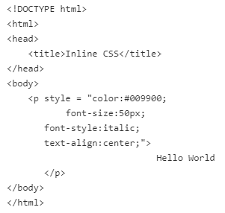
Inline Styling
There are three (3) methods in which you can include CSS rules in your HTML document.
Inline: CSS rules are contained within the associated HTML tag using the ‘style’ attribute.
Inline CSS is inflexible and not re-usable, but will overrule any other CSS styling method, so it can be used for very specific style requirements.

Slide 10
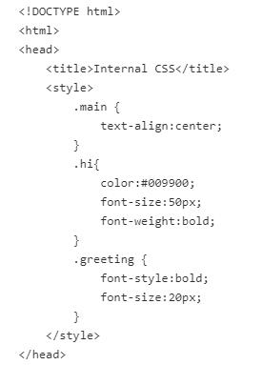
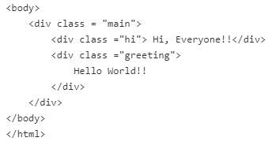
Internal Stylesheets
Internal/Embedded stylesheets are styling rules which are contained in the head section of your HTML file.
Internal stylesheets require the use of CSS selectors to determine which element(s) the rules apply to.
Internal Stylesheets are more manageable (you do not need to duplicate the same styles for multiple elements), but they are still not reusable.
These can be used when there are unique styling rules for a single HTML document.

Slide 11
External Stylesheets
External Stylesheets are separate files using the ‘.cs’ or ‘.css’ extension, which contain only styling rules.
Like internal stylesheets, external stylesheets require the use of CSS selectors.
External stylesheets are the standard method when styling webpages. The styles can be re-used across multiple HTML documents, offering consistency, maintainability and modularity.
An external stylesheet is referenced within an HTML document using the <link> element with a ‘rel’ (relationship) and ‘href’ attributes.
The value of rel should be ‘stylesheet’
The value of href should be a url/path to the stylesheet file.

Slide 12
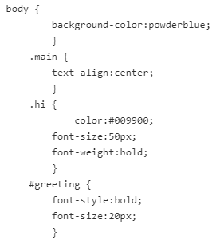
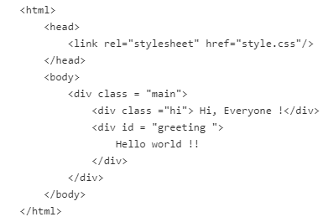
External Stylesheets
style.css file
index.html file

Slide 13
CSS Selectors: Elements
CSS selectors “select”.
They are used to determine on which elements your styling should apply
Selector | Description
* | All elements
x | All <x> elements
.x | All elements where class=“x”
#x | All elements with the id=“x”
x, y | All <x> and <y> elements
x y | All <y> elements nested in an <x> element
x>y | All <y> elements where <x> is the immediate parent
x+y | All <y> elements immediately after a sibling <x> element
x~y | All <y> elements after a sibling <x> element

Slide 14
CSS Selectors: Attributes
Selecting elements with matching attributes…
Selector | Description
[x] | All elements with the “x” attribute
[x=y] | All elements where the attribute x has the value y
[x~=y] | All elements where the attribute x’s value contains the phrase y
[x|=y] | All elements where the attribute x’s value is a hyphen-separated list starting with y
[x^=y] | All elements where the attribute x’s value is a string starting with y
[x$=y] | All elements where the attribute x’s value is a string ending with y
[x*=y] | All elements where the attribute x’s value is a string containing y

Slide 15
CSS Selectors: Interactive
CSS Selectors that are applied dynamically…
And more! - CSS selectors - CSS | MDN
Selector | Description
x:active | Styles the “active” <x> element (last clicked-on)
x:hover | Styles the <x> element you are currently hovering over
a:link | Styles all unvisited links
a:visited | Styles all visited links
x:checked | Styles a checkbox, radio button, or dropdown option currently selected
x:optional | Styles all elements without a “required” attribute
x:required | Styles all elements with a “required” attribute

Slide 16
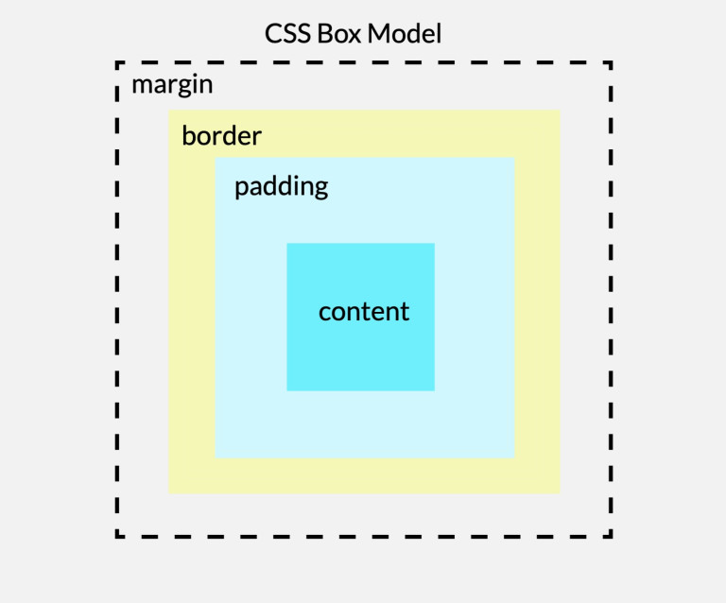
The Box Model
Box Model: every HTML element exists in a “box”.
Margin: The space between borders – used to separate an element from its neighbor
Border: Area between padding and margin – can be styled to provide a visual container for an element
Padding: space between the content and border of the element.
Content: the rendered content (text, images, etc…).
All box measurements can be changed to move content around within boxes
<div> and <span> elements arrange boxes on a page

Slide 17
Box Model Sizing
When sizing box-model properties, you can provide 1 to 4 values.
Based on the number of values given, the size of the top, right, bottom and left of the styled box-model property will either share a given value or have a unique value.
The example below explains how this works for border, padding and margin sizes.
Examples | Explanation
p { padding: 70px; } | Sets the padding for an <p> element to 70 pixels for all four sides
p { padding: 35px 70px; } | Sets the padding for an <p> element to 35 pixels for top and bottom and 70 pixels for right and left sides.
p { padding: 35px 70px 40px; } | Sets the padding for an <p> element to 35 pixels for the top, 70 pixels for the left and right side and 40 pixels for the bottom.
p { padding: 35px 70px 40px 80px; } | Sets the padding for an <p> element to 35 pixels for the top, 70 pixels for the right side, 40 pixels for the bottom and 80 pixels for the left side.

Slide 18
CSS Properties

Slide 19
CSS Properties
As previously stated, there are numerous CSS properties which can be used to style webpages.
A full list of properties can be found here: CSS properties - CSS | MDN
Property | Example Values | Description
border-width | medium, thin, thick, # px | Defines the border area of a box. Sets the top, bottom, left and right, based on the number of values provided.
border-style | none, hidden, dashed, dotted, double, solid | Sets the style of a box’s border.
border-color | hex-value for color | Specifies the color of a box’s border
padding | medium, thin, thick, # px | Sets the size of the padding for the element.
margin | medium, thin, thick, # px | Sets the size of the margins for the element.

Slide 20
More CSS Properties
Property | Example Values | Description
color | color name (ex: red), color hex value | Sets the color of the element’s text content
background-color | color name (ex: red), color hex value | Sets the color of the background of the content area for an element
font-family | named font (ex: “arial”) | Sets the type of font for the element’s text content
font-size | x-small, small, medium, large, # px, % | Sets the size of the element’s text content
text-align | left, right, justify, center | Aligns the text of the element’s content
position | static, relative, absolute, sticky | Positions an element on the page, either relative to surrounding elements, based on the document, or based on the viewing window
width | # px, %, auto | Sets the height of an element. Defines the size of either the content area, or the up to the border when combined with the ‘box-sizing’ property
height | # px, %, auto | Sets the width of an element. Defines the size of either the content area, or the up to the border when combined with the ‘box-sizing’ property

Slide 21
CSS Specificity

Slide 22
Cascading Styles
Why do we say style sheets “cascade”?
If multiple CSS selectors apply to a single element, they will all apply their properties.
p { color: green; } .test { font-family: monospaced; } <p class=“test”>This is a test!</p>
What about when two properties conflict?
p { color: green; } .test { color: red; }
The most specific selector wins…

Slide 23
CSS Specificity
CSS properties are assigned a weight based on how specific their selectors are:
Elements: 1pt
Classes: 10pts
IDs: 100pts
If the property is in the style attribute: 1000pts
p { … } : 1pt .test { … } : 10pts p.test { … } : 11pts <p style=“…”> : 1000pts
Almost all overlaps can be resolved in this way.

Slide 24
Responsive Web Design

Slide 25
Responsive Web Design
Responsive Web design is the approach that allows websites and pages to render (or display) on all devices and screen sizes by automatically adapting to the screen, whether it’s a desktop, laptop, tablet, or smartphone.
Responsive web design works through CSS, using various settings to serve different style properties depending on the screen size, orientation, resolution, color capability, and other characteristics of the user’s device
It is a combination of flexible grids, flex boxes, flexible images, and media queries.
Modern CSS supports responsive web design, all kinds of transitions, transformations, and animations, and provides box-sizing tools that enable the user to adjust the size of any element without changing the dimensions or padding of the element.

Slide 26
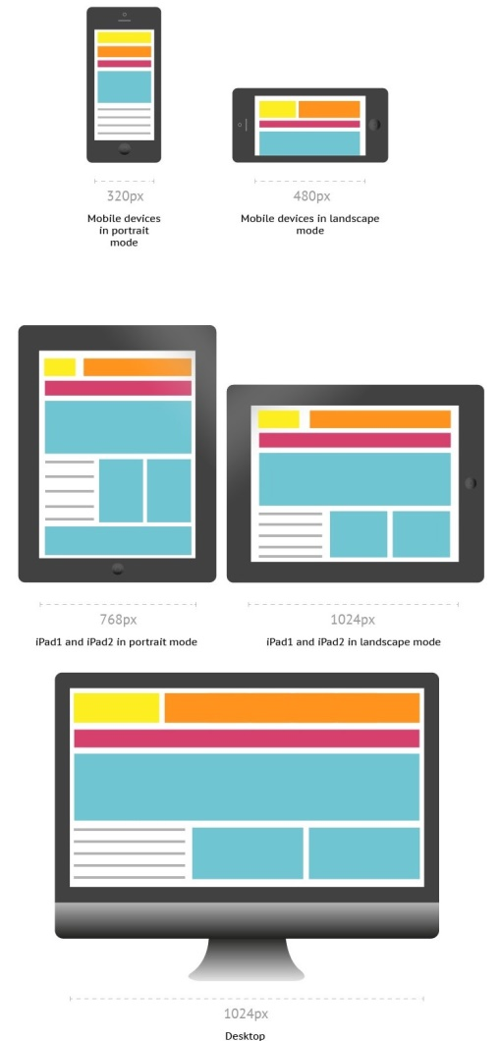
Responsive Web Design

Slide 27
Media Queries
Media queries allow you to customize the presentation of your web pages for a specific range of devices, like mobile phones, tablets, desktops, etc… without any change in markups
Media queries are composed of an optional media type and expressions that check for the conditions of particular media features
Media queries may also be combined in various ways by using logical operator expressions.
More information regarding Media queries can be found here: CSS media queries - CSS | MDN

Slide 28
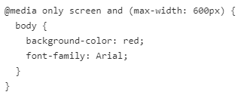
Media Queries | Example
The following example changes the background color of the <body> element to "red" and the font style to "Arial" when the browser window is 600px wide or less.

Slide 29
Flexbox
Flexbox, short for “Flexible Box Layout”, is a CSS layout module that provides a flexible and efficient way to arrange and align elements within a container.
Flexbox introduces a one-dimensional layout model, allowing you to align items along a single axis (either horizontally or vertically).
The main idea behind flexbox is to distribute available space within the container and control the alignment and positioning of its child elements, also known as flex items
When working with any flexbox layout, the first step is to create a flex container by setting the element’s display property to flex or inline-flex
The direct children of the flex container are called flex items.
See the documentation for more information on Flexbox: CSS flexible box layout - CSS | MDN

Slide 30
CSS Grid
CSS Grid Layout brings a 2D grid system to CSS, unlike flexbox which is 1D
A grid is comprised of columns and rows in which we can place our items
Items can be positioned on the grid explicitly using numbers
CSS Grid will also calculate where items go when they are not given specific positions.
By setting the display property of an HTML element to grid or inline-grid, we turn that element in a grid container, all direct children of the grid container are grid items.
For more information, see the documentation: CSS grid layout - CSS | MDN

Slide 31
CSS Variables
Custom Properties in CSS are property names prefixed with a double dash. (i.e. --my-custom-color)
Note: By convention, multiple-words for CSS properties should be separated with a dash.
The var() function is used to insert the value of a custom property.
E.g. color: var(--my-custom-color)
CSS variables have access to the DOM, which means that you can create variables with local or global scope, change the variables with JavaScript, and change the variables based on media queries.
A good way to use CSS variables is when it comes to the colors of your design.
CSS variables allow designers and developers to reuse values for better consistency and maintainability of styles in your stylesheets.

Slide 32
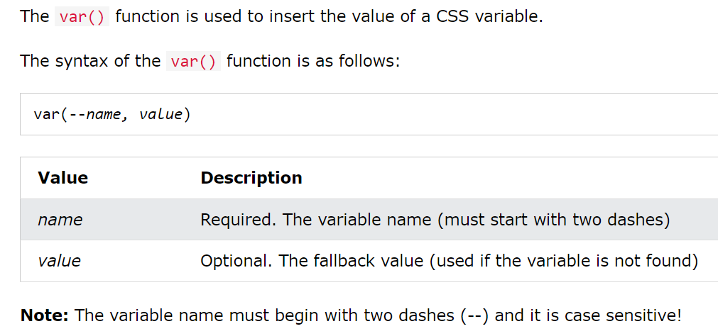
CSS Variables | var() syntax

Slide 33
CSS Variables
CSS variables can have a global or local scope.
Global variables can be accessed/used through the entire document, while local variables can be used only inside the selector where it is declared.
To create a variable with global scope, declare it inside the :root selector. The :root selector matches the document's root element.
To create a variable with local scope, declare it inside the selector that is going to use it.
In the following example (next slide), two global variables are created
(--blue and --white)
The var() function is used to insert the value of those variables later in the stylesheet.

Slide 34
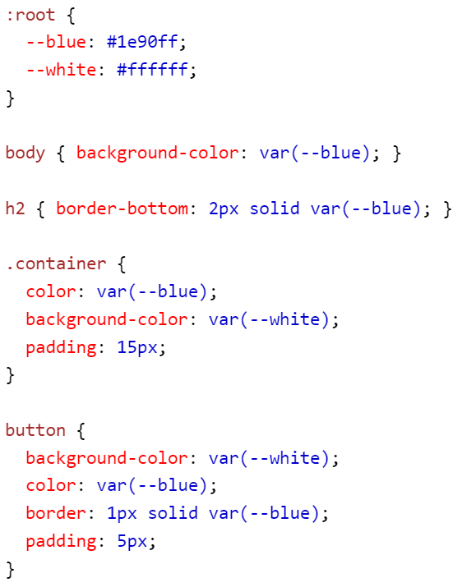
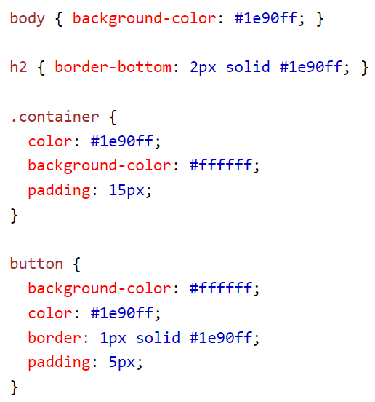
CSS Variables

Slide 35
Bootstrap
Bootstrap is an open-source, front-end framework and mobile-first approach for developing responsive websites, which supports HTML and CSS.
To use bootstrap you can either download Bootstrap from: getbootstrap.com.
Alternatively, you can include Bootstrap by using the links here: BootstrapCDN.
By downloading (or linking to) bootstrap, you gain access to various container classes you essentially gain access to a large library of custom variables and pre-configured, responsive class property rules that you can apply to your own HTML elements quickly and easily.
See the Bootstrap documentation for more information: Get started with Bootstrap · Bootstrap v5.3

Slide 36
Bootstrap
Bootstrap uses a grid system, which consists of a series of containers, rows and columns to built the layout of your webpage and align content
Bootstrap creates a responsive layout using the grid and flexboxes of CSS.
As a screen or viewport changes sizes, a breakpoint is used to determine the transition between the various screen sizes.
When an element exceeds the dimensions for a breakpoint, new styling rules/container sizes, etc… are dynamically applied.

Slide 37
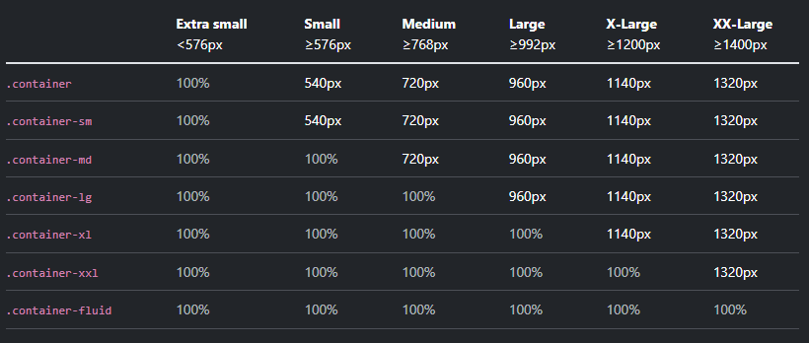
Bootstrap
Containers act as the fundamental building block of Bootstrap, which contain, pad and align your content.
Bootstrap provides three (3) container classes:
.container: max-width at each responsive breakpoint
.container-{breakpoint}: width is 100% until the specified breakpoint
.container-fluid: width is 100% at all breakpoints
The table below shows these container classes, and their pixel breakpoints

Slide 38
Bootstrap
Bootstrap also has pre-configured styling rules for:
Tables: Tables · Bootstrap v5.3
Forms & Form Elements: Forms · Bootstrap v5.3
Buttons: Buttons · Bootstrap v5.3
Alert Messages: Alerts · Bootstrap v5.3
Navbars: Navbar · Bootstrap v5.3
And basic text and background colors: Color and background · Bootstrap v5.3

