Slide 1
Maven

Slide 2
Outline
What is Maven?
Maven Repository
Config & POM File
Maven Lifecycle

Slide 3

What is Maven?

Slide 4
Maven
Maven comes from a Yiddish word meaning “Accumulation of knowledge”
Maven is a tool that can be used for building and managing programming projects
Maven automates the process of importing files into your build path/project structure
Sometimes you want to use code from a jar (java archive) that some else made…Once maven is given certain instructions, it will go and download the particular dependencies that you need
Maven uses a large online repository full or projects that have been deployed to it that are all ready to be downloaded and used if desired.

Slide 5
Maven Repository

Slide 6
Maven Repository
https://mvnrepository.com/
The maven repository holds build artifacts including libraries and other dependencies that a maven project may access based on the configurations in the project’s POM file.
Maven will search this repository and remotely download and cache this information.

Slide 7
Maven Configurations & POM File

Slide 8
POM
Maven manages your project through the configuration of an XML POM file.
XML – Extensible Markup Language
POM – Project Object Model
The POM.xml file is a singleton configuration file that contains most of the information that is required to build a project in just the way you want.

Slide 9
Maven Configurations
<groupId> – The group id unique identifies your project, across any other. The typical naming convention is to follow Java package naming rules.
All lower case.
Words are divided with a period
The name generally matches a reversed website domain to ensure uniqueness.
Ex: ‘com.revature’.
<artifactId> – The Artifact ID is the name of the jar/war file to be created, without a version appended.
<version> – Corresponds to the version number when distributed. Default is 0.0.1-Snapshot.
<packaging> - type of output (jar, war, etc…)

Slide 10
Maven Configurations - Dependencies
<dependencies> – contains all project dependencies
<dependency> – Single dependency with its own groupId, artifactId and version
<scope> – When the dependency is needed (compile, test, runtime, etc…)

Slide 11
Maven Lifecycle

Slide 12
Maven LifeCycles
There are technically 3 lifecycles, Cleaning, Default* and Site.
Typically, when referring to the Maven Lifecycles, we refer to the Default cycle.
The “other two” (you don’t need to know):
Cleaning – Used to remove excess files & reduce clutter
Site – Documentation of project.

Slide 13
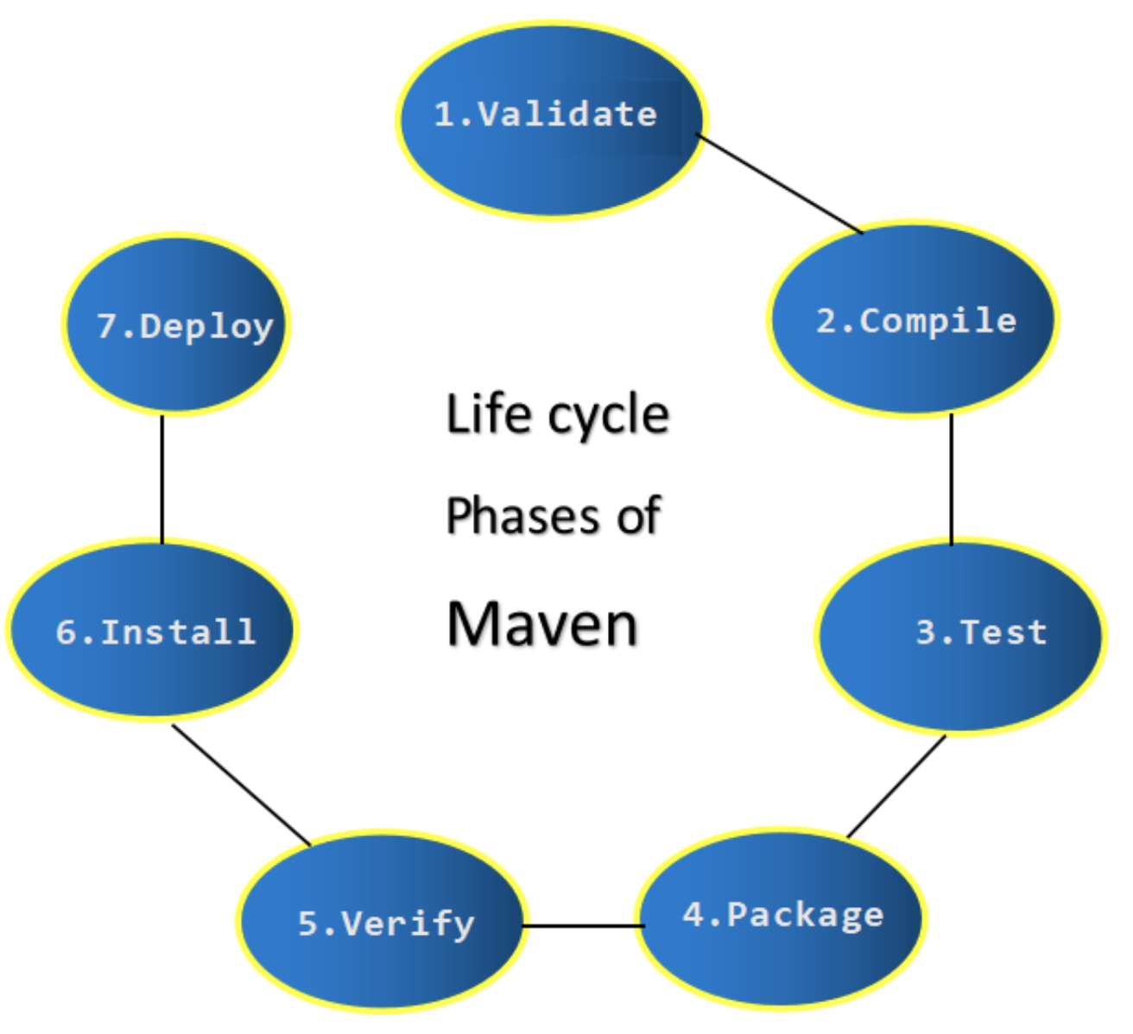
Maven LifeCycles

Slide 14
Maven Goals- Default Lifecycle
Validate – Confirm the project is correct and all necessary information is available. We check the pom.xml, parse it, then locate and download dependencies
After validation, we write code
Compile – Source Code is Compiled
Testing – Code is tested using suitable unit testing frameworks, such as JUNIT
Package – Compiled code is packages into a distributable format, such as a jar or war.
Verify – Run check on results of integration tests to ensure quality is met
Install – Installs the project as a potential dependency in the local repo
Deploy – Copies packages into remote repository. Performed in build environment.
If any of the steps above are called, all the steps before are called as well.

