Slide 1
Spring Security

Slide 2
Outline
Spring Security Basics
Authentication vs Authorization
Security Filter Chain
Authentication Providers
Password Encoding
Authorization
Cookies & Session Management
CSRF & CORS Basics

Slide 3

Spring Security Basics

Slide 4
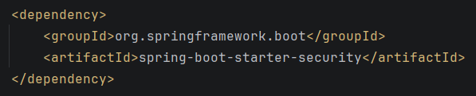
Spring Security
Spring Security is Spring’s dedicated framework for handling authentication and authorization
Protect web app endpoints
Authentication: verify who a user is
Authorization: control what a user is allowed to do
Starter Dependency:

Slide 5
Spring Security
Once added to a Spring Boot Project, Spring Security’s auto-configuration kicks in immediately.
Secure-by-default
Every single endpoint in the application requires authentication if no configuration is written by hand
Without custom configuration, Spring Boot’s auto-configuration will provide a default, temporary user to login with:
The default username is: ‘user’
The default password will be generated and printed to the console

Slide 6
Authentication vs Authorization

Slide 7
Authentication & Authorization [Recap]
Authentication and Authorization are two distinct concerns which are foundational to the security of any application.
Authentication answers the question: “Who are you?
Typically this is checked by submitting a username and password (or some other known credential) against known and trusted data
Authorization answers the question: “What are you allowed to do?”
Authorization is asked after authentication has succeeded
Authorization is detailed for already-known users based on permissions that user have been provided.

Slide 8
Authentication & Authorization [Recap]
These two concerns are sequential and dependent
Authorization decisions are only meaningful once authentication has been established
E.g. A ‘Role’ on a user’s login details can determine what actions they have access to perform.
In HTTP, the failure of Authentication vs Authorization are represented by two different status codes:
401 Unauthorized: An authentication failure
Despite the name, this is a failure to prove who you are
403 Forbidden: An authorization failure.
An authenticated user is not permitted to some endpoint

Slide 9
Security Filter Chain

Slide 10
Security Filter Chain
The Security Filter Chain is the actual mechanism Spring Security uses to intercept every incoming HTTP request to perform authentication
Built on Servlet Filters – a component that can inspect, modify or reject a request before it reached it’s intended destination
Spring Security registers many individual filters which are chained together.
Each filter is responsible for one specific piece of security-related processing.
A request passes through each filter in sequence, and any filter in the chain can stop the request

Slide 11
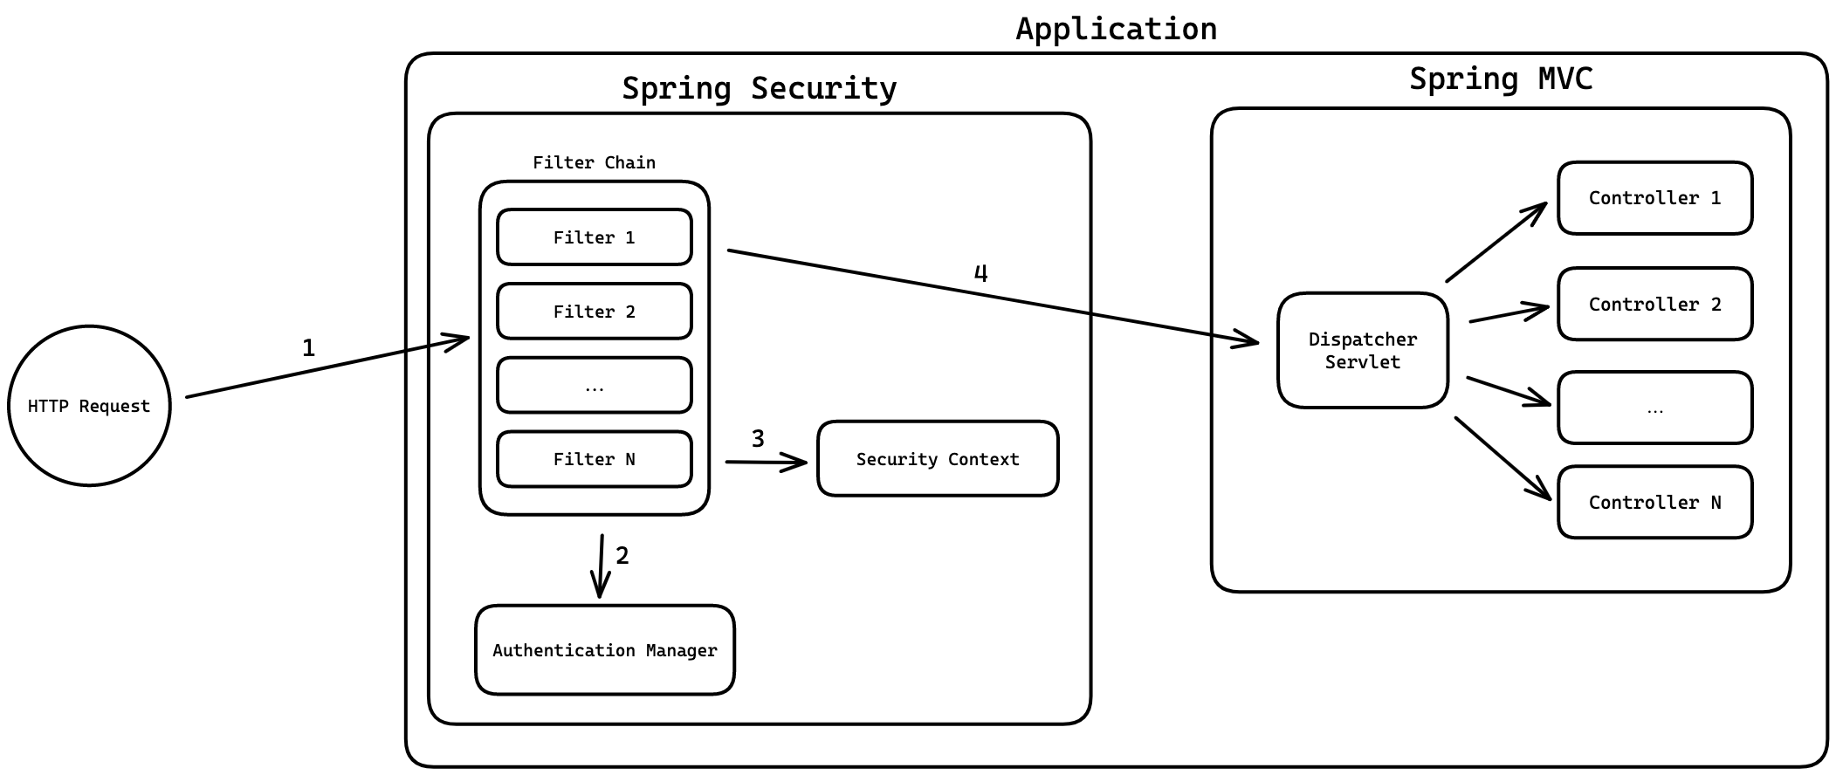
Security Filter Chain

Slide 12
Security Filter Chain
The Security Filter chain causes Spring Security to perform its work entirely separately from, and before Spring Web MVC handles any request
Some important filters in a typical chain include:
A filter responsible for extracting credentials from the request
A filter responsible for performing authentication
A filter responsible for enforcing authorization rules
The filter chain is configured through a SecurityFilterChain bean – defined in a @Configuration class
This is typically where configuration takes place, rather than configuring through application.properties

Slide 13
Authentication Providers

Slide 14
Authentication Providers
In a typical Filter Chain, a filter is used to perform authentication against a user’s credentials.
AuthenticationProvider is an interface responsible for the actual logic to verify submitted credentials.
Spring Security ships with a default AuthenticationProvider implementation (DaoAuthenticationProvider) which handles the comparison logic itself.
Alone the DaoAuthenticationProvider doesn’t know where the real user data actually lives.
Locating the data is a responsibility that should be handed off to a service which is responsible for returning user data – the UserDetailsService

Slide 15
UserDetailsService & UserDetails
The UserDetailsService and UserDetails are Spring Security’s own representation of “a user”
The UserDetails includes the username, the (hashed) password, and the user’s granted authorities (roles/permissions)
A common pattern is to create a separate Adapter class to separate your Database entities from your Security beans
NOTE: You can just implement UserDetails on your entity class directly; however, this is typically seen as poor design (changes to your database representation should not impact how authentication is viewed)

Slide 16
Adapter Pattern
The Adapter design pattern is a structural pattern used to allow objects with incompatible interfaces to collaborate.
The Adapter pattern is achieved by creating a special object that wraps one entity, and performs the conversion logic.
This pattern hides the complexity of the conversion behind the wrapper, allowing you to focus only on the data needed for the conversion.

Slide 17
Password Encoding

Slide 18
Password Encoding
Storing plain text passwords is a serious, well-known security risk.
If a database is ever compromised, ever user’s actual password can become immediately exposed.
The standard solution to this is password hashing
Hashing: passing a value through a one-way mathematical function that transforms it into a fixed-length, seemingly random string from which the original cannot practically be recovered.
Note: The DaoAuthenticationProvider requires passwords to be encoded – so you must register a password encoder when creating your own SecurityFilterChain

Slide 19
Password Encoding
Spring Security expresses hashing through the PasswordEncoder interface.
PasswordEncoder is a single abstraction that covers both encoding (hashing a raw password for storage) and matching (checking whether a raw, submitted password corresponds to a previously hashed one)
BCryptPasswordEncoder is Spring Security’s standard, recommended implementation

Slide 20
Authorization

Slide 21
Authorization
Authorization is Spring Security can be enforced at two different levels
URL-based authorization:
Configured directly in the SecurityFilterChain bean
Restricts access based on the request path itself (i.e. “only ROLE_ADMIN may access anything under /logins endpoint”)
Method-level authorization
Configured directly on individual service or controller methods
Restricts access based on what that specific method does, regardless of which URL happens to route to it
The decision of which to use comes down to your goals with your endpoints:
Use URL-based authorization if you have general rules to apply to a top-level endpoint
Use Method-level Authorization when you need finer-grained control.
Note that URL based authorization is evaluated first

Slide 22
Authorization | URL Authorization
URL-based authorization uses ‘hasRole()’ (and related matchers) inside the authorizeHttpRequests block of your SecurityFilterChain
Passing a string into hasRole() checks the GrantedAuthority on the UserDetails object.
Note: “ROLE_” is prefixed in this check, so: hasRole(“ADMIN”) actually checks the string “ROLE_ADMIN”.

Slide 23
Authorization | URL Authorization
If different endpoints for your application require different role or permissions, then it is typical to create multiple SecurityFilterChains
You may only have a single “fall-back” chain
i.e. You can only have a single SecurityFilterChain that does not specify an endpoint using .securityMatcher(…)
If you define multiple SecurityFilterChains, you must use the @Order annotation
The SecurityFilterChains are evaluated in the order specified, so the first securityMatcher that matches the request is used.

Slide 24
Authorization | Method-based Authorization
In order to enable Method-level authorization, a Configuration class is needed, which is annotated with @EnableMethodSecurity.
Method-level authorization uses annotations (most commonly @PreAuthorize), placed directly on a method.
@PreAuthorize accepts a Spring Expression Language (SpEL) string, which is evaluated at the moment the method is called
These annotations are checked before that method is allowed to execute at all.

Slide 25
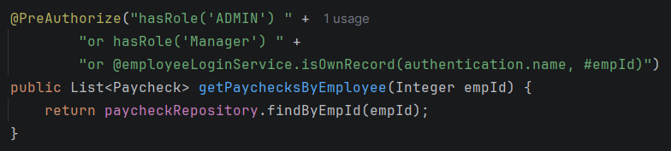
Spring Security SpEL Context
Spring Security builds a Root context object (MethodSecurityExpressionRoot) when evaluating an expression.
This root context object is given an authentication property with the Authentication object before the expression is evaluated.
hasRole(‘Admin’) – calls the hasRole method on the context object – checking the role of the authenticated user
@employeeLoginService – reference to a registered bean.
Note the ‘@’ in Spring is used to reference registered beans
#empId – reference to the empId in the getPaychecksByEmployee() method.
Note: Spring security binds the method parameters to the context using under their own name (using setVariables()). This uses the reflections api.

Slide 26
Cookies & Session Management

Slide 27
Spring Security Sessions
HTTP itself is fundamentally stateless. Without some additional mechanism, a user would need to re-authenticate on every single request.
Spring Security’s default solution to this issue is to create an HttpSession and store the authenticated user’s identity in it.
This gives the browser a cookie (by default named JSESSIONID)
This cookie references the user’s session
On subsequent requests, the browser automatically includes that cookie, allowing the server recognize the user.
Note: Since this is default behavior of your browser, a frontend created with Angular or React will automatically leverage this behavior so long as you include the correct header information.

Slide 28
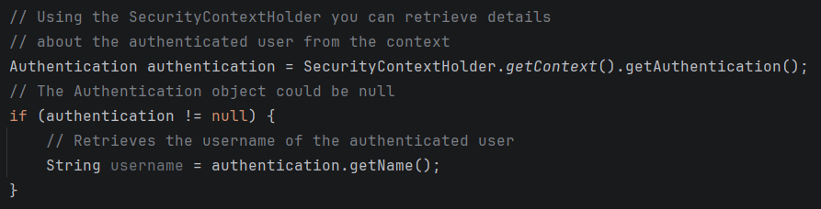
Spring Security Sessions
After a session is created, the authenticated user’s identity is available throughout the application via a SecurityContextHolder.
You can access details about the currently authenticated user from the Context of the SecurityContextHolder

Slide 29
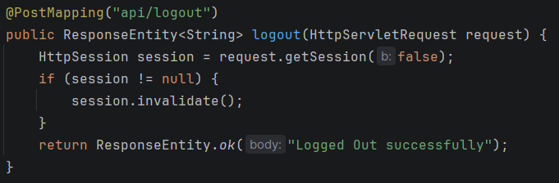
Spring Security Sessions
To log out of your application, you simply need to invalidate the current session in Spring.
Spring Security automatically provides an endpoint with a simple button that can perform this operation.
http://localhost:8080/logout
Typically, this is controlled via a post request in your frontend application to the default endpoint.
Alternatively, you can create a custom endpoint in your application to handle this logic

Slide 30
CSRF & CORS Basics

Slide 31
CSRF & CORS Basics
With a basic Security Chain (including Spring Security’s defaults) – you might notice that your frontend application, including forms cause many 401 errors.
This is due to standard, browser-built security implementations for CORS and CSRF.
Cross-Origin Resource Sharing (CORS): Determines which origins (client endpoints) are allowed to read a response from your API
Cross-Site Request Forgery (CSRF): Prevents a malicious site from tricking a logged-in user’s browser into submitting an unwanted request.
i.e. It protects users’ authenticated sessions.

Slide 32
CORS
CORS is enforced entirely by the browser.
A server can technically respond to any cross-origin request it receives.
The browser will block the frontend JavaScript code from reading that response unless the server’s response includes specific healers permitting it.
CORS is primarily important once you have a frontend running on it’s own origin
i.e. localhost:4200 or localhost:3000
Within Spring Security, you will need to create a security configuration for CORS which permits your Frontend application to make credentialed, cross-origin requests.

Slide 33
CORS | Server Config
Create a Configuration Class (or update your existing one)
Create a Bean to manage the CORS configuration.
Your bean method should return a ‘CorsConfigurationSource’ object – imported from springframework.web.cors
Within the bean method - Create a CorsConfiguration object
Also from springframework.web.cors
Use the ‘setAllowedOrigins’, ‘setAllowedMethods’, ‘setAllowedHeaders’, and ‘setAllowCredentials’ methods to configure the CORS configuration.
Register the configuration to a ‘UrlBasedCorsConfigurationSource’ object.
Note: UrlBasedCorsConfigurationSource allows you to configure which endpoints of your application to apply these CORs rules to.

Slide 34
CSRF
CSRF exploits a specific combination of two things:
Browsers automatically attach cookies to requests
A malicious website’s ability to trigger a request to another side (e.g. using an ‘auto-submitting’, hidden form)
Spring Security enables CSRF protection by default
CSRF protection works be requiring a CSRF token (a value the server generates and expects to see resubmitted alongside any state-changing request)
A malicious, external site has no way to obtain this token, since it cannot be read from the victim’s session

Slide 35
CSRF
CSRF exploits a specific combination of two things:
Browsers automatically attach cookies to requests
A malicious website’s ability to trigger a request to another side (e.g. using an ‘auto-submitting’, hidden form)
Spring Security enables CSRF protection by default
CSRF protection works be requiring a CSRF token
The CSRF token is a value the server generates and expects to see resubmitted alongside any state-changing request
A malicious, external site has no way to obtain this token, since it cannot be read from the victim’s session

Slide 36
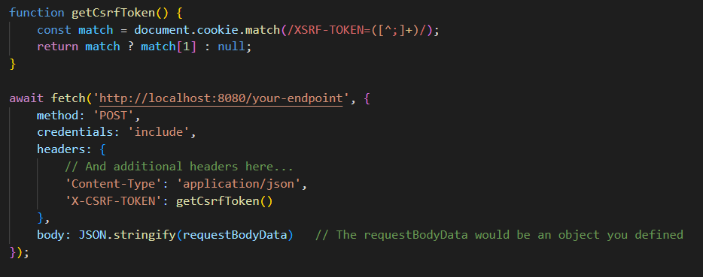
CSRF | Considerations
Your CSRF token must be included for any POST/PUT/DELETE requests
In a Frontend application, you would need to include the token by reading it from a readable cookie
Since our application is very simple, we will just disable this protection as a simple work-around.

Slide 37
Bonus

Slide 38
Spring Security | 1000 foot view
Create a SecurityFilterChain
Create Authentication Layer
Implement a UserDetailsService & UserDetails object (typically using an adapter pattern)
Register a Password Encoder
Control Authorization
Use securityMatchers to set URL-level security
Use @PreAuthorize Annotation to set Method-level security
Remember that @PreAuthorize requires a config class with @EnableMethodSecurity
Configure CORS & CSRF

