Slide 1
Kafka Application Development

Slide 2
Outline
Producer Development
Consumer Development
Error Handling Techniques

Slide 3

Producer Development

Slide 4
KafkaTemplate.send()
KafkaTemplate.send() is asynchronous by default
It returns immediately with a CompletableFuture object
This means the producer can send manage messages quickly without blocking the program
It also means you need a way to know if a send actually succeeded or failed
Attaching a callback lets you react to success or failure without slowing down the producer
SendResult<K, V> is a wrapper in Spring Kafka that wraps the event data after sending a message to a partition.
SendResults contains:
A reference to the record’s metadata (getRecordMetadata()), which details where the message landed.
A reference to the original ProducerRecord<K, V> that was actually sent (getProducerRecord()), which contains the event payload.

Slide 5
Completable Future
The typical callback is set using the whenComplete() method on the CompletableFuture object.
This method is given the SendResult object and potentially a throwable object (if the send failed).

Slide 6
Message Keys and Partitioning
Providing a key ensures all messages with that key land on the same partition, preserving order for related events
Choosing a good key isn’t just “picking something unique”. Keys should reflect what actually needs to stay ordered, relative to itself
(e.g. all events for one order, not all events for one customer)
Without a key, Kafka distributes messages across partitions using some partitioning strategy (typically ‘round-robin’)
Kafka does allow you to explicitly specify a target partition; however, is not very common, and should be used deliberately.

Slide 7
Serialization
StringSerializer is useful for simple text payloads; however, real applications typically send structured data (objects).
This requires a JSON-capable serializer instead
Sending structured objects means defining a plain Java class representing the event shape.
You then match producers and consumers to expect this type.
Multiple serialization strategies can coexist in one application (different topics can use different producer configurations)
Requires explicit, and separately configured producers (and consumers)

Slide 8
Delivery Guarantees vs Throughput
Since requests are sent asynchronously, brokers need to send some confirmation to an application, acknowledging an event was received.
The ‘acks’ setting (set in your application.properties) is used to control how many brokers must confirm a message before the producer considers it “sent successfully”.
This is a tradeoff between safety and speed
acks=0: don’t wait for any confirmation. This is the fastest, but could result in silently losing data.
acks=1: wait for the partition leader only. Middle-ground approach, safe against most failures, but not all.
acks=all: wait for all in-sync replicas to confirm. Safest, but slowest approach.

Slide 9
Consumer Development

Slide 10
Offset Commits
By default, Spring Kafka automatically commits offsets on a schedule.
Spring Kafka marks messages as “processed” without any extra code
Automatic commits are simple, but create a subtle risk: a message can be marked as processed before your business logic actually finishes handling it.
This means a crash at the wrong moment can silently lose work.
Manual offset commits gives you control over exactly when a message is considered “done” (typically only after your processing logic completes successfully.

Slide 11
Consumer Configuration | Revisit
Just as producers can be configured for structured (JSON) data, consumers need matching deserializers to convert bytes back into a usable Java object.
A ConsumerFactory defines how to build a properly configured Kafka consumer client.
A ListenerContainerFactory defines how to run that consumer continuously and deliver records to your @KafkaListener method.
When an application needs more than one consumer configuration (e.g. one topic using a String, another using JSON), each @KafkaListener must be explicitly told which container factory to use.
Spring Boot’s auto-configuration handles all of this invisibility when there’s only one default configuration in play. (Typically, your apps would only process JSON data).

Slide 12
Error Handling Techniques

Slide 13
Common Failures
Failures can occur at different levels when producing and consuming event data
Deserialization failures: A message arrives in a format the consumer doesn’t expect
E.g. malformed JSON, or JSON that doesn’t match the target class
Processing failures: The message deserializes fine, but something goes wrong while handling it
E.g. A downstream service is unavailable, a database write fails, business logic throws an exception.
Transient Failures: A brief network hiccup/blip. This may succeed if reattempted.
E.g. A message queue is currently full.
Permanent Failures: A consistent issue which will never succeed no matter how many times it’s retried
E.g. service is down, malformed data, etc…

Slide 14
Retry Strategies
Spring Kafka provides built-in retry support.
Failed messages are automatically reprocessed a configurable number of times before giving up.
Retires are well-suited for transient failures.
Temporary unavailability of a service
Note: Retrying blindly can delay processing of subsequent messages on the same partition. Retrying on a permanent failure wastes resources without ever succeeding.
Backoff strategies: waiting longer between each retry attempt.
Helps overwhelming a potentially struggling downstream system.

Slide 15
Dead Letter Topics (DLT)
A Dead Letter Topic is a separate topic where messages get routed after they’ve exhausted their retry attempts and still failed.
This prevents a single “poison pill” message from blocking an entire partition indefinitely
It allows a consumer to move onto the next message instead of retrying the same one forever.
Messages in a DLT aren’t lost, they are preserved for later inspection, manual reprocessing, or alerting.
Spring Kafka provides built-in support for automatically routing failed messages to a DLT after retries are exhausted.

Slide 16
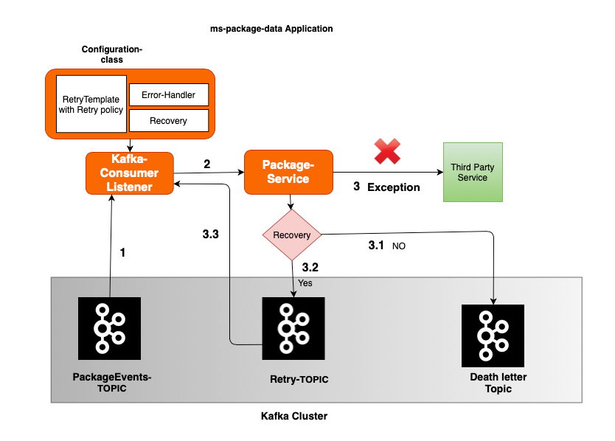
Dead Letter Topics (DLT)

Slide 17
Error Handling in Design
Your error handling strategy should be decided intentionally up front, not bolted on reactively after a production incident
The right strategy depends on the cost of failure for that specific data
Losing any analytics event might be tolerable, but losing a payment confirmation isn’t
A Dead Letter Topic, which is full of unprocessed messages, should be monitored (not created and forgotten)
Good error handling turns “the application crashed and we don’t know why” into “we know exactly which messaged failed, why and where to find them”.

Slide 18
Bonus | Tying it all together

Slide 19
Applications with Kafka
Kafka messaging can be modularly added to an existing application quite simply.
In a typical application, a Controller calls an appropriate service.
That service (containing business logic), is responsible for calling the producer.
Message Producer Services should be relatively narrow by design.
Take data, serialize it, send it to Kafka.
Message Producers should not decide whether an event is valid, perform any calculations, or communicate with a repository – that is the responsibility of the preceeding service.
Consumers, additionally, should be quite narrow.
Receive & deserialize available messages, perform light validation/logging, then hand-off business logic to an appropriate service.

Slide 20
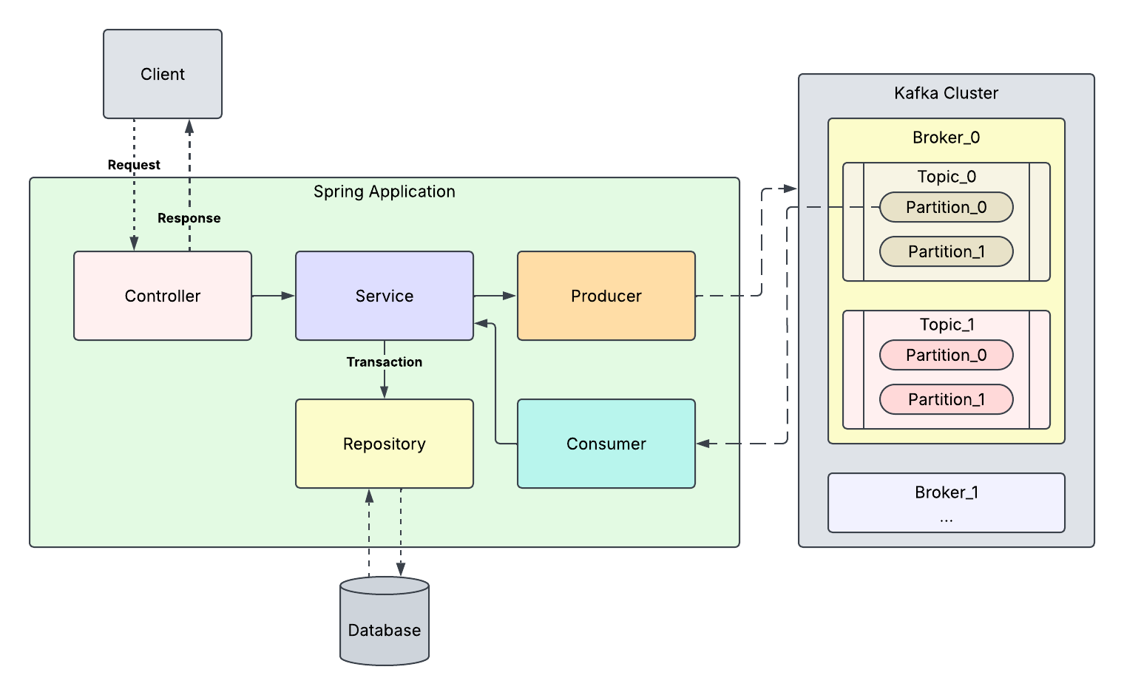
Applications with Kafka

