Slide 1
Event Driven Architecture and Kafka

Slide 2
Outline
Event Driven Architecture
Kafka Setup
Kafka Fundamentals
Spring Kafka Introduction

Slide 3

Event Driven Architecture

Slide 4
Event Driven Architecture
Event Driven Architecture (EDA) is a software design pattern where the flow of the application is determined by events.
These events are significant occurrences within a system that trigger responses or actions
It is commonly used in systems requiring scalability, flexibility, and real-time processing
Essentially, in EDA, you write events to a log as data and consumers read data from the log to perform actions in response.

Slide 5
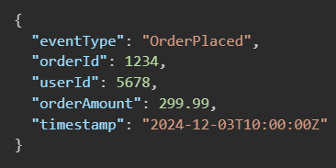
EDA | Core Concepts
Events: Represent a significant (meaningful) action or change in the system.
E.g. “order placed”, “user signed up”
Events are immutable
Events are self-contained, carrying all necessary information to describe the occurrence
Asynchronous

Slide 6
EDA | Core Concepts
REST APIs follow a Request/Response cycle.
A client “asks a question” and must wait for a direct response.
More tightly coupled interaction
Event-Driven Architecture follow an asynchronous and loosely coupled approach:
A producer emits an event and move on.
Interested parties react whenever they’re ready
In event-driven systems, the producer doesn’t need to know who (if anyone) is listening

Slide 7
EDA | Core Concepts
Producers: Components that generate events
Detect changes or an action that needs to be communicated, and creates an event
Typically, producers are user-facing components or services that trigger actions based on business logic
Recall the button presses in Angular
Consumers: Components that react to events
Consumers subscribe to events and take appropriate actions when an event they are interested in occurs
A consumer may act by updating databases, invoking business logic, or notifying other services

Slide 8
EDA | Core Concepts
Event Brokers: Middleware that facilitates communication between producers and consumers
Decouples the event generation from event handling by ensuring that producers to not directly interact with consumers.
The event bus enables the asynchronous, reliable delivery of events
Ex: Kafka
Event Bus: General term for the “pipeline” events flow through. This is a combination of the Broker and other tools (e.g. “Topics” in Kafka)
Event Handlers: Logic that executes in response to an event
i.e. this is the code a developer writes to perform some action after reading a published event

Slide 9
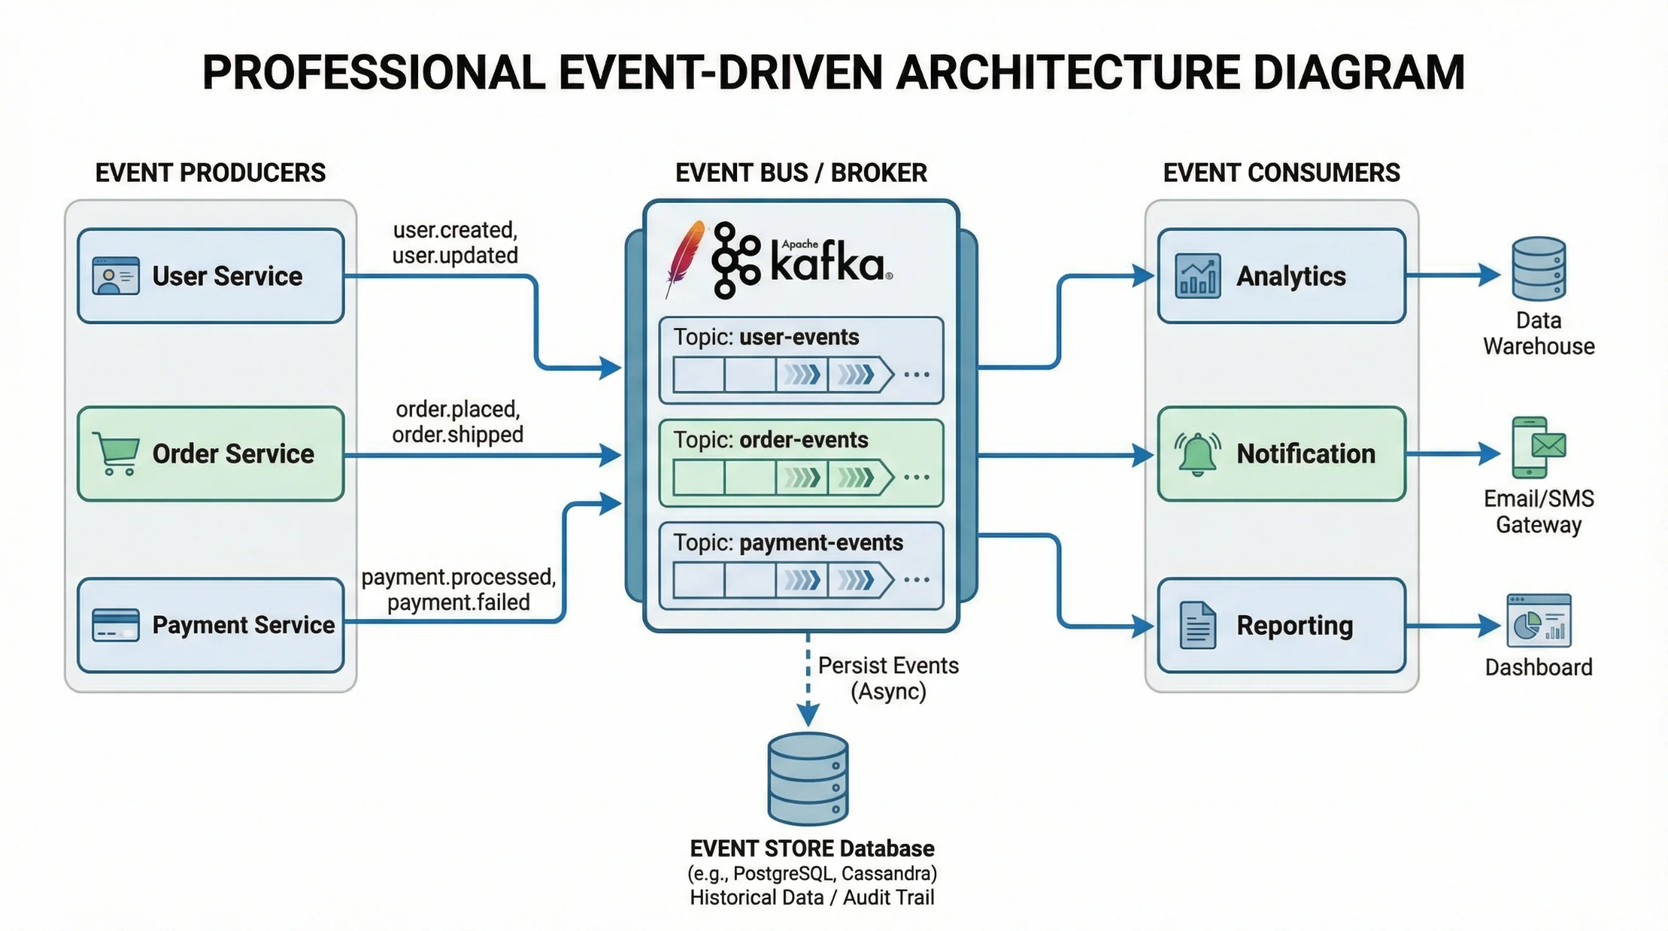
EDA | Core Concepts

Slide 10
EDA | Core Concepts
Event Brokers/Event Bus’ perform the following roles:
Event Dispatching: Ensures events are sent from the producer to the appropriate consumer
Message Queuing: It can temporarily store events, allowing consumers to process events at their own pace. This ensures reliable delivery even if consumers are temporarily unavailable
Routing: Determines which consumers should receive specific events
Persistence: Some event brokers can persist events, enabling replay and auditing

Slide 11
EDA | Types of EDA Patterns
Simple Event Processing
Events trigger specific actions in near real-time.
Example: A motion sensor turning on lights.
Event Stream Processing
Events are continuously analyzed in a stream.
Example: Real-time fraud detection in banking.
Complex Event Processing (CEP)
Multiple events are analyzed and correlated to identify patterns.
Example: Monitoring stock trading for unusual patterns.

Slide 12
EDA | Common Use Cases
Real-Time Applications:
Chat applications, live dashboards, and notifications.
IoT Systems:
Sensors generating events for devices to act upon.
Microservices Communication:
Services communicating asynchronously to achieve scalability.
E-commerce:
Order processing workflows with events like "Order Placed" or "Item Shipped."
Event Sourcing:
Capturing the state changes as a sequence of events for reconstructing state.

Slide 13
EDA | Key Technologies
Event Brokers/Message Queues:
Kafka, RabbitMQ, Apache Pulsar, Amazon SNS/SQS, Azure Event Grid.
Streaming Frameworks:
Apache Flink, Apache Storm, Spark Streaming.
Serverless Solutions:
AWS Lambda, Azure Functions, Google Cloud Functions.

Slide 14
EDA | Advantages
Scalability
Independent components can be scaled based on load
Loosely Coupled Systems
Produces and consumers operation independently, reducing dependencies
Real-Time Processing
Events are processed as they occur, enabling near-instantaneous responses.
Flexibility
Adding new features or consumers doesn’t require significant changes to existing components
Resilience
Systems can continue operations even if some components fail

Slide 15
EDA | Challenges
Event Duplication:
Handling duplicate events due to retries or distributed systems.
Solution: Use idempotent consumers.
Debugging:
Asynchronous nature can make debugging challenging.
Solution: Implement logging and monitoring.
Complexity:
Designing and maintaining loosely coupled systems can be difficult.
Solution: Proper documentation and use of standards.
Data Consistency:
Ensuring eventual consistency across components.
Solution: Adopt patterns like Saga for distributed transactions.

Slide 16
Kafka Setup

Slide 17
Kafka
Apache Kafka is an open-source, distributed event stream platform, used to handle large volumes of real-time data.
Kafka is typically used for managing streams of data, event sourcing, log aggregation, and message brokering.

Slide 18
Kafka Setup
Before writing any code, you need a running Kafka broker to connect to
Kafka can be run locally for testing/development, or in a managed cluster for a production environment
Docker is the fastest, and simplest way to get a local Kafka environment running
Install Docker (Install Docker Engine | Docker Docs)
[optional but recommended] Install Docker Desktop (Install Docker Desktop on Windows | Docker Docs)
You can confirm your docker installation with the following command in your terminal:
docker --version

Slide 19
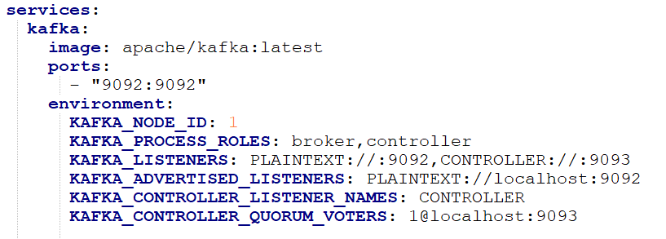
Kafka Setup
Navigate to a directory of your choice, and create a docker-compose.yml file to setup a simple broker.
Note: the following docker-compose.yml file showcases a very basic, one-broker setup. Our example will have multiple brokers, with some additional settings

Slide 20
Docker-Compose File Breakdown
services: declares the list of containers docker will manage (3 kafka brokers)
kafka-{num}: Name of the service
image: informs Docker which image to pull and run
In this case, the latest, official kafka image.
ports: which port the container will use.
Left port: host machine port
Right port: port inside the docker container
environment block: details variables to pass to the container, which kafka uses to configure the broker
KAFKA_NODE_ID: unique integer id to identify each broker
KAFKA_PROCESS_ROLES: Allows each node to act as a broker (store data and serve clients), and a controller (manage cluster metadata) – required for cluster management, more on this later.
KAFKA_LISENERS: declares which network interfaces/ports the broker listens on inside the contains.
Regular traffic (unencrypted – “platintext”) and controller-to-controller communication
KAFKA_ADVERTISED_LISENERS: The address the broker tells clients to use when connecting to the broker
This is what our Spring Boot app will use

Slide 21
Docker-Compose File Breakdown
KAFKA_INTER_BROKER_LISTENER_NAME: Informs the broker which listener (port) it should use to talk to other brokers.
This is important for replication and syncing metadata
KAFKA_LISTENER_SECURITY_PROTOCOL_MAP: Tells Kafka what security protocol to use for each named listener.
Format: LISTENER_NAME: PROTOCOL. ‘Plaintext” means no encryption/authentication
KAFKA_CONTROLLER_LISTENER_NAMES: Tells Kafka which of the listener named (defined above) is used for controller traffic specifically. Used with broker management – more later.
KAFKA_CONTROLLER_QUORUM_VOTERS: Lists every controller-eligible node in the cluster (nodeId@host:port).
Used so that all brokers know about each other and can form a consensus group.
This should be identical for all brokers on a cluster.
This is how they find each other and agree on cluster metadata

Slide 22
Kafka Setup
Start the broker using docker compose (terminal opened in the same directory as the docker-compose.yml file:
docker compose up -d
You can verify the broker is running using Docker desktop (‘Containers’ tab should show the active container) or using the following command:
docker ps
You can stop the container using the GUI in Docker desktop, or using the following command:
docker compose down

Slide 23
Kafka Fundamentals

Slide 24
Kafka | Core Concepts
Topic: A named location, in which event data (messages) are stored.
Topics are split into partitions
Partition: A smaller, immutable sequence of messages within a topic.
Essentially it is a “bucket” that holds some of the messages for a topic.
Partitions are strictly ordered; however, that ordering is not guaranteed across partitions in the same topic.
Each event in a partition is given an offset
Offset: a sequential ID marking it’s position in a partition’s log
Offsets are used by consumers to keep track of what data within a topic has been consumed already

Slide 25
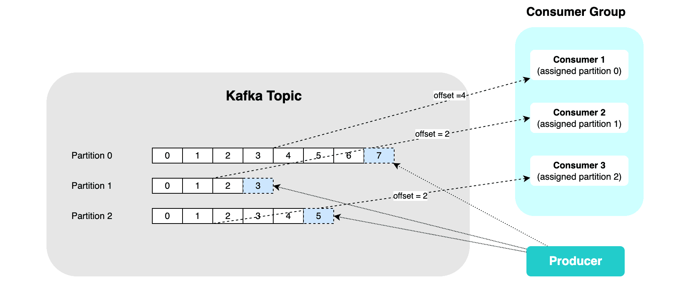
Offset Commits

Slide 26
Kafka | Core Concepts
Broker: A single, core servers in Kafka which manages the storage, distribution and retrieval of event messages.
Brokers may replicate partition data across the Kafka cluster to ensure fault tolerance.
Replication means multiple brokers hold copies of the same partition data, so Kafka can survive a broker going down without losing data.
Each partition in a topic has a leader broker that handles all reads/writes for that partition
Each partition has zero or more follower brokers which replicate the leader’s data.
Cluster: A group of brokers working together.
Clusters allow Kafka to scale horizontally.

Slide 27
Kafka | Core Concepts
Producer: An application or service that sends data to Kafka Topics.
Producers may write events directly or indirectly to a specific partition within a topic
Consumer: An application or service that subscribes to Kafka topics and processes the message data.
Consumers track their own offset.
This allows consumers to re-read old events by “rewinding” if needed.
Kafka retains events for a configurable period (or size), not just until they are read.
Allows multiple consumers to read the same event independently.

Slide 28
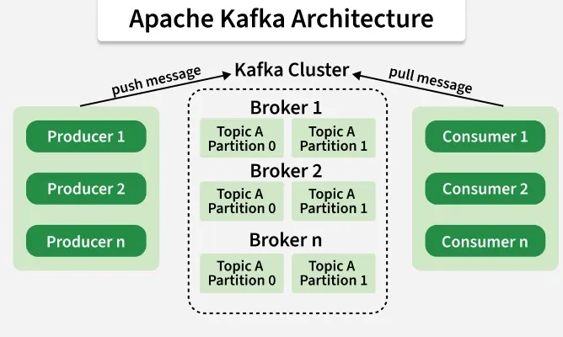
Kafka | Core Concepts

Slide 29
Kafka | Core Concepts
Consumer Groups: A group of consumers that jointly consume messages from one or more Kafka topics.
Allows consumers to share work reading partitions on a topic.
Each consumer within a group reads data from an exclusive partition (i.e. one consumer can read from one partition at a time).
Consumer groups enable Kafka to handle parallel processing
Different consumer groups are fully independent
The same event can be processed separately by multiple groups (i.e. one group for analytics, another for notifications, etc…)

Slide 30
Kafka CLI Fundamentals

Slide 31
Kafka CLI
Kafka ships with a set of command-line tools for interacting directly with a cluster
No backend application is required to use Kafka
The CLI can be useful for local development, debugging, quick verification
i.e. confirming a topic exists, checking if messages are being produced, inspecting consumer lag, etc…
Even with a project (such as Spring Kafka-based application), developers can use the CLI for sanity-testing
CLI tools are typically shell scripts (.sh files on Mac/Linux, .bat on Windows), bundled with Kafka installation (or within a docker container).

Slide 32
Kafka CLI Command Basics
kafka-topics.sh: create, list, describe, and delete topics
kafka-console-producer.sh: send messages to a topic directly from the terminal
kafka-console-consumer.sh: read messages from a topic directly in the terminal
kafka-consumer-groups.sh: inspect consumer groups, their members, and offset/lag information

Slide 33
Running CLI Commands against Docker
If running Kafka inside a Docker container, CLI commands need to be run inside a container, using docker exec.
Every CLI command requires a --bootstrap-server flag, pointing to a running broker
E.g. --bootstrap-server localhost:9092
Command structure is as follows:
kafka-<tool>.sh --<action> --bootstrap-server <address> [options]

Slide 34
Intro to Spring Kafka

Slide 35
Spring Kafka
Spring Kafka is a wrapper/abstraction layer over the plain Kafka Java client
Spring Kafka simplifies how your application code interacts with Kafka architecture (brokers, topics, partitions)
Removes a lot of manual boilerplate code (creating producers/consumers, managing connections, handling serialization)
Leverages Spring Boot auto-configuration
<dependency> <groupId>org.springframework.boot</groupId> <artifactId>spring-boot-starter-kafka</artifactId> </dependency>

Slide 36
Spring Kafka | Core Building Blocks
KafkaTemplate<K,V> – A class used as the primary tool for producing (sending) messages
Wraps the underlying Kafka producer client
@KafkaListener – annotation used to mark a method as a consumer for a given topic
Spring handles the underlying poll (reading) loop
ProducerFactory/ConsumerFactory: lower-level beans responsible for creating producer/consumer clients using configured properties
Spring Boot typically auto-configures the producer/consumer settings for you based on properties set in your application.yml / application.properties.

Slide 37
Spring Kafka | Configuration Basics
Connection and behavior settings live in your application.properties (or application.yml)
Nearly all settings are set under the ‘spring.kafka’ prefix
Common settings:
spring.kafka.bootstrap-servers: one or more host:port addresses used for the client’s initial connection to the cluster.
Once connected, the client learns about the rest of the brokers automatically
Can be a single address (localhost:9092), or a comma-separated list for multiple brokers (useful for resilience if the first one listed happens to be down when the app starts)

Slide 38
Spring Kafka | Configuration Basics - Producers
spring.kafka.producer.key-serializer / value-serializer
Tells Spring how to convert your Java objects into bytes before sending them to Kafka
e.g. StringSerializer for plain text, JacksonJsonSerializer for objects
Serializers must match the data type you’re actually sending

Slide 39
Spring Kafka | Configuration Basics - Consumers
spring.kafka.consumer.group-id
Assigns this consumer to a consumer group
Required for @KafkaListener to function
spring-kafka.consumer.auto-offset-reset
Determines where a consumer starts reading if it has no previously committed offset
earliest: start reading from the beginning of the topic if no committed offset exists
Latest (default): start reading only from new messages produced after the consumer connections. Ignore anything already in the topic.
none: Throw an exception if no committed offset is found, rather than picking a starting point automatically.
Spring.kafka.consumer.key-deserializer / value-deserializer
Reverse of a producer’s serializers.
Converts bytes back into usable Java objects
Must match how that data was originally serialized

Slide 40
Spring Kafka | Configuration Basics – Json vs String Serialization
For a simple project, I would recommend starting with just String serialization/deserialization.
JsonSerialization/Deserialization requires additional configuration including:
ConcurrentKafkaListenerContainerFactory: used to inform spring what type of deserialization method to use.
Note: You can have a project which contains Json & String serialization/deserialization of events as well
This also requires additional configuration.

