Slide 1
Collaboration with GIT

Slide 2
Git
Distributed Version control tool
A Distributed Version Control tool means that the entire codebase and history of a project is available to everyone who is part of the project in their own local repository.
This allows for…
safer collaboration between teams
More reliability (you don’t need to access to the remote repository at all times – but can sync changes when available)
Many different hosting tools for git-based repositories.
github, gitlab etc.
git is the underlying software that these platforms rely on, but it is not the platform itself

Slide 3
Understanding Git
Working Directory: The files you are actively working on. These are normal files on your filesystem.
Staging Area: A binary file called the Git index that git stores a hash of a file’s contents
Local Repository: A database that lives inside of the ‘.git’ folder in your file system. Git manages the file contents including directory structure, and commits here.
Remote Repository: Same as the Local Repo, but remotely stored. Git does not work “in” the remote repo – it is used to coordinate commit history variance among collaborators on a project.

Slide 4
Understanding Git
Developer 1
Remote Repo
Working Directory
Staging Area
Local Repo
git add
git commit
git push
git pull
git checkout
git merge
Developer 2
Working Directory
Staging Area
Local Repo
git add
git commit
git push
git pull
git checkout
git merge

Slide 5
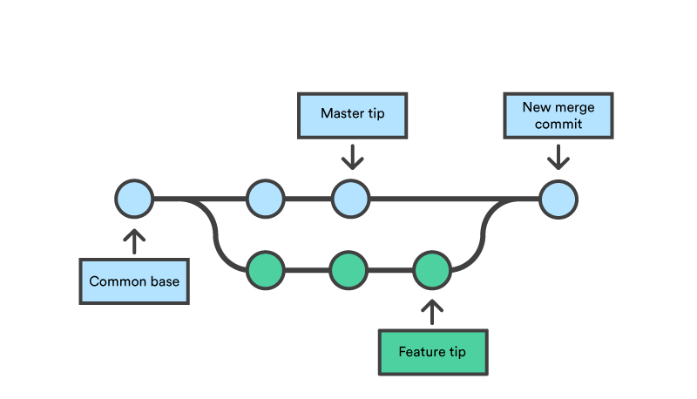
Branching

Slide 6
Git Workflow
Create Remote repository
Create/Edit file(s) in local repository
Stage file for commit
Commit (add a comment with your commit)
Push
Clone Local Repository

Slide 7
Example
$ git clone url
$ cd newdirectory
…code is written and saved in this folder…
$ git add .
$ git commit –m “description of work completed”
$ git pull origin main
$ git push origin main

Slide 8
.gitignore
The .gitignore file tells git which files and folders to ignore (those which should not be tracked).
This is useful for keeping log files, temporary files, build artifacts, or personal files out of a repository.
The .gitignore file itself is tracked by Git, so everyone using the repository ignores the same files.
Within the .gitignore file, you may specify folder names and/or file names, extension types, etc… which git should ignore.

Slide 9
Git CLI Commands
git clone – create a copy of a repository on github.com or gitlab.com onto your local machine.
git add – stage files (staging indicates which files you want to keep a record of or remove. i.e. it tracks your current work)
git commit – take a ‘snapshot’ of your staged files, and inform git to use these as a working standard moving forward. You interact with remove git repositories using these commits..
Note that commit must always be accompanied by a message. Using the ‘-m’ flag will allow you to write a message automatically.
git pull – a command used retrieve and merge the most recent commit from a branch on a linked, remote repository
git push – a command used to copy your local commit from a repository to a branch on a linked, remote repository.
git status – a utility command used to compare your local repository, the stages files, and your record of commits, as compared to the linked repository branch.

Slide 10
Create branch
$ git checkout –b “Branch1”
Create a new branch called Branch1.
Then switch to that branch.
Now when you add files and commit it will be to this new branch.
Shorthand for
git checkout “Branch1”
git branch “Branch1”

Slide 11
Merge branch
$ git checkout main
$ git merge Branch1
To merge Branch1 into main
Switch from any other branch to main.
Call git merge from main siting the other branch
Possibly resolve merge conflicts

Slide 12

Forking Repositories
Forking a repository creates your own copy of a project.
Created using the fork button on github
Clone this repo as you would any other to create a local copy.
If you want to pull in changes from the original repo
$ git pull url-of-original
If you made changes that you want the original to add in --- you create a pull request
You request that they pull in your changes to their repo.

Slide 13
Pull Requests
Pull Requests allow a developer to request changes from a branch be pulled into, or merged into another branch (e.g. ‘feature-branch’ merged into ‘production/main’).
Pull Requests are a fundamental part of collaborative development in Git.
Pull requests are a mechanism which allows developers to notify others about changes they’ve made to a branch in a git repository.
Pull requests also allow a team to establish review and approval workflows for work completed.

