Slide 1
React

Slide 2
Outline
Single Page Applications
Introduction to React
JSX & TSX
Component Basics
Component Lifecycle
TypeScript with React
Props & State
Intro to Hooks
Event Handling
Rendering
Lists & Keys

Slide 3

Single Page Applications

Slide 4
MPA vs SPA
In a “traditional” Multi-Page Application (MPA), Clicking a link or submitting a form sends a request to the server.
The server then responds with a whole new HTML page.
The browser reloads everything – even parts of the page that didn’t change (like the navigation bar or footer)
A Single Page Application (SPA) is a web app that loads a single HTML page and then updates content dynamically as the user interacts with it.
SPAs use client-side rendering, meaning the browser (not the server) is responsible for building and updating the HTML using JavaScript.
SPAs use client-side routing to simulate multiple “pages” or views, even though the browser never technically leaves the single HTML page.

Slide 5
Single-Page Applications
SPAs typically load once, then communicate with a server using API calls (often via fetch or another tool) to get the data they need.
Because only the necessary parts of the page update, SPAs generally feel faster and smoother once the initial page has loaded.
Common SPA frameworks/libraries include: React, Angular and Vue.
These tools help developers manage dynamic content without manually manipulating the DOM.

Slide 6
Introduction to React

Slide 7
React
React is a JavaScript library (not a full framework) developed by Meta.
React is used to build user interfaces, particularly interactive and dynamic web applications.
It can be used to build anything from small interactive widgets embedded in a page, to full-scale SPAs.
React is built around the idea of components – small, reusable and self-contained pieces of UI that you can combine to build a full application.
React uses a declarative style of programming.
Instead of writing step-by-step instructions for how to update the page (imperative style) you describe what the UI should look like for a given state and React figures out how to make that happen.

Slide 8
React DOM
React maintains a Virtual DOM – A lightweight, in-memory representation of the actual page.
When data changes React does the following:
Updates the Virtual DOM
Performs Reconciliation: compares the updated virtual DOM to the previous version
Updates only the parts of the real DOM that actually changed
This approach makes updates fast and efficient, single directly manipulating the real DOM is comparatively slow.

Slide 9
React DOM
React is often used alongside a broader ecosystem of tools and libraries including:
React Router
State Management tools such as the built-in Context API or external libraries like Redux
Build tools that handle project setup like Vite* or Create React App
TypeScript for adding type safety.
Note: Since React is a JavaScript library, we don’t need TypeScript to use it; however, TypeScript is commonly used for the additional type safety benefits and other typescript features and datatypes.

Slide 10
React Setup
Before writing any React code, you will need Node.js and npm installed – React projects rely on a JavaScript runtime and package ecosystem outside of the browser.
The recommended way to start a new React project is using a built tool – such as Vite.
Note: Older tutorials often reference Create React App (CRA), but it is deprecated and generally not considered the best starting point for new projects
The start a new project, you can run the command:
npm create vite@latest <your-app-name>
i.e. npm create vite@latest my-react-app

Slide 11
React Setup
When running the setup command, Vite will prompt you for two separate choices – its important to understand these:
Framework (React, Vue, Svelte, Vanilla, etc…): This determines which library your entire project is built around, including it’s file structure, syntax and dependencies (You should select React for this training)
Variant (JavaScript, TypeScript, JavaScript + React, etc…): This old affects the starter files and tooling within your react project.
Selecting JavaScript gives you .jsx file configurations, selecting TypeScript gives you .tsx file configurations
See this link for information about all variants: Choosing the Right React Variant with Vite - Coding Architect Dev

Slide 12
React Setup
Once installed, navigate your terminal to the newly created directory, then run your local development server using the following command:
npm run dev
Note: ‘npm run dev’ is used to run your app in a development environment, which provides faster reloading and development tools
npm start is used to run your app in a production environment
npm run test is used to run your app’s test suite
Press CTRL+C to stop your app running

Slide 13
React Setup
When your app has started, you can view changes almost instantly due to a feature known as Hot Module Replacement (HMR).
A freshly scaffolded react project has a predictable folder and file structure:
src/ – Where the actual application code lives
public/ – static assets that don’t need to be processed by the build tool (ex: images/icons)
package.json – lists your project’s dependencies and defines useful scripts (like dev, build)
index.html – The single HTML page your entire SPA is loaded into
node_modules/ - where all installed packages live (never edited directly and never manually shared/committed)

Slide 14
JSX & TSX

Slide 15
JSX & TSX
JSX stands for JavaScript XML
It is a syntax extension that lets you write HTML-like markup directly inside your JavaScript code
JSX is not valid JavaScript on its own.
Build tools like Vite use a compiler to transform JSX into regular JavaScript function calls behind the scenes before it reaches the browser.
TSX is simply JSX written inside a TypeScript file (.tsx extension instead of .jsx)
The markup for TSX is identical to JSX – TSX just means the file also supports TypeScript’s type annotations in addition to JSX markup.

Slide 16
JSX Syntax
Every JSX element must have exactly one root/parent element
If you need to return multiple sibling elements, wrap them in a <div> or a Fragment (<>…</>)
You can embed and valid JavaScript expression inside JSX using curly braces
JSX uses camelCase for most HTML attributes that have multiple words (e.g. OnClick instead of onclick, className vs class)
Note: className is used because class is a reserved word in JavaScript
Self-closing tags (like <img> and <br>) must include the closing slash in JSX (<img /> | <br />) unlike regular HTML.

Slide 17
Component Basics

Slide 18
Components
A component is a reusable, self-contained building block of a React UI
Typically, Components are written as a JavaScript function that returns JSX describing what should appear on the screen.
Component function names must start with a Capital letter (e.g. ‘Header’, not ‘header’).
Note: This is not just a style convention – React uses capitalization to distinguish your custom components from regular HTML elements in JSX.
function Header() { return (
<header>
<h1> My App Header </h1>
</header>
); }
export default Header;

Slide 19
Default Exports & Imports
JavaScript modules let your split code across multiple files and share functionality using the keywords export (make something available) and import (bring something into another file)
You can export the following:
Functions
Variables (typically declared with ‘const’)
Classes
Objects
Expressions (can only be exported as a default export – quite uncommon)
There are two ways to export an entity:
A named export
A default export

Slide 20
Named Exports
A named export uses the export keyword in front of a declaration
e.g., export function myFunc() {}
Named exports can be used to export multiple entities from a file.
You can consolidate named exports using the following syntax:
export { customFunc1, customClass1, etc… }
When consolidating named exports, you can also use the ‘as’ keyword to give the export a new alias to reference in imports.
export { customFunctionName as Alias }

Slide 21
Named Imports
When importing a named export, you must use the exact same name of the entity, wrapped in curly braces:
import { myFunc } from ‘./FilePath’;
If the named export was given an alias (using the ‘as’ keyword), you must reference the alias name instead:
export { myFunc as alias };
import { alias } from ‘./FilePath’;
You can also use an alias in the import statement for named exports.
import { namedExport as NE } from ‘path’

Slide 22
Default Exports
A default export uses the keywords export default to mark a single entity in your file.
Each file can only have a single default export
Syntax: export default <Entity-Name>
You can have a default export and multiple named exports in a file.
export const CARD_MAX_WIDTH = 400;
// This Component expects a string value for title when used in another file
function Card( {title} ) { return <div style={{ maxWidth: CARD_MAX_WIDTH }}>{title}</div> }
export default Card;
When importing a default export, you can name the import whatever you want (though, by convention typically we use the same exported name to avoid confusion)

Slide 23
Components
A component can be as small as a single button, or as large as an entire page.
The goal of components are to break your UI into logical, manageable and reusable pieces
Components can be placed inside other components (nesting components) to create larger UIs
Note: nesting components is the basis of SPA and Component based development in React

Slide 24
Components
Every component should ideally do one thing well – this makes components easier to:
Test
Reuse
Maintain within your project (allows you to organize code into logical units).
By convention, each component should live in their own file, named the same as the default export for that component
e.g. ‘Header.jsx’ contains a ‘Header’ function with a ‘default export Header’ statement at the bottom of the file.

Slide 25
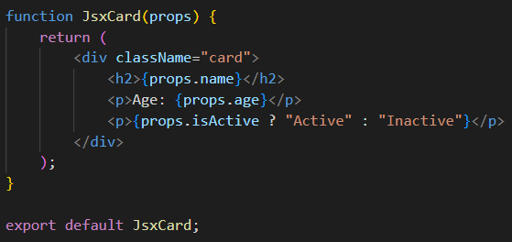
Component Props
Properties (Props) are how you pass data into a component from it’s parent.
Similar to passing arguments into a function
With JSX (JavaScript) there is no type-safety for your added props.

Slide 26
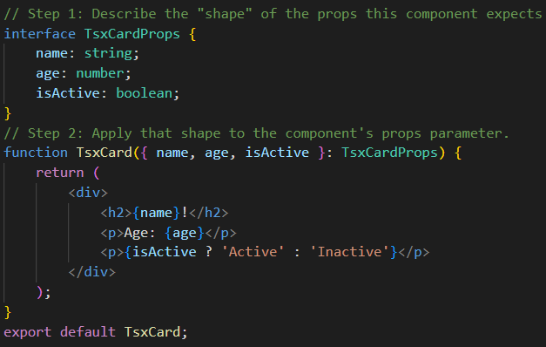
Component Props
When using TypeScript (tsx files), components are created in two phases:
Create an interface to determine the expected types for the component’s props.
Declare that interface as the prop datatype:

Slide 27
Class Components
Class components were the original way developed created components that required state or lifecycle behavior.
This was before hooks were introduced in 2019.
Class components are considered a legacy version of component creation – function-based components are the standard approach
A class component is written using JavaScript’s class syntax by extending React’s built-in React.Component class.
Instead of a return statement directly in the function body, class components define a render() method which returns the JSX to display.
State in a class component is stored as a single object (this.state)
State is updated using a built-in method called this.setState(), rather than the setState hook

Slide 28
Component Lifecycle

Slide 29
Component Lifecycle
Every React component goes through a predictable lifecycle
The component is created and displayed for the first time
It may update multiple times
Eventually it is removed from the screen
Understanding these stages matters, because certain tasks only make sense at a specific point in this lifecycle
Ex: Fetching data once when a component first appears | cleaning up a timer right before a component disappears.

Slide 30
Component Lifecycle | Stages
Mounting:
First Stage
Occurs when a component is created and inserted into the page for the very first time
Updating:
Intermediate Stage
Component re-renders, running its function again to reflect new data.
Triggered by changes to its state or props it receives from its parent.
Unmounting:
Final Stage
Happens when a component is removed from the page entirely
E.g. when a user navigates away, or a conditional render stops displaying it.

Slide 31
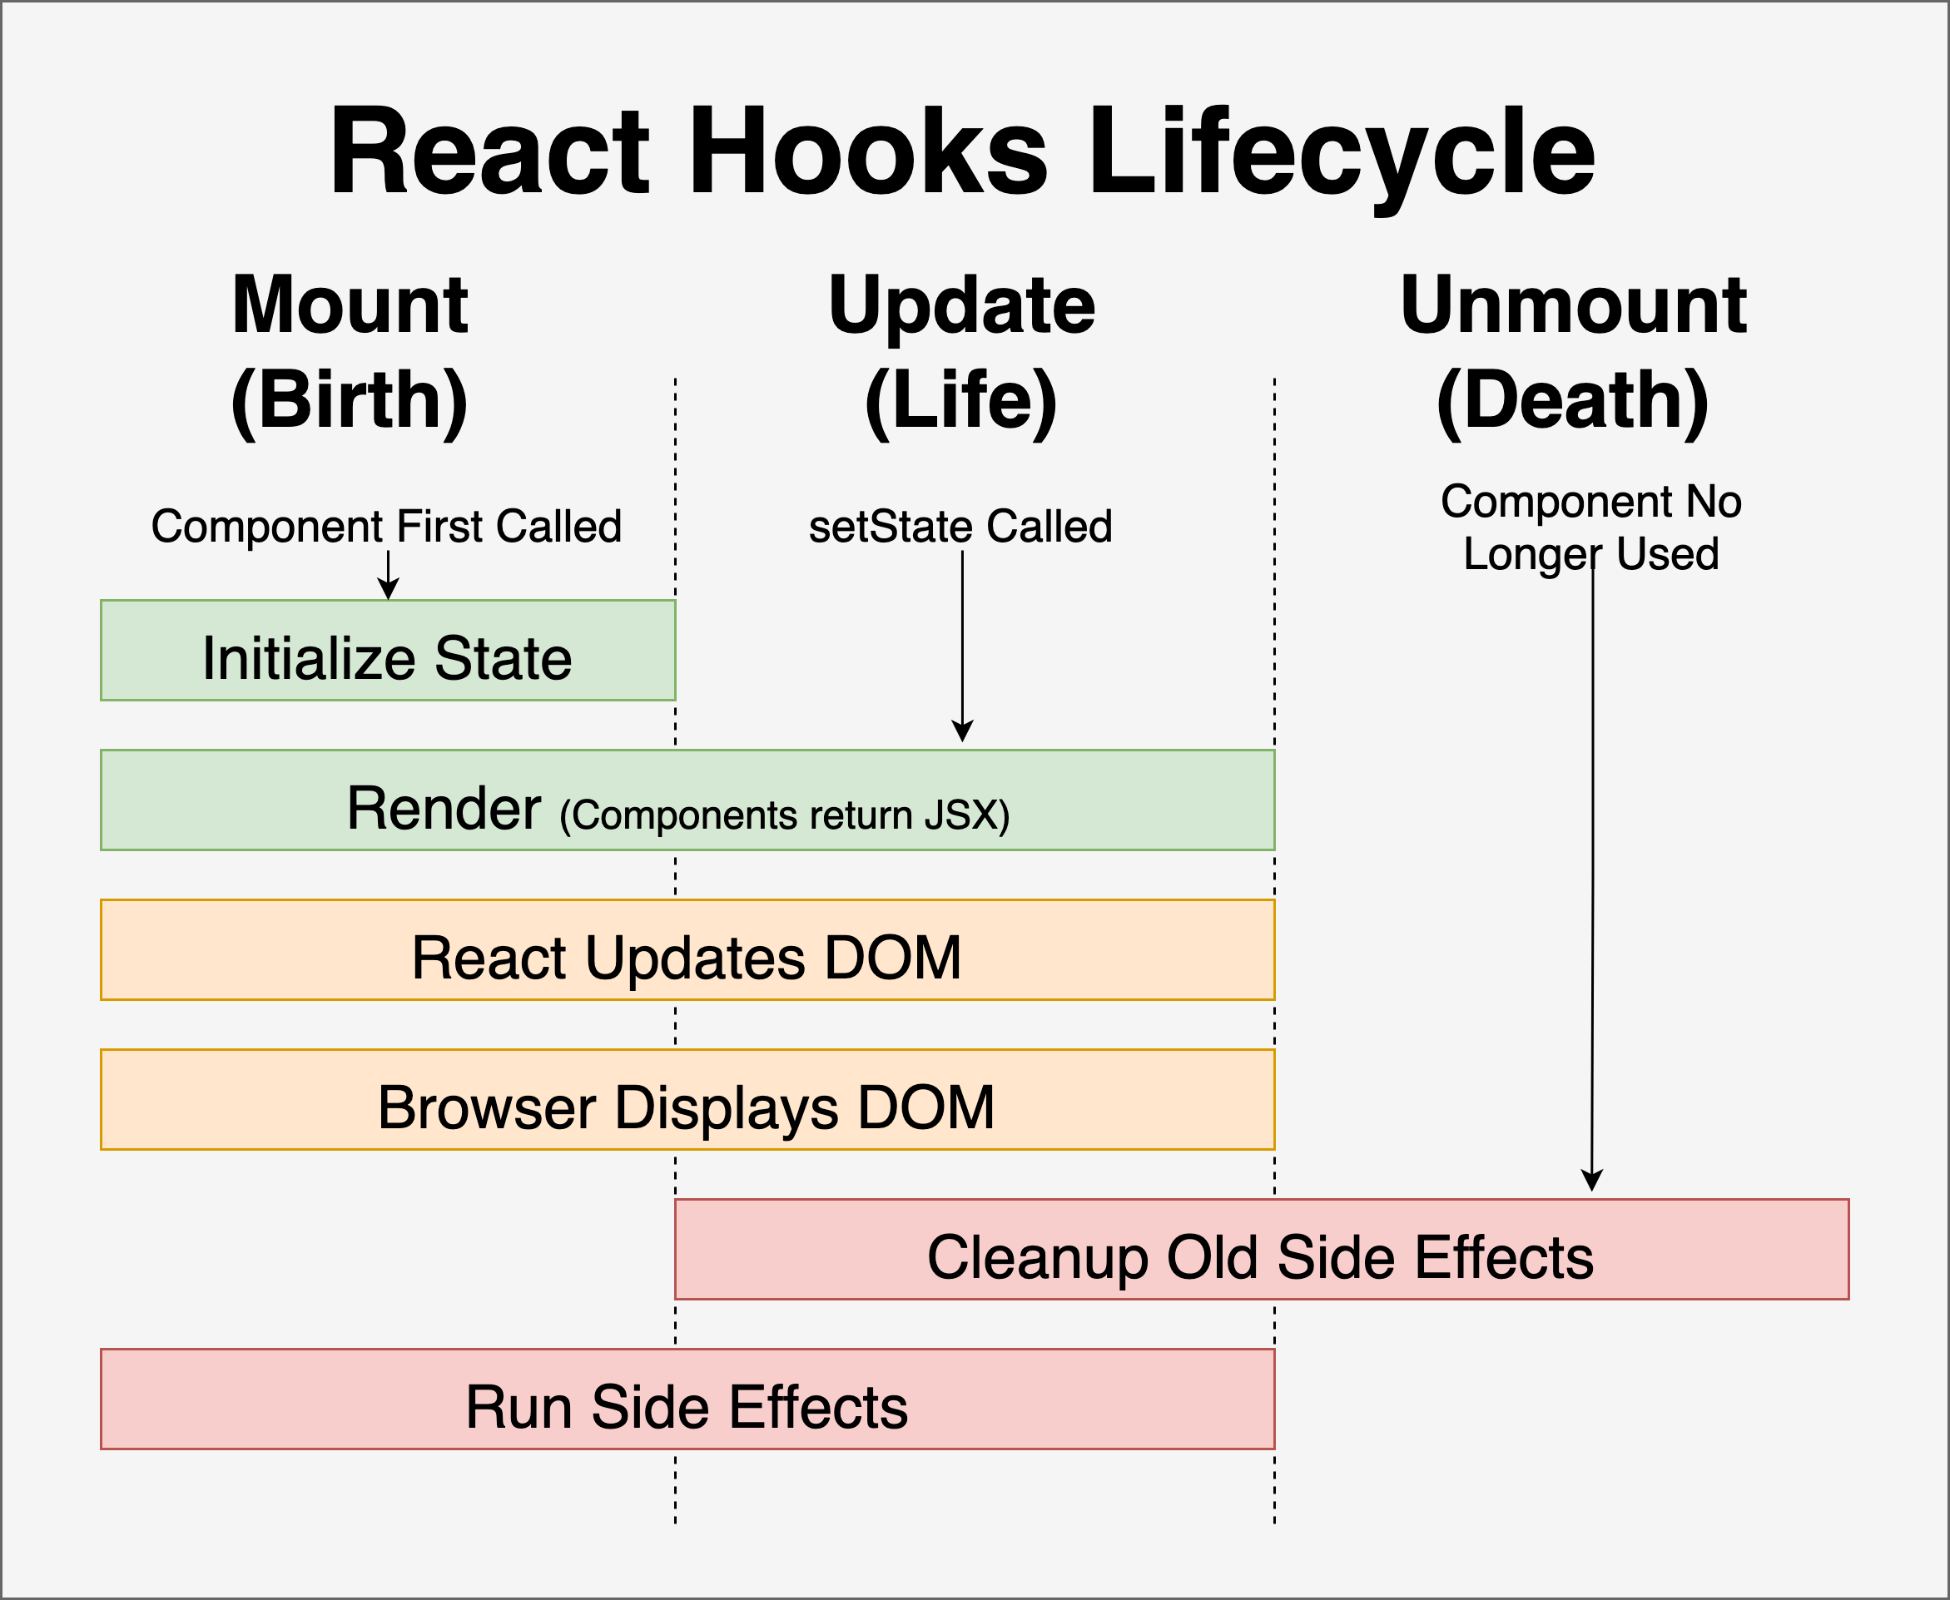
Component Lifecycle | Hooks

Slide 32
Component Lifecycle | Class Components
Older React Code (using class components) handled these stages using specifically named methods, such as:
componentDidMount
componentDidUpdate
componentWillUnmount
In modern function components, lifecycle behavior is handled using Hooks, specifically useEffect.

Slide 33
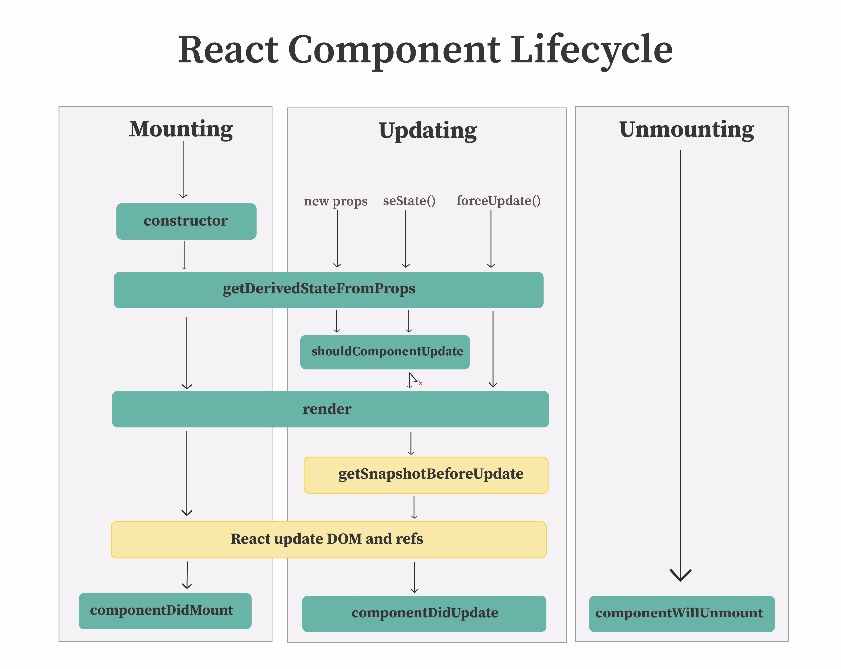
Component Lifecycle | Class Components

Slide 34
TypeScript with React

Slide 35
TypeScript & React
Recall that TypeScript code is checked at compile time – meaning many bugs get caught by your editor and build tools before your code ever runs.
E.g. Passing the wrong type of data to a component
When using TypeScript with React, files use the .tsx extension instead of .jsx
The most common use of TypeScript in React is typing a component’s props
This allows you, and your editor to know exactly what data a component expects to receive
This also catches mistakes like missing or mistypes props immediately.

Slide 36
TypeScript & React
TypeScript helps with typing state (using the useState hook)
TypeScript also helps with event handlers, ensuring data flowing through your component behaves as expected.
You can use TypeScript interfaces or Type Aliases to describe the “shape” of an object
Interfaces is the more common convention, but either work.

Slide 37
Interface vs Type Alias Structure
Why use Interfaces or Type Alias for component structure?
Interfaces:
Support extends
Interfaces with the same name in the same scope are automatically merged together (declaration merging).
Type Aliases:
Support Union/Literal Types
What about classes?
Interfaces and Type Aliases are used to define types for Props (data passed to components).
Classes are more concrete datatypes that would be used to represent data (i.e. class components – but remember that is the only way to create components!)

Slide 38
Props & State

Slide 39
Properties
As discussed previously, Props are how data is passed into a component
Props are read-only from the receiving component’s perspective.
A component should never attempt to modify it’s own props directly.
Data flows through props in one direction only from parent to child.
This is referred to as “one-way” or “unidirectional” data flow.
One-way data flow makes applications easier to reason about, since you always know the direction with which data originates.

Slide 40
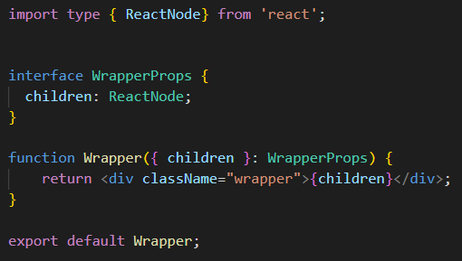
Children Properties
When passing rendered data (other components), React provides built-in types to help manage the flow of data.
props.children is a special, built-in prop representing whatever content is placed between a component’s opening and closing tags.
This is what allows components to act as flexible “wrappers”, without knowing their content in advance

Slide 41
Children Properties | ReactNode
ReactNode is a built-in type in React which can be used to describe any valid type that can be rendered as a child to an element.
This includes:
Text
Other HTML elements
Numbers
Arrays
Etc…
ReactNode is typically used in combination with children references to enable a component to wrap other elements
This is one tool that truly enables components to act as reusable pieces of UI

Slide 42
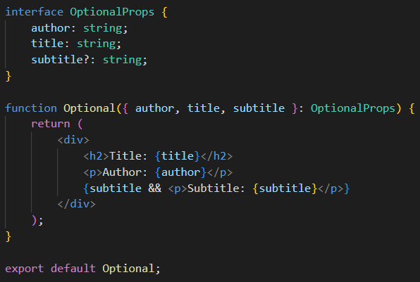
Optional Properties
A prop can be marked optional using a ‘?’ after its name in the interface
E.g. subtitle?: string;
This denotes that the component can be used with or without that prop being provided.
Note: all props are required by default, so TypeScript components will throw an error at compile time if any non-optional prop is not supplied with a value.

Slide 43
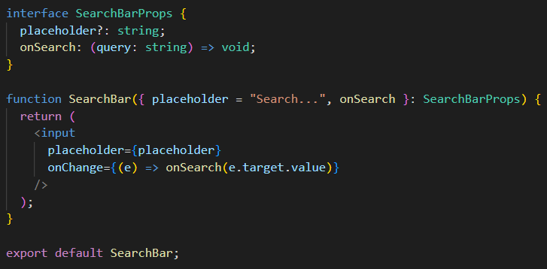
Function-Type Properties
Function-type props (like event handlers or callbacks) can also be typed
This describes what arguments the function accepts and what it returns
Default values for these props can be provided directly using the pattern: { prop=“value” }

Slide 44
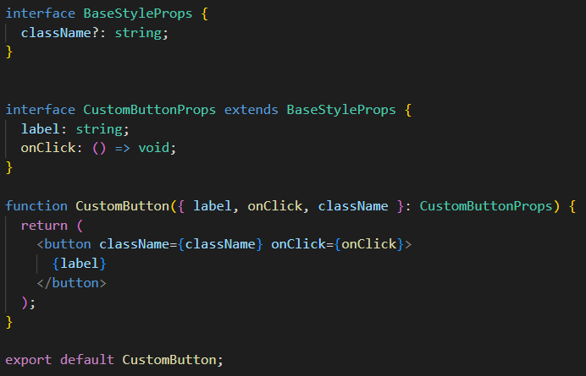
Re-using Props
You can reuse props defined in another interface using the ‘extends’ keyword:

Slide 45
State
While props are data passed into a component from it’s parent; state is data a component manages internally
State can change over time (typically in response to user interaction).
Unlike Props, which are read-only, state is specifically designed to be updated by the component that owns it.
To create and manage state inside a function component, React provides the useState Hook

Slide 46
State
useState returns an array with exactly two values: the current state value, and a function used to update it.
This is almost always using the array syntax:
const [value, setValue] = useState(initialValue);
Calling the state-updating function (e.g. setValue) does two things:
Updates the stored value
Tells React to re-render the component so that UI reflects the new value.

Slide 47
State
You should never modify state directly (e.g. value = newValue).
i.e. Consider all states on a component as ‘directly immutable’ – we can change the value, but we should only do so using a prescribed function (i.e. useState hook)
Always use an updated function returned by useState.
Directly modifying state will not trigger a re-render and can lead to bugs that are hard to track down.
A component can have multiple, independent pieces of state, simply calling useState more than once.
With TypeScript, useState can be given an explicit type ( e.g. useState<number>(0) )
Props and state are frequently used together - a parent component can hold state and pass both the value and an updater function down to a child as props as needed.
The child can trigger changes without ever owning or directly modifying the state itself.

Slide 48
Lifting State
When two or more sibling components (components with the same parent), require access to the same piece of state data, it is common to follow a pattern called “lifting up state”.
“Lifting” state, refers to the idea that a parent component should be responsible for managing state, and children should only read data.
If a child needs to update that state, the parent passes a modifier/updater function as a prop as well.

Slide 49
Intro to Hooks

Slide 50
Introduction to Hooks
A Hook is a special function in React that lets function components “hook into” React features
Such as state or lifecycle behavior
Hooks always start with the word “use”
E.g. useState, useEffect
This naming conventions isn’t just a style choice, it’s how React (and any linting tools) can identify and enforce the rules Hooks must follow.
All hooks have different structure when used, for instance, the useState hook is used with a stateful field and a function that is used to update it:
const [myField, setMyField] = useState(“initial value”);
React provides several built-in Hooks, and you can even write your own custom Hooks to reuse stateful logic across components.

Slide 51
Rules of Hooks
There are two rules that must be followed when using Hooks
Note: these are not rules to normal JavaScript functions, these are rules for using Hooks
Rule #1: Only call Hooks at the top level
Never call a hook inside a loop, a conditional (if statement), or a nested function.
Hooks must always run in the exact same order on every single render.
Rule #2: Only call Hooks from React function components (or custom Hooks).
Don’t call Hooks from regular JavaScript functions, classes, or outside of a component entirely.
These rules exist because React tracks each Hook by the order it’s called in, not by name.
If you break this consistent order, it can cause React to mix up which state belongs to which useState call, leading to confusing bugs.

Slide 52
Hooks Reference
Hook | Description | Awareness
useState | Lets a component create and manage its own internal state | Know & Use
useEffect | Runs side effects (data fetching, subscriptions, manual DOM work) tied to a component’s lifecycle | Know & Use
useRef | Creates a persistent reference to a DOM element or value that doesn’t trigger a re-render when it changes. Used for uncontrolled components and direct DOM access | Know & Use
useContext | Lets a component read a value from React Context without needing that valued passed down manually through every level of props | Know
useReducer | An alternative to useState for managing more complex state logic | Know
useMemo | “memoizes” (caches) the result of an expensive calculation so it isn’t recalculated on every render unless it’s dependencies change | Know
useCallback | Similar to useMemo, but memoizes a function rather than a calculated value | Know
useLayoutEffect | Siimlar to useEffect, but runs synchronously right after the DOM updates – rarely used | Know
Note: You can create your own hook as well

Slide 53
Event Handling

Slide 54
Event Handling
React lets you respond to user interactions (clicks, typing, form submissions, etc…) using event handlers
Event Handlers: Functions that run in response to a specific event.
Event handler props in JSX follow a camelCase naming conventions, prefixed with “on”
E.g. onClick, onChange, onSubmit
React handlers are passed as JavaScript functions, typically wrapped in curly braces:
E.g. onClick={handleClick}
Note: contrast this to plain HTML in which event handlers are often written as strings:
onclick=“handleClick()”

Slide 55
Common Mistake
A common mistake is calling the function, rather than passing a reference:
onClick={handleClick} // Correct
onClick={handleClick()} // Incorrect
If you call the function, this will immediately call it during browser rendering, which often leads to bugs.

Slide 56
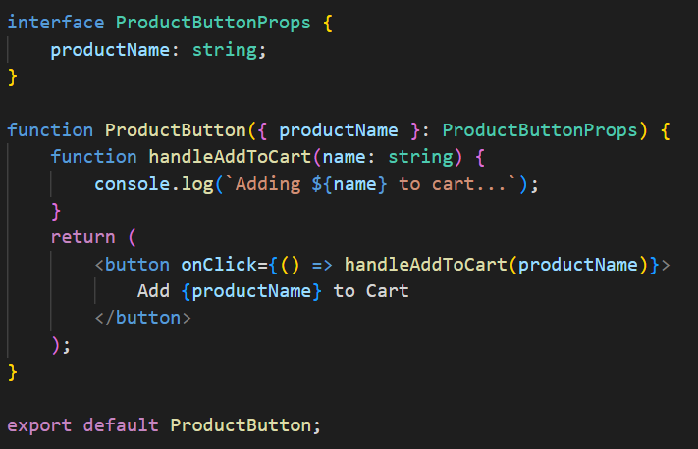
Passing Arguments to Events
You can pass arguments to an event handler by wrapping the call in an arrow function:
onClick={() => handleClick(someValue)}

Slide 57
Event Object
React wraps native browser events in it’s own SyntheticEvent system – which allows you to access events via this syntax:
React.EventType<HTMLElementType>
This SyntheticEvent Object is passed automatically to your handlers.
This allows you to reference the events directly in your handler logic

Slide 58
React Event Handlers
EventHandler | Fires On | Typical Use Case | Common Element(s)
onClick | A click (mouse or touchpad) | Button Presses, toggles, navigation triggers | <button> Most elements
onChange | A form element’s value changes | Controlled component updates | <input>, <textarea> <select>
onSubmit | A form is submitted | Handling form submission (typically paired with event.preventDefault() | <form>
onFocus / onBlur | An element gains focus or loses focus | Highlighting a field, showing helper text. Validating a field once the user leaves | Focusable elements
onKeyDown / onKeyUp | A key is pressed / released | Detecting specific key presses (enter, escape, keyboard shortcuts) | Focusable elements
OnMouseEnter / OnMouseLeave | The mouse pointer enters an element | Showing / Hiding a tooltip or hover effect – neither events bubble | Any element
OnMouseOver | The mouse pointer leaves an element | Similar to onMouseEnter, but event bubble through nested elements | Any element
OnDoubleClick | An element is double-clicked | Triggering a secondary/advanced action | Any element
onScroll | An element (or the page) is scrolled | Infinite scrolling, sticky headers, scroll-based animations | Scrollable containers
onLoad | An element finishes loading | Hiding a loading spinner once content is ready | <img>, <script>
onCopy / onPaste | Text is copied / pasted | Custom clipboard handling | Text-containing or input elements

Slide 59
Rendering

Slide 60
Rendering
Rendering is the process React uses to figure out what your UI should look like
This process determines what to display or update on screen
A component re-renders (runs its function again to figure out the new UI) when:
It’s state changes
It’s props receives changes
It’s parent component re-renders
Not every re-render results in visible DOM updates.
Recall: React compares the new virtual DOM to the previous one (reconciliation) – and only updates the real parts of the DOM that changed

Slide 61
Rendering | useEffect
As a component goes through it’s lifecycle, the useEffect hook allow you to run code in response to those specific points.
This is most commonly done for side effects:
Fetching data
Setting up subscriptions
Manually interacting with the DOM
useEffect accepts a function to run, and an optional dependency array (this controls when that function re-runs:
On every render, only once (on mount) or only when specific values change.

Slide 62
Conditional Rendering
Conditional rendering means displaying different content based on some condition
Similar to if statements, but expressed through JS expressions
Common Conditional rendering patterns include:
Ternary operations (condition ? <A /> : <B />)
Logical AND operator (condition && <A />)
Simply returning null to render nothing

Slide 63
Lists & Keys

Slide 64
Lists & Keys
Rendering a list in React typically means transforming an array of data into an array of JSX elements.
This is most commonly achieved using JavaScript’s built-in .map() method.
Every element in a rendered list needs a special prop called key
key is a unique identifier that helps React track each item individually across re-renders.
Keys should be unique among siblings in that specific list
Note: the key doesn’t need to be globally unique across the entire app.
Ideally, the key should come from the data itself (like a database ID) – not arbitrarily made up.

Slide 65
Lists & Keys
Using an item’s array index is a common shortcut, but is typically considered an anti-pattern
This can cause subtle bugs if the list is reordered, filtered, or has items inserted/removed from the middle.
Keys are not passed down to your component as a regular prop – react only uses them internally for tracking
i.e. you don’t have access to: props.key in the component

Slide 66
Keys | Considerations
Without keys (or with poorly chosen keys), React can lose track of which rendered element corresponds to which piece of data.
This can cause:
Incorrect UI updates
Form input values appearing on the wrong list item
Component state updating incorrect items.
If you do need access to the key inside the component you need to pass it again as a separate, explicitly named prop.

