Slide 1
Introduction to Spring
Inversion of Control & Dependency Injection

Slide 2
Topics
Intro to Spring
Inversion of Control
Beans & Bean Factory
ApplicationContext & Bean Configuration
Dependency Injection

Slide 3

Introduction to Spring

Slide 4
What is Spring?
Powerful and popular framework used to simplify development of enterprise applications.
Three core building blocks of Enterprise-Level Spring Applications:
Web Layer : Handles user requests & responses
Service Layer : Encapsulates business logic & connections web and data access layers
Data Access Layer : interacts with database and/or external data sources. Retrieves and Persists data.
Spring was created by Rod Johnson in 2003 as a response to the complexity of Java EE.

Slide 5
The Spring Framework
The Spring Framework is a comprehensive infrastructure of tools built to support the development of Java Applications
Enables development of loosely coupled, easily testable and scalable applications.
Provides capabilities such as Dependency Injection, Aspect Oriented Programing and more
Configuration can be a bit verbose and often requires a lot of XML configuration (although annotation-based configuration is also available).
Useful when you have specific needs that require detailed setup and customization

Slide 6
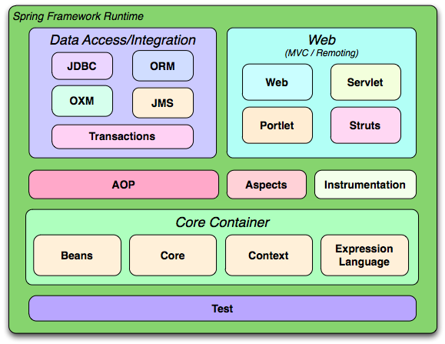
Spring Architecture

Slide 7
Key Features of Spring
Inversion of Control (IoC) – Spring manages object creation & lifecycle
Dependency Injection (DI) – components receive their dependencies automatically
Aspect-Oriented Programming (AOP) – separates cross-cutting concerns
e.g. logging, security
Modular architecture – use only what you need (core, MVC, Data, Security, etc…)
Excellent Integration – works seamlessly with Hibernate, JPS, REST, Kafka and more

Slide 8
Why Spring?
Reduces boilerplate code dramatically
Promotes loose coupling and testability
Large, active community
Wide, module & varied ecosystem (spring boot, spring cloud, etc…)
Industry Standard – widely expected knowledge for Java developers

Slide 9
Inversion of Control

Slide 10
Inversion of Control (IoC)
Design principle which shifts the control of object creation and management from the application to a container or framework.
i.e. IoC is about outsourcing the creation and management of objects to a container instead of manually creating the objects and managing them.
Spring IoC container creates and manages objects for each layer of the application
The two main IoC Container implementations of Spring are:
BeanFactory: Basic container
ApplicationContext: More feature-rich container built atop BeanFactory.
IoC automatically injects dependencies into appropriate components, which enables decoupling between layers
Decoupling improves maintainability, scalability and testing
With Spring IoC, developers can focus on writing layer-specific logic without worrying about cross-layer dependency management.

Slide 11
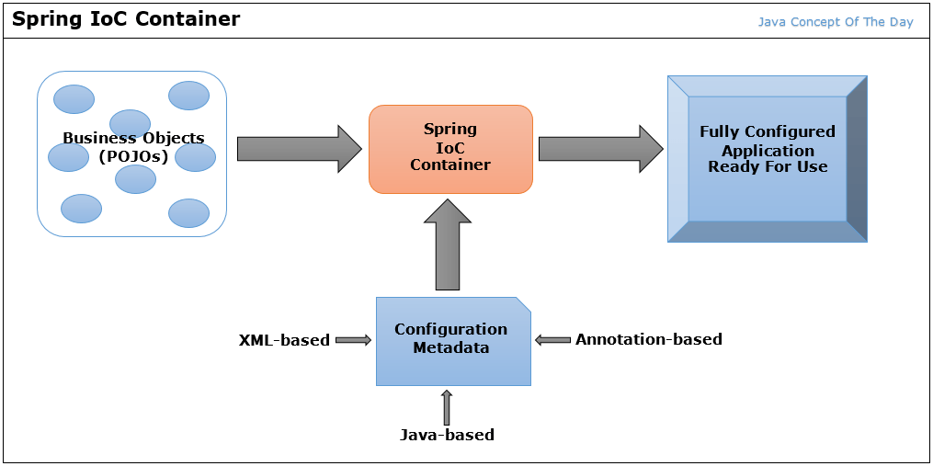
Inversion of Control (IoC)

Slide 12
Beans & Bean Factory

Slide 13
BeanFactory
The BeanFactory is an interface which serves as the foundation for the IoC Container.
Responsible for managing and providing instances of beans
Beans are objects which are instantiated, configured and managed by the IoC container.
Beans are the core build block of Spring applications, containing business logic, configurations, connections, etc…
The BeanFactory is the central registry for bean definitions. It will create and initialize beans based on provided definitions
The BeanFactory performs lazy initialization of beans by default.

Slide 14
Spring Bean
In Spring a Bean is simply a Java object whose lifecycle is managed by the Spring IoC container.
Beans are configured, wired together, and destroyed by Spring, rather than by the developer
In other words: as a developer, you define the definition of the bean (basically the object class), and Spring will manage the creation of the actual bean objects.
Bean – any object instantiated and managed by the Spring Container

Slide 15
Bean Lifecycle
Every bean goes through a bean lifecycle – a predictable sequence of stages managed by the IoC Container.
Several of these stages have callback methods which the container executes.
You can provide custom functionality for some of these methods if you want greater control over resource management of your application.

Slide 16
Bean Lifecycle
Instantiation: The container calls the bean’s constructor
Populate Properties: Dependencies are injected via setters/fields
Aware interfaces are called (if implemented): gives the bean access to container-level info about itself
This includes these interfaces:
BeanNameAware (gives a bean access to its own registered name)
ApplicationContextAware (gives a bean a reference to the IoC Container)
BeanPostProcesser (before initialization): registered post-processors can modify the bean before init callback run
Initialization Callbacks are run if present (in this order):
@PostConstruct (recommended approach)
afterPropertierSet() (via InitializingBean interface)
Custom init-methods (configured via @Bean(initMethod = “…”))
BeanPostProcessor (after initialization): registered post-processors get a second pass.
This is how Spring build proxies for things like AoP and @Transactional
Bean is ready for use
Destruction callbacks are run if present (note, this applies to singleton-scoped beans only):
@PreDestroy
destroy() (via DisposableBean interface)
Custom destroy-methods (configured via @Bean(destroyMethod = “…”))

Slide 17
Spring Bean Scope
When you create a bean definition, you can control the “scope” of the objects created.
Scope | Description
singleton | (Default) Scopes a single bean to a single object instance. Best for stateless beans.
prototype | Scopes a single bean definition to any number of object instances. Best for stateful beans.
request* | Scopes a single bean definition to the lifecycle of a single HTTP request. I.e. each HTTP request has its own instance of a bean created off the back of a single bean definition.
session* | Scopes a single bean definition to the lifecycle of an HTTP Session.
You can define the scope of a bean using the ‘@Scope’ annotation or adding the ‘scope’ attribute in an XML configuration
*Only valid in the context of a web-aware Spring ApplicationContext

Slide 18
ApplicationContext & Bean Configuration

Slide 19
ApplicationContext
The ApplicationContext is an interface which extends the BeanFactory in spring to provide a broader range of functionalities to support an application.
Supports advanced dependency injection, automatically wiring and resolving dependencies between objects.
The ApplicationContext allows for flexible application configuration using:
XML File Configuration
Spring Annotation Configuration
Java-code Configurations
The ApplicationContext performs eager initialization of beans by default (all beans are configured upfront).

Slide 20
XML File Configuration
<!-- applicationContext.xml -->
<beans xmlns=“http://www.springframework.org/schema/beans”
<!-- other bean xmlns config -->
<bean id=“beanName” class=“package.name.ClassName”>
<!-- additional Config goes here -->
</bean>
</beans>
// Within a Java Class
public static void main(String[] args) {
ApplicationContext ctx = new ClassPathXmlApplicationContext(“applicationContext.xml”);
ClassName bean = ctx.getBean(“beanName”, ClassName.class);
}
Beans definitions live outside of Java code
“id” attribute in xml config file names the bean
“class” attribute specifies full-qualified class name for bean class
<property> or <constructor-arg> tags can be used to inject dependencies
XML config can be verbose and hard to maintain for larger projects

Slide 21
Spring Annotation Configuration
@Service
public class MyService {
public String functionality() { return “This is the Service Bean”; }
}
@Configuration
@ComponentScan(basePackages =“com.example”)
public class AppConfig {}
public class App {
public static void main(String[] args) {
ApplicationContext ctx = new AnnotationConfigApplicationContext(AppConfig.class);
MyService service = ctx.getBean(MyService.class);
}
}
Beans definitions are created using @Component annotations, and various Component stereotypes:
@Component (basic bean)
@Service (business logic)
@Repository (data access)
@Controller (web)
The @autowired annotation tells spring to inject dependencies
The @ComponentScan annotation informs spring where to locate the defined beans. Note, @ComponentScan will scan the current package and subpackages if not specified.
Much less code than XML since annotations live alongside the class they describe

Slide 22
Java Code Configuration
@Configuration
public class AppConfig {
@Bean
public MyRepository myRepository() {
return new MyRepository();
}
@Bean
public MyService myService(MyRepository myRepository) {
// Dependency passed manually via method call
return new MyService(myRepository);
}
}
// Within another Java Class
public static void main(String[] args) {
ApplicationContext ctx = new AnnotationConfigApplicationContext(AppConfig.class);
MyService service = ctx.getBean(MyService.class);
}
Java-code config is similar to annotation config; however, beans are not explicitly defined in Java Code
The @Bean annotation on a method registers the return value as a Spring bean
Fully type-safe: compile-time errors instead of runtime XML parse errors
Preferred in Spring Boot and modern Spring projects
Dependencies can by passed via method calls within the @Bean annotated method

Slide 23
Component Scanning
Component scanning is the process by which ApplicationContext automatically detects classes annotated with stereotype annotations (like @component)
With Component scanning, ApplicationContext locates beans and registers them.
ApplicationContext must be told where to look
@ComponentScan(basePackages = “…”)
Note: component scanning is performed automatically in Spring Boot applications via @SpringBootApplication

Slide 24
Dependency Injection

Slide 25
Dependency Injection (DI)
The technique wherein an Object’s dependencies are “injected” into it by an external source (IoC Container), rather than the object itself creating them.
DI promotes loose coupling and improves maintainability and scalability of your code
In Spring DI is achieved using:
Constructor Injection: Dependencies are injected through the constructor of the class
Requires: Parameterized constructor
Setter Injection: Dependencies are injected through setter methods of the class
Requires: No-arg constructor & field setter method
Field Injection: Dependencies are injected directly into the fields of the class.
Requires: No-arg constructor & no setter method
Spring’s IoC Container injects dependencies based on the configured beans

Slide 26
Constructor Injection
@Component
public class OrderService {
private final PaymentService paymentService;
// @Autowired annotation informs Spring to perform injection of the paymentService
@Autowired
public OrderService (PaymentService paymentService) {
this.paymentService = paymentService;
}
public void placeOrder() {
paymentService.charge();
}
}
Key Points
Dependencies should be declared as final (guarantee immutability for injection point)
Easiest to unit test – just pass mock objects to constructor)
Considered to be the default approach, and recommended by Spring team, and most guides

Slide 27
Setter Injection
@Component
public class NotificationService {
private EmailSender emailSender;
// Spring calls this setter and injects the dependency
@Autowired
public void setEmailSender(EmailSender emailSender) {
this.emailSender = emailSender;
}
public void notify(String message) {
emailSender.send(message);
}
}
Key Points
Dependencies can be changed or re-injected after construction
Good for optional dependencies that have a sensible default
Object can exist in partially initialized state (requires careful handling)
Less preferred than construction injection for mandatory dependencies

Slide 28
Field Injection
@Component
public class ReportService {
// Spring injects this field directly via reflection
@Autowired
private DataSource dataSource;
public void generateReport() {
dataSource.generate();
}
}
Key Points
Most concise (no constructor/setter boilerplate code required)
Cannot by used with final fields (fields must be mutable)
Hard to unit test without a Spring context (requires reflection to inject mocks)
Typically you should avoid this in production code

