Slide 1
Spring Boot

Slide 2
Topics
Spring Boot
Spring Modules
Spring DevTools
Lombok

Slide 3

Spring Boot

Slide 4
Spring Boot | Setup
Spring initializer: A web app used to generate the starting structure of a Spring project.
https://start.spring.io/
Note: Many modern Java-based IDEs have built-in tools which leverage this tool
Spring Boot project Configurations are centralized within:
pom.xml (maven)
application.properties (or application.yaml)

Slide 5
Spring Boot
Spring Boot is a project built on top of the Spring Framework
Simplifies project structure, setup & configuration
Key Features
Auto-Configuration: automatically configures common beans based on what’s present on the application’s classpath
Starter Dependencies: bundled dependency sets that pull in everything commonly needed for a given task
E.g. ‘building a web app’
Embedded Servers: Spring boot apps can run as a standalone Java app with a server built-in
Opinionated Defaults: Spring boot makes sensible default choices out of the box, but allows them to be overridden if needed.
Spring Boot is described as “convention over configuration”
Reduces Setup time significantly and minimizes boilerplate code

Slide 6
Spring Boot | Auto-Config
Auto-Configuration in Sprint Boot is the mechanism that automatically configures common beans based on what is present on the classpath.
Auto-Config is enabled through use of the ‘@EnableAutoConfiguration’ annotation.
Note: typically you don’t call this annotation directly, it is wrapped in other annotations:
@SpringBootApplication is a single, convenience annotation that combines three separate annotations into one:
@EnableAutoConfiguration: Enables auto-config behavior
@ComponentScan: enables component scanning
@Configuration: marks the class itself as a source of bean definitions.

Slide 7
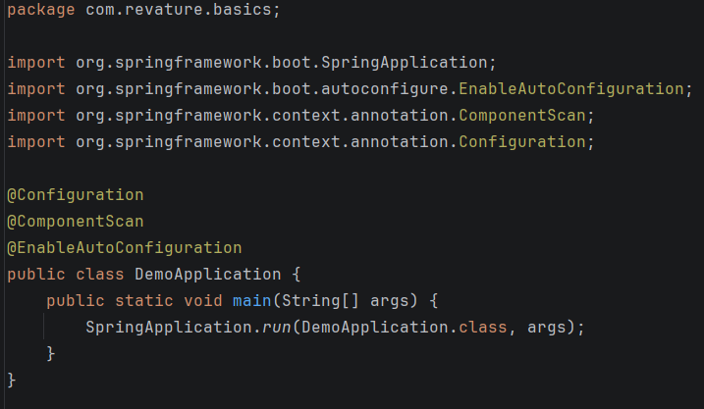
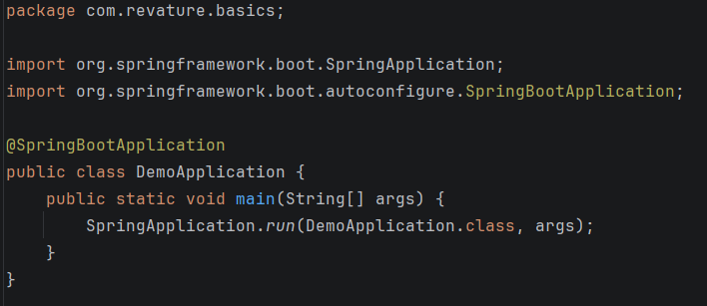
Spring Boot | Auto-Config
The following two are functionally the same:

Slide 8
Spring Boot | Auto-Config
Auto-config works by examining the classpath of your project (this includes chosen spring starters and libraries are present) and applying conditional configuration
Conditional configuration will only activate if:
“The class is on the classpath”, and
“The developer has not already defined the beans”
This allows spring boot to remain a powerful tool while allowing flexibility for developers
E.g. Adding “spring-boot-starter-web” to the classpath causes auto-config to automatically set up an embedded Tomcat server, and more tools.

Slide 9
Spring Boot Starters

Slide 10
Spring Boot
A starter is a special kind of Spring boot dependency that bundles everything common needed for a specific task.
Every starter follows a consistent naming convention:
spring-boot-starter-[type]
E.g. spring-boot-starter-web
Most common starters:
spring-boot-starter-web: everything needed to build a web app or REST API.
spring-boot-starter-data-jpa: everything needed for database access to a relational database using JPA/Hibernate
Note: spring has a ‘spring-boot-starter-data-mongo’ for mongo NoSql database support
spring-boot-starter-test: testing dependencies bundled together (Junit, Mockito, etc…)
spring-boot-starter-security: authentication & authorization support
spring-boot-starter-validation: support for validating incoming data using standard annotations
spring-boot-starter-actuator: production-read monitoring and management endpoints

Slide 11
Spring Environment

Slide 12
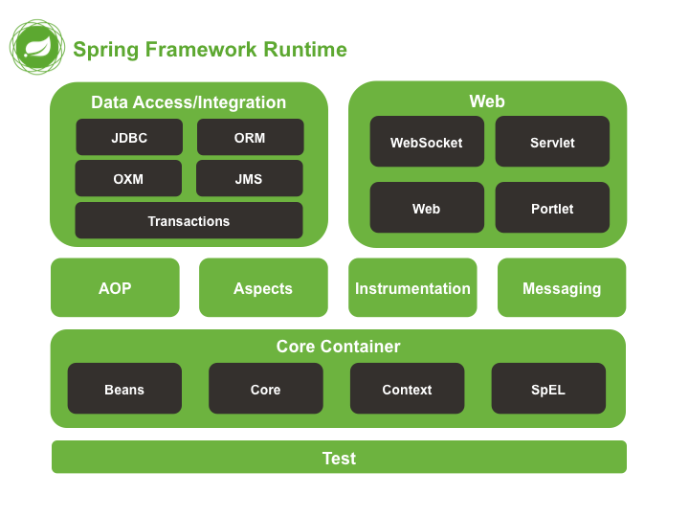
Spring Boot

Slide 13
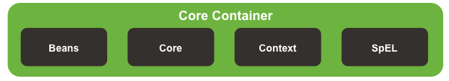
Spring Boot Modules - Core
*Beans : Provides support for configuring and managing beans in the IoC Container.
*Core : Core Module providing fundamental parts of the framework, including IoC Container and Dependency Injection features
*Context : Acts as the “glue” for the Spring application (application context). Provides access to application objects
Spring Expression Language (SpEL) : Powerful expression language for querying and manipulating objects at runtime.

Slide 14
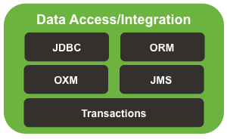
Spring Boot Modules - Data
JDBC : Offers JDBC-Abstraction layer for Spring App
Object Relational Mapping (ORM) : Provides integration with popular ORM frameworks such as Hibernate, JPA and JDO.
Object XML Mappers (OXM) : provides abstraction layer to support Object / XML mapping tools
Java Messaging Service (JMS) : Helps in producing and consuming messages using Springs JMS Support tools.
Transactions : Provides declarative transaction management capabilities.

Slide 15
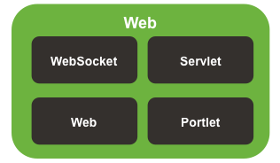
Spring Boot Modules - Web
WebSocket : Offers support for WebSocket-based communication between client and servers
Servlet : Provides Model-view-controller architecture and components to develop web applications
Web : Contains features for developing web apps including RESTful applications
Portlet : Offers support for developing portlet-based applications

Slide 16
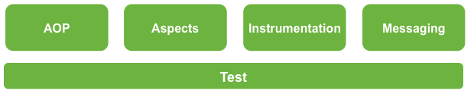
Spring Boot Modules - Other
Aspect-Oriented Programming (AOP) : provides support for aspect-oriented programming
Aspects : Provides integration with AspectJ, which is a richer and more powerful AOP library.
Instrumentation : Provides support for class instrumentation and classloader implementations for use in certain application servers.
Messaging : Provides support for messaging between different parts of a program or between programs (uses the observer design pattern).
Test : Supports testing of Spring components with JUnit or TestNG.

Slide 17
Spring DevTools

Slide 18
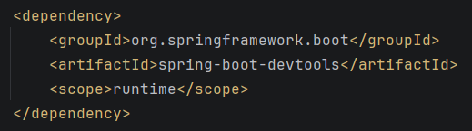
Spring Boot DevTools
The Spring Boot DevTools (developer tools) module provides convenient features that aim to simplify the development and testing process.
Added as a standard dependency:

Slide 19
Spring Boot DevTools
Key Features:
Automatic Restart : Reloads Java classes and configures them on the server-side on change.
This leads to dynamic server restarts upon modification of code.
Live Reload : Spring Boot DevTools includes an embedded server called ‘LiveReload’ which allows the application to automatically trigger a browser refresh when changes are made to resources.
Property Defaults for Development: DevTools automatically disables certain production-oriented optimizations (like template caching) which might prevent changes from being reflected immediately.
Global Configurations : Allows for global settings for all Spring Boot applications on a machine, allowing for re-use of common configurations, such as logger settings.
Remote Debugging : Supports remote debugging of an application to help with troubleshooting in different environments.
Note: DevTools is automatically disabled in a production build

Slide 20
Lombok

Slide 21
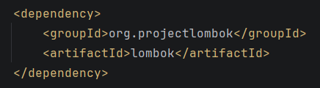
Lombok
Lombok is a Java Library which provides functionality to reduce the amount of boilerplate Java code you have to write.
Lombok provides a number of annotations which can be used to automatically generate boilerplate java code for basic POJO and Bean classes.

Slide 22
Lombok Annotations
@Getter: Generates getters for the fields of a class
@Setter: Generates setters for the fields of a class
@ToString: Implements the toString method to print the object attributes.
@EqualsAndHashCode: Generates hashCode and equals methods.
@AllArgsConstructor: Generates a constructor with arguments for all fields.
@NoArgsConstructor: Generates a constructor with no arguments.
@RequiredArgsConstructor: Generates a constructor for all final fields, with parameters for those fields.
@Data: A shortcut annotation for @ToString, @EqualsAndHashCode, @Getter on all fields, and @Setter on all non-final fields, and @RequiredArgsConstructor.

