Slide 1
Getting Started with pytest
Install pytest, write and organise your first tests, and read what a failing assertion tells you.
Install
Configure
Discover
Write
Assert
Notes:
Lecture 1 of Day 1, 45 minutes. Diagram colour legend (code weeks): blue = application under test; green = test code; orange = fixtures, setup and teardown; purple = runner, configuration, CLI; red = failures and errors; black = structure.

Slide 2
Learning Objectives
1
Install pytest, run it, and set options in pytest.ini or pyproject.toml.
2
Compare pytest with unittest and explain why pytest needs less code.
3
Apply the naming rules pytest uses to discover tests.
4
Write tests as plain functions and group them in test classes.
5
Read assertion failures and compare floats with pytest.approx.
2 / 33

Slide 3
Installation and Basic Configuration
01
Install pytest, run it, configure it once
3 / 33

Slide 4
What Is pytest?
PART 1
A third-party testing framework for Python.
Less boilerplate than unittest: plain functions are enough.
Uses Python's plain assert statement.
Extended with plugins, for example HTML reports or Playwright.
Runs existing unittest tests without changes.
4 / 33

Slide 5
Install and Verify
PART 1
$ pip install pytest
$ pytest --version
pytest 9.1.1
pip install adds pytest to the active environment.
pytest --version confirms the install worked.
Version shown is from the run used for these slides.
5 / 33

Slide 6
Running Tests
PART 1
pytest # run all tests in the current folder and its subfolders
pytest tests/ # run tests in one folder
pytest test_math.py # run one file
No argument: current folder and all subfolders.
A folder: only tests inside it.
A file: only that file's tests.
6 / 33

Slide 7
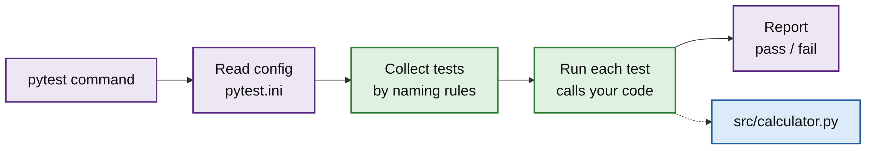
How a pytest Run Works
PART 1
The pytest command reads the config file first.
It collects tests by naming rules, then runs each one.
Tests call your application code, then results are reported.
7 / 33

Slide 8
Two Config File Options
PART 1
PYTEST.INI
PYPROJECT.TOML
[pytest]
testpaths = tests
addopts = -v
[tool.pytest.ini_options]
testpaths = ["tests"]
addopts = "-v"
TIP
Keep one config file in the project root. If both exist, pytest.ini is read before pyproject.toml.
8 / 33
Notes:
pytest 9 also reads a native [tool.pytest] table and pytest.toml; [tool.pytest.ini_options] still works and matches the written lesson.

Slide 9
Common Settings
PART 1
Setting | Meaning
testpaths | Folders to search for tests
pythonpath | Folders added to the import path, so tests can import your code (for example src)
addopts | Command-line options added to every run
python_files | File-name patterns treated as test files
markers | Custom markers to register (covered in Lecture 2)
9 / 33

Slide 10
pytest vs unittest
02
Same tests, less code
10 / 33

Slide 11
Key Idea: Migrate Gradually
PART 2
pytest runs this unittest file without any changes:
$ pytest tests/test_unit_style.py -v
...
tests/test_unit_style.py::TestAdd::test_add PASSED
...
1 passed in 0.01s
Keep old unittest files.
Write new tests in pytest style.
One command runs both.
11 / 33

Slide 12
The Same Test in Both Styles
PART 2
UNITTEST
PYTEST
import unittest
from calculator import add
class TestAdd(unittest.TestCase):
def setUp(self):
self.x = 2
def test_add(self):
self.assertEqual(add(self.x, 3), 5)
from calculator import add
def test_add():
assert add(2, 3) == 5
12 / 33

Slide 13
Assertions: unittest vs pytest
PART 2
unittest | pytest
self.assertEqual(a, b) | assert a == b
self.assertTrue(x) | assert x
self.assertIn(a, b) | assert a in b
self.assertRaises(E) | pytest.raises(E)
13 / 33

Slide 14
Structure Differences
PART 2
Test classes
unittest: must subclass unittest.TestCase. pytest: plain functions are enough.
Setup and teardown
unittest: setUp / tearDown methods. pytest: fixtures (Lecture 3).
Running
unittest: unittest.main() in the file. pytest: run the pytest command.
14 / 33

Slide 15
Test Discovery and Organization
03
How pytest finds your tests
15 / 33

Slide 16
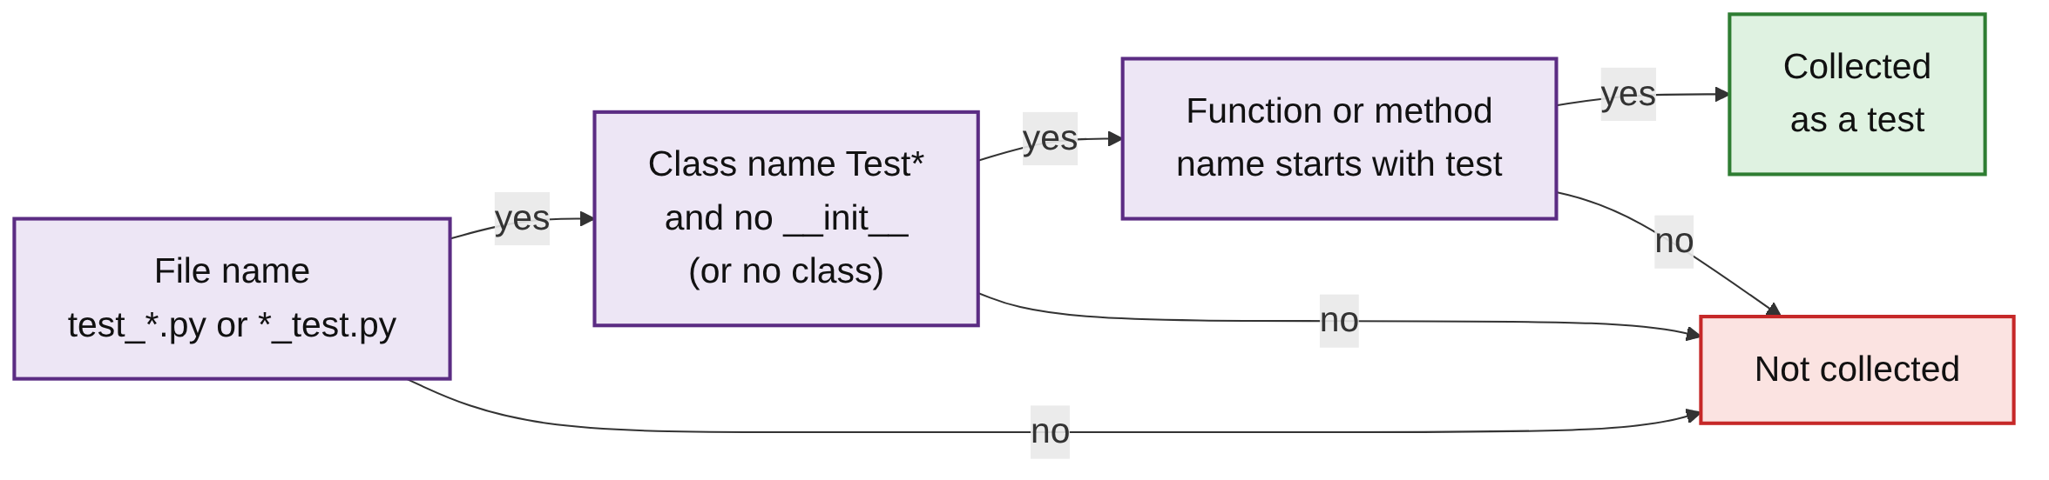
Test Discovery
PART 3
Discovery means pytest finds tests automatically by naming rules.
Every check must pass, or the item is not collected.
16 / 33

Slide 17
Default Naming Rules
PART 3
Item | Rule
Files | test_*.py or *_test.py
Functions | Names start with test
Classes | Names start with Test and the class has no __init__ method
Methods in those classes | Names start with test
COMMON MISTAKE
calculator_tests.py is not discovered: it neither starts with test_ nor ends in _test.py.
17 / 33

Slide 18
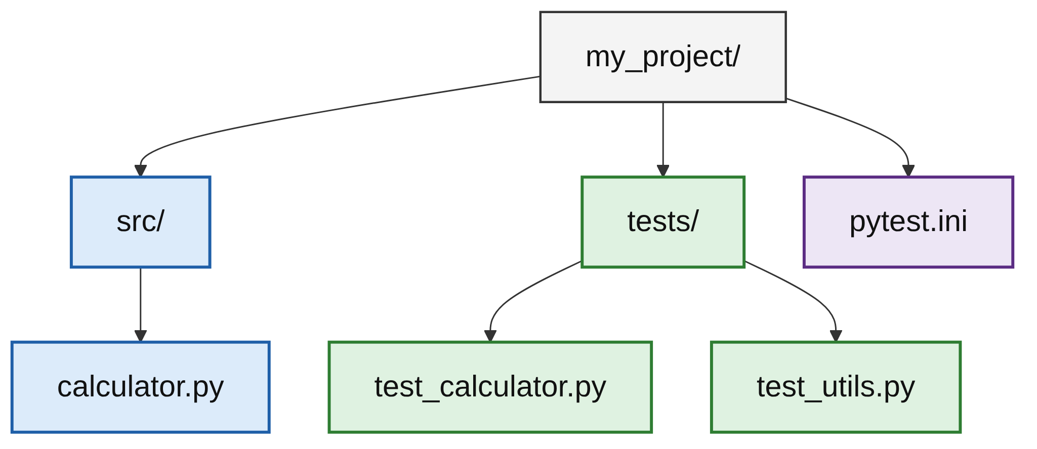
Recommended Project Layout
PART 3
src/ holds the application code.
tests/ holds the test files.
pytest.ini sits in the project root.
pythonpath = src lets tests import from src.
18 / 33

Slide 19
Preview with --collect-only
PART 3
$ pytest --collect-only -q
tests/test_calc.py::test_add
tests/test_calc.py::test_multiply_positive
...
tests/test_calc.py::TestMultiply::test_negative
...
9 tests collected in 0.01s
Lists what pytest found; runs nothing.
Check a new test is picked up.
tests/calculator_tests.py is missing: wrong name.
19 / 33

Slide 20
Test Functions and Classes
04
Write tests, group them, run one
20 / 33

Slide 21
Test Functions
PART 4
def multiply(a, b):
return a * b
def test_multiply_positive():
assert multiply(3, 4) == 12
def test_multiply_by_zero():
assert multiply(5, 0) == 0
An ordinary function whose name starts with test.
One behaviour per test.
Names describe the behaviour being checked.
21 / 33

Slide 22
Test Classes
PART 4
class TestMultiply:
def test_positive(self):
assert multiply(3, 4) == 12
def test_negative(self):
assert multiply(-2, 3) == -6
Group related tests in a class.
Name starts with Test.
No base class, no __init__.
22 / 33

Slide 23
A Fresh Instance per Test
PART 4
class TestCart:
def test_add(self):
self.items = ["apple"]
assert self.items == ["apple"]
def test_starts_clean(self):
assert not hasattr(self, "items")
pytest creates a new instance for every test.
Tests cannot share state through self.
Both tests pass.
23 / 33

Slide 24
Running One Test by Node ID
PART 4
$ pytest test_calc.py::test_multiply_positive
$ pytest test_calc.py::TestMultiply
$ pytest test_calc.py::TestMultiply::test_negative -v
...
test_calc.py::TestMultiply::test_negative PASSED
1 passed in 0.01s
Node ID: file::class::test.
Run one function, one class, or one method.
24 / 33

Slide 25
Assertions and Assertion Introspection
05
Plain assert, detailed failures
25 / 33

Slide 26
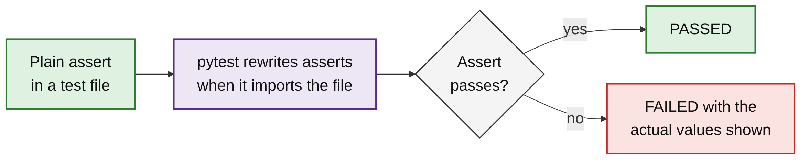
Assertion Introspection
PART 5
pytest uses Python's plain assert statement.
On failure it shows the actual values, not just AssertionError.
26 / 33

Slide 27
Everyday Assertions
PART 5
def test_equal():
assert 2 + 2 == 4
def test_list_contains():
assert "apple" in ["apple", "banana"]
def test_dict():
user = {"name": "testuser", "age": 25}
assert user["age"] > 18
Equality with ==.
Membership with in.
Comparisons with >, <, >=.
27 / 33

Slide 28
Reading a Failure
PART 5
TEST
def test_lists():
assert [1, 2, 3] == [1, 2, 4]
OUTPUT
> assert [1, 2, 3] == [1, 2, 4]
E assert [1, 2, 3] == [1, 2, 4]
E At index 2 diff: 3 != 4
E Use -v to get more diff
tests/test_fail.py:2: AssertionError
READ IT LIKE THIS
> marks the failing line. E lines explain why: here, the values differ at index 2.
28 / 33

Slide 29
Custom Failure Messages
PART 5
TEST
def test_age():
age = 15
assert age >= 18, f"User must be an adult, got age {age}"
OUTPUT (TRIMMED)
> assert age >= 18, f"User must be an adult, got age {age}"
E AssertionError: User must be an adult, got age 15
E assert 15 >= 18
29 / 33

Slide 30
Comparing Floats with approx
PART 5
TEST
OUTPUT OF THE PLAIN VERSION
import pytest
def test_float_plain():
assert 0.1 + 0.2 == 0.3 # FAILS
def test_float():
assert 0.1 + 0.2 == pytest.approx(0.3)
> assert 0.1 + 0.2 == 0.3
E assert (0.1 + 0.2) == 0.3
TIP
Floats are stored approximately. Use pytest.approx() whenever you compare them.
30 / 33

Slide 31
Common Mistakes
WRAP-UP
Wrong file name
calculator_tests.py is never collected. Use test_*.py or *_test.py.
__init__ in a test class
pytest warns "cannot collect test class" and skips every test in it.
Floats with ==
0.1 + 0.2 == 0.3 fails. Use pytest.approx.
State through self
Each test gets a new instance, so values set in one test are gone.
31 / 33

Slide 32
Key Takeaways
SUMMARY
1
Install with pip install pytest; check with pytest --version.
2
Put settings such as testpaths and pythonpath in one config file.
3
pytest runs unittest tests unchanged, so teams can migrate gradually.
4
Files, classes and functions are found by naming rules.
5
Use plain functions; group related tests in Test* classes.
6
Plain assert plus introspection shows exactly what differed.
32 / 33

Slide 33
Additional Resources
1
Get started
https://docs.pytest.org/en/stable/getting-started.html
2
Configuration
https://docs.pytest.org/en/stable/reference/customize.html
3
Good practices and layout
https://docs.pytest.org/en/stable/explanation/goodpractices.html
4
Running unittest tests
https://docs.pytest.org/en/stable/how-to/unittest.html
5
Assertions
https://docs.pytest.org/en/stable/how-to/assert.html
33 / 33

