Slide 1
Exceptions, Markers and Running Tests
Check that code raises the right errors, label tests with markers, and choose exactly which tests run.
pytest.raises
Built-in markers
Custom markers
Select and filter
Notes:
Lecture 2 of Day 1, 45 minutes. Diagram colour legend (code weeks): blue = application under test; green = test code; orange = fixtures, setup and teardown; purple = runner, configuration, CLI; red = failures and errors; black = structure.

Slide 2
Learning Objectives
1
Test expected exceptions with pytest.raises, match and excinfo.
2
Skip tests and mark known bugs with skip, skipif and xfail.
3
Create, register and apply custom markers safely.
4
Select tests by name with -k and by marker with -m.
5
Control a run and its output with -x, --lf, -v and -rsx.
2 / 33

Slide 3
Exception Testing
01
Prove that bad input raises the right error
3 / 33

Slide 4
pytest.raises Basics
PART 1
import pytest
def divide(a, b):
if b == 0:
raise ValueError("Cannot divide by zero")
return a / b
def test_divide_by_zero():
with pytest.raises(ValueError):
divide(10, 0)
Checks that bad input raises the right error.
Replaces unittest's assertRaises.
Passes only if ValueError is raised in the with block.
4 / 33

Slide 5
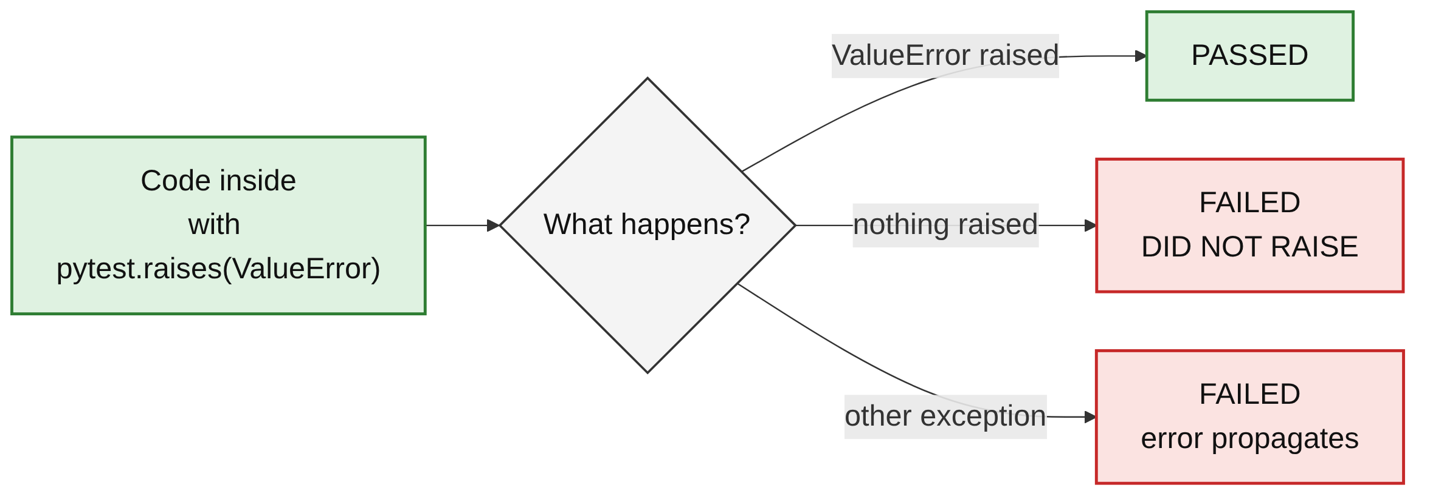
Three Possible Outcomes
PART 1
Expected exception raised: the test passes.
Nothing raised: Failed: DID NOT RAISE ValueError.
A different exception: it propagates and the test fails.
5 / 33

Slide 6
Checking the Message with match
PART 1
TEST
match is a regular expression.
It is searched for in the error message.
Escape special characters such as . or (.
def test_divide_by_zero_message():
with pytest.raises(ValueError, match="divide by zero"):
divide(10, 0)
OUTPUT WHEN THE PATTERN IS WRONG (match="by one")
E AssertionError: Regex pattern did not match.
E Expected regex: 'by one'
E Actual message: 'Cannot divide by zero'
6 / 33

Slide 7
Inspecting the Exception
PART 1
def test_divide_excinfo():
with pytest.raises(ValueError) as excinfo:
divide(10, 0)
assert str(excinfo.value) == "Cannot divide by zero"
assert excinfo.type is ValueError
as excinfo keeps the caught exception.
excinfo.value is the exception object.
excinfo.type is its class.
7 / 33

Slide 8
Keep the with Block Small
PART 1
RISKY
BETTER
def test_passes_for_wrong_reason():
with pytest.raises(ValueError):
b = int("zero") # raises here
divide(10, b) # never reached
def test_only_the_call():
b = 0
with pytest.raises(ValueError):
divide(10, b)
TIP
Both tests pass. In the risky one, int("zero") raises first, so divide is never tested. Keep only the line that should raise inside the block.
8 / 33

Slide 9
unittest vs pytest
PART 1
unittest | pytest
with self.assertRaises(ValueError): | with pytest.raises(ValueError):
assertRaisesRegex(ValueError, "msg") | pytest.raises(ValueError, match="msg")
9 / 33

Slide 10
Built-in Markers
02
Skip tests and mark known bugs
10 / 33

Slide 11
What Is a Marker?
PART 2
A label on a test
Added with @pytest.mark.<name>. It changes how a test runs or lets you select groups.
skip / skipif
Do not run the test: always, or only when a condition is true.
xfail
Run the test but expect it to fail, for a known bug.
pytest.skip()
Skip from inside the test once you know you cannot continue.
11 / 33

Slide 12
skip: Always Skip
PART 2
import pytest
@pytest.mark.skip(reason="Feature not implemented yet")
def test_export_pdf():
...
The test is not run.
Always give a reason.
Reported as s / SKIPPED.
12 / 33

Slide 13
skipif: Skip on a Condition
PART 2
import sys
import pytest
@pytest.mark.skipif(
sys.platform == "win32",
reason="Does not run on Windows",
)
def test_linux_paths():
assert "/" in "/home/user"
Skips only when the condition is true.
Here: on Windows.
Runs everywhere else.
13 / 33

Slide 14
xfail: Expected Failure
PART 2
@pytest.mark.xfail(reason="Bug #123: rounding error")
def test_rounding():
assert round(2.675, 2) == 2.68
For a known bug: the test still runs.
A failure is reported as XFAIL, not FAILED.
round(2.675, 2) gives 2.67 because of float storage.
14 / 33

Slide 15
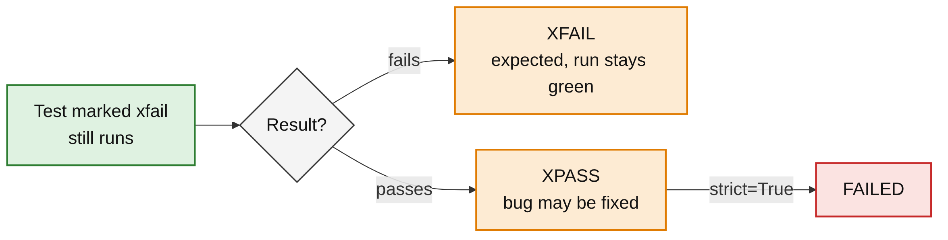
xfail Results
PART 2
XFAIL: failed as expected.
XPASS: passed unexpectedly; the bug may be fixed.
strict=True turns an XPASS into a failure.
15 / 33

Slide 16
Skipping Inside a Test
PART 2
def test_needs_config():
config = None
if config is None:
pytest.skip("Config not available")
pytest.skip() stops the test at runtime.
Use it when the condition is only known while running.
16 / 33

Slide 17
Seeing Reasons with -rsx
PART 2
$ pytest test_markers.py -rsx
test_markers.py s.xXFs
...
SKIPPED [1] test_markers.py:4: Feature not implemented yet
SKIPPED [1] test_markers.py:27: Config not available
XFAIL test_markers.py::test_rounding - Bug #123: rounding error
1 failed, 1 passed, 2 skipped, 1 xfailed, 1 xpassed
s skipped, x xfail, X xpass, F failed.
-r adds a reason summary: s skips, x xfails.
The F here is a strict xfail that passed.
17 / 33

Slide 18
Custom Markers
03
Your own labels for groups of tests
18 / 33

Slide 19
Applying Custom Markers
PART 3
import pytest
@pytest.mark.smoke
def test_login(): ...
@pytest.mark.smoke
@pytest.mark.api
def test_get_user(): ...
Labels you invent: smoke, slow, api.
Stack decorators to add several markers.
Use them to choose which tests run.
19 / 33

Slide 20
Registering Markers
PART 3
[pytest]
markers =
smoke: quick checks of core features
slow: tests that take a long time
api: tests that call the API
addopts = --strict-markers
Documents each marker with a description.
Avoids "unknown marker" warnings.
pytest --markers lists them all.
20 / 33

Slide 21
--strict-markers Catches Typos
PART 3
TEST WITH A TYPO
@pytest.mark.smok
def test_login():
assert True
OUTPUT
ERROR test_typo.py - Failed: 'smok' not found in `markers` configuration option
!!!!!!!!!!!!!!! Interrupted: 1 error during collection !!!!!!!!!!!!!!!
21 / 33

Slide 22
Marking a Class or Module
PART 3
WHOLE CLASS
A class marker applies to every method in it.
pytestmark marks every test in the file.
@pytest.mark.api
class TestUserAPI:
def test_create(self): ...
def test_delete(self): ...
WHOLE FILE (TOP OF THE MODULE)
# At the top of a test file: marks every test in the file
pytestmark = pytest.mark.slow
22 / 33

Slide 23
Test Execution and Filtering
04
Choose which tests run and how results show
23 / 33

Slide 24
Selecting Tests
PART 4
Command | What it does
pytest test_file.py | Run one file
pytest test_file.py::test_name | Run one test
pytest -k "login" | Run tests whose names contain "login"
pytest -k "login and not admin" | Combine name filters with and / or / not
pytest -m smoke | Run tests marked smoke
pytest -m "smoke and not slow" | Combine marker filters
24 / 33

Slide 25
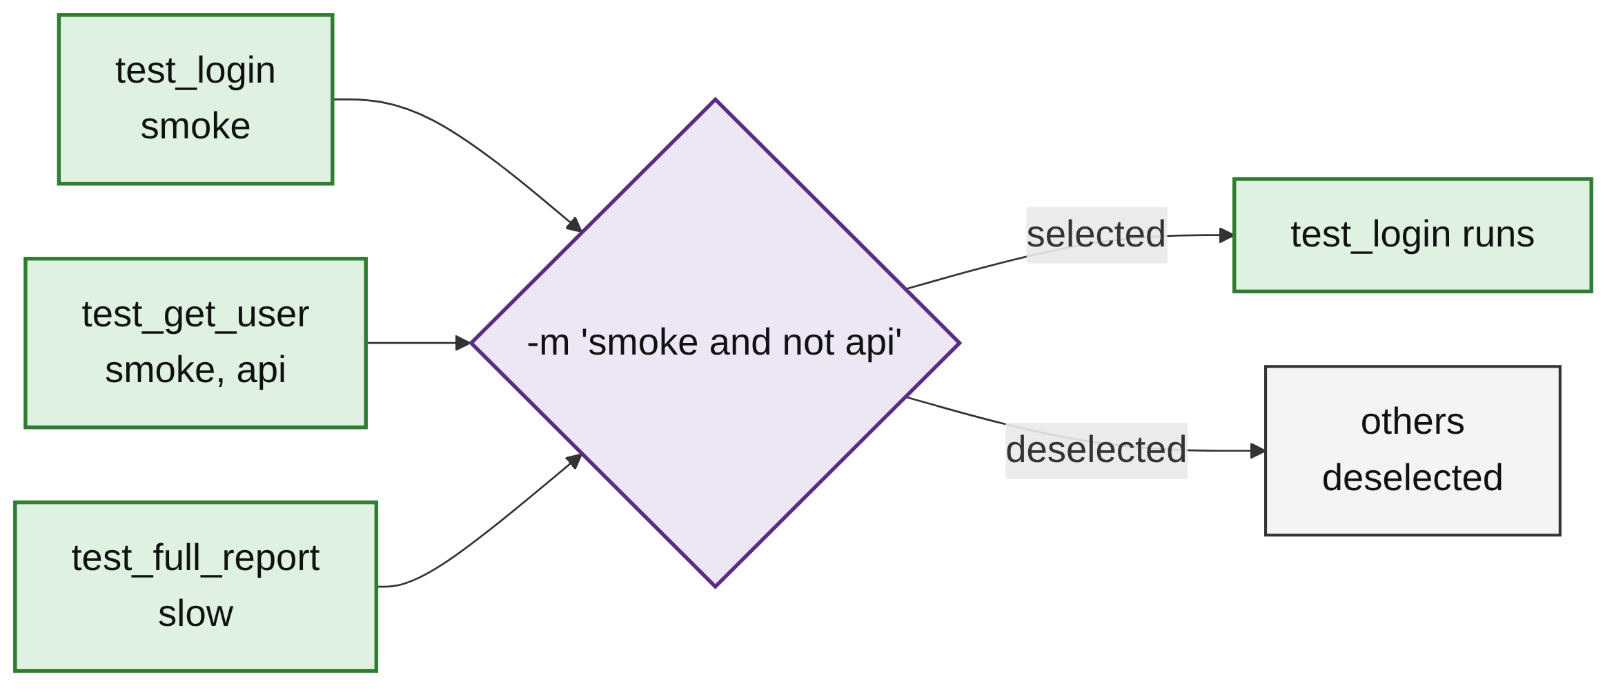
How -m Selects Tests
PART 4
-m filters by marker expression.
and, or and not combine markers.
Tests that do not match are deselected, not skipped.
25 / 33

Slide 26
-k and -m in Action
PART 4
$ pytest -m smoke -q
2 passed, 4 deselected
$ pytest -m "smoke and not api" -q
1 passed, 5 deselected
$ pytest -k login -q
2 passed, 4 deselected
$ pytest -k "login and not admin" -q
1 passed, 5 deselected
-k login matches test_login and test_login_admin.
Read the deselected count to check your filter.
26 / 33

Slide 27
Controlling the Run
PART 4
Command | What it does
pytest -x | Stop at the first failure
pytest --maxfail=2 | Stop after 2 failures
pytest --lf | Rerun only the tests that failed last time
pytest --ff | Run last time's failures first, then the rest
27 / 33

Slide 28
Stop Early, Rerun Failures
PART 4
STOP AT THE FIRST FAILURE
$ pytest -x -q
FAILED test_divide.py::test_no_raise_bad - Failed: DID NOT RAISE ValueError
!!!!!!!!!!!!!!!! stopping after 1 failures !!!!!!!!!!!!!!!!
1 failed, 3 passed
RERUN ONLY LAST RUN'S FAILURES
$ pytest --lf -q
...
3 failed, 3 deselected
28 / 33

Slide 29
Controlling the Output
PART 4
Command | What it does
pytest -v | Verbose: one line per test
pytest -q | Quiet: minimal output
pytest -s | Show print() output
pytest -rsx | Show reasons for skipped and xfailed tests
29 / 33

Slide 30
-k vs -m
PART 4
-k | -m
Filters by test name | Filters by marker
pytest -k "divide" | pytest -m smoke
WATCH OUT
A filter that matches nothing runs nothing: pytest -m nosuch reports "6 deselected" and exits with code 5.
30 / 33

Slide 31
Common Mistakes
WRAP-UP
Too much in the with block
An earlier line raises the error and the test passes for the wrong reason.
Skip without a reason
Nobody knows later why the test is off. Always pass reason=.
Unregistered markers
A typo such as smok silently selects nothing. Use --strict-markers.
Ignoring XPASS
A known bug may be fixed. Use strict=True so it gets noticed.
31 / 33

Slide 32
Key Takeaways
SUMMARY
1
pytest.raises passes only when the expected exception is raised.
2
match checks the message; excinfo gives the exception object.
3
skip, skipif and xfail handle tests that cannot or should not pass.
4
Register custom markers and turn on --strict-markers.
5
-k selects by name, -m by marker.
6
-x, --lf, -v and -rsx control the run and its output.
32 / 33

Slide 33
Additional Resources
1
Assertions about expected exceptions
https://docs.pytest.org/en/stable/how-to/assert.html
2
Skip and xfail
https://docs.pytest.org/en/stable/how-to/skipping.html
3
Markers
https://docs.pytest.org/en/stable/how-to/mark.html
4
Invoking pytest and selecting tests
https://docs.pytest.org/en/stable/how-to/usage.html
33 / 33

