Slide 1
Fixtures
Prepare what each test needs, control how often it is created, and share it across files.
@pytest.fixture
yield teardown
Scopes
conftest.py
Notes:
Lecture 3 of Day 1, 45 minutes. Diagram colour legend (code weeks): blue = application under test; green = test code; orange = fixtures, setup and teardown; purple = runner, configuration, CLI; red = failures and errors; black = structure.

Slide 2
Learning Objectives
1
Create fixtures with @pytest.fixture and request them by name.
2
Write setup and teardown with yield.
3
Combine fixtures and use autouse where it fits.
4
Choose a fixture scope: function, class, module or session.
5
Share fixtures across files with conftest.py.
2 / 29

Slide 3
Fixtures
01
Prepare what a test needs, then clean up
3 / 29

Slide 4
What Is a Fixture?
PART 1
A function that prepares something a test needs.
For example an object, data, a file or a connection.
Created with the @pytest.fixture decorator.
A test uses it by naming it as a parameter.
Replaces unittest's setUp and tearDown.
4 / 29

Slide 5
A Basic Fixture
PART 1
Cart is a small class with an items list and an add() method.
@pytest.fixture
def cart():
return Cart()
def test_cart_starts_empty(cart):
assert cart.items == []
def test_add_item(cart):
cart.add("apple")
assert cart.items == ["apple"]
The parameter name cart requests the fixture.
Each test gets a fresh Cart.
Tests do not affect each other.
5 / 29

Slide 6
setUp vs a Fixture
PART 1
UNITTEST
PYTEST
class TestCart(unittest.TestCase):
def setUp(self):
self.cart = Cart()
def test_add_item(self):
self.cart.add("apple")
self.assertEqual(self.cart.items, ["apple"])
@pytest.fixture
def cart():
return Cart()
def test_add_item(cart):
cart.add("apple")
assert cart.items == ["apple"]
6 / 29

Slide 7
Fixture Lifecycle
PART 1
Code before yield is setup.
The yielded value is passed to the test.
Code after yield is teardown.
Teardown runs even if the test fails.
7 / 29

Slide 8
Setup and Teardown with yield
PART 1
FIXTURE AND TEST
-s shows print() output.
Setup prints before the test dot.
Teardown prints after it.
@pytest.fixture
def db_connection():
print("\nConnecting to database")
conn = {"connected": True} # setup
yield conn # test runs here
conn["connected"] = False # teardown
print("\nDisconnected")
OUTPUT OF pytest -s
Connecting to database
.
Disconnected
8 / 29

Slide 9
Teardown Runs After a Failure
PART 1
TEST
OUTPUT
@pytest.fixture
def resource():
print("\nsetup")
yield 1
print("\nteardown still runs")
def test_fails(resource):
assert resource == 2
$ pytest -s -q
setup
F
teardown still runs
9 / 29

Slide 10
Fixtures Using Fixtures
PART 1
FIXTURES
A fixture can request other fixtures.
pytest builds them in the right order.
F means function scope.
@pytest.fixture
def user():
return {"name": "testuser"}
@pytest.fixture
def cart_with_owner(cart, user):
cart.owner = user["name"]
return cart
pytest --setup-show (TRIMMED)
SETUP F cart
SETUP F user
SETUP F cart_with_owner (fixtures used: cart, user)
test_owner (fixtures used: cart, cart_with_owner, user) .
10 / 29

Slide 11
Several Fixtures in One Test
PART 1
def test_user_and_cart(user, cart):
cart.add("book")
assert user["name"] == "testuser"
assert len(cart.items) == 1
List each fixture as a parameter.
Order of parameters does not matter.
Each one is created for this test.
11 / 29

Slide 12
autouse Fixtures
PART 1
@pytest.fixture(autouse=True)
def announce():
print("\nStarting a test")
autouse=True runs it for every test automatically.
The test does not request it.
Use sparingly: hidden setup is harder to follow.
12 / 29

Slide 13
Fixture Scopes
02
How often a fixture is created
13 / 29

Slide 14
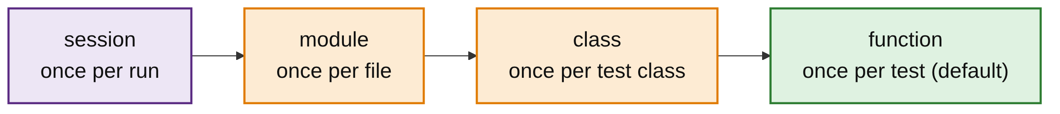
The Four Scopes
PART 2
Scope controls how often a fixture is created.
Default is function: once per test.
Wider scopes are created less often and shared longer.
14 / 29

Slide 15
When Each Scope Is Created
PART 2
Scope | Created | Typical use
function (default) | Once per test | Most objects
class | Once per test class | Shared state within a class
module | Once per test file | Data loaded from a file
session | Once per entire test run | Database connection, browser, server
15 / 29

Slide 16
A Module-Scoped Fixture
PART 2
FIXTURE
scope="module": once per test file.
Both tests share the same object.
@pytest.fixture(scope="module")
def expensive_resource():
print("\n>>> Creating resource")
yield {"data": [1, 2, 3]}
print("\n>>> Destroying resource")
TESTS
def test_one(expensive_resource):
assert len(expensive_resource["data"]) == 3
def test_two(expensive_resource):
assert 1 in expensive_resource["data"]
16 / 29

Slide 17
Seeing the Scope Run
PART 2
PYTEST -S
PYTEST --SETUP-SHOW
$ pytest test_scope.py -s -q
>>> Creating resource
..
>>> Destroying resource
2 passed
$ pytest test_scope.py --setup-show -q
SETUP M expensive_resource
test_one (fixtures used: ...) .
test_two (fixtures used: ...) .
TEARDOWN M expensive_resource
17 / 29

Slide 18
Rules to Remember
PART 2
Use a wider scope for things slow to create and safe to share.
A test that changes a shared fixture can break later tests.
Keep function scope when tests modify the object.
A fixture can only use fixtures of the same or wider scope.
18 / 29

Slide 19
ScopeMismatch Error
PART 2
SESSION FIXTURE USING A FUNCTION FIXTURE
The test errors at setup.
Widen user, or narrow session_user.
@pytest.fixture
def user():
return {"name": "testuser"}
@pytest.fixture(scope="session")
def session_user(user):
return user
OUTPUT (TRIMMED)
ERROR at setup of test_bad
ScopeMismatch: You tried to access the function scoped fixture
user with a session scoped request object.
19 / 29

Slide 20
conftest.py and Sharing Fixtures
03
One place for fixtures many files need
20 / 29

Slide 21
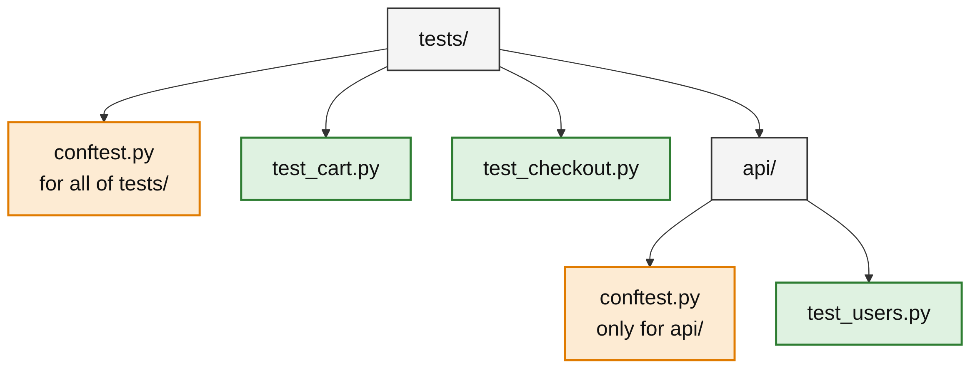
What Is conftest.py?
PART 3
Holds fixtures that several test files need.
pytest loads it automatically.
You never import it.
A nested conftest.py applies only to its folder.
21 / 29

Slide 22
A Shared conftest.py
PART 3
tests/conftest.py (the Cart class is defined above these fixtures):
import pytest
@pytest.fixture
def cart():
return Cart()
@pytest.fixture(scope="session")
def app_config():
return {"currency": "USD", "tax_rate": 0.1}
cart: a fresh object per test.
app_config: one shared dict for the whole run.
22 / 29

Slide 23
Test Files Need No Import
PART 3
tests/test_cart.py
Fixtures come from conftest.py.
No import line in either file.
def test_add(cart):
cart.add("pen")
assert cart.items == ["pen"]
tests/test_checkout.py
def test_currency(app_config):
assert app_config["currency"] == "USD"
OUTPUT OF pytest tests -v (TRIMMED)
tests/test_cart.py::test_add PASSED
tests/test_checkout.py::test_currency PASSED
23 / 29

Slide 24
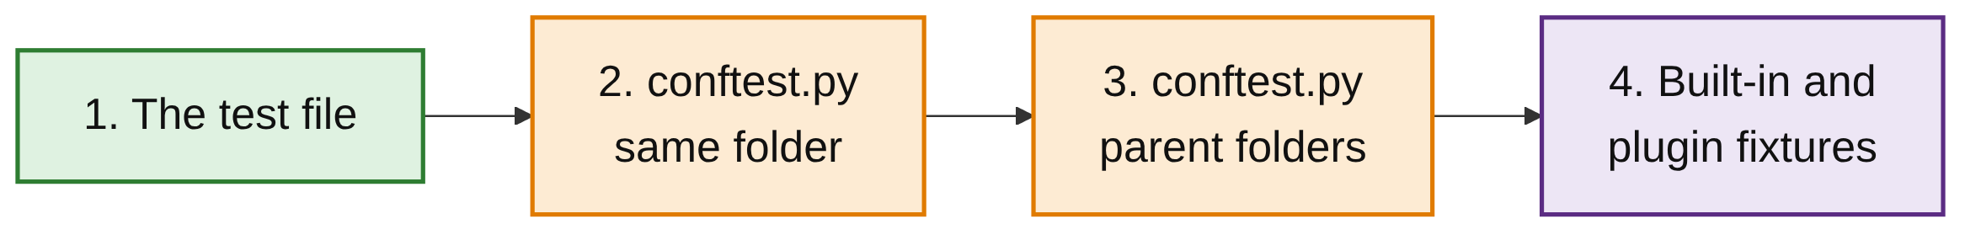
How pytest Finds a Fixture
PART 3
pytest searches from the test outwards and uses the first match.
A closer conftest.py overrides one with the same name further up.
24 / 29

Slide 25
Overriding in a Closer conftest
PART 3
tests/api/conftest.py
Tests in api/ get the EUR config.
All other tests still get USD.
@pytest.fixture(scope="session")
def app_config():
return {"currency": "EUR", "tax_rate": 0.2}
pytest tests/api --fixtures-per-test (TRIMMED)
fixtures used by test_users_currency
app_config -- tests/api/conftest.py:4
25 / 29

Slide 26
Listing Available Fixtures
PART 3
$ pytest tests --fixtures
...
cart -- tests/conftest.py:11
app_config [session scope] -- tests/conftest.py:15
app_config [session scope] -- tests/api/conftest.py:4
Shows every fixture, its scope and where it is defined.
Built-in fixtures are listed too.
26 / 29

Slide 27
Common Mistakes
WRAP-UP
Calling a fixture directly
Request it as a parameter; pytest creates it for you.
Importing conftest.py
Never import it. pytest loads it automatically.
Wide scope, mutable object
One test changes it and later tests break. Keep function scope.
Scope mismatch
A session fixture cannot use a function fixture.
27 / 29

Slide 28
Key Takeaways
SUMMARY
1
A fixture prepares what a test needs; the test requests it by name.
2
Code after yield is teardown and runs even when the test fails.
3
Fixtures can use other fixtures; autouse applies one to every test.
4
Scope sets how often a fixture is created; the default is per test.
5
Use wider scopes only for slow, safe-to-share resources.
6
Put shared fixtures in conftest.py; closer files override.
28 / 29

Slide 29
Additional Resources
1
How to use fixtures
https://docs.pytest.org/en/stable/how-to/fixtures.html
2
Fixtures reference
https://docs.pytest.org/en/stable/reference/fixtures.html
3
Getting started
https://docs.pytest.org/en/stable/getting-started.html
29 / 29

