Slide 1
Built-in Fixtures and Parametrization
WEEK 4 · DAY 2
Use the fixtures pytest gives you, run one test against many inputs, and combine both.
tmp_path
capsys
monkeypatch
parametrize
params=
Notes:
Lecture 4 of Day 2, 45 minutes. Diagram colour legend (code weeks): blue = application under test; green = test code; orange = fixtures, setup and teardown; purple = runner, configuration, CLI; red = failures and errors; black = structure.

Slide 2
Learning Objectives
1
Use tmp_path, capsys and monkeypatch in tests.
2
Run one test with many inputs using @pytest.mark.parametrize.
3
Name cases with ids and mark single cases with pytest.param.
4
Predict how many tests stacked decorators create.
5
Choose between parametrize and a parametrized fixture.
Built-in Fixtures and Parametrization · Week 4 · Day 2 | 2 / 28

Slide 3
Built-in Fixtures
01
Ready-made fixtures that come with pytest
Built-in Fixtures and Parametrization · Week 4 · Day 2 | 3 / 28

Slide 4
Four Built-in Fixtures
PART 1
Fixture | Purpose
tmp_path | A temporary folder (a pathlib.Path), unique to each test
capsys | Captures what the code prints (stdout / stderr)
monkeypatch | Temporarily changes attributes, environment variables or dictionaries
request | Information about the current test (used in parametrized fixtures)
Built-in Fixtures and Parametrization · Week 4 · Day 2 | 4 / 28

Slide 5
tmp_path: Working with Files
PART 1
def save_report(path, text):
path.write_text(text)
def test_save_report(tmp_path):
file = tmp_path / "report.txt"
save_report(file, "All tests passed")
assert file.read_text() == "All tests passed"
A temporary folder, unique to each test.
It is a pathlib.Path, so / builds paths.
pytest creates it and cleans up old ones.
Built-in Fixtures and Parametrization · Week 4 · Day 2 | 5 / 28

Slide 6
capsys: Checking Printed Output
PART 1
def greet(name):
print(f"Hello, {name}!")
def test_greet(capsys):
greet("testuser")
captured = capsys.readouterr()
assert captured.out == "Hello, testuser!\n"
Captures stdout and stderr.
readouterr() returns .out and .err.
print() adds a newline: expect \n.
Built-in Fixtures and Parametrization · Week 4 · Day 2 | 6 / 28

Slide 7
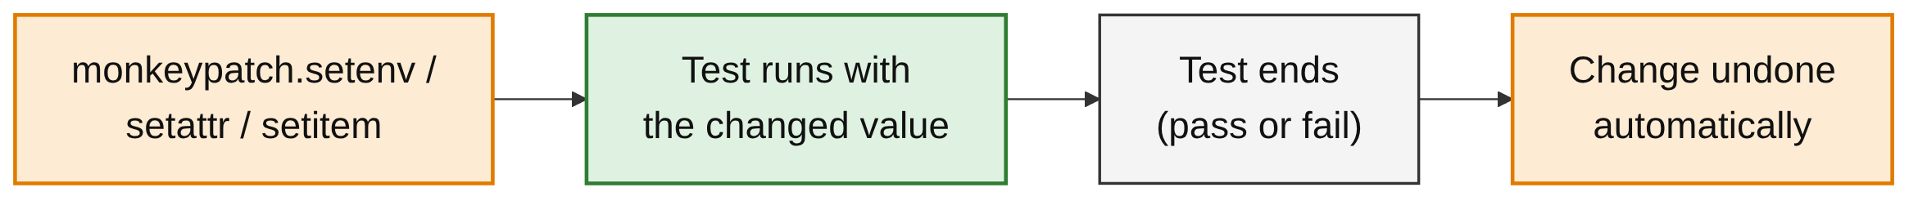
monkeypatch: Temporary Changes
PART 1
Changes attributes, environment variables or dictionary entries.
Every change is undone automatically after the test.
Later tests always see the original values.
Built-in Fixtures and Parametrization · Week 4 · Day 2 | 7 / 28

Slide 8
Environment Variables
PART 1
CODE UNDER TEST
setenv sets a variable for one test.
delenv removes it.
raising=False: no error if it was not set.
import os
def get_env():
return os.getenv("APP_ENV", "development")
TESTS
def test_env_production(monkeypatch):
monkeypatch.setenv("APP_ENV", "production")
assert get_env() == "production"
def test_env_default(monkeypatch):
monkeypatch.delenv("APP_ENV", raising=False)
assert get_env() == "development"
Built-in Fixtures and Parametrization · Week 4 · Day 2 | 8 / 28

Slide 9
Replacing a Function
PART 1
import random
def roll_dice():
return random.randint(1, 6)
def test_roll_dice(monkeypatch):
monkeypatch.setattr(random, "randint", lambda a, b: 4)
assert roll_dice() == 4
setattr swaps random.randint for a lambda.
The result becomes predictable: always 4.
The real function is back after the test.
Built-in Fixtures and Parametrization · Week 4 · Day 2 | 9 / 28

Slide 10
monkeypatch Methods
PART 1
monkeypatch method | Use
setattr(obj, name, value) | Replace an attribute or function
setenv(name, value) | Set an environment variable
delenv(name) | Remove an environment variable
setitem(dict, key, value) | Change a dictionary entry
UNDO IS AUTOMATIC
Checked in a run: after setitem changed a dictionary in one test, the next test saw the original value again.
Built-in Fixtures and Parametrization · Week 4 · Day 2 | 10 / 28

Slide 11
Parametrization
02
Write a test once, run it for many inputs
Built-in Fixtures and Parametrization · Week 4 · Day 2 | 11 / 28

Slide 12
The Problem: Repeated Tests
PART 2
def is_even(n):
return n % 2 == 0
def test_even_2():
assert is_even(2)
def test_even_4():
assert is_even(4)
# ... and one more copy for every new value
Same logic copied for every value.
A change means editing every copy.
Built-in Fixtures and Parametrization · Week 4 · Day 2 | 12 / 28

Slide 13
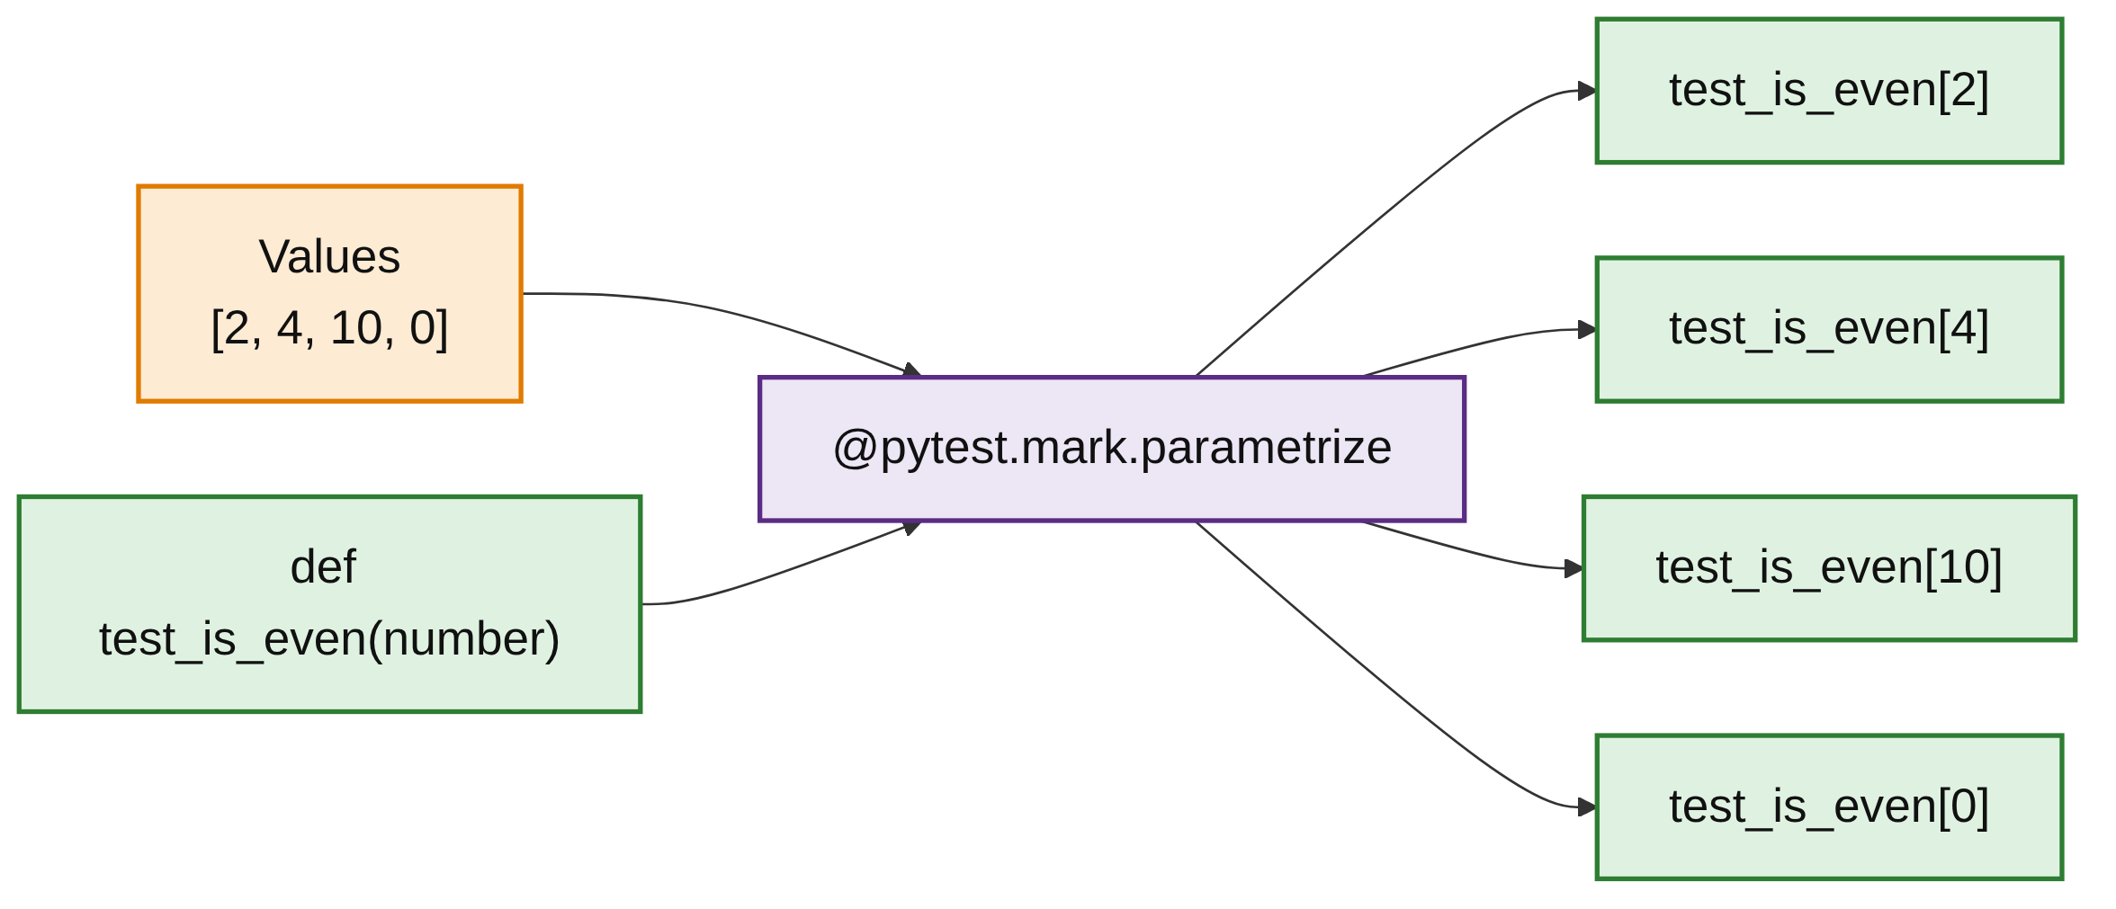
How parametrize Works
PART 2
Runs the same test with different inputs.
Write the test once.
pytest runs it once per value.
Each value is reported as its own test.
Built-in Fixtures and Parametrization · Week 4 · Day 2 | 13 / 28

Slide 14
parametrize in Action
PART 2
TEST
OUTPUT (TRIMMED)
import pytest
@pytest.mark.parametrize("number", [2, 4, 10, 0])
def test_is_even(number):
assert is_even(number)
$ pytest -v
test_is_even[2] PASSED
test_is_even[4] PASSED
test_is_even[10] PASSED
test_is_even[0] PASSED
...
4 passed
Built-in Fixtures and Parametrization · Week 4 · Day 2 | 14 / 28

Slide 15
Inputs and Expected Output
PART 2
@pytest.mark.parametrize("a, b, expected", [
(1, 2, 3),
(0, 0, 0),
(-1, 1, 0),
(10, -5, 5),
])
def test_add(a, b, expected):
assert add(a, b) == expected
Names in one comma-separated string.
One tuple per case.
IDs are built from the values: test_add[1-2-3].
Built-in Fixtures and Parametrization · Week 4 · Day 2 | 15 / 28

Slide 16
Readable Names with ids
PART 2
TEST
@pytest.mark.parametrize("a, b, expected", [
(1, 2, 3),
(-1, -1, -2),
(0, 5, 5),
], ids=["positive", "negative", "with_zero"])
def test_add_named(a, b, expected):
assert add(a, b) == expected
OUTPUT
test_add_named[positive] PASSED
test_add_named[negative] PASSED
test_add_named[with_zero] PASSED
Built-in Fixtures and Parametrization · Week 4 · Day 2 | 16 / 28

Slide 17
Marking One Case with pytest.param
PART 2
TEST
@pytest.mark.parametrize("a, b, expected", [
(1, 2, 3),
pytest.param(0.1, 0.2, 0.3,
marks=pytest.mark.xfail(reason="float precision")),
])
def test_add_param(a, b, expected):
assert add(a, b) == expected
OUTPUT
test_add_param[1-2-3] PASSED
test_add_param[0.1-0.2-0.3] XFAIL (float precision)
Built-in Fixtures and Parametrization · Week 4 · Day 2 | 17 / 28

Slide 18
Parametrizing Exception Tests
PART 2
TEST
@pytest.mark.parametrize("a, b", [(1, 0), (100, 0), (-5, 0)])
def test_divide_by_zero(a, b):
with pytest.raises(ValueError):
divide(a, b)
OUTPUT
test_divide_by_zero[1-0] PASSED
test_divide_by_zero[100-0] PASSED
test_divide_by_zero[-5-0] PASSED
Built-in Fixtures and Parametrization · Week 4 · Day 2 | 18 / 28

Slide 19
Stacking Decorators
PART 2
TEST
OUTPUT
@pytest.mark.parametrize("x", [1, 2])
@pytest.mark.parametrize("y", [10, 20])
def test_multiply(x, y):
assert x * y > 0
test_multiply[10-1] PASSED
test_multiply[10-2] PASSED
test_multiply[20-1] PASSED
test_multiply[20-2] PASSED
4 passed
Built-in Fixtures and Parametrization · Week 4 · Day 2 | 19 / 28

Slide 20
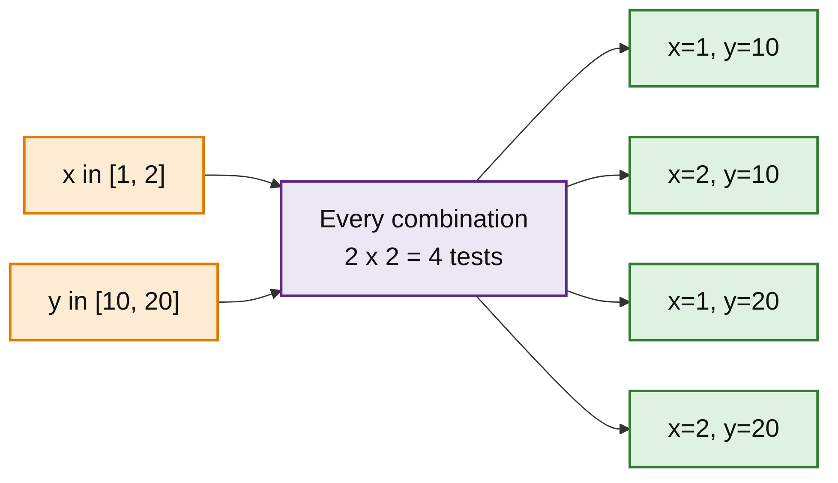
Every Combination
PART 2
Stacked decorators multiply.
2 values x 2 values = 4 tests.
Three lists of 5 values would give 125 tests.
Built-in Fixtures and Parametrization · Week 4 · Day 2 | 20 / 28

Slide 21
Combining Fixtures and Parametrization
03
Fresh setup for every input
Built-in Fixtures and Parametrization · Week 4 · Day 2 | 21 / 28

Slide 22
Option 1: Fixture Plus parametrize
PART 3
Cart is a small class with an items list and an add() method.
@pytest.fixture
def cart():
return Cart()
@pytest.mark.parametrize("item", ["apple", "book", "pen"])
def test_add_item(cart, item):
cart.add(item)
assert item in cart.items
The fixture and the parameter are both test arguments.
Each of the 3 runs gets a fresh cart.
Built-in Fixtures and Parametrization · Week 4 · Day 2 | 22 / 28

Slide 23
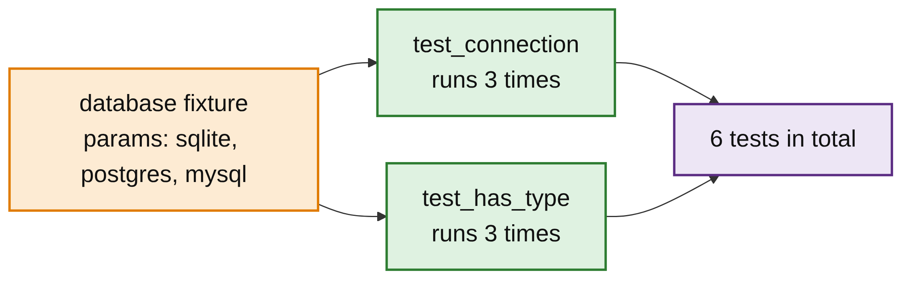
Option 2: Parametrized Fixtures
PART 3
A fixture can have params.
Every test using it runs once per value.
2 tests x 3 params = 6 tests.
Built-in Fixtures and Parametrization · Week 4 · Day 2 | 23 / 28

Slide 24
params= and request.param
PART 3
FIXTURE AND TESTS
@pytest.fixture(params=["sqlite", "postgres", "mysql"])
def database(request):
return {"type": request.param, "connected": True}
def test_connection(database):
assert database["connected"]
def test_has_type(database):
assert database["type"] in ["sqlite", "postgres", "mysql"]
OUTPUT
test_connection[sqlite] PASSED
test_connection[postgres] PASSED
test_connection[mysql] PASSED
test_has_type[sqlite] PASSED
test_has_type[postgres] PASSED
test_has_type[mysql] PASSED
Built-in Fixtures and Parametrization · Week 4 · Day 2 | 24 / 28

Slide 25
Which Should You Use?
PART 3
Use | When
@pytest.mark.parametrize | Different input data for one test
@pytest.fixture(params=...) | Different setups or environments that many tests should run against
RULE OF THUMB
Input data for one test: parametrize. A setup or environment that many tests should run against: a parametrized fixture.
Built-in Fixtures and Parametrization · Week 4 · Day 2 | 25 / 28

Slide 26
Common Mistakes
WRAP-UP
Names do not match
parametrize("nmber", ...) with def test(number) stops collection: "function uses no argument 'nmber'".
Changing os.environ directly
The change leaks into later tests. Use monkeypatch.setenv.
Float expected values
0.1 + 0.2 == 0.3 fails. Use pytest.approx or mark the case.
Too many combinations
Stacked lists multiply quickly. Count tests with --collect-only.
Built-in Fixtures and Parametrization · Week 4 · Day 2 | 26 / 28

Slide 27
Key Takeaways
SUMMARY
1
Built-in fixtures are requested by name, like your own.
2
tmp_path for files, capsys for output, monkeypatch for temporary changes.
3
parametrize runs one test per set of values.
4
ids gives readable names; pytest.param marks single cases.
5
Stacked parametrize decorators produce every combination.
6
Parametrized fixtures run every test that uses them once per param.
Built-in Fixtures and Parametrization · Week 4 · Day 2 | 27 / 28

Slide 28
Additional Resources
1
Built-in fixtures
https://docs.pytest.org/en/stable/reference/fixtures.html
2
Temporary directories
https://docs.pytest.org/en/stable/how-to/tmp_path.html
3
Capturing output
https://docs.pytest.org/en/stable/how-to/capture-stdout-stderr.html
4
monkeypatch
https://docs.pytest.org/en/stable/how-to/monkeypatch.html
5
Parametrizing tests
https://docs.pytest.org/en/stable/how-to/parametrize.html
Built-in Fixtures and Parametrization · Week 4 · Day 2 | 28 / 28

