Slide 1
Data-Driven Tests and Mocking
WEEK 4 · DAY 2
Keep test data in files, and replace slow or unreliable dependencies with mocks you control.
CSV / JSON data
Mock
MagicMock
patch
Verify calls
Notes:
Lecture 5 of Day 2, 45 minutes. Diagram colour legend (code weeks): blue = application under test; green = test code; orange = fixtures, setup and teardown; purple = runner, configuration, CLI; red = failures and errors; black = structure. The weather example uses api.example.com instead of a real service.

Slide 2
Learning Objectives
1
Load test cases from CSV and JSON files into parametrize.
2
Configure Mock and MagicMock with return_value and side_effect.
3
Replace real code during a test with patch, patching where the name is used.
4
Set up and debug chained mocks such as get().json().
5
Verify how a mock was called.
Data-Driven Tests and Mocking · Week 4 · Day 2 | 2 / 32

Slide 3
Data-Driven Test Design
01
Test logic once, cases in a data file
Data-Driven Tests and Mocking · Week 4 · Day 2 | 3 / 32

Slide 4
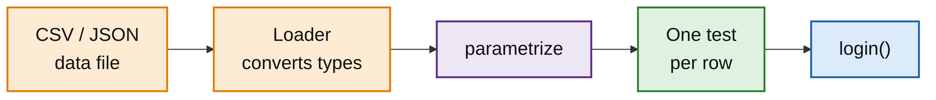
What Is Data-Driven Testing?
PART 1
Test data lives in a CSV or JSON file, separate from test code.
Adding a case means adding a row, not writing code.
Builds on parametrize: load the rows, pass them in.
People who do not code can add cases; each row is its own test.
Data-Driven Tests and Mocking · Week 4 · Day 2 | 4 / 32

Slide 5
The Data and the Code
PART 1
TESTS/DATA/LOGIN_CASES.CSV
AUTH.PY
username,password,expected
admin,admin123,True
admin,wrong,False
,admin123,False
guest,guest123,True
USERS = {"admin": "admin123", "guest": "guest123"}
def login(username, password):
return USERS.get(username) == password
Data-Driven Tests and Mocking · Week 4 · Day 2 | 5 / 32

Slide 6
Loading Rows into parametrize
PART 1
Each CSV row becomes one test. Run result: 4 passed, e.g. test_login[admin-wrong-False].
LOADER (IMPORTS: csv, Path, pytest, login)
DATA_FILE = Path(__file__).parent / "data" / "login_cases.csv"
def load_cases():
with open(DATA_FILE) as f:
reader = csv.DictReader(f)
return [
(row["username"], row["password"], row["expected"] == "True")
for row in reader
]
TEST
@pytest.mark.parametrize("username, password, expected", load_cases())
def test_login(username, password, expected):
assert login(username, password) == expected
Data-Driven Tests and Mocking · Week 4 · Day 2 | 6 / 32

Slide 7
CSV Values Are Strings
PART 1
LOADER WITHOUT CONVERSION
OUTPUT
# expected left as the raw CSV text
(row["username"], row["password"], row["expected"])
E AssertionError: assert True == 'True'
E + where True = login('admin', 'admin123')
...
4 failed
Data-Driven Tests and Mocking · Week 4 · Day 2 | 7 / 32

Slide 8
Example with JSON
PART 1
JSON keeps numbers as numbers. ids names the cases SAVE10-100, SAVE20-200, NONE-50; all 3 pass.
tests/data/discount_cases.json
[
{"price": 100, "code": "SAVE10", "expected": 90},
{"price": 200, "code": "SAVE20", "expected": 160},
{"price": 50, "code": "NONE", "expected": 50}
]
tests/test_discount.py (apply_discount defined above)
CASES = json.loads(DATA_FILE.read_text())
@pytest.mark.parametrize(
"case", CASES, ids=[f"{c['code']}-{c['price']}" for c in CASES]
)
def test_discount(case):
result = apply_discount(case["price"], case["code"])
assert result == pytest.approx(case["expected"])
Data-Driven Tests and Mocking · Week 4 · Day 2 | 8 / 32

Slide 9
Mock and MagicMock
02
Fake objects you control
Data-Driven Tests and Mocking · Week 4 · Day 2 | 9 / 32

Slide 10
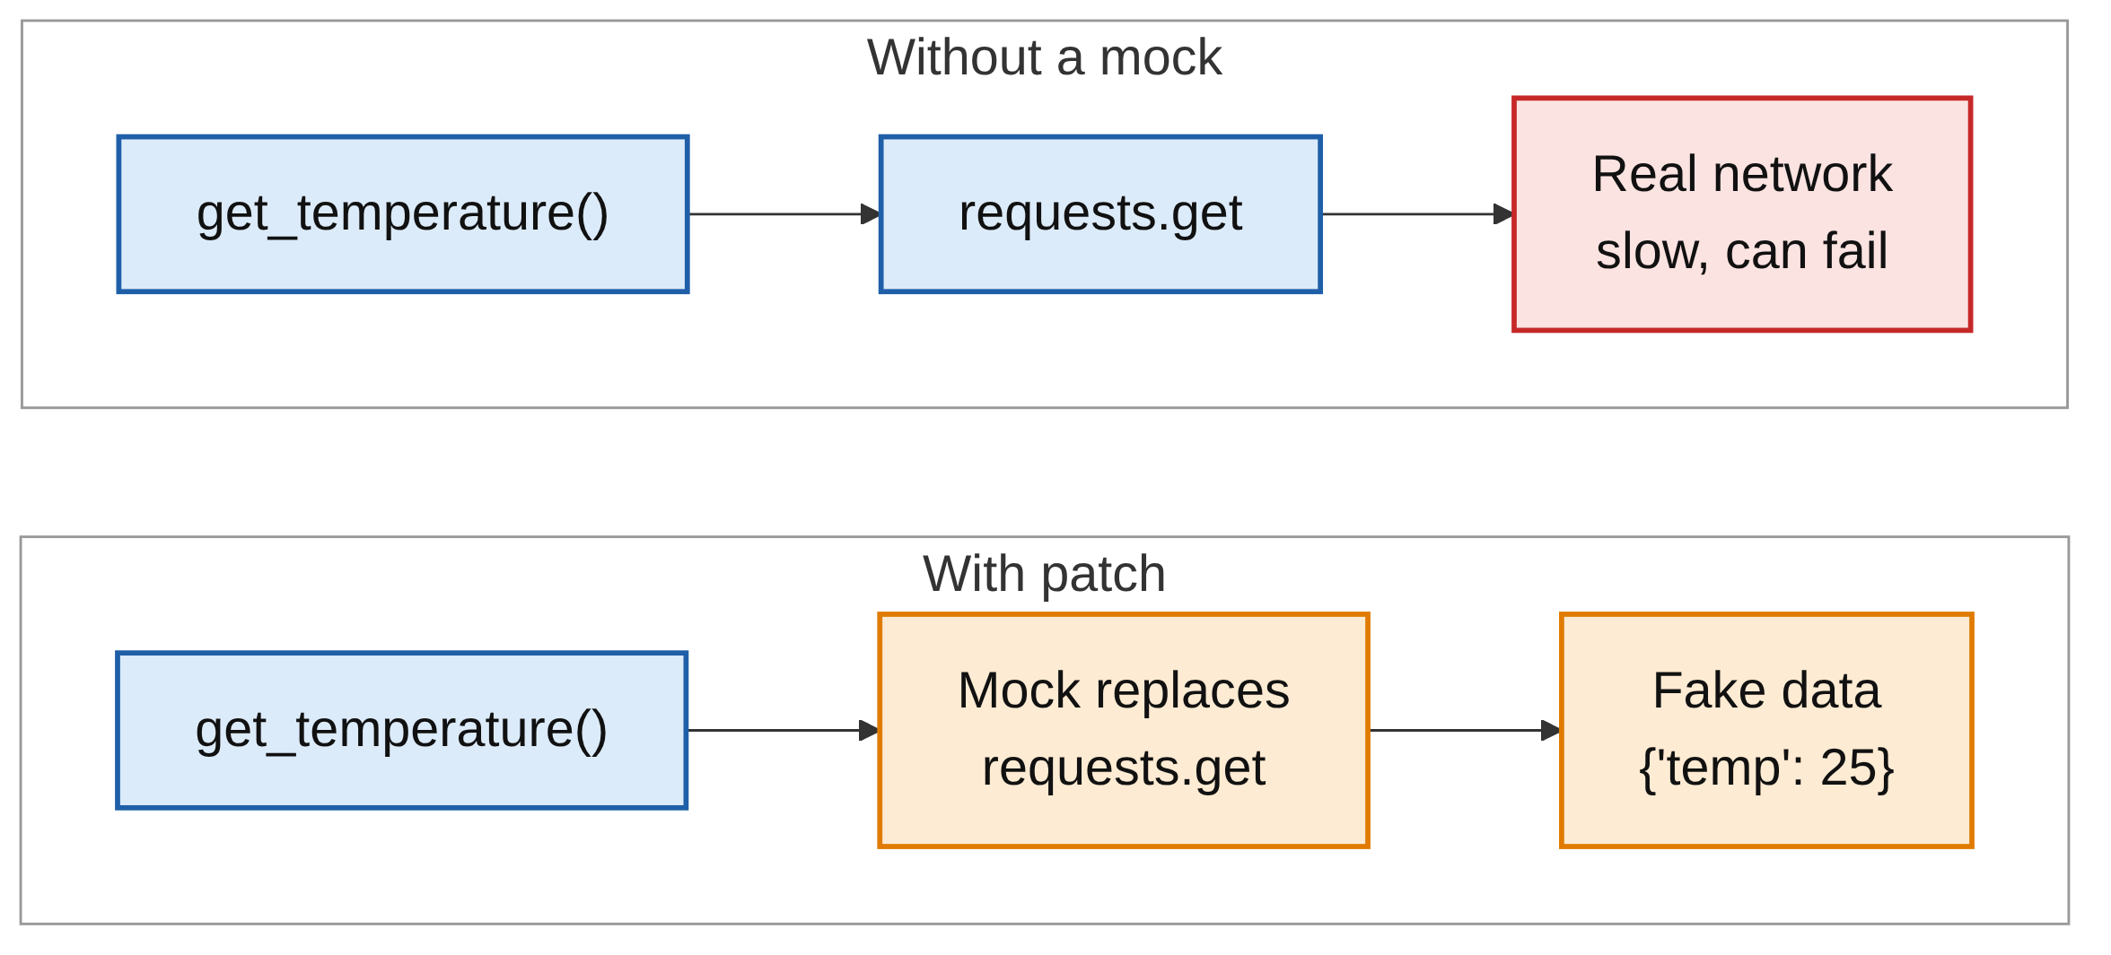
What Is Mocking?
PART 2
Replaces a real dependency with a fake you control.
For example an API, database, file or clock.
Tests stay fast, reliable and independent.
unittest.mock is in the standard library.
Data-Driven Tests and Mocking · Week 4 · Day 2 | 10 / 32

Slide 11
Mock Basics
PART 2
from unittest.mock import Mock
m = Mock()
m.get_price.return_value = 100 # set what it returns
print(m.get_price("apple")) # 100
m.get_price.assert_called_once_with("apple") # check how it was called
return_value: what the mock returns.
Any attribute or method can be called.
assert_called_once_with checks how it was used.
Data-Driven Tests and Mocking · Week 4 · Day 2 | 11 / 32

Slide 12
side_effect: Errors and Sequences
PART 2
m = Mock()
m.fetch.side_effect = ConnectionError("Server down")
# m.fetch() now raises ConnectionError
m.next_number.side_effect = [1, 2, 3]
m.next_number() # 1
m.next_number() # 2
An exception: calling the mock raises it.
A list: each call returns the next value.
Use it to test error handling.
Data-Driven Tests and Mocking · Week 4 · Day 2 | 12 / 32

Slide 13
Mock vs MagicMock
PART 2
MOCK
MAGICMOCK
m = Mock()
len(m)
# TypeError: object of type
# 'Mock' has no len()
mm = MagicMock()
mm.__len__.return_value = 3
len(mm) # 3
mm.__iter__.return_value = iter(["a", "b"])
list(mm) # ['a', 'b']
Data-Driven Tests and Mocking · Week 4 · Day 2 | 13 / 32

Slide 14
MagicMock as a Context Manager
PART 2
mm = MagicMock()
mm.__enter__.return_value = "file contents"
with mm as f:
print(f) # file contents
Use MagicMock for len(), for, [], with or comparisons.
Use Mock for simple objects and method calls.
IMPORTANT
patch() creates a MagicMock by default, so you often use one without creating it.
Data-Driven Tests and Mocking · Week 4 · Day 2 | 14 / 32

Slide 15
patch: Replacing Real Code
03
No real network calls during tests
Data-Driven Tests and Mocking · Week 4 · Day 2 | 15 / 32

Slide 16
Patching a Network Call
PART 3
weather.py
import requests
def get_temperature(city):
response = requests.get(f"https://api.example.com/weather/{city}")
return response.json()["temp"]
test_weather.py
@patch("weather.requests.get")
def test_get_temperature(mock_get):
mock_get.return_value.json.return_value = {"temp": 25}
assert get_temperature("London") == 25
mock_get.assert_called_once_with(
"https://api.example.com/weather/London")
Data-Driven Tests and Mocking · Week 4 · Day 2 | 16 / 32

Slide 17
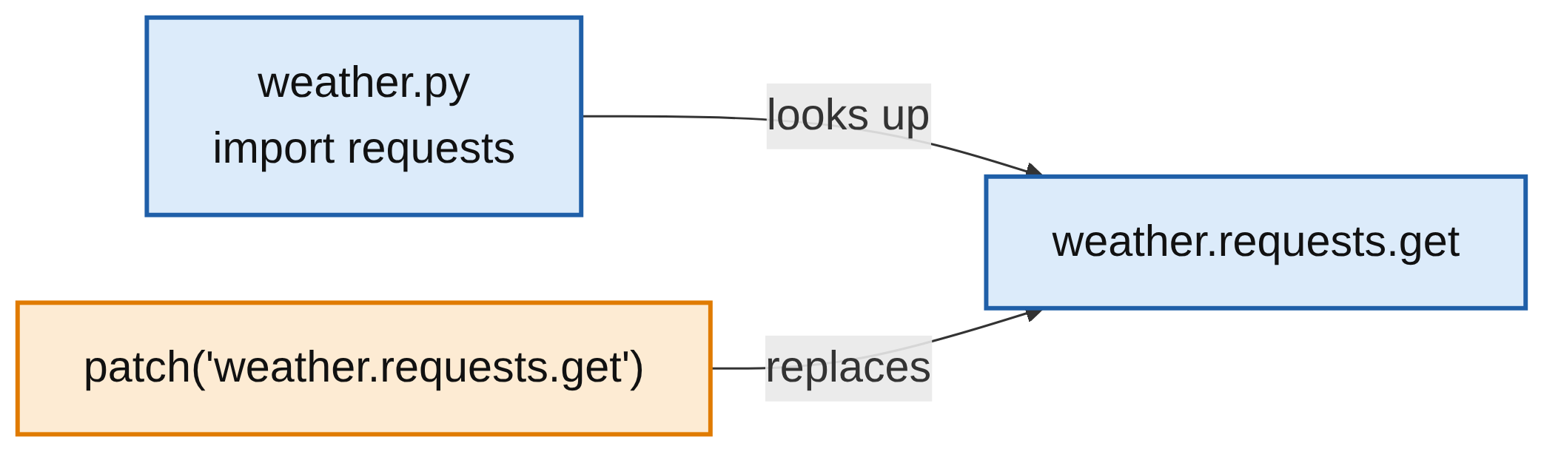
Patch Where the Name Is Used
PART 3
weather.py uses requests.get.
So patch "weather.requests.get".
from os import getcwd in a module: patch "that_module.getcwd", not "os.getcwd".
Data-Driven Tests and Mocking · Week 4 · Day 2 | 17 / 32

Slide 18
patch as a Context Manager
PART 3
def test_get_temperature_ctx():
with patch("weather.requests.get") as mock_get:
mock_get.return_value.json.return_value = {"temp": 30}
assert get_temperature("Paris") == 30
The patch lasts only inside the with block.
Same result as the decorator form.
Data-Driven Tests and Mocking · Week 4 · Day 2 | 18 / 32

Slide 19
Mocking a File Read
PART 3
mock_open fakes open(); read_data is the file content. No file is touched on disk.
config_reader.py
def read_config(path):
with open(path) as f:
return f.read()
TEST
from unittest.mock import patch, mock_open
from config_reader import read_config
def test_read_config():
with patch("builtins.open", mock_open(read_data="debug=true")):
assert read_config("app.cfg") == "debug=true"
Data-Driven Tests and Mocking · Week 4 · Day 2 | 19 / 32

Slide 20
Understanding Mock Chaining
04
Every () in the real code is a .return_value
Data-Driven Tests and Mocking · Week 4 · Day 2 | 20 / 32

Slide 21
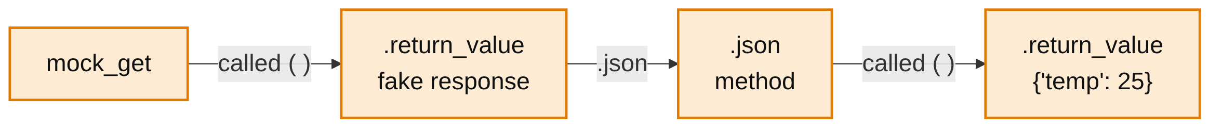
Reading the Chain
PART 4
Real code makes two calls: requests.get(url), then response.json().
So the mock is set up two levels deep.
Rule: every () in the real code becomes .return_value.
Data-Driven Tests and Mocking · Week 4 · Day 2 | 21 / 32

Slide 22
The Chain, Part by Part
PART 4
Chain part | Meaning | In the real code
mock_get | The fake requests.get function | requests.get
mock_get.return_value | What calling get(...) returns: the fake response | response
.json | The json method on that fake response | response.json
.json.return_value | What calling json() returns | the dictionary
= {"temp": 25} | The data we want the code to see | {"temp": 25}
Data-Driven Tests and Mocking · Week 4 · Day 2 | 22 / 32

Slide 23
Long Version vs Short Version
PART 4
LONG: ONE STEP AT A TIME
SHORT: SAME THING
@patch("weather.requests.get")
def test_long(mock_get):
fake_response = Mock()
fake_response.json.return_value = {"temp": 25}
mock_get.return_value = fake_response
assert get_temperature("London") == 25
@patch("weather.requests.get")
def test_short(mock_get):
mock_get.return_value.json.return_value = {
"temp": 25}
assert get_temperature("London") == 25
Data-Driven Tests and Mocking · Week 4 · Day 2 | 23 / 32

Slide 24
Missing a .return_value
PART 4
No crash: the code gets an unconfigured MagicMock. Its name shows the calls the code made; compare it with your setup.
WRONG SETUP
mock_get.json.return_value = {"temp": 25} # missing the first .return_value
OUTPUT
E AssertionError: assert <MagicMock
name='get().json().__getitem__()' id='...'> == 25
Data-Driven Tests and Mocking · Week 4 · Day 2 | 24 / 32

Slide 25
mocker, autospec and Verifying Calls
05
Cleaner patching and checking how mocks were used
Data-Driven Tests and Mocking · Week 4 · Day 2 | 25 / 32

Slide 26
The mocker Fixture
PART 5
INSTALL
Comes from the pytest-mock plugin.
Undoes the patch after the test.
No decorator or with block.
pip install pytest-mock
TEST
def test_get_temperature_mocker(mocker):
mock_get = mocker.patch("weather.requests.get")
mock_get.return_value.json.return_value = {"temp": 18}
assert get_temperature("Oslo") == 18
Data-Driven Tests and Mocking · Week 4 · Day 2 | 26 / 32
Notes:
pytest-mock could not be installed in the build environment, so this snippet was not run.

Slide 27
spec and autospec
PART 5
The mock matches the real object, so typos raise an error instead of passing silently. With mocker: mocker.patch(..., autospec=True).
TEST WITH A TYPO
with patch("weather.requests.get", autospec=True) as mock_get:
mock_get.assert_called_once_wiht("x")
OUTPUT
E AttributeError: 'function' object has no attribute
'assert_called_once_wiht'. Did you mean: 'assert_called_once_with'?
Data-Driven Tests and Mocking · Week 4 · Day 2 | 27 / 32

Slide 28
Verifying Calls
PART 5
Method / attribute | Checks
mock.assert_called() | Called at least once
mock.assert_called_once() | Called exactly once
mock.assert_called_with(args) | The last call used these arguments
mock.assert_called_once_with(args) | Called once, with these arguments
mock.assert_not_called() | Never called
Data-Driven Tests and Mocking · Week 4 · Day 2 | 28 / 32

Slide 29
call_count and Last Call
PART 5
def test_call_verification():
from unittest.mock import Mock
notifier = Mock()
notifier.send("hi")
notifier.send("bye")
assert notifier.send.call_count == 2
notifier.send.assert_called_with("bye")
call_count: number of calls.
assert_called_with checks the last call only.
call_args_list: every call with its arguments.
Data-Driven Tests and Mocking · Week 4 · Day 2 | 29 / 32

Slide 30
Common Mistakes
WRAP-UP
Comparing raw CSV text
'True' is not True. Convert CSV values in the loader.
Patching the wrong place
Patch where the name is used: weather.requests.get.
Missing .return_value
The code gets a MagicMock; the failure shows <MagicMock name='get().json()...'>.
Unchecked mocks
A mock accepts any call. Use autospec and verify the calls.
Data-Driven Tests and Mocking · Week 4 · Day 2 | 30 / 32

Slide 31
Key Takeaways
SUMMARY
1
Data-driven tests load CSV or JSON rows into parametrize.
2
CSV values are strings; convert them before comparing.
3
Mock fakes objects; MagicMock adds len, iter and with support.
4
patch replaces real code during one test; patch where the name is used.
5
Every () in the real code becomes .return_value in the mock setup.
6
Verify calls with assert_called_once_with and call_count.
Data-Driven Tests and Mocking · Week 4 · Day 2 | 31 / 32

Slide 32
Additional Resources
1
Parametrizing tests
https://docs.pytest.org/en/stable/how-to/parametrize.html
2
unittest.mock
https://docs.python.org/3/library/unittest.mock.html
3
unittest.mock examples
https://docs.python.org/3/library/unittest.mock-examples.html
4
pytest-mock
https://pytest-mock.readthedocs.io/en/latest/
Data-Driven Tests and Mocking · Week 4 · Day 2 | 32 / 32

