Slide 1
Practical Tools
WEEK 4 · DAY 2
Write reusable assertions, organise a growing suite, report results and coverage, and find slow tests.
Custom assertions
Organization
Templates
Reports
Profiling
Notes:
Lecture 6 of Day 2, 45 minutes. Diagram colour legend (code weeks): blue = application under test; green = test code; orange = fixtures, setup and teardown; purple = runner, configuration, CLI; red = failures and errors; black = structure. pytest-html, pytest-cov, pytest-benchmark and pytest-xdist could not be installed in the build environment, so their outputs on these slides are the sample outputs from the written lesson.

Slide 2
Learning Objectives
1
Write custom assertion helpers that report failures at the test line.
2
Organise tests, fixtures, helpers and data in a clear layout.
3
Reuse templates: AAA, test classes, factory fixtures, a file skeleton.
4
Create HTML reports and measure coverage with plugins.
5
Find slow tests with --durations and measure code speed.
Practical Tools · Week 4 · Day 2 | 2 / 30

Slide 3
Custom Assertions
01
One meaningful name for several checks
Practical Tools · Week 4 · Day 2 | 3 / 30

Slide 4
The Problem: Repeated Checks
PART 1
def test_create_user():
user = {"id": 1, "name": "testuser", "email": "test.user@example.com"}
assert "id" in user
assert user["name"]
assert "@" in user["email"]
def test_update_user():
...
# the same three checks again
Every test repeats the same checks.
A new rule means editing every test.
Practical Tools · Week 4 · Day 2 | 4 / 30

Slide 5
The Solution: A Helper
PART 1
A custom assertion bundles several checks into one meaningful name, so tests stay short.
HELPER
def assert_valid_user(user):
__tracebackhide__ = True
assert "id" in user, "User has no id"
assert user["name"], "User name is empty"
assert "@" in user["email"], f"Invalid email: {user['email']}"
TEST
def test_create_user():
user = {"id": 1, "name": "testuser", "email": "test.user@example.com"}
assert_valid_user(user)
Practical Tools · Week 4 · Day 2 | 5 / 30

Slide 6
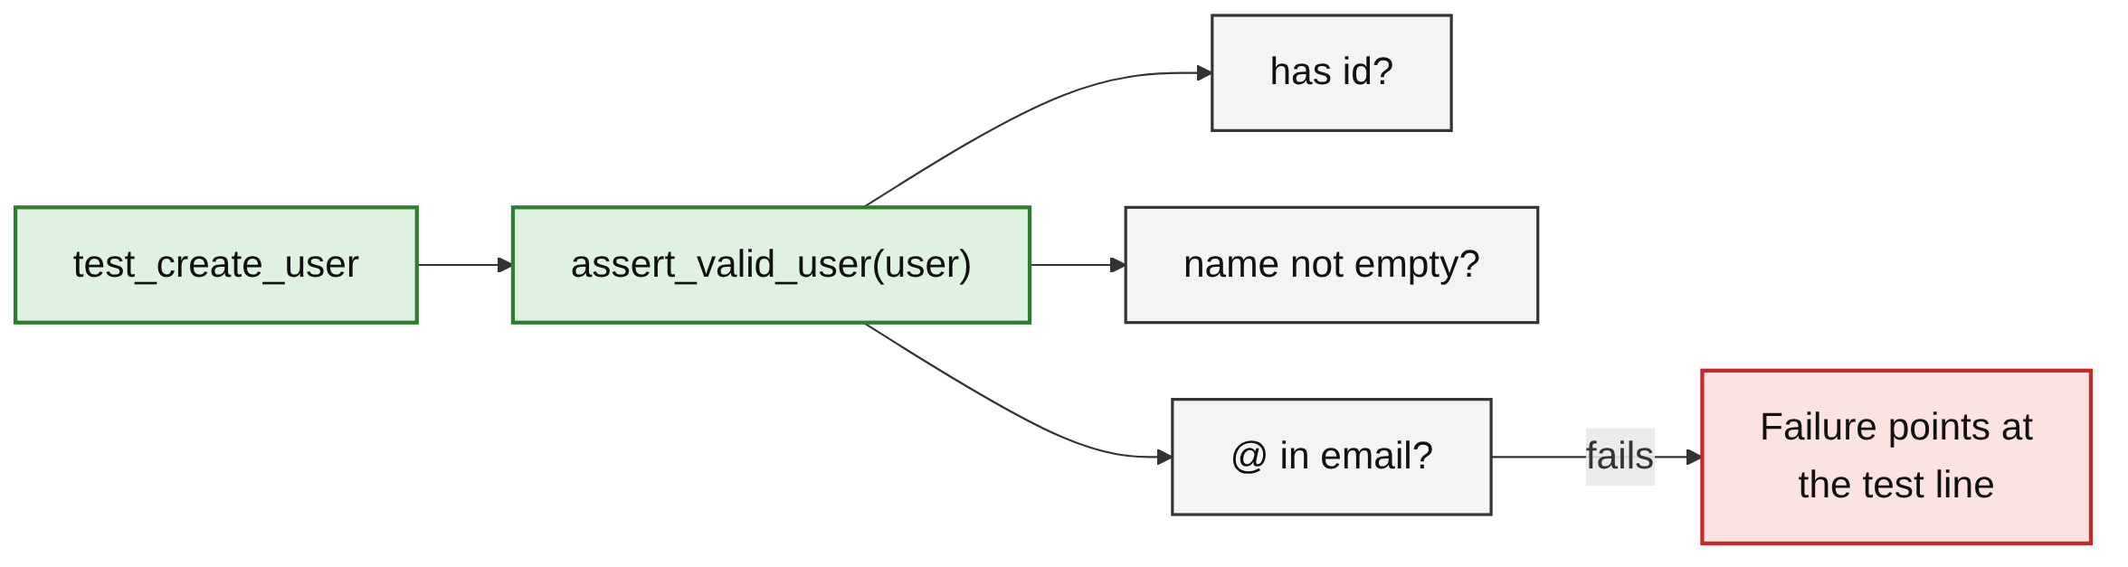
Where the Failure Points
PART 1
__tracebackhide__ = True hides the helper's own lines.
The failure points at the test that called the helper.
Practical Tools · Week 4 · Day 2 | 6 / 30

Slide 7
A Helper Failure
PART 1
TEST
def test_bad_email():
user = {"id": 2, "name": "testuser",
"email": "test.user.example.com"}
assert_valid_user(user)
OUTPUT (TRIMMED)
> assert_valid_user(user)
E AssertionError: Invalid email:
E test.user.example.com
E assert '@' in
E 'test.user.example.com'
tests/test_l6.py:12
Practical Tools · Week 4 · Day 2 | 7 / 30

Slide 8
Helper Modules and pytest.fail
PART 1
register_assert_rewrite keeps detailed output for helpers. pytest.fail prints your own message: Failed: List is not sorted: [3, 1, 2].
tests/conftest.py
# tests/conftest.py
import pytest
pytest.register_assert_rewrite("helpers")
tests/helpers.py
import pytest
def assert_sorted(items):
__tracebackhide__ = True
if items != sorted(items):
pytest.fail(f"List is not sorted: {items}")
Practical Tools · Week 4 · Day 2 | 8 / 30

Slide 9
Custom Comparison Messages
PART 1
HOOK (ADVANCED)
# conftest.py
from money import Money
def pytest_assertrepr_compare(op, left, right):
if (isinstance(left, Money) and isinstance(right, Money)
and op == "=="):
return ["Comparing Money objects:",
f" amounts: {left.amount} != {right.amount}"]
OUTPUT
> assert Money(10) == Money(12)
E assert Comparing Money objects:
E amounts: 10 != 12
Practical Tools · Week 4 · Day 2 | 9 / 30

Slide 10
Test Organization and Templates
02
A suite that stays easy to navigate
Practical Tools · Week 4 · Day 2 | 10 / 30

Slide 11
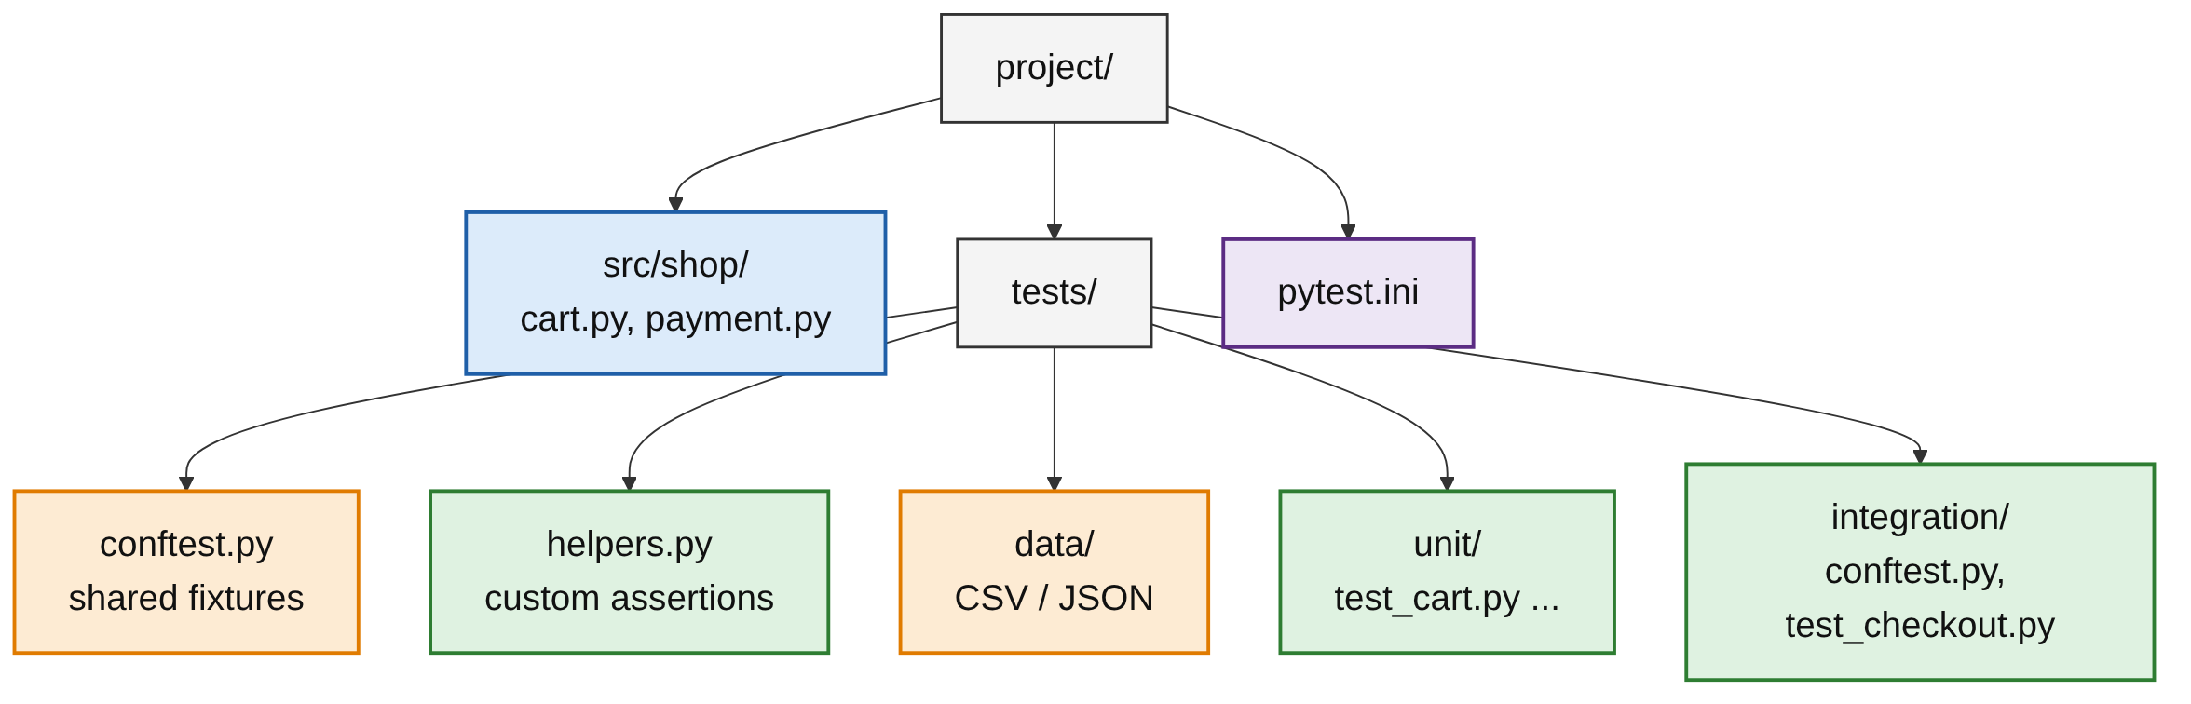
Recommended Project Layout
PART 2
Shared fixtures in conftest.py, helpers in helpers.py, data in data/.
Unit and integration tests in separate folders.
Practical Tools · Week 4 · Day 2 | 11 / 30

Slide 12
Organization Guidelines
PART 2
Mirror the source: cart.py becomes test_cart.py.
Separate unit and integration tests.
Shared fixtures in conftest.py, helpers in helpers.py.
Name tests test_<what>_<condition>_<expected>.
Example: test_withdraw_more_than_balance_raises_error.
Practical Tools · Week 4 · Day 2 | 12 / 30

Slide 13
Template 1: Arrange, Act, Assert
PART 2
def test_add_item_increases_total(cart):
# Arrange
cart.add("pen", price=10)
# Act
total = cart.total()
# Assert
assert total == 10
Arrange: set up the data.
Act: do one thing.
Assert: check the result.
Practical Tools · Week 4 · Day 2 | 13 / 30

Slide 14
Template 2: Grouping with a Class
PART 2
class TestCartAdd:
def test_add_single_item(self, cart): ...
def test_add_same_item_twice(self, cart): ...
def test_add_negative_price_raises(self, cart): ...
class TestCartRemove:
def test_remove_existing_item(self, cart): ...
def test_remove_missing_item_raises(self, cart): ...
One class per behaviour: add, remove.
Method names read like a specification.
Practical Tools · Week 4 · Day 2 | 14 / 30

Slide 15
Template 3: The Factory Fixture
PART 2
The fixture returns a function, so each test creates objects with its own values.
conftest.py
# conftest.py
import pytest
@pytest.fixture
def make_user():
def _make_user(name="Test User", role="customer"):
return {"name": name, "role": role}
return _make_user
TESTS
def test_admin(make_user):
admin = make_user(role="admin")
assert admin["role"] == "admin"
def test_default_user(make_user):
user = make_user()
assert user["role"] == "customer"
Practical Tools · Week 4 · Day 2 | 15 / 30

Slide 16
Template 4: A Test File Skeleton
PART 2
TOP OF THE FILE
"""Tests for shop.cart."""
import pytest
from shop.cart import Cart
pytestmark = pytest.mark.unit
@pytest.fixture
def cart():
return Cart()
SECTIONS
class TestHappyPath:
def test_add_item_increases_total(self, cart): ...
@pytest.mark.parametrize("price, expected", [(0, 0), (99, 99)])
def test_edge_cases(cart, price, expected): ...
class TestErrors:
def test_add_negative_price_raises(self, cart):
with pytest.raises(ValueError):
cart.add("pen", price=-1)
Practical Tools · Week 4 · Day 2 | 16 / 30

Slide 17
HTML Reporting and Coverage
03
Results for everyone, and what your tests really run
Practical Tools · Week 4 · Day 2 | 17 / 30

Slide 18
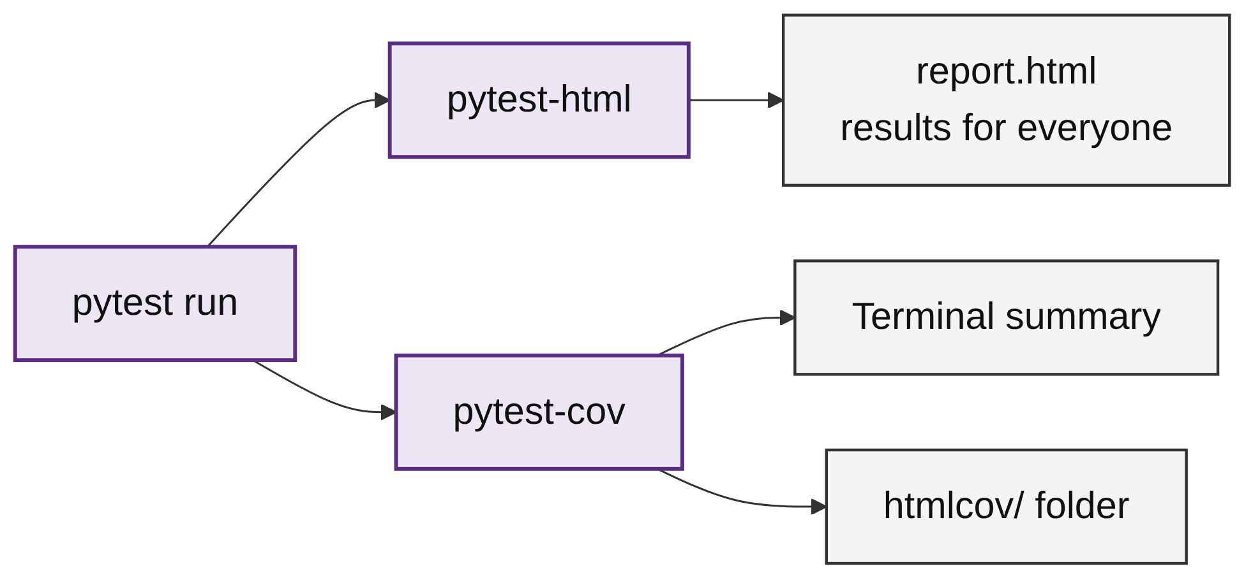
Two Reporting Plugins
PART 3
pytest-html: a page with every result, duration and failure.
Share it with people who do not use the terminal.
pytest-cov: how much source code ran during the tests.
Practical Tools · Week 4 · Day 2 | 18 / 30

Slide 19
Creating an HTML Report
PART 3
pip install pytest-html
pytest --html=report.html --self-contained-html
--html=report.html creates the report.
--self-contained-html puts styling in one file.
Easy to email or upload.
Practical Tools · Week 4 · Day 2 | 19 / 30

Slide 20
A Report on Every Run
PART 3
[pytest]
addopts = --html=reports/report.html --self-contained-html
Add the options to addopts in pytest.ini.
Every pytest run now writes the report.
Practical Tools · Week 4 · Day 2 | 20 / 30

Slide 21
Coverage Commands (pytest-cov)
PART 3
Command | Output
pytest --cov=shop | Coverage summary in the terminal
pytest --cov=shop --cov-report=term-missing | Also lists the line numbers that never ran
pytest --cov=shop --cov-report=html | Browsable report in the htmlcov/ folder
pytest --cov=shop --cov-fail-under=80 | Fails the run if coverage is below 80%
Practical Tools · Week 4 · Day 2 | 21 / 30

Slide 22
Reading Coverage Output
PART 3
Sample output from the written lesson:
Name Stmts Miss Cover Missing
------------------------------------------------
shop/cart.py 20 2 90% 34-35
shop/payment.py 15 0 100%
------------------------------------------------
TOTAL 35 2 94%
Stmts: statements; Miss: never ran.
Missing: line numbers that never ran.
REMEMBER
100% coverage does not mean bug-free. Every line ran, but not every case was checked.
Practical Tools · Week 4 · Day 2 | 22 / 30

Slide 23
Performance Profiling
04
Find slow tests and measure code speed
Practical Tools · Week 4 · Day 2 | 23 / 30

Slide 24
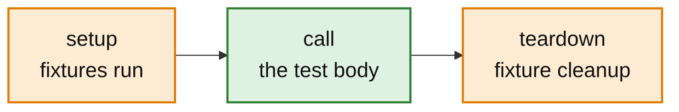
Where Test Time Goes
PART 4
A slow suite gets run less often.
pytest times each test in three phases.
A slow setup often means a fixture's scope should be widened.
Practical Tools · Week 4 · Day 2 | 24 / 30

Slide 25
Finding the Slowest Tests
PART 4
COMMANDS
pytest --durations=5 # show the 5 slowest tests
pytest --durations=0 # show all durations
pytest --durations=5 --durations-min=0.5 # only those slower than 0.5 seconds
OUTPUT
$ pytest --durations=3
...
===== slowest 3 durations =====
1.00s call tests/test_l6.py::test_full_report
0.50s setup tests/test_l6.py::test_query
(1 durations < 0.005s hidden.)
Practical Tools · Week 4 · Day 2 | 25 / 30

Slide 26
Measuring Code Speed
PART 4
pytest-benchmark
Runs the function many times.
Reports min, max and mean.
fib(20) is 6765.
def fib(n):
return n if n < 2 else fib(n - 1) + fib(n - 2)
def test_fib_speed(benchmark):
result = benchmark(fib, 20)
assert result == 6765
RUN
$ pip install pytest-benchmark
$ pytest --benchmark-only
Practical Tools · Week 4 · Day 2 | 26 / 30

Slide 27
Profiling and Parallel Runs
PART 4
cProfile: WHERE THE TIME GOES
cProfile lists the functions that took the most time.
-n auto uses all CPU cores.
Parallel runs need independent tests.
python -m cProfile -s cumtime -m pytest tests/test_report.py
pytest-xdist: PARALLEL (OPTIONAL)
pip install pytest-xdist
pytest -n auto # use all CPU cores
Practical Tools · Week 4 · Day 2 | 27 / 30

Slide 28
Common Mistakes
WRAP-UP
Helper without __tracebackhide__
The failure points inside the helper instead of at the test.
Helpers not registered
Without register_assert_rewrite, helper asserts lose detailed output.
Chasing 100% coverage
Coverage shows what ran, not what was checked.
Parallel with shared state
pytest -n auto breaks tests that depend on each other.
Practical Tools · Week 4 · Day 2 | 28 / 30

Slide 29
Key Takeaways
SUMMARY
1
Custom assertions give several checks one meaningful name.
2
__tracebackhide__ points failures at the test line.
3
Mirror the source layout; keep fixtures, helpers and data in known places.
4
Templates: AAA, test classes, factory fixtures, a file skeleton.
5
pytest-html reports results; pytest-cov measures coverage.
6
--durations finds slow tests; benchmark and cProfile measure code.
Practical Tools · Week 4 · Day 2 | 29 / 30

Slide 30
Additional Resources
1
Assertions and assertrepr hook
https://docs.pytest.org/en/stable/how-to/assert.html
2
Good practices
https://docs.pytest.org/en/stable/explanation/goodpractices.html
3
pytest-html
https://pytest-html.readthedocs.io/en/latest/
4
pytest-cov
https://pytest-cov.readthedocs.io/en/latest/
5
pytest-benchmark
https://pytest-benchmark.readthedocs.io/en/latest/
6
pytest-xdist
https://pytest-xdist.readthedocs.io/en/latest/
Practical Tools · Week 4 · Day 2 | 30 / 30

