Slide 1
CSS Selectors
Find exactly the elements you need: for styling a page and for locating elements in automated tests.
Basics
Attributes
Combinators
Pseudo-classes
Dynamic
XPath
Notes:
One lecture, 75 minutes, for beginners who know HTML. Practice page: practice.html (full code in 02-css-selectors-demo.md). Diagram colour legend (code weeks): blue = application under test; green = test code; orange = fixtures, setup and teardown; purple = runner, configuration, CLI; red = failures and errors; black = structure.

Slide 2
Learning Objectives
1
Read a CSS rule and predict which rule wins using specificity.
2
Write basic, attribute and combinator selectors for elements on a page.
3
Use state and structural pseudo-classes, and avoid the nth-child trap.
4
Choose robust selectors over generated, brittle ones.
5
Translate CSS to XPath and know when XPath is the better tool.
2 / 35

Slide 3
Introduction and CSS Fundamentals
01
What a selector is and how a CSS rule works
3 / 35
Notes:
0-13 min: Introduction (0-5) and CSS Fundamentals (5-13).

Slide 4
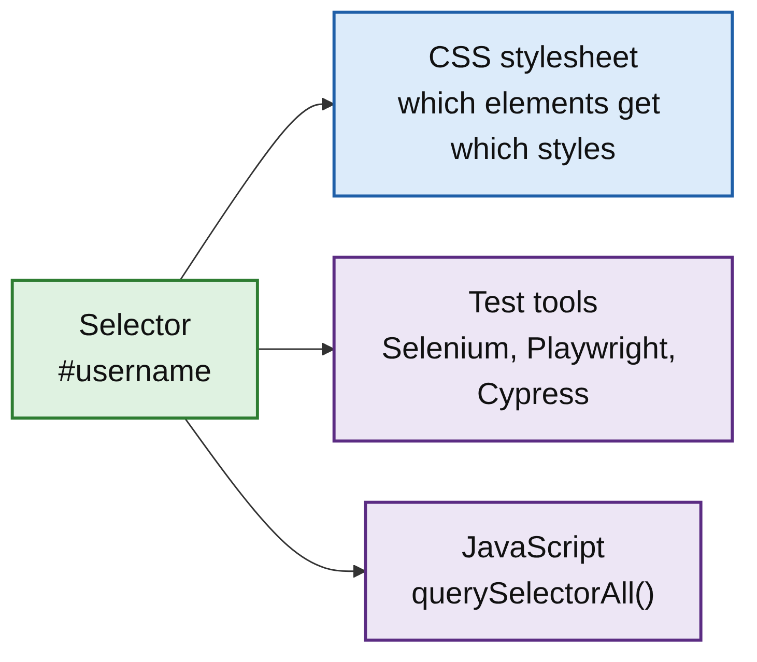
One Selector, Two Uses
PART 1
A selector is a pattern that matches HTML elements.
Styling: CSS decides which elements get which styles.
Locating: test tools and JavaScript use the same selectors to find elements.
Learn selectors once, use them in both places.
4 / 35

Slide 5
Anatomy of a CSS Rule
PART 1
PATTERN
h1: the selector, which elements.
color: the property, what to change.
navy: the value.
color: navy; is a declaration; { ... } is the declaration block.
selector {
property: value;
property: value;
}
EXAMPLE
h1 {
color: navy;
font-size: 32px;
}
6 / 35

Slide 6
Three Ways to Add CSS
PART 1
1. Inline
A style attribute on the element: <p style="color: red;">. Only for quick tests.
2. Internal
A <style> tag in the <head>: p { color: red; }.
3. External
A separate .css file: <link rel="stylesheet" href="styles.css">. Recommended.
7 / 35

Slide 7
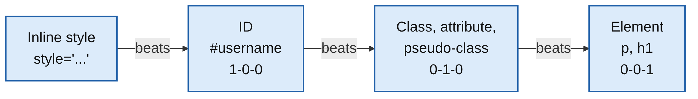
Specificity: Which Rule Wins
PART 1
Two rules target one element: the more specific selector wins.
Equal specificity: the rule written later wins.
p, .intro and #welcome all set a colour on <p id="welcome" class="intro">: it is red.
Remember: ID beats class, class beats element.
8 / 35
Notes:
Switch to Demo 2. Result checked in Chromium: the element's computed colour is red.

Slide 8
Basic and Attribute Selectors
02
Match by tag, class, id and attributes
9 / 35
Notes:
13-26 min.

Slide 9
Basic Selectors
PART 2
Selector | Syntax | Matches | Example
Universal | * | Every element | *
Type (element) | tag | All elements of that tag | h2
Class | .name | Elements with that class | .btn
ID | #name | The element with that ID | #username
REMEMBER
An element can have many classes (class="btn btn-primary") but only one ID, and an ID should be unique on the page.
10 / 35

Slide 10
Combining Basic Selectors
PART 2
Selector | Syntax | Matches | Example
Multiple classes | .a.b (no space) | Elements with both classes | .btn.btn-primary
Tag + class | tag.name | That tag with that class | div.product
Grouping | a, b | Elements matching either | h1, h3
ONE SPACE CHANGES EVERYTHING
.btn.btn-primary matches the Log In button. .btn .btn-primary (with a space) matches nothing on the practice page: the space is a combinator (Part 3).
11 / 35

Slide 11
Attribute Selectors
PART 2
Selector | Matches | Example
[attr] | Has the attribute at all | [placeholder]
[attr="value"] | Attribute equals the value exactly | [type="password"]
tag[attr="value"] | That tag with that attribute value | input[type="text"]
EXAMPLES
Examples: input[type="password"], [data-category="books"], [placeholder]. .btn is similar to [class~="btn"], and #username to [id="username"].
12 / 35
Notes:
Switch to Demo 3.

Slide 12
Combinators
03
Select elements by their relationship in the DOM tree
13 / 35
Notes:
26-37 min.

Slide 13
Four Combinators
PART 3
Combinator | Syntax | Meaning | Example
Descendant | A B (space) | B anywhere inside A, at any depth | #login-form input: 4 inputs
Child | A > B | B is a direct child of A | #login-form > input: 2 inputs
Adjacent sibling | A + B | B immediately after A, same parent | label + input
General sibling | A ~ B | B anywhere after A, same parent | #login ~ section
SIBLINGS ONLY LOOK FORWARD
A + B and A ~ B only look forward. CSS cannot select a previous sibling or a parent; this matters when we compare CSS with XPath.
14 / 35

Slide 14
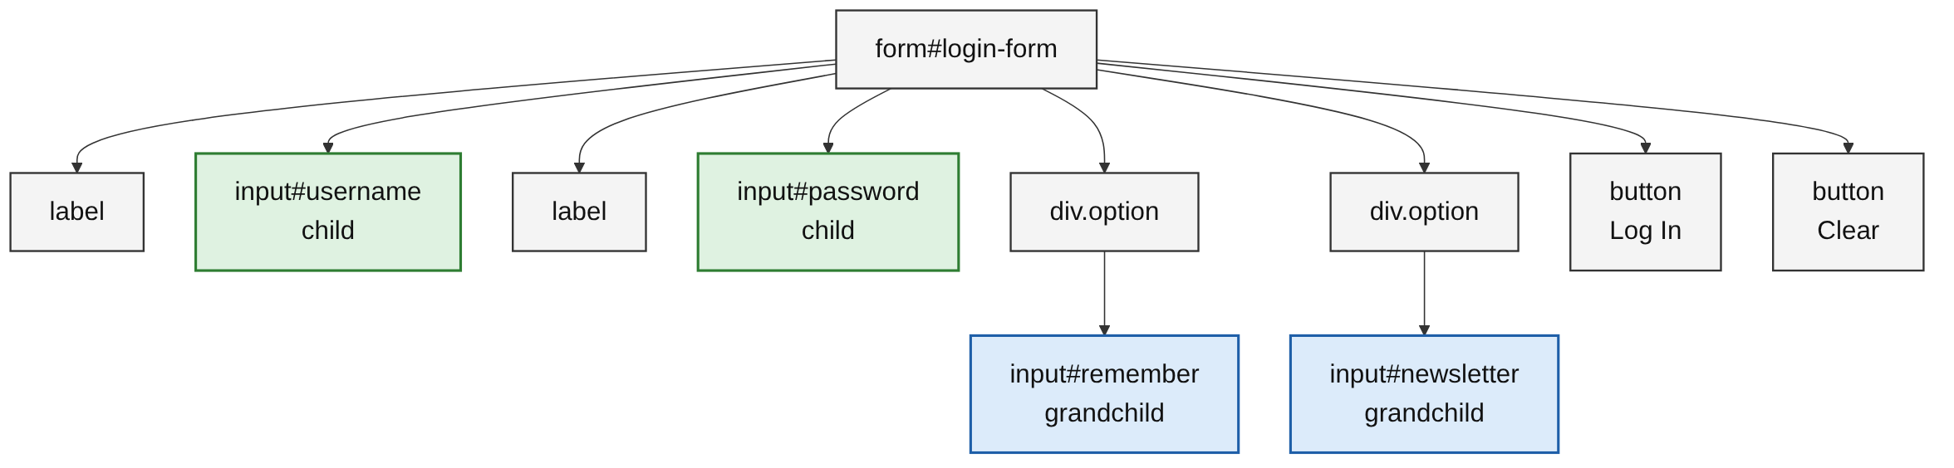
Descendant vs Child
PART 3
#login-form input (descendant): 4 inputs, at any depth.
#login-form > input (child): 2 inputs, username and password.
The checkboxes sit inside div.option: grandchildren, not children.
15 / 35
Notes:
Draw this tree on the board and keep it there for the rest of the lecture. Counts checked in Chromium on a page with this structure. Switch to Demo 4.

Slide 15
Pseudo-classes
04
Select by state or position
16 / 35
Notes:
37-50 min.

Slide 16
State Pseudo-classes
PART 4
Pseudo-class | Matches
:hover | Element under the mouse pointer
:focus | Element that is currently focused (for example, the input you're typing in)
:checked | A checked checkbox or radio button
:disabled | A disabled form element
:enabled | An enabled form element
:required | An input with the required attribute
17 / 35
Notes:
Example rules: button:hover { background: lightblue; } input:focus { outline: 2px solid orange; }

Slide 17
Structural Pseudo-classes
PART 4
Pseudo-class | Matches
:first-child | The first child of its parent
:last-child | The last child of its parent
:nth-child(n) | The nth child (counting starts at 1)
:nth-child(odd) / :nth-child(even) | Odd or even children
:nth-child(2n+1) | A formula; this one is the same as odd
:first-of-type / :nth-of-type(n) | Counts only siblings of the same tag
18 / 35

Slide 18
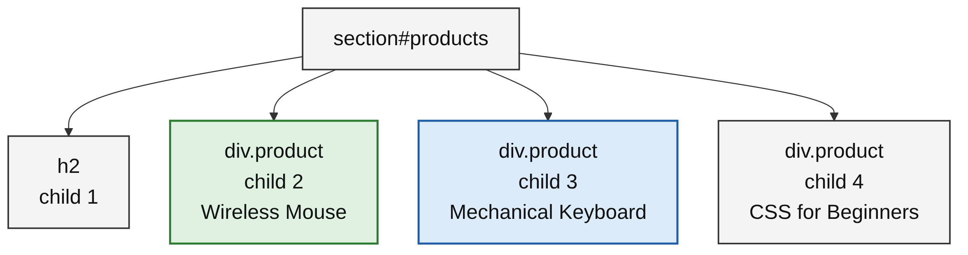
The nth-child Trap
PART 4
:nth-child() counts all children, whatever their tag or class.
.product:nth-child(2): Wireless Mouse, the 1st product.
.product:nth-of-type(2): Mechanical Keyboard, the 2nd div.
19 / 35
Notes:
Rows: #orders-table tbody tr:nth-child(3) is the 3rd row; :nth-child(even) gives rows 2 and 4; :last-child the last row.

Slide 19
The :not() Pseudo-class
PART 4
.product:not(.featured) /* products that are not featured */
input:not([type="checkbox"]) /* inputs that are not checkboxes */
.product:not(.featured): products that are not featured.
input:not([type="checkbox"]): username and password only.
Inside :not() use a class, attribute or other selector.
20 / 35
Notes:
Switch to Demo 5.

Slide 20
Dynamic Selectors
05
Generated IDs and how to avoid brittle selectors
21 / 35
Notes:
50-61 min.

Slide 21
The Problem: Generated IDs
PART 5
<button id="btn_8472">Log In</button> <!-- tomorrow: btn_9913 -->
<div id="msg-39fj2">Welcome back!</div> <!-- next load: msg-k28dq -->
Many web apps generate IDs and classes on every build or load.
#btn_8472 passes today and fails tomorrow, with nothing broken.
These are brittle selectors.
22 / 35

Slide 22
Partial Attribute Matching
PART 5
Selector | Meaning | Example
[attr^="val"] | Starts with | [id^="msg-"]
[attr$="val"] | Ends with | a[href$="/products"]
[attr*="val"] | Contains | [class*="btn-"]
MEMORY TRICK
As in regular expressions: ^ marks the start, $ the end, * anywhere. [id^="product-"] finds all three product cards; a[href^="mailto:"] finds email links.
23 / 35

Slide 23
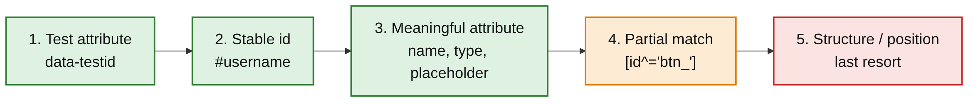
Order of Preference
PART 5
Choose the most stable option the element has.
Test attributes (data-testid, data-test, data-cy) rarely change.
Structure such as form > button:nth-child(7) breaks when the layout changes.
If developers can add data-testid, ask them to.
24 / 35
Notes:
Switch to Demo 6.

Slide 24
XPath Basics
06
A query language for XML and HTML documents
25 / 35
Notes:
61-75 min covers Parts 6 and 7.

Slide 25
Paths and Attributes
PART 6
XPath | Meaning
/ | Direct child (at the start, begins at the root)
// | Any descendant, at any depth
//tag | All elements with that tag
//* | All elements
[@attr='value'] | Attribute equals the value
WHAT IS XPATH?
XPath navigates XML and HTML documents. Automation tools support it alongside CSS. Test it in the Chrome Console with $x("//h2").
26 / 35

Slide 26
Text, Position and Moving Around
PART 6
XPath | Meaning
[contains(@attr,'val')] / [starts-with(@attr,'val')] | Attribute contains / starts with
[text()='Log In'] | Text equals the value
[contains(text(),'Cart')] | Text contains the value
[1], [3], [last()] | Position, counting from 1
/.. or /parent::tag | Up to the parent
/following-sibling::tag, /preceding-sibling::tag | Siblings after / before
27 / 35

Slide 27
Translating CSS to XPath
PART 6
Goal | CSS | XPath
By ID | #username | //input[@id='username']
By class | .price | //p[@class='price']
By attribute | [data-testid="login-submit"] | //*[@data-testid='login-submit']
Starts with | [id^="msg-"] | //*[starts-with(@id,'msg-')]
Descendant | #login-form input | //form[@id='login-form']//input
3rd row | tbody tr:nth-child(3) | //tbody/tr[3]
CLASS TRAP
@class='btn' must match the whole attribute: it finds Clear but not class="btn btn-primary". contains(@class,'btn') finds both, but also matches classes like btn-primary.
28 / 35

Slide 28
CSS vs XPath
07
Start with CSS; switch when CSS cannot do the job
29 / 35

Slide 29
Only XPath Can Do This
PART 7
Goal | CSS | XPath
By visible text | Not possible | //button[text()='Log In']
Parent | Not possible | //h3[text()='CSS for Beginners']/..
Previous sibling | Not possible | //td[text()='Cancelled']/preceding-sibling::td
NOTE
Modern CSS has :has() (.product:has(.featured)), which selects a parent by its children. It still cannot match visible text, so XPath remains the tool for that.
30 / 35

Slide 30
CSS vs XPath
PART 7
 | CSS selectors | XPath
Readability | Short and clean | Longer, more verbose
Speed | Generally faster | Slightly slower (rarely matters)
Match by text | No | Yes
Parent or ancestor | No | Yes
Previous siblings | No | Yes
Used for styling | Yes | No
31 / 35
Notes:
Tool support: CSS works everywhere (stylesheets, JS, every test tool); XPath works in test tools and JS (document.evaluate) but not in stylesheets.

Slide 31
When to Use XPath
PART 7
Use CSS by default: it is faster, easier to read and works in every tool. Use XPath when you need:
//button[text()='Log In']
//h3[text()='CSS for Beginners']/..
//td[text()='ORD-504']/following-sibling::td[2]
Matching visible text: a button that only says Log In.
Moving up to a parent: the card around a product name.
Relative to another element: the status in order ORD-504's row.
32 / 35
Notes:
Switch to Demo 7.

Slide 32
Common Mistakes
WRAP-UP
Space or no space
.btn.btn-primary is one element with both classes; .btn .btn-primary is a descendant.
Child vs descendant
> skips grandchildren: #login-form > input misses the checkboxes.
nth-child counts everything
.product:nth-child(2) is the 1st product, not the 2nd.
Generated IDs
#btn_8472 breaks on the next build. Prefer data-testid or a partial match.
33 / 35

Slide 33
Key Takeaways
SUMMARY
1
One selector syntax serves both styling and test automation.
2
Specificity: ID beats class, class beats element; later wins a tie.
3
Combinators select by relationship; CSS only looks down and forward.
4
Pseudo-classes select by state or position; nth-child counts all children.
5
Prefer test attributes and stable IDs; use partial matches for generated values.
6
Start with CSS; use XPath for text, parents and previous siblings.
34 / 35

Slide 34
Additional Resources
1
CSS selectors (MDN)
https://developer.mozilla.org/en-US/docs/Web/CSS/CSS_selectors
2
Specificity (MDN)
https://developer.mozilla.org/en-US/docs/Web/CSS/Specificity
3
Pseudo-classes (MDN)
https://developer.mozilla.org/en-US/docs/Web/CSS/Pseudo-classes
4
XPath (MDN)
https://developer.mozilla.org/en-US/docs/Web/XPath
35 / 35

