Slide 1
Cypress Foundations
WEEK 5 · CYPRESS LECTURE 1
See how Cypress runs inside the browser, write a first test, and understand the command queue.
Architecture
Layout
Writing tests
Async model
Notes:
Cypress Lecture 1 of 5, about 48 minutes: architecture 10, project layout and run modes 10, writing tests 15, the async model 13. Installation steps are covered in the separate setup guide. Diagram colour legend (code weeks): blue = application or browser under test; green = test code; orange = fixtures, setup and teardown; purple = runner, configuration, CLI; red = failures and errors; black = structure.

Slide 2
Learning Objectives
1
Explain how Cypress differs from Playwright.
2
Describe the Cypress folder layout and the open and run modes.
3
Write a test with describe, it and beforeEach.
4
Explain why cy commands are not awaited.
5
Use .then(), aliases and cy.wrap() to work with values.
Cypress Foundations · Week 5 · Cypress Lecture 1 | 2 / 31

Slide 3
Cypress Architecture
01
Inside the browser, not outside it
Cypress Foundations · Week 5 · Cypress Lecture 1 | 3 / 31

Slide 4
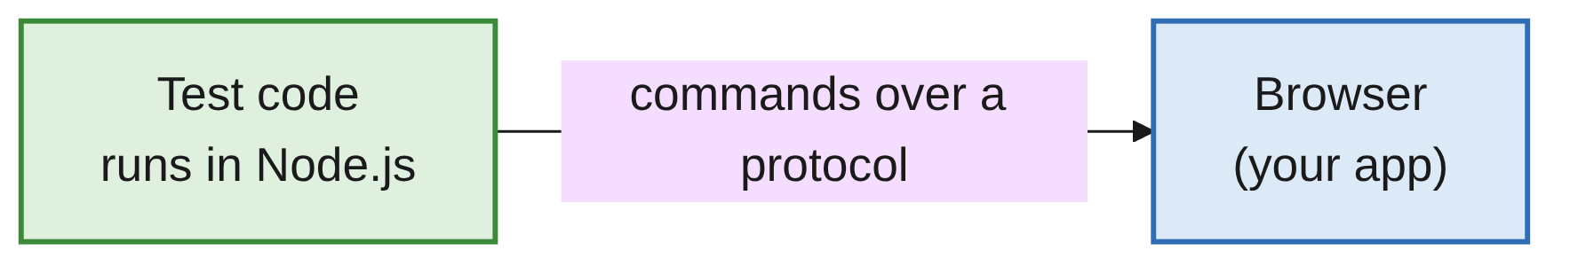
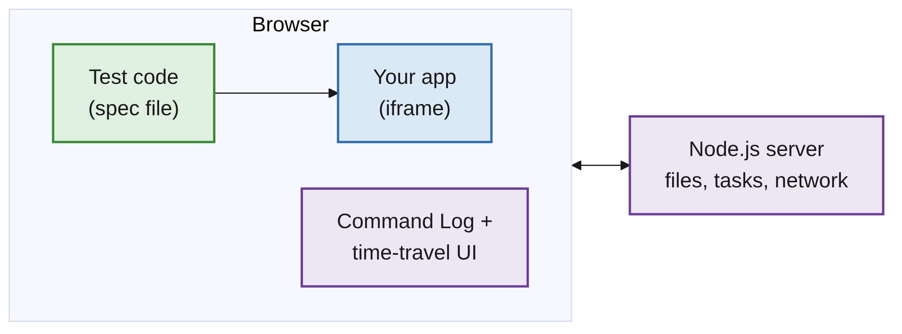
Outside vs Inside the Browser
PART 1
PLAYWRIGHT: FROM OUTSIDE
CYPRESS: INSIDE THE BROWSER
Cypress Foundations · Week 5 · Cypress Lecture 1 | 4 / 31
Notes:
Playwright's test runs in Node.js and sends commands over a protocol. Cypress test code runs in the same browser as the app, next to it in another iframe.

Slide 5
The Parts of a Cypress Run
PART 1
Test code (spec)
Runs in the browser, next to your app.
Your app (iframe)
The page under test, loaded in its own iframe.
Command Log
Lists every command and gives time-travel snapshots.
Node.js server
Does what the browser can't: read files, run tasks, handle network.
Cypress Foundations · Week 5 · Cypress Lecture 1 | 5 / 31

Slide 6
Writing Tests: What Changes
PART 1
 | Playwright | Cypress
Where tests run | Node.js, outside the browser | Inside the browser
Language | JS/TS, Python, Java, .NET | JavaScript/TypeScript only
Waiting | await every action | No await. Commands are queued
Test structure | test(), test.describe() | Mocha: it(), describe()
Assertions | expect(locator).toHaveText() | .should('have.text', ...) (Chai)
Auto-waiting | Yes | Yes. Commands and assertions retry
Cypress Foundations · Week 5 · Cypress Lecture 1 | 6 / 31

Slide 7
Tools and Features: What Changes
PART 1
 | Playwright | Cypress
Fixtures | Setup/teardown functions injected into tests | Static data files (JSON)
Reusable setup | Custom fixtures | Custom commands and hooks
Multiple tabs | Supported | Not supported
Debugging | Trace Viewer, Inspector | Time-travel in the Command Log, DevTools
Recording | Codegen | Cypress Studio
KEY MESSAGE
The pytest and Playwright idea of a fixture does not carry over. In Cypress, a fixture is just a data file.
Cypress Foundations · Week 5 · Cypress Lecture 1 | 7 / 31

Slide 8
Project Layout and Run Modes
02
Where files live and how tests run
Cypress Foundations · Week 5 · Cypress Lecture 1 | 8 / 31

Slide 9
Where Things Live
PART 2
Path | Purpose
cypress.config.js | Configuration, such as baseUrl
cypress/e2e/ | Test files (specs), named *.cy.js
cypress/fixtures/ | Test data files
cypress/support/e2e.js | Runs before every spec
cypress/support/commands.js | Custom commands
Cypress Foundations · Week 5 · Cypress Lecture 1 | 9 / 31

Slide 10
Set a baseUrl
PART 2
CYPRESS.CONFIG.JS
const { defineConfig } = require('cypress');
module.exports = defineConfig({
e2e: {
baseUrl: 'http://localhost:8080',
},
});
With baseUrl set, tests use short paths: cy.visit('/login.html').
Change the site address in one place, not in every test.
Cypress Foundations · Week 5 · Cypress Lecture 1 | 10 / 31

Slide 11
Two Ways to Run Tests
PART 2
Mode | Command | Use it for
Open | npx cypress open | Writing and debugging. You can watch tests run
Run | npx cypress run | Headless runs in the terminal or CI
RULE OF THUMB
Use open mode while you write a test, and run mode for the full suite.
Cypress Foundations · Week 5 · Cypress Lecture 1 | 11 / 31

Slide 12
Writing Cypress Tests
03
Mocha for structure, Chai for assertions
Cypress Foundations · Week 5 · Cypress Lecture 1 | 12 / 31

Slide 13
A First Cypress Test
PART 3
HOME.CY.JS
describe('Home page', () => { // groups tests
beforeEach(() => { // runs before each test
cy.visit('/');
});
it('shows the title', () => { // one test case
cy.get('[data-cy=page-title]').should('have.text', 'Cypress Practice App');
});
});
Mocha gives the structure (describe, it); Chai gives the assertions.
Both are bundled with Cypress: nothing extra to install.
Cypress Foundations · Week 5 · Cypress Lecture 1 | 13 / 31

Slide 14
Mapping from What You Know
PART 3
pytest / unittest | Playwright | Cypress
class TestX | test.describe() | describe()
def test_x() | test() | it()
setUp / function fixture | test.beforeEach() | beforeEach()
setUpClass | test.beforeAll() | before()
tearDown | test.afterEach() | afterEach()
Cypress Foundations · Week 5 · Cypress Lecture 1 | 14 / 31

Slide 15
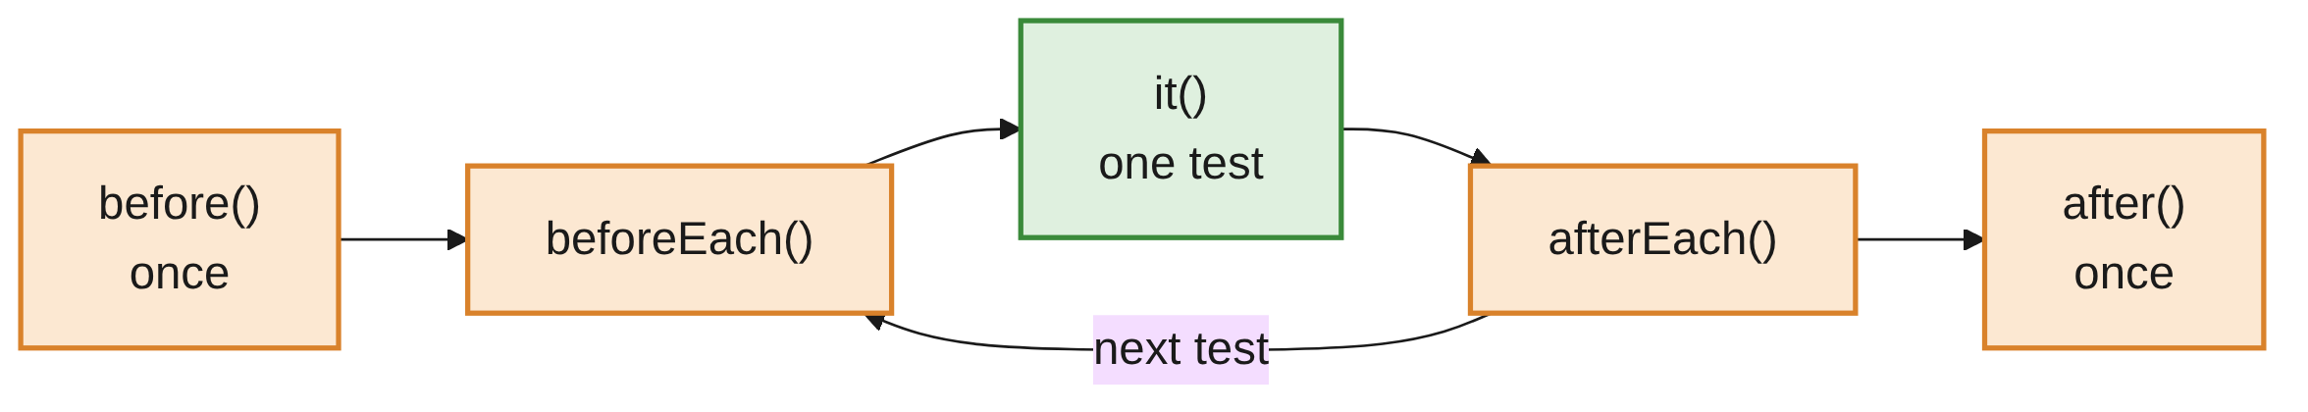
Hooks Run in Order
PART 3
before and after run once per describe block.
beforeEach and afterEach run around every it.
Put shared setup, such as cy.visit(), in beforeEach.
Cypress Foundations · Week 5 · Cypress Lecture 1 | 15 / 31

Slide 16
Useful First Commands
PART 3
cy.visit('/login.html'); // open a page
cy.get('[data-cy=username]'); // find an element
cy.title().should('eq', 'Login'); // check the page title
cy.url().should('include', '/login'); // check the URL
cy.visit() uses baseUrl, so a short path is enough.
cy.title() and cy.url() read page values; .should() checks them.
Cypress Foundations · Week 5 · Cypress Lecture 1 | 16 / 31

Slide 17
The Runner in Open Mode
PART 3
The Command Log on the left lists every command.
Tests re-run automatically when you save the file.
Green and red ticks show passed and failed tests and assertions.
SCREENSHOT: Cypress runner, open mode: Command Log (left) and app preview (right) for the first spec
Cypress Foundations · Week 5 · Cypress Lecture 1 | 17 / 31
Notes:
Live demo: run lecture1-foundations.cy.js in open mode and point out the three items.

Slide 18
Every Test Starts Fresh
PART 3
Cypress clears cookies, localStorage and sessionStorage between tests.
Each test starts from a clean browser state.
Don't rely on state left by a previous test.
Put the steps a test needs in beforeEach, or in the test itself.
Cypress Foundations · Week 5 · Cypress Lecture 1 | 18 / 31

Slide 19
The Async Model
04
The most important idea for Playwright users
Cypress Foundations · Week 5 · Cypress Lecture 1 | 19 / 31

Slide 20
Await vs the Command Queue
PART 4
PLAYWRIGHT: AWAIT EACH ACTION
const title = await page.locator('h1').textContent();
CYPRESS: QUEUED, NO AWAIT
cy.get('h1').should('have.text', 'Cypress Practice App');
Cypress commands are not run when called.
They are queued and run later, one after another.
They do not return the element or the value.
Cypress Foundations · Week 5 · Cypress Lecture 1 | 20 / 31

Slide 21
How the Queue Works
PART 4
First, your test function runs: plain JavaScript executes straight away.
Each cy call only adds a command to the queue.
Then Cypress runs the queued commands in order, waiting and retrying as needed.
Cypress Foundations · Week 5 · Cypress Lecture 1 | 21 / 31

Slide 22
Mistake: Treating cy.get as a Value
PART 4
// WRONG: cy.get() does not return the element
const button = cy.get('[data-cy=increment]');
const text = cy.get('[data-cy=count]').invoke('text');
if (text === '0') { /* never true */ } // text is a Cypress chain
cy.get() returns a chainable Cypress object, not the element.
text is a chain, not a string, so the comparison is never true.
Cypress Foundations · Week 5 · Cypress Lecture 1 | 22 / 31

Slide 23
Mistake: async/await with cy
PART 4
// ALSO WRONG: never use async/await with cy commands
it('broken', async () => {
const title = await cy.title();
});
Cypress commands are not Promises, so await doesn't work on them.
Mixing async tests with the queue gives confusing failures.
Cypress Foundations · Week 5 · Cypress Lecture 1 | 23 / 31

Slide 24
Proof: Commands Are Queued
PART 4
console.log('1. plain JS');
cy.get('[data-cy=page-title]').then(() => console.log('3. inside .then()'));
console.log('2. plain JS');
// Prints 1, 2, 3
Both plain console.log lines run while the queue is being built.
The .then() callback runs only when Cypress reaches that command.
See the order in DevTools (F12) > Console in the runner.
Cypress Foundations · Week 5 · Cypress Lecture 1 | 24 / 31

Slide 25
Right Way 1: .then() for a Value
PART 4
cy.get('[data-cy=count]').invoke('text').then((text) => {
const before = Number(text);
cy.get('[data-cy=increment]').click();
cy.get('[data-cy=count]').should('have.text', String(before + 1));
});
.then() receives the value once the command has run.
Commands inside the callback are queued after it.
Cypress Foundations · Week 5 · Cypress Lecture 1 | 25 / 31

Slide 26
Right Way 2: Aliases with .as()
PART 4
cy.get('[data-cy=increment]').as('plusButton');
cy.get('@plusButton').click();
cy.get('@plusButton').click();
cy.get('[data-cy=count]').should('have.text', '2');
.as('name') saves the element under an alias.
cy.get('@name') refers to it again later in the test.
Cypress Foundations · Week 5 · Cypress Lecture 1 | 26 / 31

Slide 27
Right Way 3: cy.wrap()
PART 4
cy.wrap({ title: 'Cypress Practice App' }).its('title').should('eq', 'Cypress Practice App');
cy.wrap() puts a plain JavaScript value into the command chain.
Then you can use .its() and .should() on it like any subject.
Cypress Foundations · Week 5 · Cypress Lecture 1 | 27 / 31

Slide 28
Which One Do I Need?
PART 4
You want to... | Use
Check something on the page | .should() (most of the time)
Use a value from the page | Get it inside .then()
Refer to the same element again | An alias: .as() and cy.get('@name')
Check a plain JavaScript value | cy.wrap()
RULE OF THUMB
If you only want to check something, use .should(). You rarely need the value itself.
Cypress Foundations · Week 5 · Cypress Lecture 1 | 28 / 31

Slide 29
Common Mistakes
WRAP-UP
Storing cy.get in a variable
It's a chain, not the element. Use .then() or an alias.
Using async/await
cy commands are not Promises. Remove async and await.
Relying on an earlier test
State is cleared between tests. Set it up in beforeEach.
Expecting pytest fixtures
A Cypress fixture is a data file, not a setup function.
Full URLs everywhere
Set baseUrl once and use short paths in cy.visit().
Cypress Foundations · Week 5 · Cypress Lecture 1 | 29 / 31

Slide 30
Key Takeaways
SUMMARY
1
Cypress runs inside the browser, next to your app; a Node.js server handles files and tasks.
2
Specs live in cypress/e2e/; npx cypress open to write, npx cypress run for headless.
3
Tests use Mocha (describe, it, hooks) and Chai assertions.
4
cy commands are queued and run later. They do not return values.
5
Use .should() to check, .then() to use a value, aliases to reuse an element.
Cypress Foundations · Week 5 · Cypress Lecture 1 | 30 / 31

Slide 31
Additional Resources
1
Introduction to Cypress
https://docs.cypress.io/app/core-concepts/introduction-to-cypress
2
Open mode and the Command Log
https://docs.cypress.io/app/core-concepts/open-mode
3
.then() command
https://docs.cypress.io/api/commands/then
4
cy.wrap() command
https://docs.cypress.io/api/commands/wrap
Cypress Foundations · Week 5 · Cypress Lecture 1 | 31 / 31

