Slide 1
Locate, Interact, Assert
WEEK 5 · CYPRESS LECTURE 2
Find elements reliably, act on them like a user, and check results with retrying assertions.
Locate
Interact
Assert
Retry-ability
Notes:
Cypress Lecture 2 of 5, about 50 minutes: location 12, interaction 15, assertions 18. Practice pages: todo.html (location and interaction), index.html (retry-ability), login.html. Diagram colour legend (code weeks): blue = application or browser under test; green = test code; orange = fixtures, setup and teardown; purple = runner, configuration, CLI; red = failures and errors; black = structure.

Slide 2
Learning Objectives
1
Find elements with cy.get, cy.contains, .find and .within.
2
Explain why data-cy attributes are the most reliable selectors.
3
Click, type, clear, check and select elements.
4
Write assertions with .should() and expect().
5
Explain retry-ability and avoid fixed waits.
Locate, Interact, Assert · Week 5 · Cypress Lecture 2 | 2 / 28

Slide 3
Element Location
01
Finding the right element
Locate, Interact, Assert · Week 5 · Cypress Lecture 2 | 3 / 28

Slide 4
cy.get(): Find by CSS Selector
PART 1
cy.get('[data-cy=new-todo]'); // data attribute (best)
cy.get('#filter'); // id
cy.get('.todos'); // class
cy.get('input[placeholder="What needs to be done?"]'); // any attribute
cy.get() takes any CSS selector.
It retries until the element appears or the timeout runs out.
Locate, Interact, Assert · Week 5 · Cypress Lecture 2 | 4 / 28

Slide 5
cy.contains(): Find by Text
PART 1
cy.contains('Write first test'); // any element with this text
cy.contains('button', 'Clear completed'); // a <button> with this text
cy.contains('[data-cy=todo-item]', 'Buy milk'); // a todo item with this text
Give only the text, or a selector plus the text.
Adding a selector avoids matching the wrong element.
Locate, Interact, Assert · Week 5 · Cypress Lecture 2 | 5 / 28

Slide 6
Narrowing Down: .find and .within
PART 1
cy.get('[data-cy=todo-list]').find('[data-cy=todo-item]'); // search inside an element
cy.get('[data-cy=todo-item]').first().within(() => { // scope all commands inside
cy.get('[data-cy=todo-text]').should('have.text', 'Install Cypress');
});
.find() searches only inside the current element.
.within() scopes every command in the callback to that element.
Locate, Interact, Assert · Week 5 · Cypress Lecture 2 | 6 / 28

Slide 7
Picking One: .first, .last, .eq
PART 1
cy.get('[data-cy=todo-text]').first(); // first match
cy.get('[data-cy=todo-text]').last(); // last match
cy.get('[data-cy=todo-text]').eq(1); // by index (0-based)
.eq() counts from 0, so .eq(0) is the same as .first().
Prefer a precise selector when you can; position can change.
Locate, Interact, Assert · Week 5 · Cypress Lecture 2 | 7 / 28

Slide 8
Which Selector to Use?
PART 1
Selector | Example | Reliability
data-cy attribute | [data-cy=submit] | Best. Only exists for tests
Text | cy.contains('Log in') | Good, but breaks if the wording changes
id | #submit | OK, but ids may change
Class | .btn-primary | Poor. Classes change with styling
Position | div > ul > li:nth-child(3) | Avoid. Breaks with any layout change
Locate, Interact, Assert · Week 5 · Cypress Lecture 2 | 8 / 28

Slide 9
Locators: Playwright vs Cypress
PART 1
Playwright | Cypress
page.locator('css') | cy.get('css')
page.getByText('x') | cy.contains('x')
page.getByTestId('x') | cy.get('[data-cy=x]')
locator.nth(1) | .eq(1)
locator.locator('child') | .find('child')
NOTE
Cypress has no built-in getByRole.
Locate, Interact, Assert · Week 5 · Cypress Lecture 2 | 9 / 28

Slide 10
The Selector Playground
PART 1
Click the crosshair icon in the runner.
Click an element in the app preview.
Cypress suggests a selector, and it prefers data-cy.
Copy it into your test.
SCREENSHOT: Cypress runner: Selector Playground (crosshair icon) suggesting a data-cy selector
Locate, Interact, Assert · Week 5 · Cypress Lecture 2 | 10 / 28

Slide 11
Element Interaction
02
Type, click, check and select
Locate, Interact, Assert · Week 5 · Cypress Lecture 2 | 11 / 28

Slide 12
Typing and Clearing
PART 2
cy.get('[data-cy=new-todo]').type('Learn Cypress'); // type text
cy.get('[data-cy=new-todo]').type('Buy milk{enter}'); // special keys in {}
cy.get('[data-cy=new-todo]').clear(); // empty an input
Special keys go in braces: {enter}, {esc}, {backspace}, {selectall}.
Modifier keys: {ctrl}, {shift}, {alt}.
.type() can't press Tab: use cy.press(Cypress.Keyboard.Keys.TAB).
Locate, Interact, Assert · Week 5 · Cypress Lecture 2 | 12 / 28

Slide 13
Clicking and Other Events
PART 2
cy.get('[data-cy=add-todo]').click(); // click
cy.get('[data-cy=add-todo]').dblclick(); // double-click
cy.get('[data-cy=add-todo]').rightclick(); // right-click
cy.get('[data-cy=add-todo]').trigger('mouseover'); // fire any DOM event
.trigger() fires any DOM event, for example to show a hover tooltip.
Locate, Interact, Assert · Week 5 · Cypress Lecture 2 | 13 / 28

Slide 14
Checkboxes and Dropdowns
PART 2
cy.get('[data-cy=todo-toggle]').eq(1).check(); // tick a checkbox or radio
cy.get('[data-cy=todo-toggle]').eq(1).uncheck(); // untick a checkbox
cy.get('[data-cy=filter]').select('Completed'); // dropdown, by visible text
cy.get('[data-cy=filter]').select('active'); // dropdown, by value
.check() works for checkboxes and radio buttons.
.select() accepts the visible text or the option's value.
Locate, Interact, Assert · Week 5 · Cypress Lecture 2 | 14 / 28

Slide 15
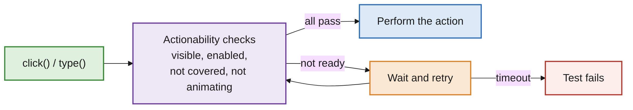
Actionability: Cypress Waits for You
PART 2
SKIP THE CHECKS ONLY WHEN YOU HAVE TO
cy.get('[data-cy=hidden-button]').click({ force: true });
Before clicking or typing, Cypress waits until the element is ready.
Same idea as Playwright's auto-waiting.
Locate, Interact, Assert · Week 5 · Cypress Lecture 2 | 15 / 28

Slide 16
Assertions
03
Check results with .should() and expect()
Locate, Interact, Assert · Week 5 · Cypress Lecture 2 | 16 / 28

Slide 17
.should(): Count, Class and State
PART 3
cy.get('[data-cy=todo-item]').should('have.length', 2);
cy.get('[data-cy=todo-item]').first().should('have.class', 'completed');
cy.get('[data-cy=todo-toggle]').first().should('be.checked');
cy.get('[data-cy=todo-toggle]').last().should('not.be.checked');
.should() is the main way to assert in Cypress.
Add not. to turn any assertion around.
Locate, Interact, Assert · Week 5 · Cypress Lecture 2 | 17 / 28

Slide 18
.should(): Values, Text, Existence
PART 3
cy.get('[data-cy=new-todo]').should('have.value', '');
cy.get('[data-cy=new-todo]').should('have.attr', 'placeholder', 'What needs to be done?');
cy.get('[data-cy=todo-count]').should('contain', 'item');
cy.get('[data-cy=message]').should('be.visible');
cy.get('[data-cy=login-error]').should('not.exist');
not.exist passes when the element is not in the DOM at all.
Locate, Interact, Assert · Week 5 · Cypress Lecture 2 | 18 / 28

Slide 19
Chaining with .and()
PART 3
cy.get('[data-cy=page-title]')
.should('be.visible')
.and('have.text', 'Cypress Practice App')
.and('have.css', 'font-weight', '700');
.and() is the same as .should(): it reads better in a chain.
All the assertions apply to the same element.
Locate, Interact, Assert · Week 5 · Cypress Lecture 2 | 19 / 28

Slide 20
Assertions for Text and Values
PART 3
Assertion | Checks
have.text / contain | Exact text / partial text
have.value | Input value
have.length | Number of elements
eq / include | Values such as cy.url() and cy.title()
Locate, Interact, Assert · Week 5 · Cypress Lecture 2 | 20 / 28

Slide 21
Assertions for State and Style
PART 3
Assertion | Checks
be.visible / not.be.visible | Visibility
exist / not.exist | In the DOM or not
be.checked / be.disabled / be.enabled | Form state
have.class / have.attr / have.css | Attributes and styles
Locate, Interact, Assert · Week 5 · Cypress Lecture 2 | 21 / 28

Slide 22
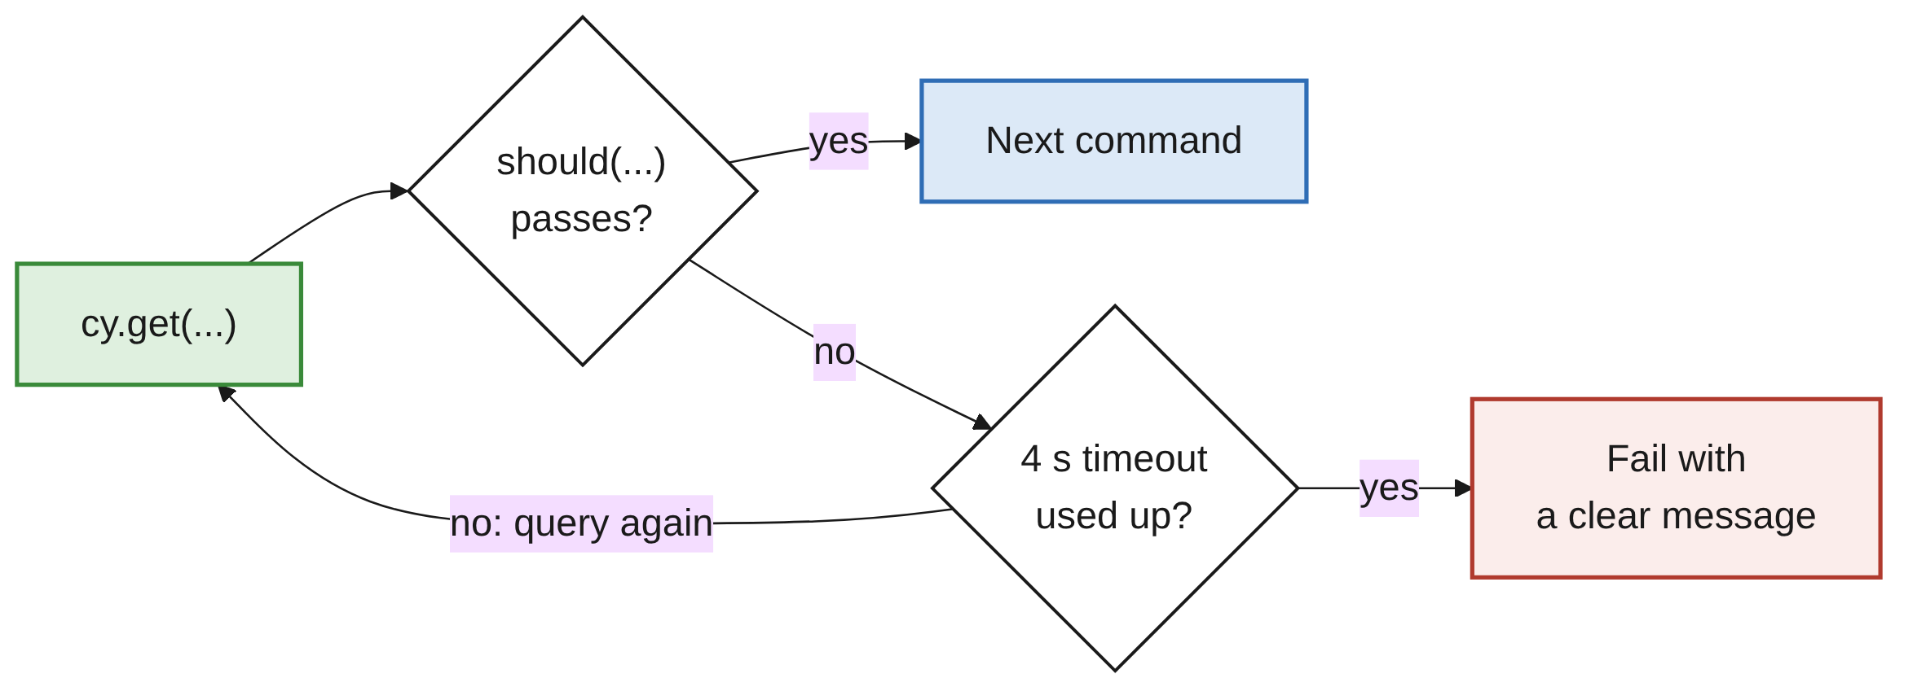
Retry-ability
PART 3
.should() re-runs the query before it until the assertion passes.
It stops when the timeout runs out: 4 seconds by default.
No manual waits needed for elements that appear late.
Locate, Interact, Assert · Week 5 · Cypress Lecture 2 | 22 / 28

Slide 23
Retrying in Practice
PART 3
A MESSAGE THAT APPEARS AFTER A DELAY
cy.get('[data-cy=show-message]').click();
// The message appears after 1.5 s. Cypress retries, no wait needed.
cy.get('[data-cy=message]').should('be.visible');
A SLOW ELEMENT: RAISE THE TIMEOUT
cy.get('[data-cy=message]', { timeout: 10000 }).should('be.visible');
Avoid cy.wait(2000): a fixed wait is slow and still flaky.
Assert on what you are waiting for instead.
Locate, Interact, Assert · Week 5 · Cypress Lecture 2 | 23 / 28

Slide 24
expect() Inside .then()
PART 3
cy.get('[data-cy=todo-text]').then(($items) => {
const texts = [...$items].map((el) => el.innerText);
expect(texts).to.deep.equal(['Install Cypress', 'Write first test']);
});
expect is Chai's BDD style, like pytest's assert.
It does not retry, so use it for values you already have.
Typical use: checks on a list of texts or other computed values.
Locate, Interact, Assert · Week 5 · Cypress Lecture 2 | 24 / 28

Slide 25
Assertions: Playwright vs Cypress
PART 3
Playwright | Cypress
await expect(loc).toHaveText('x') | .should('have.text', 'x')
await expect(loc).toBeVisible() | .should('be.visible')
await expect(loc).toHaveCount(2) | .should('have.length', 2)
expect(value).toBe(1) | expect(value).to.equal(1)
Locate, Interact, Assert · Week 5 · Cypress Lecture 2 | 25 / 28

Slide 26
Common Mistakes
WRAP-UP
Styling-based selectors
Classes change with styling. Use data-cy attributes.
Fixed waits
cy.wait(2000) is slow and flaky. Assert on the element instead.
expect() on live elements
expect doesn't retry. Use .should() for the page.
Pressing Tab with .type()
Not supported. Use cy.press(Cypress.Keyboard.Keys.TAB).
force: true by default
It hides real problems. Use it only when you have to.
Locate, Interact, Assert · Week 5 · Cypress Lecture 2 | 26 / 28

Slide 27
Key Takeaways
SUMMARY
1
Find with cy.get (CSS) and cy.contains (text); narrow with .find and .within.
2
data-cy selectors are the most reliable because they exist only for tests.
3
.type, .click, .check, .select act like a user, after actionability checks.
4
.should() and .and() retry for up to 4 seconds: no fixed waits.
5
Use expect() inside .then() for values you already have.
Locate, Interact, Assert · Week 5 · Cypress Lecture 2 | 27 / 28

Slide 28
Additional Resources
1
cy.get()
https://docs.cypress.io/api/commands/get
2
cy.contains()
https://docs.cypress.io/api/commands/contains
3
.should()
https://docs.cypress.io/api/commands/should
4
cy.press()
https://docs.cypress.io/api/commands/press
Locate, Interact, Assert · Week 5 · Cypress Lecture 2 | 28 / 28

