Slide 1
Organizing Tests
WEEK 5 · CYPRESS LECTURE 3
Choose which tests run, load test data, reuse steps, stub the network and pick a browser.
Selection
Fixtures
Commands
Intercept
Browsers
Notes:
Cypress Lecture 3 of 5, about 50 minutes: selection 8, fixtures 15, custom commands 12, cy.intercept demo 8, browsers 7. Diagram colour legend (code weeks): blue = application or browser under test; green = test code; orange = fixtures, setup and teardown; purple = runner, configuration, CLI; red = failures and errors; black = structure.

Slide 2
Learning Objectives
1
Run one test, skip a test or run selected spec files.
2
Load test data from fixture files and write data-driven tests.
3
Write custom commands to reuse steps such as logging in.
4
Stub an API response with cy.intercept.
5
Choose a browser, run headed or headless, and change the viewport.
Organizing Tests · Week 5 · Cypress Lecture 3 | 2 / 29

Slide 3
Test Selection
01
Run only what you need
Organizing Tests · Week 5 · Cypress Lecture 3 | 3 / 29

Slide 4
In Code: .only and .skip
PART 1
it.only('runs only this test', () => { ... }); // like pytest -k for one test
it.skip('skips this test', () => { ... }); // shown as "pending"
describe.only('runs only this group', () => { ... });
describe.skip('skips this group', () => { ... });
WARNING
Remove .only before committing, or the rest of the suite silently stops running in CI.
Organizing Tests · Week 5 · Cypress Lecture 3 | 4 / 29

Slide 5
From the Command Line: --spec
PART 1
npx cypress run --spec cypress/e2e/lecture3-organizing.cy.js
npx cypress run --spec "cypress/e2e/solutions/*.cy.js"
npx cypress run --spec "cypress/e2e/lecture1*.cy.js,cypress/e2e/lecture2*.cy.js"
One file, a glob pattern, or a comma-separated list.
Quote patterns so the shell doesn't expand them.
Organizing Tests · Week 5 · Cypress Lecture 3 | 5 / 29

Slide 6
Tags with @cypress/grep
PART 1
TAG A TEST
it('logs in', { tags: '@smoke' }, () => { ... });
RUN ONLY THAT TAG
npx cypress run --expose grepTags=@smoke
Cypress has no built-in tags; the official @cypress/grep plugin adds them.
Cypress 15.10+ uses --expose; older guides use --env.
Good to know about: we don't set it up in class.
Organizing Tests · Week 5 · Cypress Lecture 3 | 6 / 29

Slide 7
Selection Across Tools
PART 1
pytest | Playwright | Cypress
pytest -k name | test.only, --grep | it.only, @cypress/grep
@pytest.mark.skip | test.skip() | it.skip()
pytest tests/test_x.py | npx playwright test x.spec.ts | --spec path
Organizing Tests · Week 5 · Cypress Lecture 3 | 7 / 29

Slide 8
Fixtures
02
Static test data, not setup functions
Organizing Tests · Week 5 · Cypress Lecture 3 | 8 / 29

Slide 9
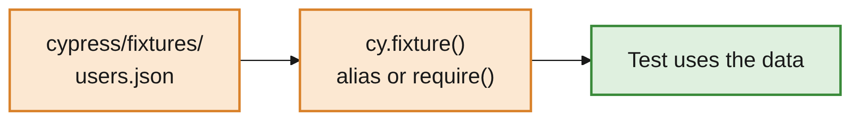
A Cypress Fixture Is a Data File
PART 2
Fixtures are static data files in cypress/fixtures/.
They are not setup functions, unlike Playwright and pytest fixtures.
For reusable setup, use hooks and custom commands (Part 3).
Organizing Tests · Week 5 · Cypress Lecture 3 | 9 / 29

Slide 10
An Example Fixture
PART 2
CYPRESS/FIXTURES/USERS.JSON
{
"valid": [
{ "username": "student", "password": "cypress123" },
{ "username": "admin", "password": "admin123" }
],
"invalid": { "username": "student", "password": "wrong-password" }
}
One file can hold several groups of test data.
Tests read it in one of three ways.
Organizing Tests · Week 5 · Cypress Lecture 3 | 10 / 29

Slide 11
Way 1: cy.fixture().then()
PART 2
cy.fixture('users.json').then((users) => {
cy.login(users.valid[0].username, users.valid[0].password);
});
The data arrives inside .then(), like any other value (Lecture 1).
Simple and explicit: good for one test.
Organizing Tests · Week 5 · Cypress Lecture 3 | 11 / 29

Slide 12
Way 2: Alias in beforeEach
PART 2
beforeEach(function () {
cy.fixture('users.json').as('users');
});
it('uses the fixture', function () { // must be function(), not () =>
cy.get('[data-cy=username]').type(this.users.invalid.username);
});
The alias is available as this.users in every test.
Arrow functions have no own this, so this.users is undefined in () => {}.
Organizing Tests · Week 5 · Cypress Lecture 3 | 12 / 29

Slide 13
Way 3: require() for Data-Driven Tests
PART 2
const users = require('../fixtures/users.json');
users.valid.forEach(({ username, password }) => {
it(`logs in as ${username}`, () => {
cy.login(username, password);
cy.get('[data-cy=welcome]').should('have.text', `Welcome, ${username}!`);
});
});
Creates one test per user: the Cypress version of @pytest.mark.parametrize.
require() reads the file when the spec loads, so you can loop over it.
Organizing Tests · Week 5 · Cypress Lecture 3 | 13 / 29

Slide 14
Custom Commands
03
Reuse steps across every spec
Organizing Tests · Week 5 · Cypress Lecture 3 | 14 / 29

Slide 15
Write a Custom Command
PART 3
// cypress/support/commands.js
Cypress.Commands.add('login', (username, password) => {
cy.visit('/login.html');
cy.get('[data-cy=username]').type(username);
cy.get('[data-cy=password]').type(password, { log: false }); // hidden in the log
cy.get('[data-cy=login-submit]').click();
});
The closest Cypress equivalent to Playwright's custom fixtures.
Commands in cypress/support/commands.js are available in every spec.
Organizing Tests · Week 5 · Cypress Lecture 3 | 15 / 29

Slide 16
Small Helper Commands
PART 3
DEFINE
Cypress.Commands.add('addTodo', (text) => {
cy.get('[data-cy=new-todo]').type(`${text}{enter}`);
});
Cypress.Commands.add('getByCy', (value) => cy.get(`[data-cy=${value}]`));
USE: CY.<COMMANDNAME>()
cy.login('student', 'cypress123');
cy.addTodo('Buy milk');
cy.getByCy('todo-item').should('have.length', 3);
Organizing Tests · Week 5 · Cypress Lecture 3 | 16 / 29

Slide 17
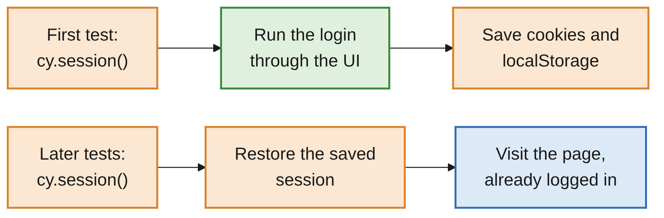
cy.session(): Log In Once, Reuse It
PART 3
Cypress.Commands.add('loginWithSession', (username, password) => {
cy.session([username, password], () => {
cy.login(username, password);
cy.url().should('include', '/dashboard.html');
});
});
Organizing Tests · Week 5 · Cypress Lecture 3 | 17 / 29
Notes:
cy.login() goes through the UI in every test, which is slow. cy.session() is similar to Playwright's storageState. Usage: cy.loginWithSession('student', 'cypress123'); then cy.visit('/dashboard.html') is already logged in.

Slide 18
Hooks vs Custom Commands
PART 3
Need | Use
The same setup before every test in a file | beforeEach()
A reusable step across many files | Custom command
Expensive setup, such as login, shared across tests | cy.session() inside a custom command
Organizing Tests · Week 5 · Cypress Lecture 3 | 18 / 29

Slide 19
cy.intercept
04
Control the network
Organizing Tests · Week 5 · Cypress Lecture 3 | 19 / 29

Slide 20
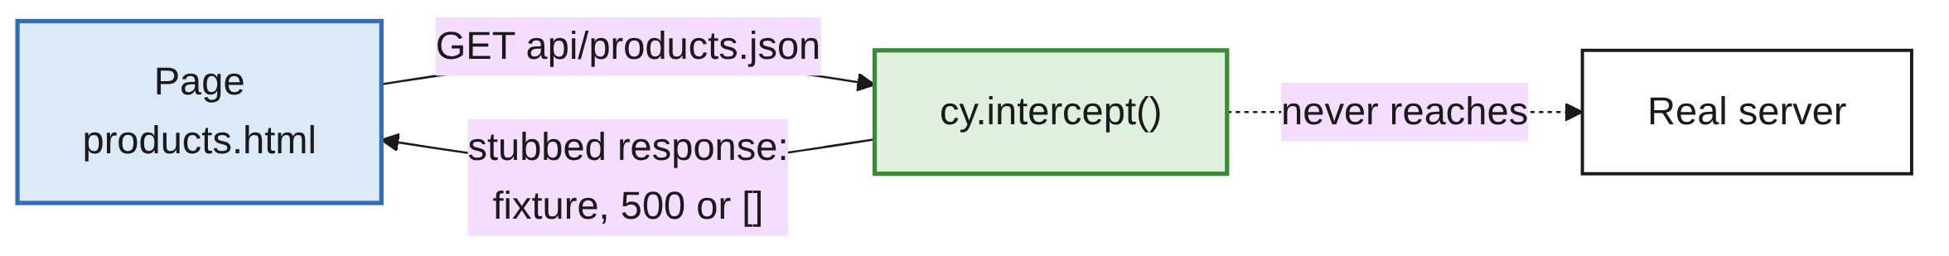
What cy.intercept Does
PART 4
Watches or changes network requests, like Playwright's page.route().
Test error and empty states without changing the server.
Tests don't depend on real backend data.
Organizing Tests · Week 5 · Cypress Lecture 3 | 20 / 29

Slide 21
Stub a Response with a Fixture
PART 4
cy.intercept('GET', '**/api/products.json', { fixture: 'products.json' }).as('getProducts');
cy.visit('/products.html');
cy.wait('@getProducts'); // wait for the request to happen
cy.get('[data-cy=product]').should('have.length', 2);
The page receives the two products from the fixture, not the real list.
cy.wait('@alias') waits for the request, not a fixed time.
Organizing Tests · Week 5 · Cypress Lecture 3 | 21 / 29

Slide 22
Simulate Errors and Empty Lists
PART 4
// Simulate a server error
cy.intercept('GET', '**/api/products.json', { statusCode: 500 });
// Simulate an empty list
cy.intercept('GET', '**/api/products.json', { body: [] });
Always call cy.intercept() before the action that triggers the request.
Usually that means before cy.visit(): the page requests data while loading.
Organizing Tests · Week 5 · Cypress Lecture 3 | 22 / 29

Slide 23
Browser Management
05
Browsers, headed mode and viewports
Organizing Tests · Week 5 · Cypress Lecture 3 | 23 / 29

Slide 24
Choosing a Browser
PART 5
npx cypress run # Electron, headless (default)
npx cypress run --browser chrome # Chrome, headless
npx cypress run --browser firefox # Firefox
npx cypress run --browser edge # Edge
npx cypress run --headed # show the browser window
npx cypress open --browser chrome # open mode with Chrome preselected
Cypress uses the browsers installed on the machine, plus bundled Electron.
In open mode, pick the browser from the drop-down at the top of the runner.
Organizing Tests · Week 5 · Cypress Lecture 3 | 24 / 29

Slide 25
Viewport and Browser Info
PART 5
SET THE VIEWPORT IN A TEST
cy.viewport('iphone-x'); // preset
cy.viewport(1280, 720); // width, height
LOG WHICH BROWSER IS RUNNING
cy.log(`Browser: ${Cypress.browser.name}, headless: ${Cypress.browser.isHeadless}`);
Or set a default in cypress.config.js: viewportWidth: 1280, viewportHeight: 720.
Organizing Tests · Week 5 · Cypress Lecture 3 | 25 / 29

Slide 26
Browsers: Playwright vs Cypress
PART 5
Playwright | Cypress
chromium, firefox, webkit projects | --browser chrome/firefox/edge/electron (WebKit is experimental)
New context per test | Automatic: Cypress clears state between tests
Multiple tabs and pages | Not supported
storageState | cy.session()
Organizing Tests · Week 5 · Cypress Lecture 3 | 26 / 29

Slide 27
Common Mistakes
WRAP-UP
Committing .only
The rest of the suite silently stops running in CI.
Arrow function with this
this.users is undefined. Use function () {}.
Fixture as setup
Fixtures are data. Put setup in hooks or custom commands.
Intercept after visit
The request has already happened. Intercept first.
UI login in every test
Slow. Wrap it in cy.session().
Organizing Tests · Week 5 · Cypress Lecture 3 | 27 / 29

Slide 28
Key Takeaways
SUMMARY
1
.only and .skip select tests in code; --spec selects files.
2
A Cypress fixture is a JSON data file: read it with cy.fixture, an alias or require().
3
Custom commands in support/commands.js reuse steps; cy.session() caches logins.
4
cy.intercept() stubs responses; set it up before the request happens.
5
--browser, --headed and cy.viewport() control where and how tests run.
Organizing Tests · Week 5 · Cypress Lecture 3 | 28 / 29

Slide 29
Additional Resources
1
cy.fixture()
https://docs.cypress.io/api/commands/fixture
2
Custom commands
https://docs.cypress.io/api/cypress-api/custom-commands
3
cy.session()
https://docs.cypress.io/api/commands/session
4
cy.intercept()
https://docs.cypress.io/api/commands/intercept
5
cy.viewport()
https://docs.cypress.io/api/commands/viewport
Organizing Tests · Week 5 · Cypress Lecture 3 | 29 / 29

