Slide 1
Debugging and Evidence
WEEK 5 · CYPRESS LECTURE 4
Find out why a test failed with time-travel and debugging tools, then save logs, screenshots and video.
Time-travel
Debug tools
Logging
Screenshots
Video
Notes:
Cypress Lecture 4 of 5, about 45 minutes: time-travel 15, debugging actions 12, logging 5, screenshots and video 13. Run the lecture in open mode with DevTools open (F12). Diagram colour legend (code weeks): blue = application or browser under test; green = test code; orange = fixtures, setup and teardown; purple = runner, configuration, CLI; red = failures and errors; black = structure.

Slide 2
Learning Objectives
1
Use the Command Log and time-travel snapshots to find why a test failed.
2
Stop a test with cy.pause(), .debug() and debugger.
3
Log to the Command Log, the browser console and the terminal.
4
Take screenshots, and turn on video recording for cypress run.
Debugging and Evidence · Week 5 · Cypress Lecture 4 | 2 / 25

Slide 3
Time-Travel Debugging
01
See the page at every step
Debugging and Evidence · Week 5 · Cypress Lecture 4 | 3 / 25

Slide 4
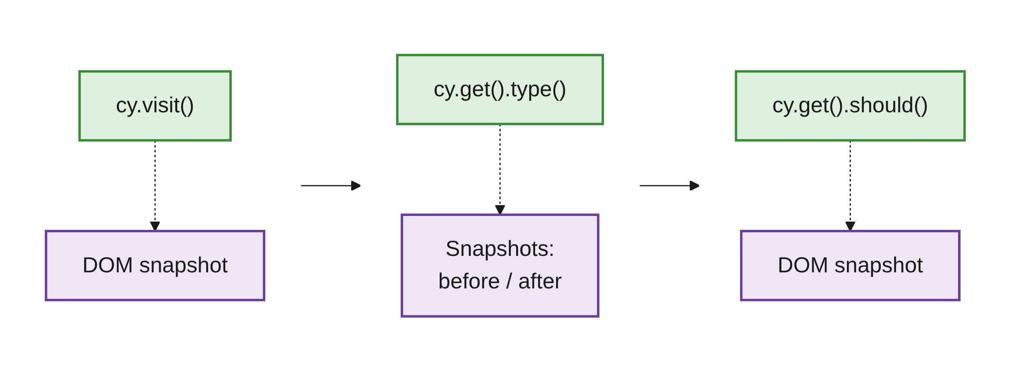
A Snapshot at Every Command
PART 1
Cypress takes a DOM snapshot at every command.
Like Playwright's Trace Viewer, but live in the runner.
Use open mode (npx cypress open) with DevTools open: most features only work there.
Debugging and Evidence · Week 5 · Cypress Lecture 4 | 4 / 25

Slide 5
Using Time-Travel
PART 1
Hover a command: the preview shows the page at that moment.
Click a command to pin the snapshot.
For type and click, toggle before / after.
A red dot shows where Cypress clicked.
Pinned: DevTools Console prints the element, matches and value.
Click again or unpin to return to the live page.
SCREENSHOT: Cypress runner: a pinned type command with the before / after toggle and the click marker
Debugging and Evidence · Week 5 · Cypress Lecture 4 | 5 / 25

Slide 6
Reading a Failure
PART 1
The red command that failed.
The error message, such as "Timed out retrying after 4000ms".
A code frame pointing to the line in your spec. Click it to open the file.
SCREENSHOT: Cypress runner: failed test with the red command, error message and code frame
Debugging and Evidence · Week 5 · Cypress Lecture 4 | 6 / 25

Slide 7
Three Usual Causes of a Failure
PART 1
Wrong selector
The element is not found.
Wrong expected value
The text or value differs from what the test expects.
A step that didn't happen
For example, a form that was never submitted.
TIP
Time-travel to the step before the failure and look at the page.
Debugging and Evidence · Week 5 · Cypress Lecture 4 | 7 / 25

Slide 8
Debugging Actions
02
Stop the test and look around
Debugging and Evidence · Week 5 · Cypress Lecture 4 | 8 / 25

Slide 9
Four Ways to Stop and Inspect
PART 2
Tool | What it does | Works in
cy.pause() | Stops the test. Click Resume, or Next to step one command | Open mode only
.debug() | Stops and exposes the current element as subject | Open mode, DevTools open
debugger | The standard JS breakpoint. Use it inside .then() | DevTools open
.then(console.log) | Prints the subject without stopping | Anywhere
Debugging and Evidence · Week 5 · Cypress Lecture 4 | 9 / 25

Slide 10
cy.pause() and .debug()
PART 2
CY.PAUSE(): STEP THROUGH COMMANDS
cy.visit('/todo.html');
cy.pause(); // test stops here, then step with "Next"
cy.get('[data-cy=new-todo]').type('After the pause{enter}');
.DEBUG(): INSPECT THE CURRENT ELEMENT
cy.get('[data-cy=todo-item]').first().debug();
// In DevTools console, type: subject
Debugging and Evidence · Week 5 · Cypress Lecture 4 | 10 / 25

Slide 11
.debug() Keeps the Chain Going
PART 2
cy.visit('/todo.html');
// With DevTools open, .debug() stops here and exposes the element as `subject`.
cy.get('[data-cy=todo-item]').first().debug().should('have.class', 'completed');
.debug() passes the same element on, so you can keep chaining.
Remove it when you are done: it only helps while DevTools is open.
Debugging and Evidence · Week 5 · Cypress Lecture 4 | 11 / 25

Slide 12
debugger: Only Inside .then()
PART 2
TOO EARLY
// WRONG: runs when the test is queued, before anything has happened
debugger;
cy.get('[data-cy=count]');
AT THE RIGHT MOMENT
// RIGHT: runs when Cypress reaches this command
cy.get('[data-cy=count]').then(($count) => {
debugger;
});
The async model again: plain JS runs before the queued commands.
Debugging and Evidence · Week 5 · Cypress Lecture 4 | 12 / 25

Slide 13
Debugging: Playwright vs Cypress
PART 2
Playwright | Cypress
await page.pause() | cy.pause()
PWDEBUG=1 / Inspector | Open mode and the Command Log
Trace Viewer | Time-travel snapshots
Debugging and Evidence · Week 5 · Cypress Lecture 4 | 13 / 25

Slide 14
Logging
03
Command Log, browser console and terminal
Debugging and Evidence · Week 5 · Cypress Lecture 4 | 14 / 25

Slide 15
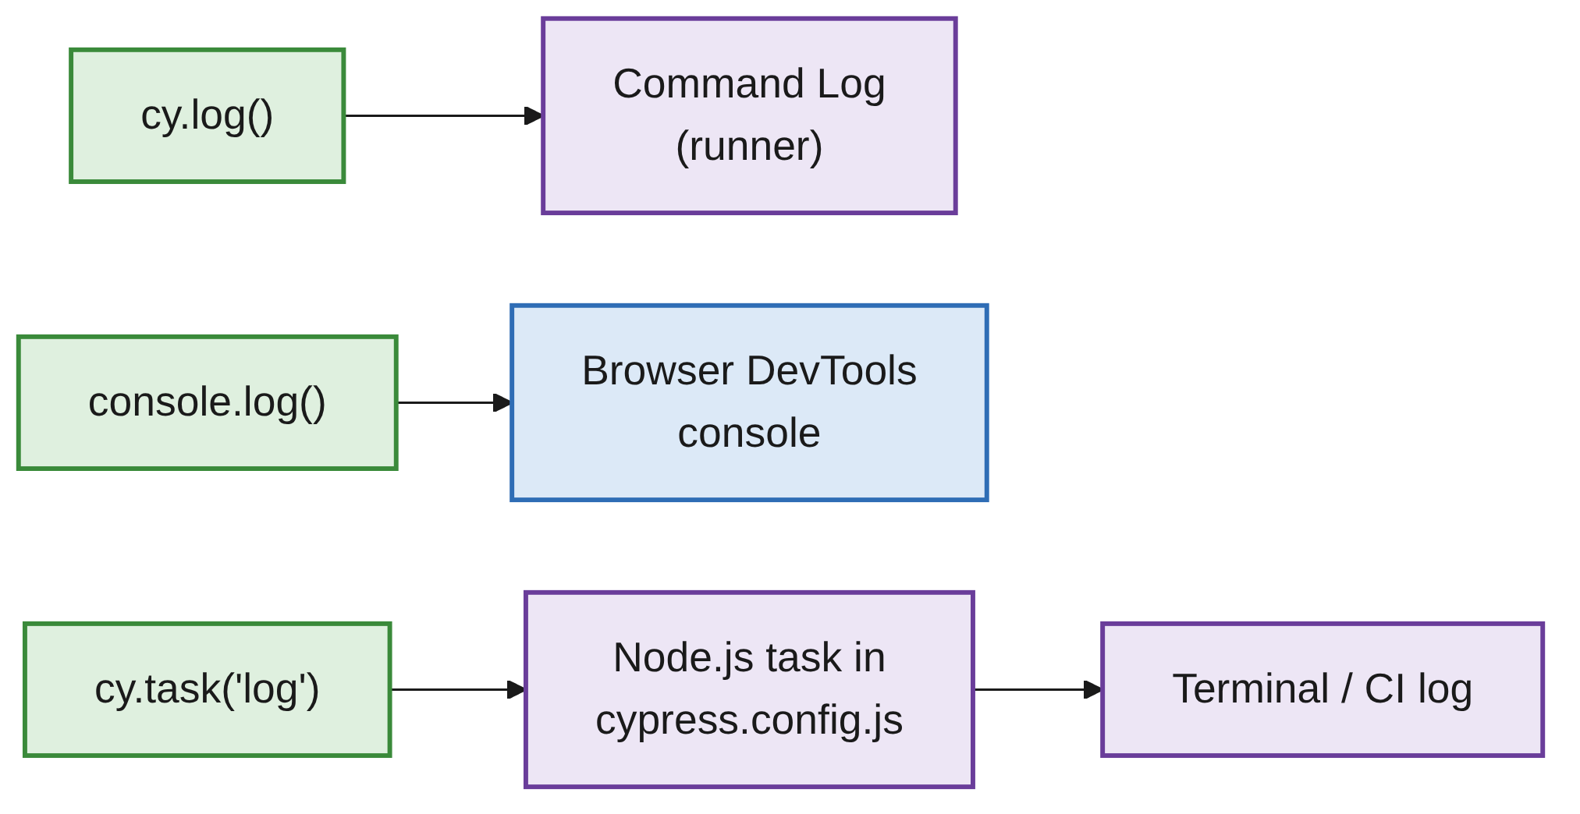
Three Places to Log
PART 3
cy.log(): shows in the Command Log next to the commands.
console.log(): browser DevTools; best inside .then().
cy.task(): runs in Node.js, so it can print to the terminal or CI log.
Debugging and Evidence · Week 5 · Cypress Lecture 4 | 15 / 25

Slide 16
Logging a Value Three Ways
PART 3
cy.get('[data-cy=product]').its('length').then((count) => {
cy.log(`Found ${count} products`);
console.log('Products on page:', count);
cy.task('log', `Terminal: found ${count} products`);
});
.its('length') yields the number of matched elements.
All three calls sit inside .then(), where count exists.
Debugging and Evidence · Week 5 · Cypress Lecture 4 | 16 / 25

Slide 17
Define the log Task
PART 3
CYPRESS.CONFIG.JS
setupNodeEvents(on, config) {
on('task', {
log(message) {
console.log(message);
return null; // a task must return something (null is fine)
},
});
}
cy.task() runs code in Node.js, outside the browser.
Use it for what the browser can't do: read files, seed a database, print to CI logs.
Debugging and Evidence · Week 5 · Cypress Lecture 4 | 17 / 25

Slide 18
Screenshots and Video
04
Keep evidence of what happened
Debugging and Evidence · Week 5 · Cypress Lecture 4 | 18 / 25

Slide 19
Screenshots on Demand
PART 4
cy.screenshot('todo-full-page'); // whole page
cy.get('[data-cy=todo-list]').screenshot('todo-list-only'); // one element
cy.screenshot('todo-viewport', { capture: 'viewport' }); // visible area only
Saved to cypress/screenshots/<spec name>/.
Give each screenshot a clear name.
Debugging and Evidence · Week 5 · Cypress Lecture 4 | 19 / 25

Slide 20
Automatic Screenshots on Failure
PART 4
npx cypress run --spec cypress/e2e/lecture4-debugging.cy.js
In cypress run, Cypress saves a screenshot when a test fails.
On by default: screenshotOnRunFailure: true.
The file name contains "(failed)".
Debugging and Evidence · Week 5 · Cypress Lecture 4 | 20 / 25

Slide 21
Turning On Video
PART 4
CYPRESS.CONFIG.JS
module.exports = defineConfig({
video: true,
// videoCompression: 32, // optional: smaller files, lower quality
e2e: { /* ... */ },
});
Video is off by default in current Cypress versions.
Recorded only in cypress run, not in open mode.
One video per spec: cypress/videos/<spec name>.mp4.
Debugging and Evidence · Week 5 · Cypress Lecture 4 | 21 / 25

Slide 22
Evidence Settings
PART 4
Setting | Default | Purpose
screenshotOnRunFailure | true | Screenshot when a test fails in run mode
screenshotsFolder | cypress/screenshots | Where screenshots go
video | false | Record a video per spec in run mode
videosFolder | cypress/videos | Where videos go
trashAssetsBeforeRuns | true | Clean up old files before each run
NOTE
Add cypress/screenshots and cypress/videos to .gitignore.
Debugging and Evidence · Week 5 · Cypress Lecture 4 | 22 / 25

Slide 23
Common Mistakes
WRAP-UP
Debugging in run mode
cy.pause() and time-travel need open mode.
debugger outside .then()
It stops before any command has run.
console.log for CI
It goes to the browser. Use cy.task('log').
Expecting a video
Video is off by default. Set video: true.
Committing evidence
Add screenshots and videos folders to .gitignore.
Debugging and Evidence · Week 5 · Cypress Lecture 4 | 23 / 25

Slide 24
Key Takeaways
SUMMARY
1
Every command has a DOM snapshot: hover or pin it to see the page at that step.
2
A failure shows the red command, the error message and a code frame.
3
cy.pause(), .debug() and debugger (inside .then()) stop the test.
4
cy.log, console.log and cy.task('log') print to three different places.
5
Failure screenshots are automatic in run mode; video needs video: true.
Debugging and Evidence · Week 5 · Cypress Lecture 4 | 24 / 25

Slide 25
Additional Resources
1
cy.pause()
https://docs.cypress.io/api/commands/pause
2
.debug()
https://docs.cypress.io/api/commands/debug
3
cy.task()
https://docs.cypress.io/api/commands/task
4
cy.screenshot()
https://docs.cypress.io/api/commands/screenshot
Debugging and Evidence · Week 5 · Cypress Lecture 4 | 25 / 25

