Slide 1
Getting Started with Playwright
Understand how Playwright drives a browser, then write, run and configure a first test.
What
Architecture
Runner
First test
Options
Notes:
Lecture 1 of the Week 5 Playwright series, 45-50 minutes. Diagram colour legend (code weeks): blue = application or browser under test; green = test code; orange = fixtures, setup and teardown; purple = runner, configuration, CLI; red = failures and errors; black = structure.

Slide 2
Learning Objectives
1
Explain what Playwright is and how it differs from Selenium.
2
Describe how Playwright for Python talks to a browser.
3
Explain how pytest, Playwright and pytest-playwright work together.
4
Write and run a first Playwright test with the page fixture.
5
Use common command-line options and save them in pytest.ini.
2 / 33

Slide 3
What Playwright Is
01
A library for real-browser tests
3 / 33

Slide 4
What Is Playwright?
PART 1
An open-source library from Microsoft for automating web browsers.
We use it for end-to-end (E2E) tests.
An E2E test opens a real browser and clicks and types like a user.
It then checks that the page behaves correctly.
Available in Python, JavaScript/TypeScript, Java and .NET.
4 / 33

Slide 5
Key Features
PART 1
Three engines
Chromium (Chrome, Edge), Firefox and WebKit (the engine behind Safari).
Auto-waiting
Waits for elements to be ready before acting, so you rarely need sleep().
Web-first assertions
expect(...) checks retry until they pass or time out.
Isolation
Each test gets a fresh browser context, like a new incognito window.
Built-in tools
Codegen records clicks as code, Inspector steps through, Trace Viewer replays a run.
Several languages
Python, JavaScript/TypeScript, Java and .NET.
5 / 33

Slide 6
Playwright vs Selenium
PART 1
 | Selenium | Playwright
Browser control | WebDriver protocol, one driver per browser | Direct, persistent connection
Waiting | Usually explicit waits (WebDriverWait) | Auto-waiting built in
Isolation | Usually a new browser per test (slow) | New browser context per test (fast)
Debugging tools | Mostly third-party | Codegen, Inspector, Trace Viewer built in
Languages | Java, Python, C#, Ruby, JavaScript, Kotlin | Python, JavaScript/TypeScript, Java, .NET
BALANCE
Neither tool is better for everything. Selenium has a longer history and wider ecosystem; Playwright is faster to write reliable tests with.
6 / 33
Notes:
Browsers row from the notes: Selenium drives real installed Chrome, Firefox, Edge and Safari; Playwright uses its own Chromium, Firefox and WebKit builds, plus installed Chrome or Edge.

Slide 7
Architecture
02
How your code reaches the browser
7 / 33

Slide 8
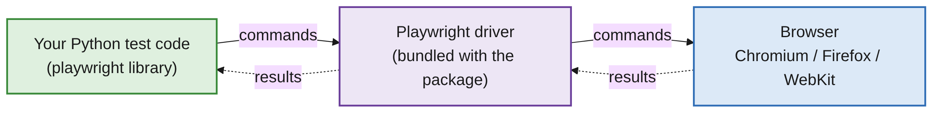
How Playwright Talks to a Browser
PART 2
Your Python code calls methods like page.goto() or page.click().
The Playwright driver, installed with the Python package, receives them.
It sends them to the browser over a fast, persistent connection.
The open connection tells Playwright about loading, animations and requests.
That knowledge is what makes auto-waiting possible.
8 / 33

Slide 9
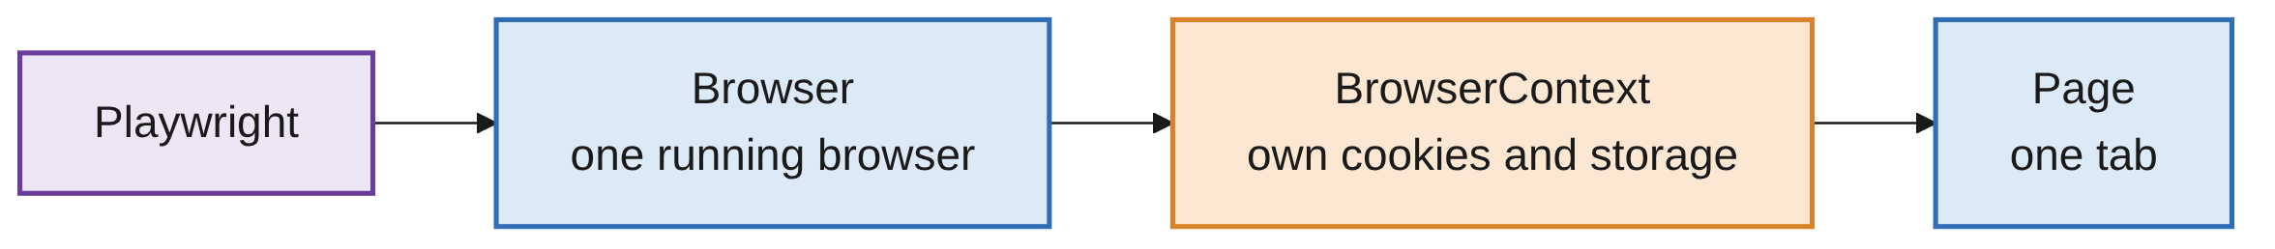
The Object Hierarchy
PART 2
Browser
Expensive to start, so it is shared across tests.
BrowserContext
Cheap to create. Each test gets its own, so tests share no cookies or logins.
Page
The tab you interact with. Almost everything in this course goes through page.
9 / 33

Slide 10
Setup and the Test Runner
03
Check the install, meet the three pieces
10 / 33

Slide 11
Check Your Setup
PART 3
$ pytest --version
$ playwright --version
Everyone runs both commands at the start of class.
Both should print a version number.
If a setup fails, pair with a neighbour and fix it after the lecture.
Most problems are covered in the installation guide's Troubleshooting section.
11 / 33

Slide 12
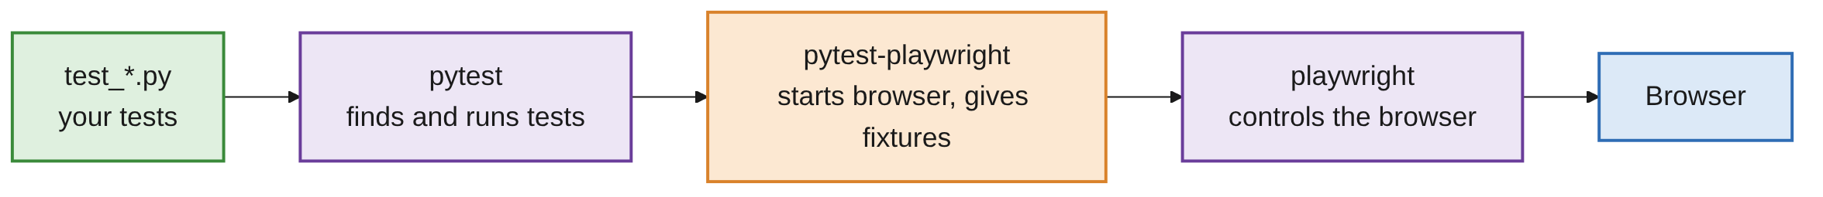
Three Pieces Work Together
PART 3
Piece | Job
playwright | The library that controls the browser
pytest | Finds and runs tests, reports pass or fail
pytest-playwright | Plugin that starts the browser and gives tests ready-made fixtures
12 / 33

Slide 13
Python Uses pytest as the Runner
PART 3
Playwright for JavaScript has its own runner, Playwright Test.
It uses npx playwright test and playwright.config.ts.
Playwright Test does not exist in Python: pytest is our runner.
Search https://playwright.dev/python for docs and examples.
Skip examples that use npx or .ts files.
13 / 33

Slide 14
Fixtures from pytest-playwright
PART 3
Fixture | What it is | Created
page | A new tab in a fresh browser context | Once per test
context | The browser context that page lives in | Once per test
browser | The running browser | Once per session (shared)
browser_name | "chromium", "firefox" or "webkit" | -
HOW TO USE
Add the fixture name as a test parameter and pytest passes it in.
14 / 33

Slide 15
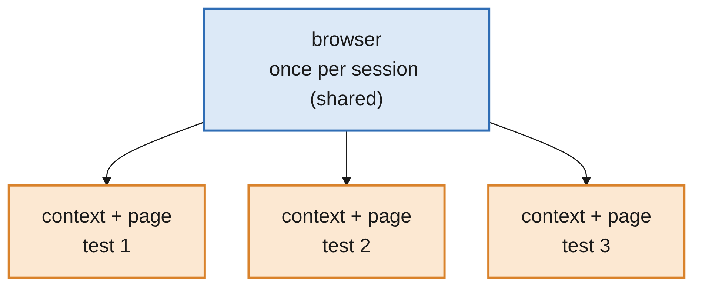
Every Test Starts Clean
PART 3
One browser is shared; context and page are new for every test.
Tests don't affect each other: no leftover cookies, logins or open tabs.
15 / 33

Slide 16
Your First Test
04
Open a page, check its title
16 / 33

Slide 17
A First Playwright Test
PART 4
TEST_FIRST.PY
from playwright.sync_api import Page, expect
def test_homepage_has_title(page: Page):
page.goto("https://the-internet.herokuapp.com/")
expect(page).to_have_title("The Internet")
pytest finds files named test_*.py or *_test.py.
It runs functions whose names start with test_.
The demo site is a public practice site for automation.
17 / 33

Slide 18
Line by Line
PART 4
Code | Meaning
from playwright.sync_api import Page, expect | Import Page (for editor hints) and expect (for assertions)
def test_homepage_has_title(page: Page): | A pytest test. Asking for page opens a browser tab for us
page.goto(...) | Open the URL and wait for the page to load
expect(page).to_have_title(...) | Check the title. Retries for up to 5 seconds before failing
18 / 33

Slide 19
Run It
PART 4
TERMINAL
$ pytest
test_first.py . [100%]
1 passed
No options needed: pytest discovers test_first.py itself.
The dot means one test passed.
No window appears: tests run headless by default (Part 5).
19 / 33

Slide 20
Sync vs Async API
PART 4
playwright.sync_api
Normal, step-by-step code. We use this one in the course.
playwright.async_api
Uses async and await. Useful in larger async apps; not needed for testing.
20 / 33

Slide 21
Why expect Instead of assert?
PART 4
# assert checks once, immediately
assert page.title() == "The Internet"
# expect keeps checking until it passes (or 5 seconds go by)
expect(page).to_have_title("The Internet")
Pages load and change over time.
expect retries, so tests are much more reliable.
Lecture 3 covers assertions fully.
21 / 33

Slide 22
Command-Line Options
05
Change browser, speed and output
22 / 33

Slide 23
Seeing and Choosing the Browser
PART 5
By default, tests run headless (no visible window) in Chromium.
Option | What it does | Example
--headed | Show the browser window | pytest --headed
--browser | Choose the browser (can repeat) | pytest --browser firefox
--slowmo | Pause between actions (ms) | pytest --headed --slowmo 1000
--browser-channel | Use installed Chrome or Edge | pytest --browser-channel chrome
23 / 33

Slide 24
URLs and Test Artefacts
PART 5
Option | Values | Saves or sets
--base-url | A URL | Prefix for relative URLs in page.goto()
--screenshot | on, off, only-on-failure | Screenshots
--video | on, off, retain-on-failure | Video recording
--tracing | on, off, retain-on-failure | A trace for Trace Viewer
--output | A folder | Where artefacts go (default test-results)
24 / 33

Slide 25
Useful pytest Options
PART 5
Option | What it does
-v | Verbose: list each test
-s | Show print() output
-k name | Run only tests whose name matches
pytest file.py::test_name | Run one specific test
25 / 33

Slide 26
Running on Several Browsers
PART 5
COMMAND
$ pytest --browser chromium --browser firefox
OUTPUT
test_first.py::test_homepage_has_title[chromium] PASSED
test_first.py::test_homepage_has_title[firefox] PASSED
Each test runs once per browser, and pytest labels it with the browser name.
BEFORE YOU RUN
Firefox and WebKit must be installed first: playwright install firefox webkit
26 / 33

Slide 27
Using --base-url
PART 5
WITH A BASE URL SET
page.goto("/login") # opens https://the-internet.herokuapp.com/login
Base URL here: https://the-internet.herokuapp.com.
With a base URL, tests can use short paths.
Full URLs starting with https:// still work and ignore the base URL.
Change the site in one place instead of in every test.
27 / 33
Notes:
The third bullet is the practical benefit of a single base URL setting.

Slide 28
Saving Options in pytest.ini
06
Stop retyping options
28 / 33

Slide 29
Options in pytest.ini
PART 6
PYTEST.INI (PROJECT FOLDER)
[pytest]
base_url = https://the-internet.herokuapp.com
addopts = --browser chromium
base_url: the base URL setting, same as --base-url.
addopts: options added to every pytest run.
Now a plain pytest uses both settings.
29 / 33

Slide 30
Watch Out: --browser Adds Up
PART 6
# pytest.ini has: addopts = --browser chromium
$ pytest --browser firefox
# tests run on chromium AND firefox
--browser options add up; they do not replace each other.
The pytest.ini value and the command-line value both apply.
If you often switch browsers, remove --browser from addopts.
30 / 33

Slide 31
Common Mistakes
WRAP-UP
Name without test_
pytest won't find the function. Rename it to start with test_.
No page parameter
NameError: name 'page' is not defined. Add page: Page to the function.
JavaScript tutorial
npx and .ts examples don't apply. Use the Python docs at playwright.dev/python.
fixture 'page' not found
Virtual environment not active, or the plugin isn't installed.
Expecting a window
Tests are headless by default. Add --headed.
31 / 33

Slide 32
Key Takeaways
SUMMARY
1
Playwright controls Chromium, Firefox and WebKit, and auto-waits for elements.
2
In Python, pytest is the test runner; pytest-playwright provides the page fixture.
3
Every test gets a fresh context and page, so tests are isolated.
4
Use expect(...) for checks, because it retries.
5
--headed, --browser, --slowmo and --base-url are the options you'll use most.
6
Save the options you always use in pytest.ini.
32 / 33

Slide 33
Additional Resources
1
Playwright for Python: getting started
https://playwright.dev/python/docs/intro
2
pytest plugin and its options
https://playwright.dev/python/docs/test-runners
3
Browsers and channels
https://playwright.dev/python/docs/browsers
4
Practice site used in the demos
https://the-internet.herokuapp.com/
33 / 33

