Slide 1
Actions, Assertions and Tools
Act on the page, check results with expect, rely on auto-waiting, and debug with Playwright's tools.
Actions
expect
Auto-waiting
Dynamic
Tools
Notes:
Lecture 3 of the Week 5 Playwright series, 45-50 minutes. Uses the local page actions_practice.html from the demo file. Tool screenshots are real Playwright 1.63 captures reused from the Week 4 Friday assets (SauceDemo practice site). Diagram colour legend (code weeks): blue = application or browser under test; green = test code; orange = fixtures, setup and teardown; purple = runner, configuration, CLI; red = failures and errors; black = structure.

Slide 2
Learning Objectives
1
Perform actions (click, fill, press, check) and read values from the page.
2
Check results with expect, and explain why it beats assert.
3
Explain auto-waiting and avoid time.sleep().
4
Test elements that load, change or disappear over time.
5
Use the Inspector, codegen and Trace Viewer.
2 / 35

Slide 3
The Practice Page
OVERVIEW
actions_practice.html has JavaScript: things happen after a delay, as on real websites.
Section | Behaviour
Log in | Message after 1 s. Login: student / secret123
Search | Press Enter to show results
Cart | Each click adds an item
Terms | Ticking the checkbox enables Continue
Section | Behaviour
Products | 'Loading...' for 2 s, then 3 products
Order | 'Processing...' becomes 'Complete' after 2 s
Notifications | A message appears, then goes after 2 s
Report | Takes 7 seconds to finish
3 / 35

Slide 4
Actions
01
Click, type and tick
4 / 35

Slide 5
Common Actions
PART 1
Action | What it does | Example
click() | Click an element | page.get_by_role("button", name="Log in").click()
fill(text) | Clear the field and enter text | page.get_by_label("Username").fill("student")
clear() | Empty a field | page.get_by_label("Username").clear()
press(key) | Press a key | search.press("Enter")
press_sequentially() | Type one key at a time | search.press_sequentially("jacket", delay=100)
check() / uncheck() | Tick / untick a checkbox | page.get_by_label("I agree to the terms").check()
5 / 35
Notes:
Lecture 4 covers more actions: dropdowns, hover, drag and drop, key combinations.

Slide 6
fill() vs press_sequentially()
PART 1
fill()
Sets the whole value at once. Fast. Use it almost always.
press_sequentially()
Types each character and fires a key event for each one. Use it when the page reacts to each key, such as auto-suggestion boxes (Lecture 4).
OLDER CODE
You may see type() in older tutorials. It is deprecated; use fill() or press_sequentially().
6 / 35

Slide 7
A Full Example
PART 1
def test_successful_login(page: Page):
page.get_by_label("Username").fill("student")
page.get_by_label("Password").fill("secret123")
page.get_by_role("button", name="Log in").click()
expect(page.locator("#login-message")).to_have_text("Welcome, student!")
Fill both fields, click the button, then check the result.
The test name says what behaviour it checks.
The last line waits for the message that appears after 1 second.
7 / 35

Slide 8
Reading Values from the Page
PART 1
Method | Returns
text_content() | Text inside an element
inner_text() | Visible text (as displayed)
input_value() | Current value of an input field
get_attribute("href") | The value of an attribute
count() | Number of matching elements
is_visible(), is_checked(), is_enabled() | True / False right now
READ ONCE
These read the page once, without waiting. To check something, use expect. Use these only when you need the value itself, for example later in the test.
8 / 35
Notes:
Examples: value = page.get_by_label("Username").input_value(); href = page.get_by_role("link", name="Help").get_attribute("href")

Slide 9
Assertions with expect
02
Checks that wait for the page
9 / 35

Slide 10
expect vs assert
PART 2
TEST
page.get_by_role("button", name="Log in").click()
# Checks ONCE, immediately. The message still says "Checking..." -> test fails
assert page.locator("#login-message").text_content() == "Welcome, student!"
# Keeps checking until it matches, for up to 5 seconds -> test passes
expect(page.locator("#login-message")).to_have_text("Welcome, student!")
THE ASSERT VERSION FAILS WITH
AssertionError: assert 'Checking...' == 'Welcome, student!'
10 / 35

Slide 11
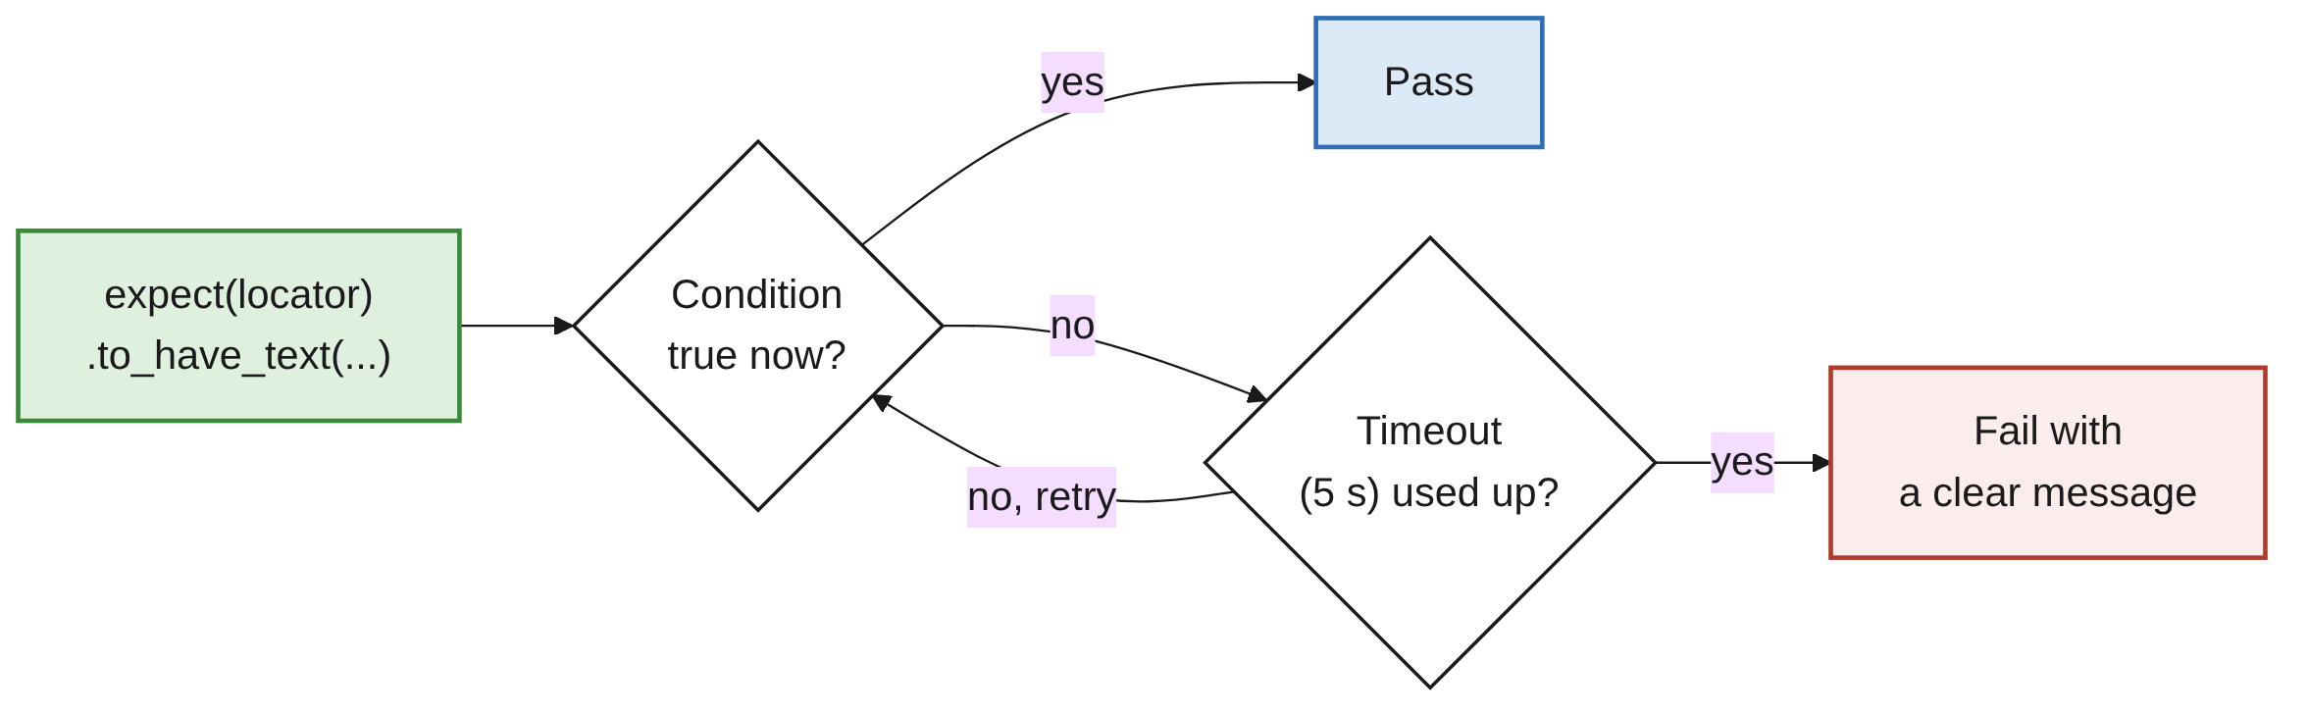
Web-First Assertions
PART 2
Web pages change over time; expect retries until true or timed out.
Use expect for anything on the page.
Plain assert is fine for normal Python values, like a number you already read.
11 / 35

Slide 12
Page Assertions and Regex
PART 2
Assertion | Checks
to_have_title("...") | Page title
to_have_url("...") | Page URL
import re
expect(page).to_have_title("Practice Store - Actions")
expect(page).to_have_url(re.compile("#dashboard")) # partial match with regex
expect(heading).to_have_text(re.compile("practice", re.IGNORECASE))
12 / 35

Slide 13
Visibility and Text
PART 2
Assertion | Checks
to_be_visible() | Element is shown
to_be_hidden() | Element is hidden or not on the page
to_be_attached() | Element is in the HTML (visible or not)
to_have_text("...") | Whole text matches
to_contain_text("...") | Text contains this
13 / 35

Slide 14
Inputs and State
PART 2
Assertion | Checks
to_have_value("...") | Input's value
to_be_empty() | Input (or element) is empty
to_be_editable() | Input can be typed in
to_be_focused() | Element has focus
to_be_enabled() / to_be_disabled() | Enabled or disabled
to_be_checked() | Checkbox or radio is ticked
14 / 35

Slide 15
Attributes, Count and not_
PART 2
Assertion | Checks
to_have_attribute("name", "value") | Attribute value
to_have_class("...") | CSS class
to_have_count(n) | Number of matches
ADD NOT_ TO ANY ASSERTION
expect(checkbox).not_to_be_checked()
expect(username).not_to_be_empty()
expect(page).not_to_have_url(re.compile("#dashboard"))
15 / 35

Slide 16
Custom Message and Timeout
PART 2
CUSTOM ERROR MESSAGE
expect(
page.get_by_role("button", name="Log in"),
"The login button should be visible on page load",
).to_be_visible()
TIMEOUT (DEFAULT 5 S)
expect(page.locator("#report-result")).to_have_text("Report ready", timeout=10_000) # ms
expect.set_options(timeout=10_000) # every expect in the run, e.g. in conftest.py
16 / 35

Slide 17
Auto-waiting
03
Playwright waits so you don't have to
17 / 35

Slide 18
Actionability Checks
PART 3
Check | Meaning | Needed for
Attached | Element is in the page | All actions
Visible | Element is shown | click, check, fill
Stable | Element isn't moving (animation finished) | click, check
Receives events | Nothing is covering it (like a popup) | click, check
Enabled | Not disabled | click, check, fill
Editable | Not read-only | fill, clear
18 / 35

Slide 19
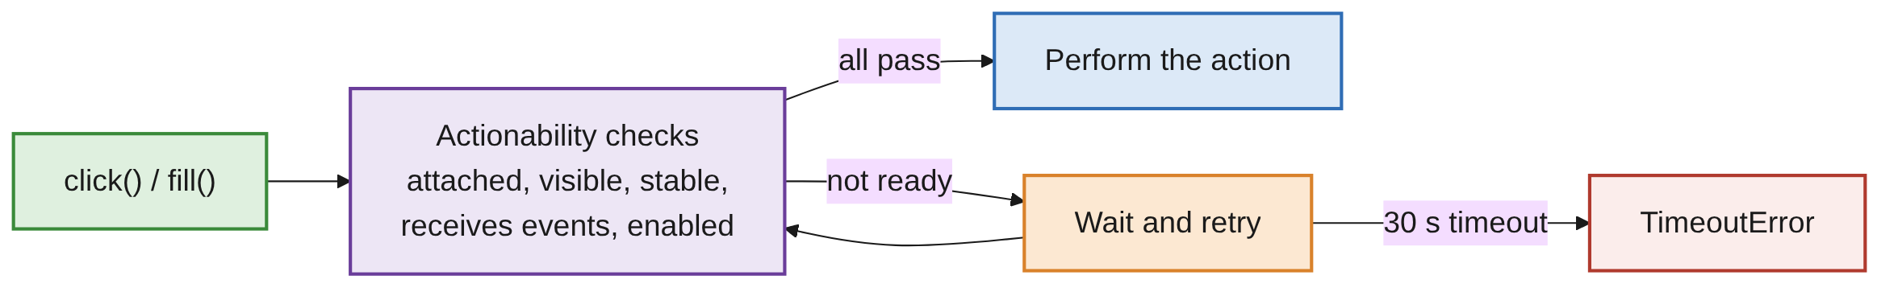
When an Element Is Never Ready
PART 3
OUTPUT (TRIMMED)
TimeoutError: Locator.click: Timeout 30000ms exceeded.
- locator resolved to <button disabled id="continue">Continue</button>
...
- waiting for element to be visible, enabled and stable
- element is not enabled
19 / 35

Slide 20
Default Timeouts
PART 3
What | Default
Actions (click, fill) | 30 seconds
Navigation (goto) | 30 seconds
expect assertions | 5 seconds
FOR A WHOLE PAGE
page.set_default_timeout(10_000)
For one call, pass timeout= in milliseconds.
20 / 35

Slide 21
Never Use sleep
PART 3
BAD
page.get_by_role("button", name="Load products").click()
time.sleep(3)
assert page.locator("#product-list li").count() == 3
GOOD
page.get_by_role("button", name="Load products").click()
expect(page.locator("#product-list li")).to_have_count(3)
sleep(3) is too short on a slow day and wasted time on a fast day.
expect waits exactly as long as needed.
page.wait_for_timeout(3000) is Playwright's sleep: for debugging only.
21 / 35

Slide 22
When You Need an Explicit Wait
PART 3
Usually expect is enough. These wait without asserting:
Method | Waits until
locator.wait_for(state="visible") | Visible (also "hidden", "attached", "detached")
page.wait_for_url("**/dashboard") | URL matches
page.wait_for_load_state("networkidle") | Page has finished loading (use sparingly)
22 / 35

Slide 23
The is_visible() Trap
PART 3
page.get_by_role("button", name="Load products").click()
page.locator("#product-list li").first.is_visible() # False: checks once, too early
expect(page.locator("#product-list li").first).to_be_visible() # passes: waits
is_visible(), is_checked(), count() and text_content() don't wait.
Don't use them in assert right after an action.
23 / 35

Slide 24
Dynamic Elements
04
Appear, change, disappear
24 / 35

Slide 25
Testing Dynamic Elements
PART 4
SPINNER, THEN CONTENT
page.get_by_role("button", name="Load products").click()
expect(page.get_by_text("Loading...")).to_be_visible()
expect(page.get_by_text("Loading...")).to_be_hidden()
expect(page.locator("#product-list li")).to_have_count(3)
TEXT CHANGES; ALERT COMES AND GOES
page.get_by_role("button", name="Process order").click()
expect(page.locator("#order-status")).to_have_text("Complete") # text changes
page.get_by_role("button", name="Show notification").click()
expect(page.get_by_role("alert")).to_be_visible() # appears...
expect(page.get_by_role("alert")).to_be_hidden() # ...then disappears
RULE OF THUMB
After an action, assert the result you expect, and let expect do the waiting.
25 / 35

Slide 26
Tools
05
Inspector, codegen, Trace Viewer
26 / 35

Slide 27
Start the Inspector
PART 5
System | Command
macOS / Linux | PWDEBUG=1 pytest -s lecture_03 -k successful
Windows PowerShell | $env:PWDEBUG=1; pytest -s lecture_03 -k successful
Windows Command Prompt | set PWDEBUG=1 then pytest -s lecture_03 -k successful
RESET AFTERWARDS
In PowerShell or Command Prompt, PWDEBUG stays set for that terminal. Reset it with $env:PWDEBUG="" (PowerShell) or set PWDEBUG= (Command Prompt).
27 / 35

Slide 28
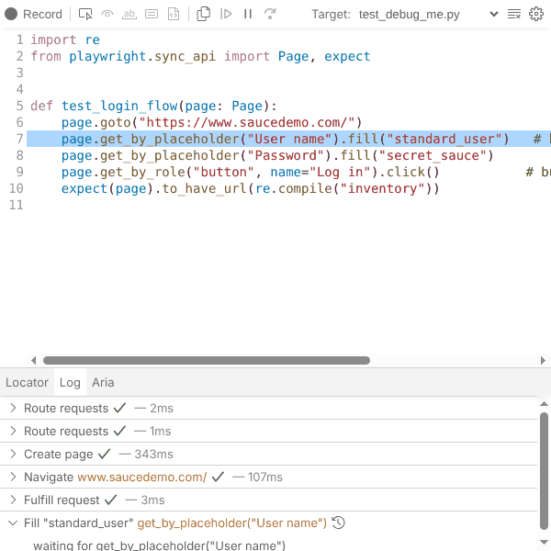
The Inspector Window
PART 5
Opens paused before the first action.
Step over one action at a time.
See the element each locator matches, highlighted in the browser.
Pick locator: click any element to get a suggested locator.
Read the log of what Playwright checked before each action.
page.pause() in a test (run --headed) pauses at that line; remove it before committing.
28 / 35

Slide 29
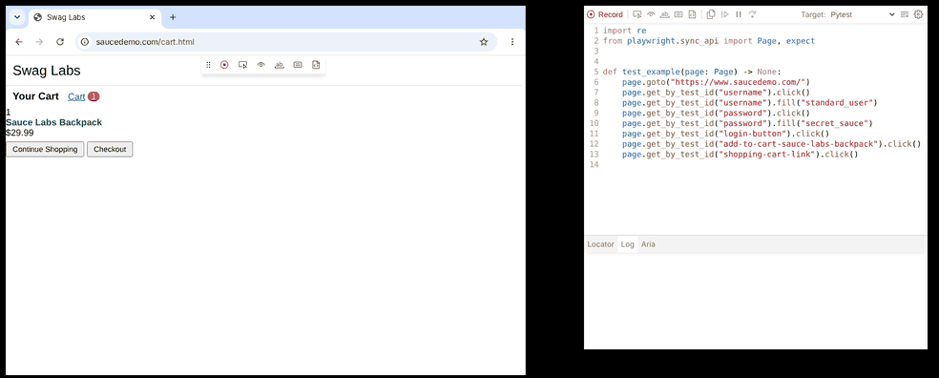
Codegen: Record Actions as Code
PART 5
RECORD (-O SAVES TO A FILE)
playwright codegen --target python-pytest https://the-internet.herokuapp.com/login
playwright codegen --target python-pytest -o test_recorded.py https://the-internet.herokuapp.com/login
Browser on the left, generated code on the right. The toolbar can also add assertions. (Captured on the SauceDemo practice site.)
29 / 35

Slide 30
Codegen Is a Starting Point
PART 5
Add or improve assertions: codegen only adds the ones you ask for.
Rename the test to describe what it checks.
Remove extra clicks you made by accident.
Check the locators: usually good (get_by_role, get_by_label), but not always.
30 / 35

Slide 31
Record a Trace
PART 5
RECORD
pytest lecture_03 --tracing on # every test
pytest lecture_03 --tracing retain-on-failure # only failed tests (recommended)
OPEN
playwright show-trace test-results/<test-folder>/trace.zip
Traces are saved as trace.zip, one folder per test, in test-results/.
Or drag trace.zip onto https://trace.playwright.dev.
That page runs in your browser; the file isn't uploaded.
31 / 35

Slide 32
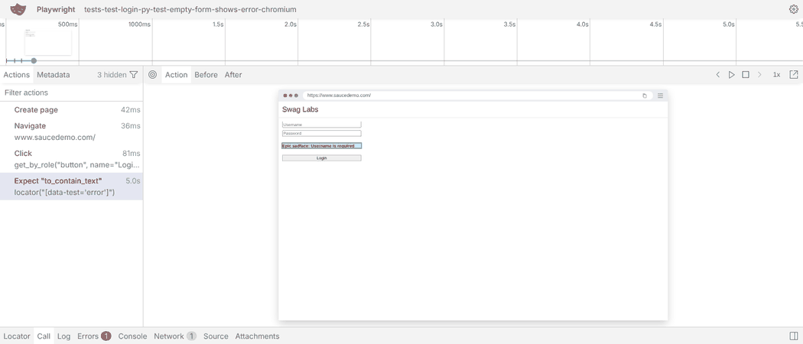
The Trace Viewer
PART 5
A timeline of every action, with before and after snapshots of the page.
Console messages, network requests and the test's source code.
The best tool for finding why a test failed, even on another computer or in CI.
32 / 35

Slide 33
Common Mistakes
WRAP-UP
time.sleep(3)
Remove it; use expect.
assert after a click
Replace assert on text_content() or is_visible() with expect.
Fails after exactly 5 s
A slow element: add timeout= to that expect.
Click times out after 30 s
The button is disabled. Check what should enable it first, e.g. a checkbox.
Raw codegen output
Add assertions, clean up, rename.
page.pause() left in
Remove it before committing.
33 / 35

Slide 34
Key Takeaways
SUMMARY
1
Actions: click, fill, clear, press, press_sequentially, check. Prefer fill.
2
Use expect for anything on the page: it retries for 5 seconds.
3
Playwright auto-waits before every action. Never use sleep.
4
For slow elements, raise the timeout; don't add waits.
5
is_visible(), count() and text_content() don't wait: avoid them in assertions.
6
Inspector to step through, codegen to record, Trace Viewer to investigate failures.
34 / 35

Slide 35
Additional Resources
1
Actions
https://playwright.dev/python/docs/input
2
Assertions
https://playwright.dev/python/docs/test-assertions
3
Auto-waiting
https://playwright.dev/python/docs/actionability
4
Debugging and the Inspector
https://playwright.dev/python/docs/debug
5
Codegen
https://playwright.dev/python/docs/codegen
6
Trace Viewer
https://playwright.dev/python/docs/trace-viewer
35 / 35

