Slide 1
Form Interactions
Work with radio buttons, checkboxes, dropdowns, the keyboard, the mouse and auto-suggestions.
Check
Select
Keyboard
Mouse
Suggest
Notes:
Lecture 4 of the Week 5 Playwright series, 45-50 minutes. Uses the local page forms_practice.html from the demo file. Diagram colour legend (code weeks): blue = application or browser under test; green = test code; orange = fixtures, setup and teardown; purple = runner, configuration, CLI; red = failures and errors; black = structure.

Slide 2
Learning Objectives
1
Select radio buttons, tick and untick checkboxes, and check their state.
2
Choose options in dropdowns and multi-selects, including custom dropdowns.
3
Press keys and key combinations, and move between fields with the keyboard.
4
Hover, double-click, right-click and drag and drop.
5
Test auto-suggestion boxes by typing and picking a suggestion.
2 / 32

Slide 3
The Practice Page
OVERVIEW
forms_practice.html has every kind of form control this lecture needs.
Section | What's there
Shipping method | 4 radio buttons (one disabled)
Interests | 3 checkboxes + Select all
Country / Sizes | A <select> and a multi-select
Colour | A custom dropdown (button + list)
Section | What's there
Keyboard | Notes, key tester, first/last name, Ctrl+S
Mouse | Hover menu, tooltip, double-click, right-click, drag and drop
Delivery city | Auto-suggestions after 2+ letters
3 / 32

Slide 4
Radios and Checkboxes
01
Tick, untick, check the state
4 / 32

Slide 5
check(), uncheck(), set_checked()
PART 1
Method | What it does
check() | Tick a checkbox / select a radio button
uncheck() | Untick a checkbox (not possible for radio buttons)
set_checked(True / False) | Tick or untick, based on a value
page.get_by_label("Express").check() # radio
page.get_by_label("Newsletter").check() # checkbox
page.get_by_label("Newsletter").uncheck()
page.get_by_label("SMS updates").set_checked(True)
5 / 32

Slide 6
Why check() Instead of click()?
PART 1
click()
Toggles. If the box is already ticked, clicking unticks it.
check()
Always ends with the box ticked, so it is safe to run twice. It also fails clearly if the click didn't change the state.
6 / 32

Slide 7
Checking the State
PART 1
expect(page.get_by_label("Express")).to_be_checked()
expect(page.get_by_label("Standard")).not_to_be_checked()
expect(page.get_by_label("Store pickup (unavailable)")).to_be_disabled()
expect(page.get_by_role("radio")).to_have_count(4)
Best locator: get_by_label("Express"), the text next to the box.
Also good: get_by_role("radio", name="Express") or get_by_role("checkbox", name=...).
7 / 32

Slide 8
Select All and Radio Groups
PART 1
LOOP OVER SEVERAL CHECKBOXES
page.get_by_label("Select all").check()
for box in page.locator(".interest").all():
expect(box).to_be_checked()
RADIO GROUP: TEST BOTH SIDES
page.get_by_label("Express").check()
expect(page.get_by_label("Express")).to_be_checked()
expect(page.get_by_label("Standard")).not_to_be_checked()
Radio buttons with the same name form a group: selecting one unselects the others.
8 / 32

Slide 9
Dropdowns
02
Normal, multi-select and custom dropdowns
9 / 32

Slide 10
select_option(): Three Ways
PART 2
HTML
<option value="in">India</option>
Choose by | Code
Value (the value attribute) | select_option("in")
Label (the visible text) | select_option(label="India")
Index (position, from 0) | select_option(index=2)
10 / 32

Slide 11
Select and Check
PART 2
TO_HAVE_VALUE CHECKS THE VALUE
country = page.get_by_label("Country")
country.select_option(label="United Kingdom")
expect(country).to_have_value("uk")
ALL OPTIONS, IN ORDER
options = page.get_by_label("Country").locator("option")
expect(options).to_have_count(5)
expect(options).to_have_text(["-- Choose a country --", "Canada", "India",
"United Kingdom", "United States"])
11 / 32

Slide 12
Multi-Selects
PART 2
sizes = page.get_by_label("Sizes")
sizes.select_option(["s", "m", "l"]) # by value
sizes.select_option(label=["XS", "XL"]) # by label
expect(sizes).to_have_values(["xs", "xl"]) # note: to_have_valueS
Pass a list to choose several options.
Each select_option() call replaces the selection; it doesn't add to it.
Check with to_have_values (plural).
12 / 32

Slide 13
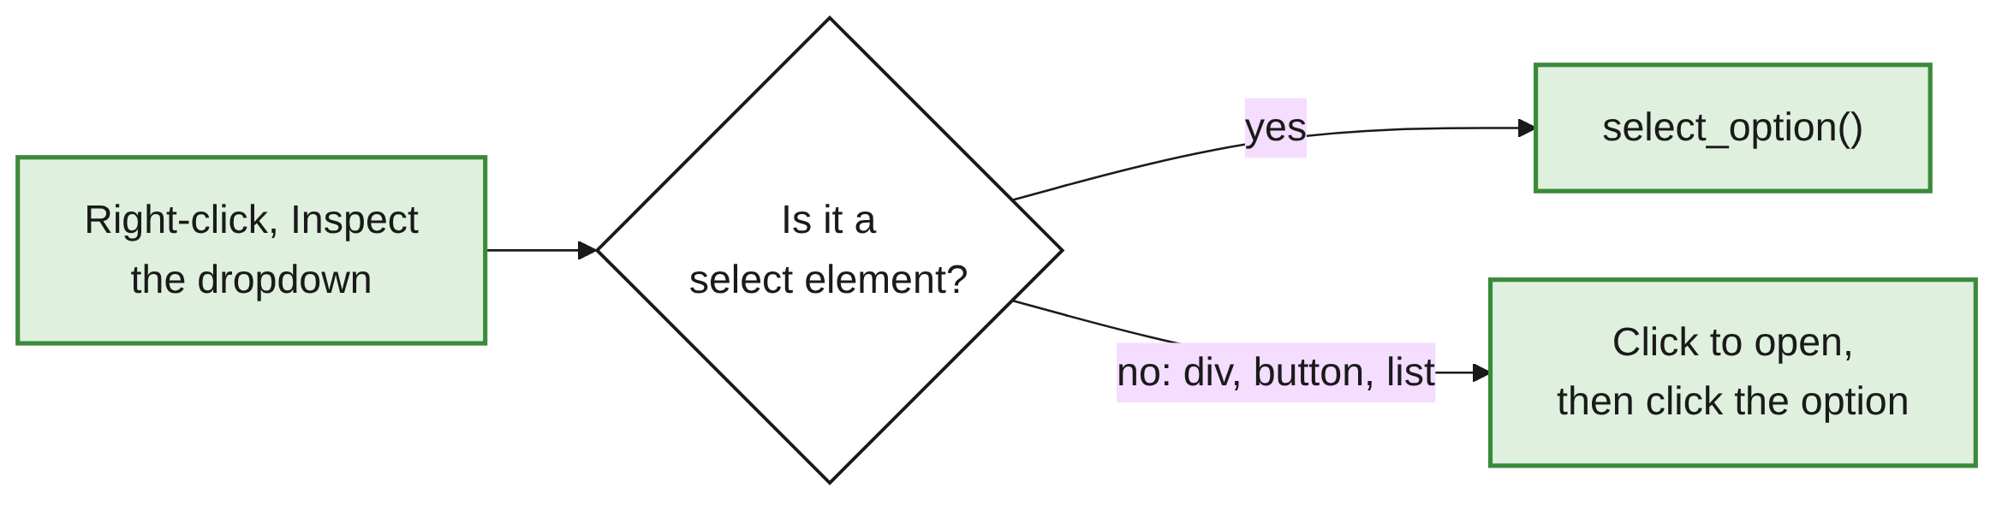
Custom Dropdowns
PART 2
page.get_by_role("button", name="Choose a colour").click()
page.get_by_role("option", name="Blue").click()
expect(page.locator("#colour-button")).to_have_text("Colour: Blue")
Many sites build dropdowns from <div>s, <button>s and lists.
select_option() doesn't work on these: interact like a user.
13 / 32

Slide 14
Keyboard Actions
03
Keys, combinations, focus
14 / 32

Slide 15
press() and Key Names
PART 3
PRESS() FOCUSES THE ELEMENT, THEN PRESSES
page.get_by_label("Press any key").press("Enter")
page.get_by_label("Notes").press("Backspace")
Type | Names
Special keys | Enter, Tab, Escape, Backspace, Delete, Space
Arrows | ArrowUp, ArrowDown, ArrowLeft, ArrowRight
Navigation | Home, End, PageUp, PageDown
Function keys | F1 to F12
Letters and digits | a, A, 1
15 / 32

Slide 16
Key Combinations
PART 3
notes.press("Shift+A") # capital A
notes.press("Control+A") # select all (Windows/Linux)
notes.press("Meta+A") # select all (macOS: Cmd)
notes.press("ControlOrMeta+A") # Ctrl on Windows/Linux, Cmd on macOS
Join keys with +.
PORTABLE SHORTCUTS
Use ControlOrMeta for shortcuts so tests work on every operating system.
16 / 32

Slide 17
page.keyboard
PART 3
Method | What it does
page.keyboard.press("Tab") | Press a key
page.keyboard.type("User") | Type into whatever has focus
page.keyboard.down("Shift") / up("Shift") | Hold / release a key
SHORTCUT, THEN TAB BETWEEN FIELDS
page.keyboard.press("ControlOrMeta+S") # page-wide shortcut
page.get_by_label("First name").fill("Test")
page.keyboard.press("Tab") # move to the next field
expect(page.get_by_label("Last name")).to_be_focused()
page.keyboard.type("User")
17 / 32

Slide 18
Recap: Typing Methods
PART 3
Method | Use when
fill("text") | Normal text entry (fastest; use by default)
press_sequentially("text") | The page reacts to each key press
press("Enter") | One key or combination on an element
page.keyboard.press(...) / type(...) | Shortcuts, or typing where the focus already is
18 / 32

Slide 19
Mouse Actions
04
Hover, clicks, drag and drop
19 / 32

Slide 20
Mouse Actions
PART 4
Action | Code
Hover | locator.hover()
Double-click | locator.dblclick()
Right-click | locator.click(button="right")
Middle-click | locator.click(button="middle")
Click with a key held | locator.click(modifiers=["Shift"])
Drag and drop | source.drag_to(target)
20 / 32

Slide 21
Hover Menus and Tooltips
PART 4
profile = page.get_by_role("link", name="Profile")
expect(profile).to_be_hidden()
page.get_by_role("button", name="Account").hover()
expect(profile).to_be_visible()
profile.click()
Check the menu item is hidden first, then hover.
After the hover, expect waits for the item to appear.
21 / 32

Slide 22
Double-Click and Right-Click
PART 4
page.get_by_text("Double-click me").dblclick()
page.get_by_text("Right-click here").click(button="right")
expect(page.get_by_role("menuitem", name="Delete")).to_be_visible()
dblclick() is a single call.
A right-click is a click() with button="right"; check the menu that appears.
22 / 32

Slide 23
Drag and Drop
PART 4
DRAG_TO()
page.get_by_text("Drag me").drag_to(page.locator("#drop-zone"))
expect(page.locator("#drop-result")).to_have_text("Dropped!")
FALLBACK: THE LOW-LEVEL MOUSE
page.get_by_text("Drag me").hover()
page.mouse.down()
page.locator("#drop-zone").hover()
page.mouse.up()
PIXELS
page.mouse also has move(x, y), click(x, y) and wheel(dx, dy). Prefer locators: coordinates break when the layout changes.
23 / 32

Slide 24
Auto-Suggestions
05
Type, wait, pick, check
24 / 32

Slide 25
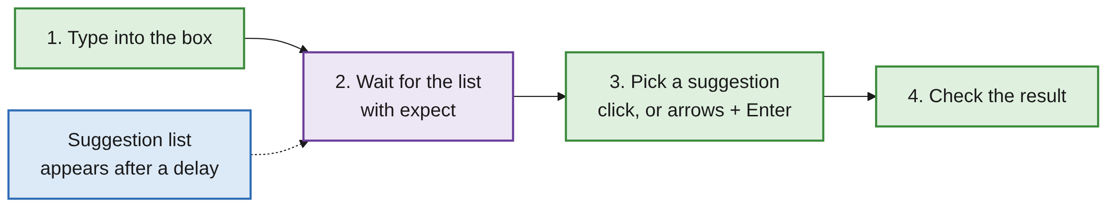
How to Test Auto-Suggestions
PART 5
Also called autocomplete or type-ahead.
Matches appear while you type, usually after a short delay.
25 / 32

Slide 26
Pick with the Mouse
PART 5
def suggestions(page):
return page.get_by_role("listbox", name="Suggestions").get_by_role("option")
page.get_by_label("City").press_sequentially("san")
expect(suggestions(page)).to_have_count(3) # waits for the list
suggestions(page).filter(has_text="San Francisco").click()
expect(page.get_by_label("City")).to_have_value("San Francisco")
26 / 32

Slide 27
Pick with the Keyboard
PART 5
city = page.get_by_label("City")
city.press_sequentially("den")
expect(suggestions(page)).to_have_count(1)
city.press("ArrowDown")
city.press("Enter")
Same steps: type, wait for the list, pick, check.
ArrowDown highlights the first suggestion; Enter picks it.
27 / 32

Slide 28
Things to Watch For
PART 5
fill vs press_sequentially
fill works for many suggestion boxes. If it shows no suggestions, use press_sequentially.
Wait for the list
The expect(...).to_have_count() line does this. Without it, the click may happen before the list appears.
28 / 32

Slide 29
Scope Your Locator
PART 5
OUTPUT WITH PAGE.GET_BY_ROLE("OPTION")
AssertionError: Locator expected to have count '3'
Actual value: 13
get_by_role("option") also matches the <option>s in the Country and Sizes dropdowns.
Search inside the suggestions list, as the suggestions() helper does.
29 / 32

Slide 30
Common Mistakes
WRAP-UP
Checkbox and radio
click() on a ticked box unticks it: use check(). uncheck() on a radio isn't allowed: select another radio.
Custom dropdown
select_option() doesn't work: click to open, then click the option.
Value checks
Multi-select: to_have_values. to_have_value checks "in", not "India".
Control+A on macOS
Fails. Use ControlOrMeta+A.
Suggestion clicked early
expect the list first.
option matches too much
Search inside the suggestions list.
30 / 32

Slide 31
Key Takeaways
SUMMARY
1
Use check(), uncheck() and set_checked() for radios and checkboxes, not click().
2
select_option() works only on <select>: by value, label= or index=; lists for multi-selects.
3
Custom dropdowns: click to open, click the option.
4
press() for keys and combinations; ControlOrMeta for shortcuts; page.keyboard for page-wide keys.
5
hover(), dblclick(), click(button="right") and drag_to() cover most mouse actions.
6
Auto-suggestions: type, wait for the list with expect, pick, check.
31 / 32

Slide 32
Additional Resources
1
Actions: checkboxes, select options, keys
https://playwright.dev/python/docs/input
2
Keyboard API
https://playwright.dev/python/docs/api/class-keyboard
3
Mouse API
https://playwright.dev/python/docs/api/class-mouse
4
Locator API: drag_to, hover, select_option
https://playwright.dev/python/docs/api/class-locator
32 / 32

