Slide 1
Events, Frames and Windows
WEEK 5 · LECTURE 6
Handle dialogs, frames, Shadow DOM, navigation, new tabs, and file upload and download.
Dialogs
Frames
Shadow DOM
Tabs
Files
Notes:
Lecture 6 of the Week 5 Playwright series, 45-50 minutes. Uses three local pages from the demo file, kept in one folder: events_practice.html (dialog buttons, iframe, Shadow DOM cards, links, tab and pop-up buttons, upload inputs, download links), frame_profile.html (the page inside the iframe, with the nested Newsletter iframe) and help.html (opened by links, redirects, new tabs and pop-ups). Diagram colour legend (code weeks): blue = application or browser under test; green = test code; orange = fixtures, setup and teardown; purple = runner, configuration, CLI; red = failures and errors; black = structure.

Slide 2
Learning Objectives
1
Handle alerts, confirms and prompts with page.on("dialog").
2
Work inside iframes and nested iframes, and explain how Playwright handles Shadow DOM.
3
Follow navigation, wait for URLs, and listen to page events.
4
Work with new tabs and pop-up windows.
5
Upload files and check downloaded files.
Events, Frames and Windows · Week 5 · Lecture 6 | 2 / 35

Slide 3
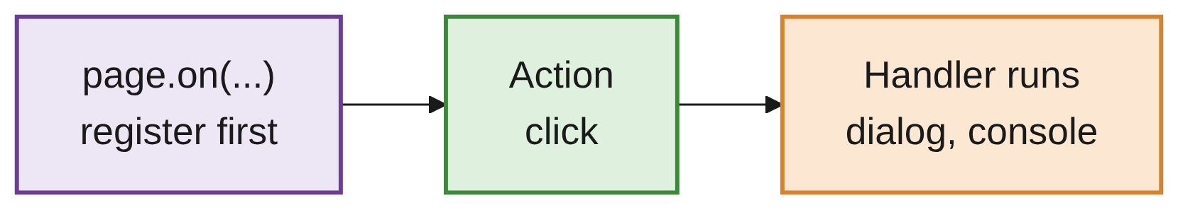
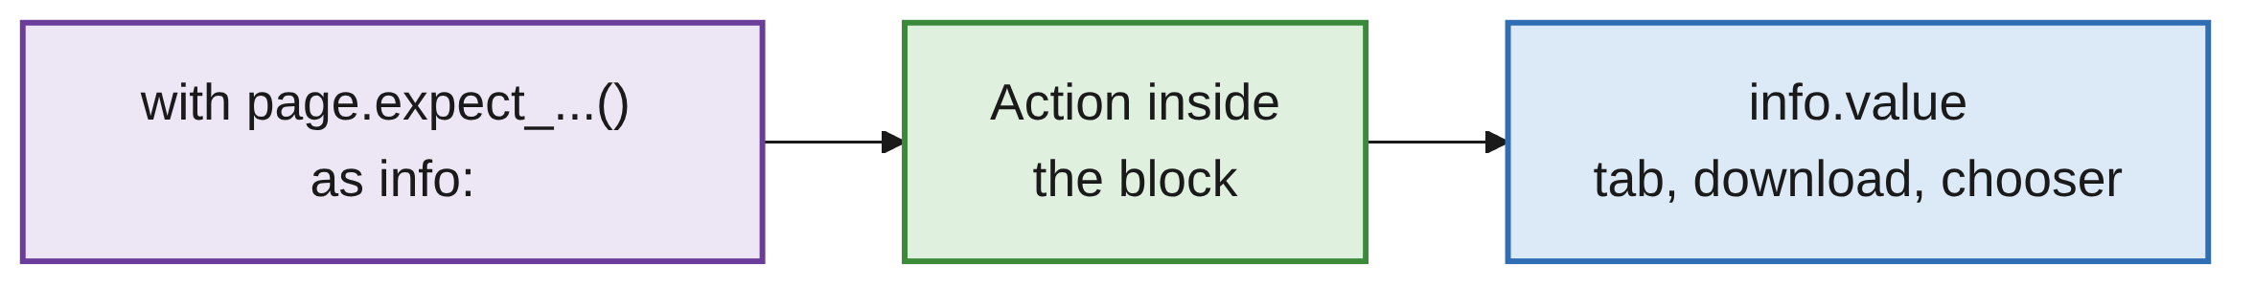
One Idea Connects This Lecture
OVERVIEW
LISTENER: THINGS THAT MAY HAPPEN ANY TIME
EXPECT BLOCK: ONE THING YOU ARE WAITING FOR
Dialogs, tabs, file choosers and downloads happen outside the normal page.
In both patterns, Playwright must be listening before the action happens.
If you click first and listen afterwards, the event has already gone.
Events, Frames and Windows · Week 5 · Lecture 6 | 3 / 35

Slide 4
The Two Patterns in Code
OVERVIEW
LISTENER
page.on("dialog", lambda dialog: dialog.accept())
page.get_by_role("button", name="Delete account").click()
EXPECT BLOCK
with page.expect_download() as download_info:
page.get_by_role("link", name="Download report").click()
download = download_info.value
Events, Frames and Windows · Week 5 · Lecture 6 | 4 / 35

Slide 5
Alerts and Dialogs
01
alert, confirm, prompt
Events, Frames and Windows · Week 5 · Lecture 6 | 5 / 35

Slide 6
Dialogs Are Dismissed by Default
PART 1
JavaScript | Looks like | Buttons
alert("...") | A message | OK
confirm("...") | A question | OK / Cancel
prompt("...", "default") | A question with a text box | OK / Cancel
page.get_by_role("button", name="Delete account").click()
expect(page.locator("#dialog-result")).to_have_text("Deletion cancelled")
Dialogs aren't part of the page: no locator can find them.
If you do nothing, Playwright clicks Cancel: a confirm returns false, a prompt null.
Events, Frames and Windows · Week 5 · Lecture 6 | 6 / 35

Slide 7
Handling a Dialog
PART 1
REGISTER THE HANDLER BEFORE THE CLICK
page.once("dialog", lambda dialog: dialog.accept()) # OK
page.get_by_role("button", name="Delete account").click()
expect(page.locator("#dialog-result")).to_have_text("Account deleted")
MORE THAN ONE LINE: USE A NORMAL FUNCTION
messages = []
def handle(dialog):
messages.append(dialog.message)
dialog.accept()
page.once("dialog", handle)
page.get_by_role("button", name="Show alert").click()
assert messages == ["Your order has been placed!"]
ON VS ONCE
page.on(...) runs for every dialog from now on; page.once(...) only for the next one.
Events, Frames and Windows · Week 5 · Lecture 6 | 7 / 35

Slide 8
The Dialog Object
PART 1
Method / property | Meaning
dialog.accept() | Click OK
dialog.accept("text") | Type into a prompt, then OK
dialog.dismiss() | Click Cancel
dialog.message | The dialog's text
dialog.type | "alert", "confirm", "prompt" or "beforeunload"
dialog.default_value | A prompt's pre-filled text
Events, Frames and Windows · Week 5 · Lecture 6 | 8 / 35

Slide 9
Three Dialog Traps
PART 1
Trap | What happens
Handler registered after the click | Too late: the dialog was already dismissed automatically
Handler that doesn't call accept() or dismiss() | The page freezes and the click times out
dialog.accept() on a prompt with a default value | Sends an empty string, not the default. Use dialog.accept(dialog.default_value)
Events, Frames and Windows · Week 5 · Lecture 6 | 9 / 35

Slide 10
Frames
02
A page inside the page
Events, Frames and Windows · Week 5 · Lecture 6 | 10 / 35

Slide 11
Stepping into an iframe
PART 2
page.get_by_label("Name") # finds nothing: the Name field is inside the iframe
profile = page.frame_locator("iframe[title='Profile form']")
profile.get_by_label("Name").fill("Test User")
profile.get_by_role("button", name="Save").click()
expect(profile.locator("#saved")).to_have_text("Saved: Test User")
An <iframe> is a separate web page inside the page.
Examples: payment forms, maps, videos, chat widgets, rich-text editors.
Locators on page can't see inside it: use frame_locator().
Events, Frames and Windows · Week 5 · Lecture 6 | 11 / 35

Slide 12
Choosing the iframe Selector
PART 2
Selector | When
iframe[title='Profile form'] | The iframe has a title (best)
iframe[name='checkout'] | The iframe has a name
#payment-frame | The iframe has an id
iframe | There's only one iframe on the page
CONTENT_FRAME: FROM AN IFRAME LOCATOR
profile = page.get_by_title("Profile form").content_frame
Events, Frames and Windows · Week 5 · Lecture 6 | 12 / 35

Slide 13
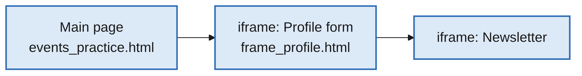
Nested Frames
PART 2
newsletter = (
page.frame_locator("iframe[title='Profile form']")
.frame_locator("iframe[title='Newsletter']")
)
newsletter.get_by_label("Newsletter email").fill("test.user@example.com")
len(page.frames) # 3 on the practice page: main page + 2 iframes
OLDER CODE
page.frame(name="...") in older tutorials still works, but frame_locator() is preferred: it auto-waits like other locators.
Events, Frames and Windows · Week 5 · Lecture 6 | 13 / 35

Slide 14
Shadow DOM
03
Hidden component internals
Events, Frames and Windows · Week 5 · Lecture 6 | 14 / 35

Slide 15
Shadow DOM Just Works
PART 3
WHAT DEVTOOLS SHOWS
<user-card>
#shadow-root (open)
<p class="name">Test User</p>
<button>Follow</button>
</user-card>
NOTHING SPECIAL NEEDED
page.get_by_role("button", name="Follow").click()
page.locator("#open-card .name") # CSS also works
Shadow DOM hides a component's inner HTML from the rest of the page; common in web components.
Built-in locators and CSS look inside open shadow roots automatically.
Events, Frames and Windows · Week 5 · Lecture 6 | 15 / 35

Slide 16
Two Exceptions
PART 3
Doesn't work | Why
XPath | Can't cross into shadow roots: page.locator("//button[text()='Follow']") finds nothing
Closed shadow roots (mode: "closed") | Designed to be unreachable from outside; rare in practice
TAKEAWAY
Another reason to prefer built-in locators over XPath.
Events, Frames and Windows · Week 5 · Lecture 6 | 16 / 35

Slide 17
Navigation and Events
04
Where did we end up?
Events, Frames and Windows · Week 5 · Lecture 6 | 17 / 35

Slide 18
Following Links
PART 4
page.get_by_role("link", name="Help page").click()
expect(page).to_have_url(re.compile(r"help\.html$"))
expect(page).to_have_title("Help Centre")
Clicking a link already waits for the new page to start loading.
Then check where you ended up: URL and title.
Events, Frames and Windows · Week 5 · Lecture 6 | 18 / 35

Slide 19
Waiting for a URL
PART 4
NAVIGATION THAT HAPPENS LATER
page.get_by_role("button", name="Go to help in 1 second").click()
page.wait_for_url("**/help.html?from=redirect") # glob pattern
page.wait_for_url(re.compile("from=redirect")) # or a regex
Glob | Matches
** | Anything, including /
* | Anything except /
WHICH ONE?
expect(page).to_have_url() also waits (5 s). Use wait_for_url to wait before doing something else. page.expect_navigation() is deprecated.
Events, Frames and Windows · Week 5 · Lecture 6 | 19 / 35

Slide 20
Browser Buttons and Load States
PART 4
BROWSER BUTTONS
page.go_back()
page.go_forward()
page.reload()
LOAD STATES
page.wait_for_load_state("load") # page and images loaded
page.wait_for_load_state("domcontentloaded") # HTML parsed
page.wait_for_load_state("networkidle") # no network activity for 500 ms (use sparingly)
Load states are usually not needed: goto, click and expect already wait.
Events, Frames and Windows · Week 5 · Lecture 6 | 20 / 35

Slide 21
Listening to Console Messages
PART 4
logs = []
page.on("console", lambda msg: logs.append(f"{msg.type}: {msg.text}"))
page.get_by_role("button", name="Write to console").click()
# logs == ["log: Button clicked", "error: Something went wrong"]
The same page.on(...) pattern works for other events.
Console messages are useful for spotting JavaScript errors.
Events, Frames and Windows · Week 5 · Lecture 6 | 21 / 35

Slide 22
Page Events
PART 4
Event | Fires when
"dialog" | A dialog opens
"console" | The page writes to the console
"pageerror" | An uncaught JavaScript error happens
"request" / "response" | A network request is sent / answered
"popup" | The page opens a new tab or window
"download" | A download starts
Events, Frames and Windows · Week 5 · Lecture 6 | 22 / 35

Slide 23
New Tabs and Pop-ups
05
Get a reference to the new page
Events, Frames and Windows · Week 5 · Lecture 6 | 23 / 35

Slide 24
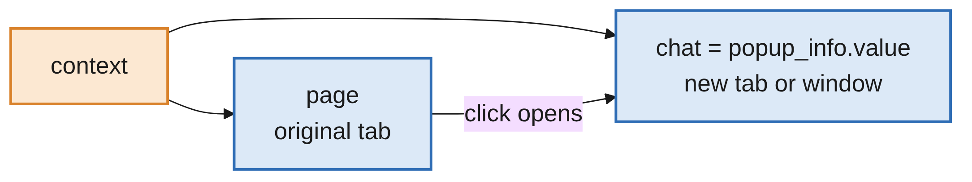
expect_popup()
PART 5
with page.expect_popup() as popup_info:
page.get_by_role("button", name="Open chat window").click()
chat = popup_info.value
expect(chat).to_have_title("Help Centre")
target="_blank" links and window.open() create a new page; page still points at the original.
Events, Frames and Windows · Week 5 · Lecture 6 | 24 / 35

Slide 25
context.expect_page()
PART 5
def test_new_tab(page, context):
with context.expect_page() as new_page_info:
page.get_by_role("link", name="Open help in a new tab").click()
help_tab = new_page_info.value
expect(help_tab).to_have_title("Help Centre")
Catches any new page in the context.
Both work for target="_blank" links and window.open().
expect_popup is the more common choice.
Events, Frames and Windows · Week 5 · Lecture 6 | 25 / 35

Slide 26
No Switching Needed
PART 5
SEVERAL PAGES
context.pages # list of every open page
help_tab.bring_to_front() # make it the active tab (rarely needed)
help_tab.close() # close it
USE THE RIGHT VARIABLE
help_tab.get_by_role("link", name="Back to the store").click() # in the new tab
expect(page).to_have_title("Practice Store - Events") # original tab unchanged
Each page object is independent. Unlike Selenium, there is no switching: just use the right variable.
Events, Frames and Windows · Week 5 · Lecture 6 | 26 / 35

Slide 27
File Upload and Download
06
Set files, catch downloads
Events, Frames and Windows · Week 5 · Lecture 6 | 27 / 35

Slide 28
Upload with set_input_files()
PART 6
NO FILE DIALOG OPENS
page.get_by_label("Resume").set_input_files("files/resume.pdf")
Task | Code
One file | set_input_files("resume.pdf")
Several files (input needs multiple) | set_input_files(["a.png", "b.png"])
Clear the selection | set_input_files([])
A file created in memory | set_input_files({"name": "notes.txt", "mimeType": "text/plain", "buffer": b"Hello"})
Events, Frames and Windows · Week 5 · Lecture 6 | 28 / 35

Slide 29
Creating Test Files with tmp_path
PART 6
def test_upload_one_file(page, tmp_path):
resume = tmp_path / "resume.txt"
resume.write_text("Test User - Quality Engineer")
page.get_by_label("Resume").set_input_files(resume)
expect(page.locator("#resume-result")).to_have_text("Uploaded: resume.txt (28 bytes)")
pytest's built-in tmp_path gives each test its own empty temporary folder.
Or keep real sample files in a test_data/ folder next to your tests.
Events, Frames and Windows · Week 5 · Lecture 6 | 29 / 35

Slide 30
When the File Input Is Hidden
PART 6
with page.expect_file_chooser() as chooser_info:
page.get_by_role("button", name="Choose avatar").click()
chooser_info.value.set_files(avatar_path)
Many sites hide the real <input type="file"> behind a styled button.
Catch the file chooser that opens when the button is clicked.
Events, Frames and Windows · Week 5 · Lecture 6 | 30 / 35

Slide 31
Download with expect_download()
PART 6
with page.expect_download() as download_info:
page.get_by_role("link", name="Download report").click()
download = download_info.value
download.suggested_filename # "sales-report.txt"
saved = tmp_path / download.suggested_filename
download.save_as(saved)
assert saved.read_text() == "Sales report: $12,500"
Without expect_download, you can't get at the file.
Events, Frames and Windows · Week 5 · Lecture 6 | 31 / 35

Slide 32
Working with the Download
PART 6
Property / method | Meaning
download.suggested_filename | The name the site gave the file
download.save_as(path) | Save it where you want
download.path() | Temporary location (deleted after the test)
download.url | Where it was downloaded from
CHECK CONTENTS WITH NORMAL PYTHON
import csv
with saved.open(newline="") as f:
rows = list(csv.DictReader(f))
assert [row["customer"] for row in rows] == ["Asha", "Ben"]
Events, Frames and Windows · Week 5 · Lecture 6 | 32 / 35

Slide 33
Common Mistakes
WRAP-UP
Dialog handler
Register page.on("dialog", ...) before the click, and call accept() or dismiss().
Field inside an iframe
page.get_by_label(...) can't see it. Use page.frame_locator(...).get_by_label(...).
XPath in Shadow DOM
Finds nothing. Use built-in locators or CSS.
Old page after a new tab
Use the new page from expect_popup().
Download or redirect
Wrap downloads in expect_download. Wait for redirects with wait_for_url, not sleep.
Absolute file paths
C:\Users\... breaks elsewhere. Use tmp_path or paths relative to the test.
Events, Frames and Windows · Week 5 · Lecture 6 | 33 / 35

Slide 34
Key Takeaways
SUMMARY
1
Listen before you act: page.on(...) before the action; with page.expect_...() around it.
2
Dialogs are dismissed automatically; use page.once("dialog", ...) and always handle the dialog.
3
Frames: frame_locator("iframe[title='...']"), chained for nested frames. Shadow DOM: no XPath.
4
Navigation: check with to_have_url; wait with wait_for_url.
5
New tabs: with page.expect_popup() as info:, then use info.value. No switching.
6
Upload: set_input_files() or expect_file_chooser(). Download: expect_download() and save_as().
Events, Frames and Windows · Week 5 · Lecture 6 | 34 / 35

Slide 35
Additional Resources
1
Dialogs
https://playwright.dev/python/docs/dialogs
2
Frames
https://playwright.dev/python/docs/frames
3
Pages, new tabs and pop-ups
https://playwright.dev/python/docs/pages
4
Navigation and events
https://playwright.dev/python/docs/events
5
Upload and download
https://playwright.dev/python/docs/input#upload-files
6
Downloads
https://playwright.dev/python/docs/downloads
Events, Frames and Windows · Week 5 · Lecture 6 | 35 / 35

