Slide 1
Page Object Model
WEEK 5 · LECTURE 8
Organise tests by putting each page's locators and actions in a class.
Why POM
Structure
Page classes
Convert
Fixtures
Notes:
Lecture 8 of the Week 5 Playwright series, 45-50 minutes. The demo file has a 4-page practice store, page objects, fixtures and tests. Diagram colour legend (code weeks): blue = application or browser under test; green = test code; orange = fixtures, setup and teardown; purple = runner, configuration, CLI; red = failures and errors; black = structure.

Slide 2
Learning Objectives
1
Explain the problems with script-style tests and how the Page Object Model (POM) solves them.
2
Organise a test suite into pages/ and tests/.
3
Write page classes with locators and actions, and share common parts in a base page.
4
Convert script-style tests to POM step by step.
5
Give tests ready-made page objects through fixtures.
Page Object Model · Week 5 · Lecture 8 | 2 / 29

Slide 3
The Practice Store
OVERVIEW
Page | What's there
login.html | student / secret123 works; locked / secret123 is locked out
products.html | 5 products with Add to cart / Remove, a Sort by dropdown
cart.html | Cart table, Remove, subtotal, Continue shopping, Checkout
checkout.html | Name and postcode, then a summary with 8% tax, then "Thank you for your order!"
Served by the same automatic local server as Lecture 7. Every page after login has a header with Products, Cart (n) and Log out.
Page Object Model · Week 5 · Lecture 8 | 3 / 29

Slide 4
Why POM
01
Scripts work, but they don't scale
Page Object Model · Week 5 · Lecture 8 | 4 / 29

Slide 5
A Script-Style Test
PART 1
TRIMMED: 13 LINES IN FULL
def test_checkout(page):
page.goto("/login.html")
page.get_by_label("Username").fill("student")
page.get_by_label("Password").fill("secret123")
page.get_by_role("button", name="Log in").click()
page.locator(".product").filter(has_text="Backpack").get_by_role("button", name="Add to cart").click()
... # Jacket, Cart, Checkout, first name, last name, postcode, Continue
expect(page.locator("#total")).to_have_text("Total: $86.38")
Problem | Example
Duplication | The 4 login lines are copied into every test
Hard to maintain | If "Log in" becomes "Sign in", you edit every test that logs in
Hard to read | You read the locators to work out what the test does
Page Object Model · Week 5 · Lecture 8 | 5 / 29

Slide 6
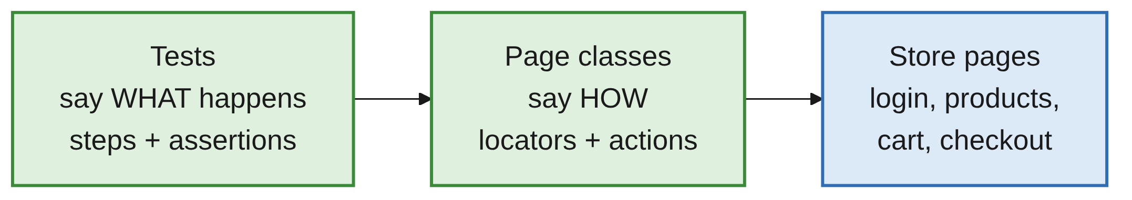
The Idea
PART 1
def test_full_checkout(cart_with_two_items, checkout_page):
cart_with_two_items.checkout()
checkout_page.enter_details("Test", "User", "10001")
expect(checkout_page.total).to_have_text("Total: $86.38")
Each page class knows where things are (locators) and what you can do there (methods).
If the "Log in" button changes, fix one line in LoginPage; every test keeps working.
Page Object Model · Week 5 · Lecture 8 | 6 / 29

Slide 7
Structure and Base Page
02
pages/ and tests/
Page Object Model · Week 5 · Lecture 8 | 7 / 29

Slide 8
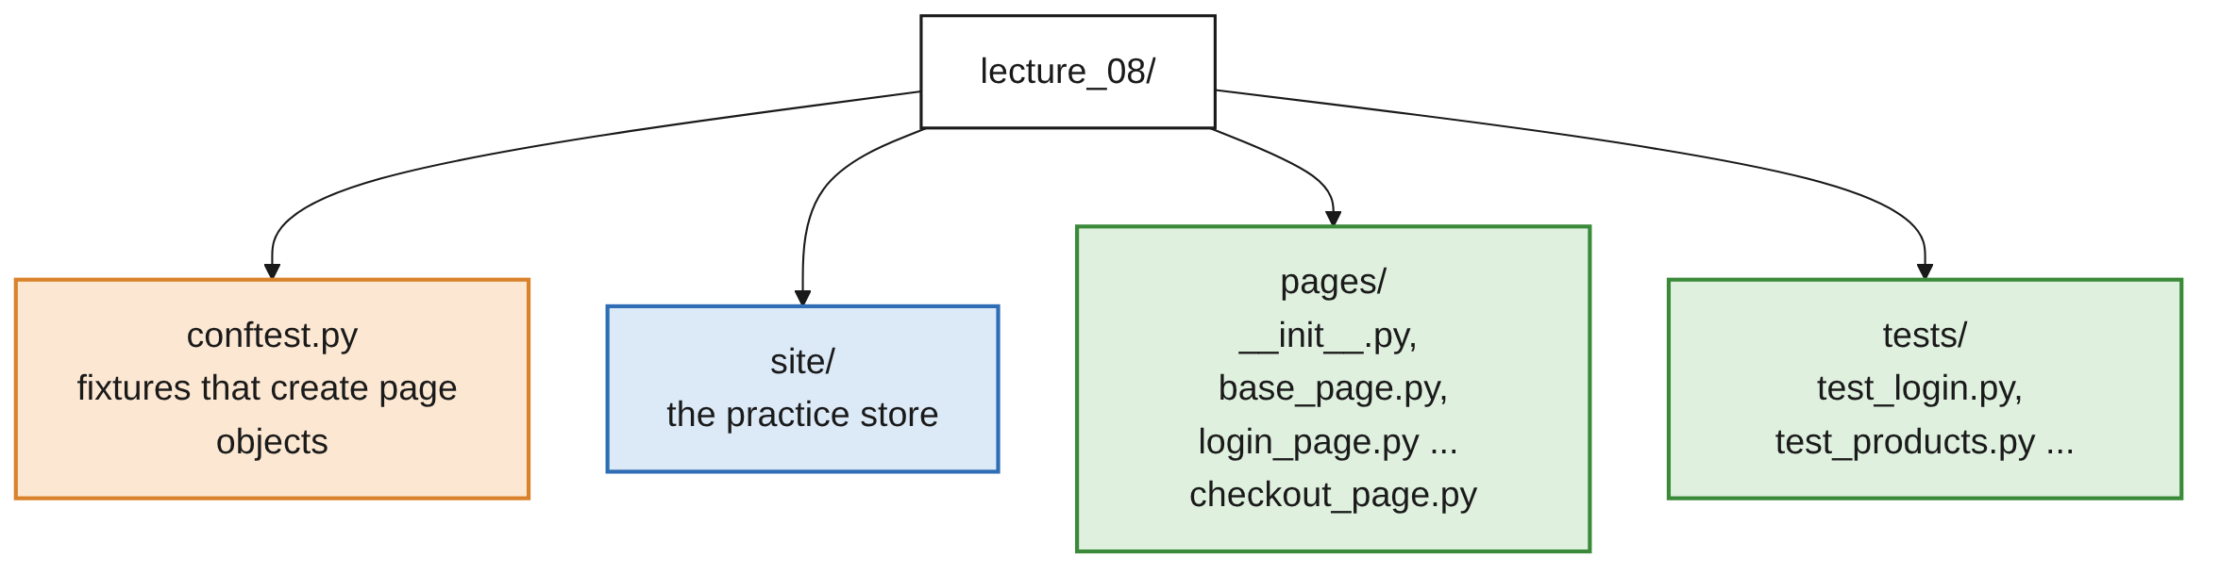
Folder Structure
PART 2
Folder | Contains | Doesn't contain
pages/ | Locators, actions | Assertions about what should happen
tests/ | Test steps, assertions | Locators
Page Object Model · Week 5 · Lecture 8 | 8 / 29
Notes:
pages/__init__.py is empty; it makes pages a Python package. tests/ also holds test_before_pom.py and test_cart_and_checkout.py.

Slide 9
The Base Page: Shared Locators
PART 2
from playwright.sync_api import Page
class BasePage:
URL = "/"
def __init__(self, page: Page):
self.page = page
self.cart_link = page.get_by_role("link", name="Cart")
self.logout_button = page.get_by_role("button", name="Log out")
Anything every page has goes in a parent class: the page, opening the page, the header.
Locators in __init__ are safe before the page loads: locators are lazy (Lecture 2).
Page Object Model · Week 5 · Lecture 8 | 9 / 29

Slide 10
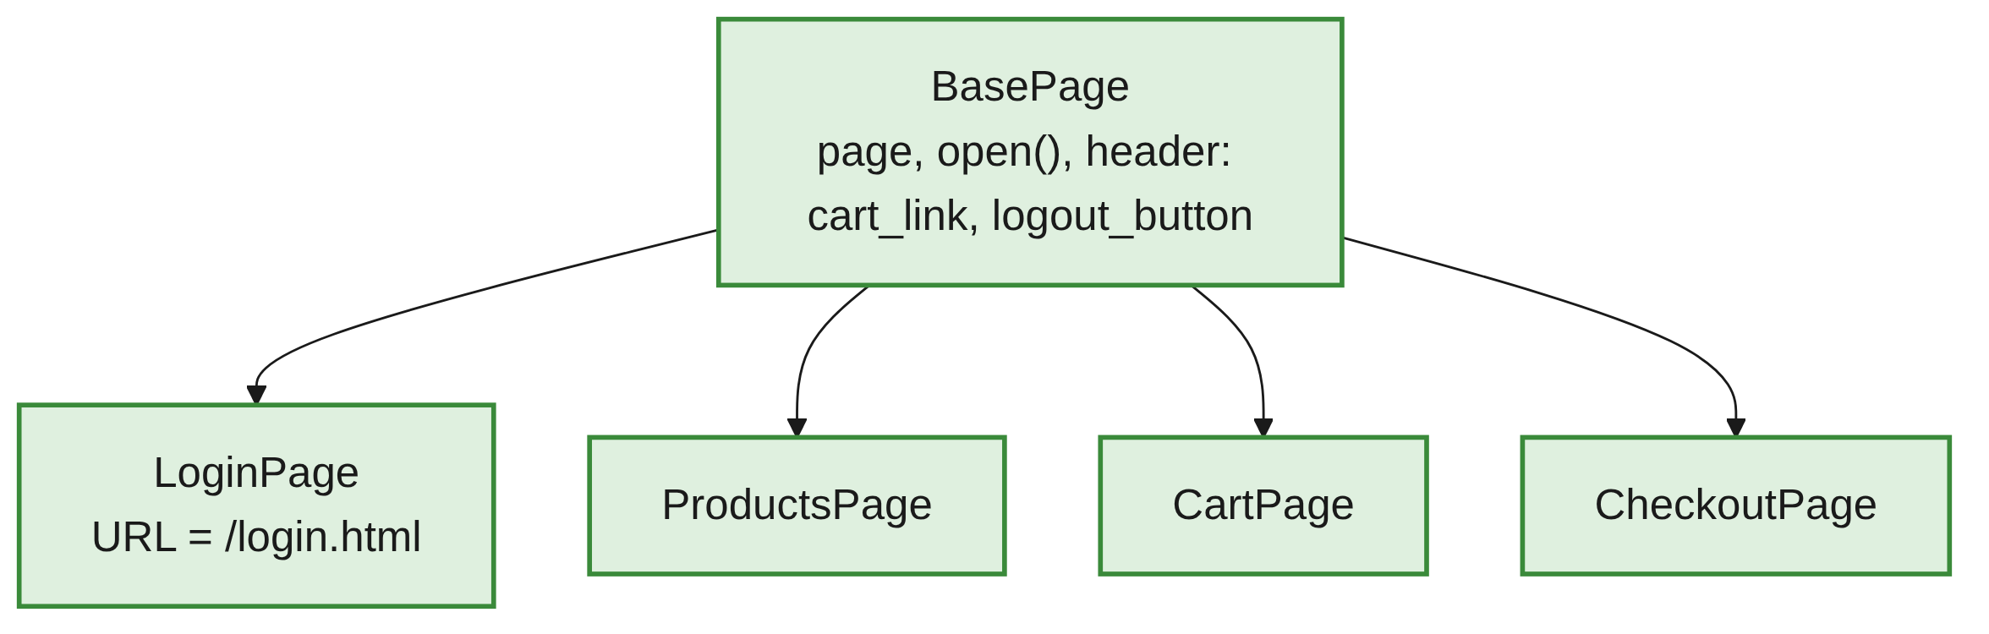
The Base Page: Shared Actions
PART 2
INSIDE BASEPAGE
def open(self):
self.page.goto(self.URL)
return self # lets you write: LoginPage(page).open()
def go_to_cart(self):
self.cart_link.click()
def log_out(self):
self.logout_button.click()
Page Object Model · Week 5 · Lecture 8 | 10 / 29

Slide 11
Building Page Classes
03
Locators, actions, data
Page Object Model · Week 5 · Lecture 8 | 11 / 29

Slide 12
A Page Class: Locators
PART 3
class LoginPage(BasePage):
URL = "/login.html"
def __init__(self, page: Page):
super().__init__(page) # 1. set up the base page
# 2. Locators
self.username_input = page.get_by_label("Username")
self.password_input = page.get_by_label("Password")
self.login_button = page.get_by_role("button", name="Log in")
self.error_message = page.get_by_role("alert")
Each page inherits from BasePage and sets its own URL.
Page Object Model · Week 5 · Lecture 8 | 12 / 29

Slide 13
A Page Class: Actions
PART 3
INSIDE LOGINPAGE
# 3. Actions
def login(self, username: str, password: str) -> None:
self.username_input.fill(username)
self.password_input.fill(password)
self.login_button.click()
USING IT
def test_wrong_password(page):
login_page = LoginPage(page).open()
login_page.login("student", "wrong")
expect(login_page.error_message).to_have_text("Invalid username or password")
Page Object Model · Week 5 · Lecture 8 | 13 / 29

Slide 14
Methods That Take Parameters
PART 3
INSIDE PRODUCTSPAGE
def product(self, name: str):
"""The card for one product."""
return self.products.filter(has=self.page.get_by_role("heading", name=name, exact=True))
def add_to_cart(self, *names: str) -> None:
for name in names:
self.product(name).get_by_role("button", name="Add to cart").click()
USING IT
products_page.add_to_cart("Backpack", "Jacket") # *names accepts any number
When a page has many similar elements, write one method with a parameter instead of one locator per element.
Page Object Model · Week 5 · Lecture 8 | 14 / 29

Slide 15
Methods That Return Data
PART 3
def get_prices(self) -> list[float]:
return [float(p.replace("$", "")) for p in self.product_prices.all_text_contents()]
Return plain Python values when tests need to calculate or compare.
Name data getters get_....
Page Object Model · Week 5 · Lecture 8 | 15 / 29

Slide 16
Naming Conventions
PART 3
Thing | Convention | Example
Class | <Name>Page | CartPage
File | <name>_page.py | cart_page.py
Locators | What it is, plus its type | login_button, username_input
Actions | A verb | login(), add_to_cart(), checkout()
Data getters | get_... | get_item_names(), get_prices()
Page Object Model · Week 5 · Lecture 8 | 16 / 29

Slide 17
Where Do Assertions Go?
PART 3
# Good: the test decides what to check
expect(login_page.error_message).to_have_text("Invalid username or password")
# Avoid: the page object decides what's "correct"
login_page.check_error_is_invalid_password()
Keep assertions in the tests. One page is used by many tests that expect different things; with expectations in the class, it ends up with one method per test.
TEAMS DIFFER
Teams differ: some add small helper checks to page objects. What matters is being consistent across a test suite.
Page Object Model · Week 5 · Lecture 8 | 17 / 29

Slide 18
Converting Scripts to POM
04
A step-by-step recipe
Page Object Model · Week 5 · Lecture 8 | 18 / 29

Slide 19
The Recipe
PART 4
1
Group the lines by page
4
Rewrite the test with the classes
2
Move locators into page classes
5
Run: same result as before
3
Turn step groups into methods
6
Move repeated setup into fixtures
Refactoring changes the structure, not the behaviour. Convert one test at a time and run after each.
Page Object Model · Week 5 · Lecture 8 | 19 / 29

Slide 20
Step 1: Group the Lines by Page
PART 4
def test_checkout(page):
# --- Login page ---
page.goto("/login.html")
... # username, password, Log in
# --- Products page ---
page.locator(".product").filter(has_text="Backpack").get_by_role("button", name="Add to cart").click()
... # Jacket, Cart link
# --- Cart page ---
page.get_by_role("button", name="Checkout").click()
# --- Checkout page --- first name, last name, postcode, Continue
Page Object Model · Week 5 · Lecture 8 | 20 / 29

Slide 21
Steps 2 and 3: Locators and Methods
PART 4
Script | Becomes
page.get_by_label("Username") | LoginPage.username_input
The 3 login lines | LoginPage.login(username, password)
The 4 checkout-form lines | CheckoutPage.enter_details(first, last, postcode)
Page Object Model · Week 5 · Lecture 8 | 21 / 29

Slide 22
Step 4: Rewrite the Test
PART 4
def test_checkout(page):
login_page = LoginPage(page).open()
login_page.login("student", "secret123")
products_page = ProductsPage(page)
products_page.add_to_cart("Backpack", "Jacket")
products_page.go_to_cart()
CartPage(page).checkout()
checkout_page = CheckoutPage(page)
checkout_page.enter_details("Test", "User", "10001")
expect(checkout_page.total).to_have_text("Total: $86.38")
Page Object Model · Week 5 · Lecture 8 | 22 / 29

Slide 23
Steps 5 and 6: Run, Then Fixtures
PART 4
Step 5: run the tests. They should pass exactly as before.
Convert one test at a time, and run after each one.
Step 6: every page object wraps the same page.
Fixtures can build the page objects for us (Part 5).
Page Object Model · Week 5 · Lecture 8 | 23 / 29

Slide 24
Fixtures for Page Objects
05
Ready-made, logged-in pages
Page Object Model · Week 5 · Lecture 8 | 24 / 29

Slide 25
Fixtures in conftest.py
PART 5
LOGIN PAGE AND SAVED LOGIN STATE
@pytest.fixture
def login_page(page) -> LoginPage:
return LoginPage(page).open()
@pytest.fixture
def logged_in_page(new_context, student_state):
return new_context(storage_state=student_state).new_page()
BOTH SHARE ONE TAB PER TEST
@pytest.fixture
def products_page(logged_in_page) -> ProductsPage:
return ProductsPage(logged_in_page).open() # already logged in and open
@pytest.fixture
def cart_page(logged_in_page) -> CartPage:
return CartPage(logged_in_page) # same tab as products_page
Page Object Model · Week 5 · Lecture 8 | 25 / 29

Slide 26
Short, Readable Tests
PART 5
A TEST
def test_add_to_cart_updates_the_cart_link(products_page):
products_page.add_to_cart("Backpack", "Onesie")
expect(products_page.cart_link).to_have_text("Cart (2)")
A FIXTURE THAT BUILDS A STARTING STATE
@pytest.fixture
def cart_with_two_items(products_page, cart_page) -> CartPage:
products_page.add_to_cart("Backpack", "Jacket")
products_page.go_to_cart()
return cart_page
Page Object Model · Week 5 · Lecture 8 | 26 / 29

Slide 27
Common Mistakes
WRAP-UP
Locators left in tests
Move them into the page class.
One method per test
Not login_as_student_with_wrong_password(): one method with parameters, login(username, password).
A huge BasePage
Only what every page shares.
expect inside page methods
Keep assertions in tests.
No super().__init__(page)
self.page and the header locators won't exist.
No module named 'pages'
Run pytest from the course folder; check pages/__init__.py. Run folders with their own pages/ separately.
Page Object Model · Week 5 · Lecture 8 | 27 / 29

Slide 28
Key Takeaways
SUMMARY
1
POM: one class per page, holding its locators and actions. Tests say what, pages say how.
2
Put shared parts (the page, open(), the header) in a base page.
3
Use parameters (product(name)) instead of one locator per item.
4
Keep assertions in tests; page objects expose locators and data.
5
Convert one test at a time: group, move locators, make methods, rewrite, run.
6
Use fixtures to hand tests ready-made, logged-in page objects.
Page Object Model · Week 5 · Lecture 8 | 28 / 29

Slide 29
Additional Resources
1
Page object models (Playwright docs)
https://playwright.dev/python/docs/pom
2
pytest fixtures
https://docs.pytest.org/en/stable/how-to/fixtures.html
3
Python classes and inheritance
https://docs.python.org/3/tutorial/classes.html
Page Object Model · Week 5 · Lecture 8 | 29 / 29

