Slide 1
Data, Reporting and Project Briefing
WEEK 5 · LECTURE 9
Drive tests from data, deal with flaky tests, report results, and start the final project.
parametrize
JSON data
Retries
Reports
Project
Notes:
Lecture 9 of the Week 5 Playwright series, 45-50 minutes. The demo file builds on the Lecture 8 store and page objects. Hand out final-project-brief.md at the end. Diagram colour legend (code weeks): blue = application or browser under test; green = test code; orange = fixtures, setup and teardown; purple = runner, configuration, CLI; red = failures and errors; black = structure.

Slide 2
Learning Objectives
1
Run one test with many inputs using @pytest.mark.parametrize, with data from JSON files.
2
Explain flaky tests, use retries, and explain why retries aren't a real fix.
3
Produce an HTML report with screenshots of failures.
4
Record screenshots, videos and traces, and put all the settings in pytest.ini.
5
Know what the final project asks for.
Data, Reporting and Project Briefing · Week 5 · Lecture 9 | 2 / 33

Slide 3
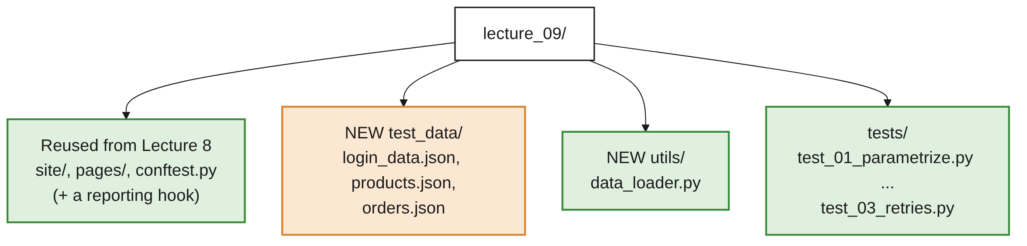
Setup for This Lecture
OVERVIEW
BOTH PLUGINS WERE IN THE INSTALLATION GUIDE
$ pip install pytest-html pytest-rerunfailures
Data, Reporting and Project Briefing · Week 5 · Lecture 9 | 3 / 33

Slide 4
parametrize
01
Same steps, different data
Data, Reporting and Project Briefing · Week 5 · Lecture 9 | 4 / 33

Slide 5
One Parameter
PART 1
@pytest.mark.parametrize("name", ["Backpack", "Bike Light", "T-Shirt", "Jacket", "Onesie"])
def test_each_product_can_be_added(products_page, name):
products_page.add_to_cart(name)
expect(products_page.cart_link).to_have_text("Cart (1)")
OUTPUT
test_each_product_can_be_added[chromium-Backpack] PASSED
test_each_product_can_be_added[chromium-Bike Light] PASSED
... <- 5 tests from 1 function
Instead of copying the test, give pytest a list of values. It runs the test once per value.
Data, Reporting and Project Briefing · Week 5 · Lecture 9 | 5 / 33

Slide 6
Several Parameters
PART 1
@pytest.mark.parametrize(
"option, first_product",
[("Name (A to Z)", "Backpack"), ("Name (Z to A)", "T-Shirt"),
("Price (low to high)", "Onesie"), ("Price (high to low)", "Jacket")],
)
def test_sorting(products_page, option, first_product):
products_page.sort_by(option)
expect(products_page.product_names.first).to_have_text(first_product)
A comma-separated string of names and a list of tuples, one value per name.
Data, Reporting and Project Briefing · Week 5 · Lecture 9 | 6 / 33

Slide 7
Readable Names with ids
PART 1
@pytest.mark.parametrize(
"items, expected_count",
[(["Backpack"], 1), (["Backpack", "Jacket"], 2), ([...5 items...], 5)],
ids=["one item", "two items", "everything"],
)
OUTPUT
test_cart_count[chromium-one item] PASSED
test_cart_count[chromium-two items] PASSED
test_cart_count[chromium-everything] PASSED
Data, Reporting and Project Briefing · Week 5 · Lecture 9 | 7 / 33

Slide 8
pytest.param: One Case's Settings
PART 1
pytest.param("Jacket", "$59.99", id="jacket-price-rise",
marks=pytest.mark.skip(reason="New price not live yet"))
Give one case its own id and marks, such as skip.
Each case is a separate test: if one fails, the others still run.
The report shows exactly which data failed.
Data, Reporting and Project Briefing · Week 5 · Lecture 9 | 8 / 33

Slide 9
Test Data in JSON
02
Keep data out of the test file
Data, Reporting and Project Briefing · Week 5 · Lecture 9 | 9 / 33

Slide 10
Why Separate Data Files?
PART 2
Anyone can add cases
Non-programmers such as BAs and manual testers can add cases without touching Python.
Reuse
The same data can be used by several tests.
Short tests
Tests stay short and focused on the steps.
Data, Reporting and Project Briefing · Week 5 · Lecture 9 | 10 / 33

Slide 11
The JSON File
PART 2
TEST_DATA/LOGIN_DATA.JSON
[
{ "id": "valid user", "username": "student", "password": "secret123", "error": null },
{ "id": "wrong password", "username": "student", "password": "wrong", "error": "Invalid username or password" },
{ "id": "locked user", "username": "locked", "password": "secret123", "error": "Sorry, this user has been locked out" }
]
JSON | Python
[ ... ] | list
{ "key": value } | dict
"text" / 29.99 | str / float
true / false | True / False
null | None
Data, Reporting and Project Briefing · Week 5 · Lecture 9 | 11 / 33

Slide 12
A Small Loader
PART 2
UTILS/DATA_LOADER.PY
import json
from pathlib import Path
DATA_DIR = Path(__file__).parent.parent / "test_data"
def load_json(file_name):
with open(DATA_DIR / file_name, encoding="utf-8") as f:
return json.load(f)
WHY __FILE__
Building the path from __file__ means it works whichever folder you run pytest from.
Data, Reporting and Project Briefing · Week 5 · Lecture 9 | 12 / 33

Slide 13
Using the Data
PART 2
LOGIN_CASES = load_json("login_data.json")
@pytest.mark.parametrize("case", LOGIN_CASES, ids=[c["id"] for c in LOGIN_CASES])
def test_login(login_page, case):
login_page.login(case["username"], case["password"])
if case["error"] is None:
expect(login_page.page).to_have_url(re.compile("products.html"))
else:
expect(login_page.error_message).to_have_text(case["error"])
Data, Reporting and Project Briefing · Week 5 · Lecture 9 | 13 / 33

Slide 14
One Case per JSON Object
PART 2
OUTPUT WITH SIX CASES IN THE FILE
test_login[chromium-valid user] PASSED
test_login[chromium-wrong password] PASSED
test_login[chromium-unknown user] PASSED
test_login[chromium-locked user] PASSED
test_login[chromium-empty username] PASSED
test_login[chromium-empty password] PASSED
THE PAYOFF
Adding a seventh case means adding seven lines of JSON, with no Python changes.
Data, Reporting and Project Briefing · Week 5 · Lecture 9 | 14 / 33

Slide 15
A JSON Object: .items()
PART 2
TEST_DATA/PRODUCTS.JSON
{ "Backpack": 29.99, "Bike Light": 9.99, "T-Shirt": 15.99, "Jacket": 49.99, "Onesie": 7.99 }
PRICES = load_json("products.json")
@pytest.mark.parametrize("name, price", PRICES.items())
def test_price_matches_catalogue(products_page, name, price):
assert products_page.price_of(name) == f"${price:.2f}"
Cases can describe whole journeys: see test_checkout_totals and orders.json in the demo.
CSV (csv), Excel (openpyxl) and YAML (PyYAML) work the same way; JSON is built in.
Data, Reporting and Project Briefing · Week 5 · Lecture 9 | 15 / 33

Slide 16
Flaky Tests and Retries
03
Passes sometimes, fails sometimes
Data, Reporting and Project Briefing · Week 5 · Lecture 9 | 16 / 33

Slide 17
What Is a Flaky Test?
PART 3
THE SAME TESTS, RUN FOUR TIMES
1 failed, 2 passed, 1 rerun
3 passed
1 failed, 2 passed
3 passed
A flaky test sometimes passes and sometimes fails without any code changing.
Causes: slow servers, animations, timing assumptions, tests that depend on each other.
Here: the 'Today's deal' banner appears after a random 0 to 8 seconds; expect waits only 5.
Data, Reporting and Project Briefing · Week 5 · Lecture 9 | 17 / 33

Slide 18
Retrying with pytest-rerunfailures
PART 3
FOR ONE TEST
@pytest.mark.flaky(reruns=3)
def test_deal_banner_with_retries(products_page):
expect(products_page.page.get_by_text("Today's deal")).to_be_visible()
FOR EVERY TEST
pytest --reruns 2 # retry failures up to 2 times
pytest --reruns 2 --reruns-delay 1 # wait 1 second between tries
A rerun shows as R in the output and as Reruns in the report.
Data, Reporting and Project Briefing · Week 5 · Lecture 9 | 18 / 33

Slide 19
Retries Hide Problems
PART 3
Do | Don't
Find why it's flaky and fix that | Add retries to every flaky test and move on
Small global retry (1-2) in CI for things outside your control | Use large retry counts
Check the report's Reruns count regularly | Ignore tests that keep needing reruns
THE REAL FIX HERE: A LONGER TIMEOUT
def test_deal_banner_fixed(products_page):
expect(products_page.page.get_by_text("Today's deal")).to_be_visible(timeout=10_000)
Data, Reporting and Project Briefing · Week 5 · Lecture 9 | 19 / 33

Slide 20
Reporting
04
Show what ran, and why it failed
Data, Reporting and Project Briefing · Week 5 · Lecture 9 | 20 / 33

Slide 21
pytest-html
PART 4
$ pytest lecture_09 --html=reports/report.html --self-contained-html
Option | Meaning
--html=reports/report.html | Where to write the report
--self-contained-html | Put CSS and images inside the one file, so it's easy to email or attach
Data, Reporting and Project Briefing · Week 5 · Lecture 9 | 21 / 33

Slide 22
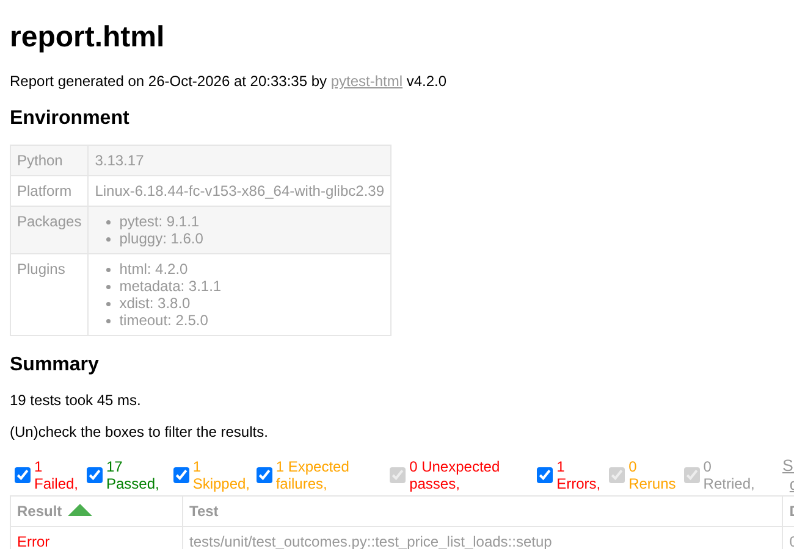
Reading the Report
PART 4
Environment: Python version and plugins.
Summary with filters: Passed, Failed, Skipped, Reruns.
Each test with its duration and, for failures, the full error.
Open reports/report.html in a browser.
A real pytest-html 4.2.0 report from an earlier pytest run.
Data, Reporting and Project Briefing · Week 5 · Lecture 9 | 22 / 33

Slide 23
A Screenshot for Each Failure
PART 4
CONFTEST.PY (TRIMMED; FULL CODE IN THE DEMO)
@pytest.hookimpl(hookwrapper=True)
def pytest_runtest_makereport(item, call):
outcome = yield
report = outcome.get_result()
if report.when == "call" and report.failed:
page = _find_page(item) # the test's Playwright page
pytest_html = item.config.pluginmanager.getplugin("html")
... # if page and pytest_html: add the extras
extras.append(pytest_html.extras.png(screenshot, "Screenshot at failure"))
report.extras = extras
pytest-html doesn't know about Playwright, so a pytest hook adds the screenshot. This is the other meaning of 'hooks' from Lecture 7.
Data, Reporting and Project Briefing · Week 5 · Lecture 9 | 23 / 33

Slide 24
What the Hook Does
PART 4
Line | What it does
hookwrapper=True + yield | Let pytest create the report first, then add to it
report.when == "call" | Only the test body (not setup or teardown)
report.failed | Only failures
page.screenshot() | Take the screenshot (as bytes)
base64... | Turn it into text that can go inside the HTML file
report.extras | Extra items pytest-html shows next to the test
No need to memorise it: it's the same everywhere. Copy it into conftest.py.
Data, Reporting and Project Briefing · Week 5 · Lecture 9 | 24 / 33
Notes:
_find_page looks through the test's fixtures for a Page, or a page object with a .page, so it works with POM tests too. The hook also adds the page URL as a link.

Slide 25
pytest-playwright Recording
PART 4
Option | Values | Records
--screenshot | on, off, only-on-failure | A screenshot at the end of each test
--video | on, off, retain-on-failure | A video of each test
--tracing | on, off, retain-on-failure | A trace (playwright show-trace; Lecture 3)
--output | A folder | Where to save them (default test-results)
RECOMMENDED
Everyday runs: --screenshot only-on-failure --tracing retain-on-failure. Everything you need to investigate a failure, and nothing for passing tests.
Data, Reporting and Project Briefing · Week 5 · Lecture 9 | 25 / 33

Slide 26
Other Reporting Tools
PART 4
Tool | Notes
pytest-html | Simple, one file, no extra software. Used in this course
Allure (allure-pytest) | Richer dashboards, history, steps. Needs the Allure command-line tool (and Java)
JUnit XML (--junitxml=report.xml) | Built into pytest. Read by CI tools like Jenkins and GitHub Actions
Data, Reporting and Project Briefing · Week 5 · Lecture 9 | 26 / 33

Slide 27
Putting It Together: pytest.ini
PART 4
All the course's options in one place.
Now a plain pytest run does everything.
Add reports/ and test-results/ to .gitignore: every run recreates them.
[pytest]
base_url = https://www.saucedemo.com
testpaths = tests
addopts =
--browser chromium
--reruns 1
--screenshot only-on-failure
--tracing retain-on-failure
--html=reports/report.html
--self-contained-html
Data, Reporting and Project Briefing · Week 5 · Lecture 9 | 27 / 33

Slide 28
Final Project Briefing
05
Everything you need was covered
Data, Reporting and Project Briefing · Week 5 · Lecture 9 | 28 / 33

Slide 29
The Final Project Brief
PART 5
1
The site: saucedemo.com, a demo store made for practising test automation
2
Requirements: POM, fixtures, JSON data, expect, pytest.ini, HTML report, README
3
Suggested structure: the same as Lectures 8 and 9
4
The grading checklist
5
The deadline and how to submit
Hand out final-project-brief.md and walk through it.
Data, Reporting and Project Briefing · Week 5 · Lecture 9 | 29 / 33

Slide 30
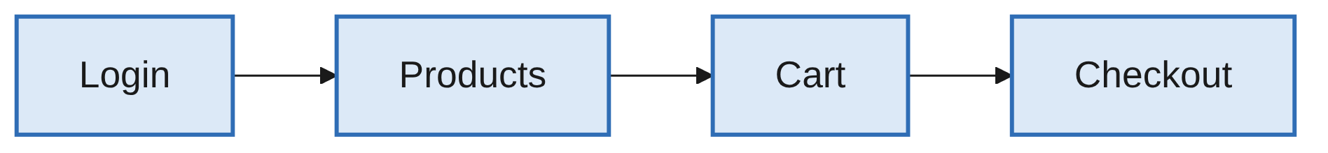
Same Shape as the Practice Store
PART 5
The Lecture 8-9 store and saucedemo follow the same journey.
Page objects, fixtures, JSON data and reporting all carry over.
Everything needed was covered in the course.
Data, Reporting and Project Briefing · Week 5 · Lecture 9 | 30 / 33

Slide 31
Common Mistakes
WRAP-UP
parametrize shapes
Several names need a tuple per case, and the names must match the function's arguments.
Data file paths
open("test_data/login_data.json") works from one folder only; build the path from __file__.
Invalid JSON
JSON needs double quotes and no trailing commas.
--reruns 5 everywhere
Hides real problems; fix the cause.
Report not self-contained
Without --self-contained-html, screenshots are separate files that get lost.
Generated folders
Add reports/ and test-results/ to .gitignore. Run lecture_08 and lecture_09 separately.
Data, Reporting and Project Briefing · Week 5 · Lecture 9 | 31 / 33

Slide 32
Key Takeaways
SUMMARY
1
@pytest.mark.parametrize runs one test with many inputs; use ids for readable names.
2
Keep larger test data in JSON files under test_data/, loaded with a small helper.
3
Retries hide flakiness: find the cause first, and keep retry counts small.
4
pytest-html plus a pytest_runtest_makereport hook gives a one-file report with failure screenshots.
5
--screenshot only-on-failure --tracing retain-on-failure records evidence for failures only.
6
Put the settings in pytest.ini so pytest alone runs everything.
Data, Reporting and Project Briefing · Week 5 · Lecture 9 | 32 / 33

Slide 33
Additional Resources
1
pytest parametrize
https://docs.pytest.org/en/stable/how-to/parametrize.html
2
pytest-html user guide
https://pytest-html.readthedocs.io/en/latest/user_guide.html
3
pytest-rerunfailures
https://github.com/pytest-dev/pytest-rerunfailures
4
Playwright pytest plugin options
https://playwright.dev/python/docs/test-runners
5
Practice site for the final project
https://www.saucedemo.com/
Data, Reporting and Project Briefing · Week 5 · Lecture 9 | 33 / 33

