Slide 1
Software Development LifeCycle &
Team Dynamics

Slide 2
SDLC Intro
The Software Development Lifecycle is a process used by the software industry to design, develop, test and maintain high-quality software and products.
The goal of SDLC is to produce quality software that meets or exceeds customer expectations.
SDLC is also known as the ‘Software Development Process’
SDLC is a framework to define tasks performed during each step of this process

Slide 3
Software Team
Client
Technology Lead
Senior Software Developer (1 or more)
Software Developer (1 or more)
Quality Assurance Lead
Senior QA (1 or more)
QA (1 or more)
Business Analyst(s)
Architect
Other Stakeholders
Project / Product
Manager

Slide 4
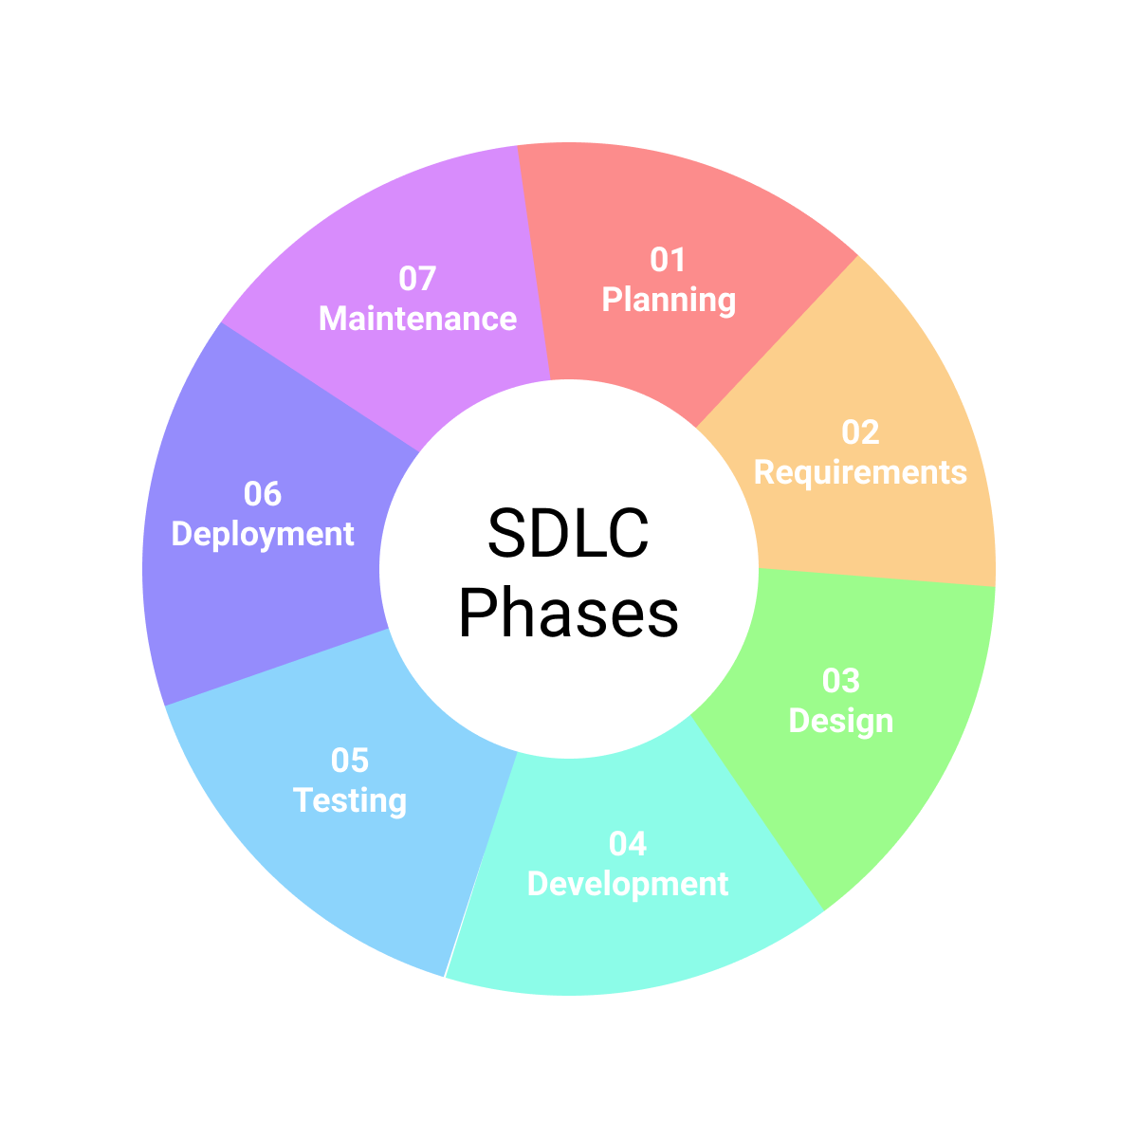
Software Development Lifecycle
Planning
Requirements Gathering/Analysis
System Design
Implementation/Development
Testing
Deployment
Maintenance & Operations

Slide 5
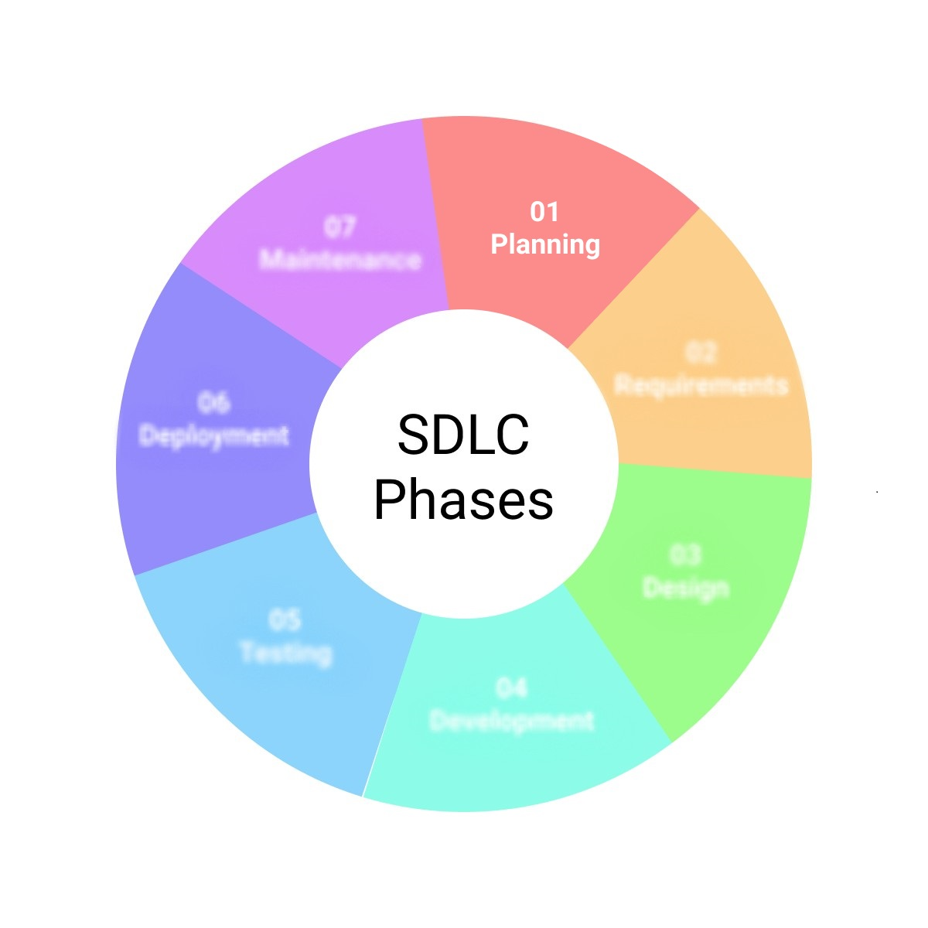
SDLC - Planning
During the Planning Phase…
  Resources are calculated and allocated
  Project Scheduling is done
  Cost Estimates are calculated
Who is involved?
  Project Managers
  Product Managers
  Business Analysts
  Clients/Stakeholders

Slide 6
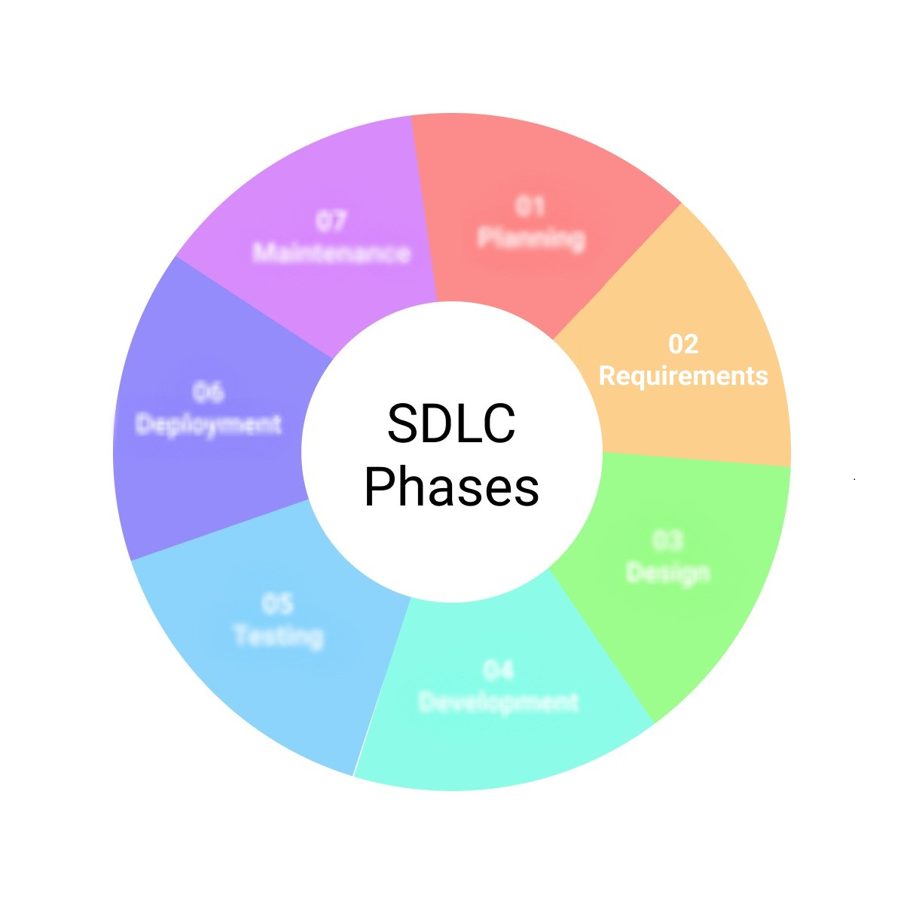
SDLC – Requirements Gathering/Analysis
During the Requirements Gathering/Analysis Phase…
  Software requirements are detailed
  Documentation is created
  Project scope is defined
Who is involved?
  Project Managers
  Product Managers
  Business Analysts
  Technology Lead/Senior Developers

Slide 7

SDLC – System Design
During the System Design Phase…
  Software Specification Documentation* is created
    *Defines the overall system architecture and design
  Sprint Planning Meetings are scheduled
  User stories are generated
Who is involved?
  Technology Lead
  Senior Developers
  System Architects
  Designers

Slide 8

SDLC – Implementation/Development
During the Implementation Phase…
  Design & System Spec documents are translated to actual code.
    This is what is traditionally referred to as “software development”
  System Tests are planned and work begins on creation of tests*
  *Note: In Test Driven Development, the tests would be created first
Who is involved?
  Technology Lead
  Developers
  Testers**
**Testers may or may not be involved, depending on the development methodology

Slide 9

SDLC – Testing
During the Testing Phase…
  Tests are created and conducted against code
  Code logic is evaluated against original user stories.
  Testing may involve:
    Unit Testing
    Integration Testing
    User Acceptance Testing (UAT)
    Etc…
Who is involved?
  QA Leads
  Quality Assurance (QA) Engineers
  Testers
  Developers

Slide 10

SDLC – Deployment
During the Deployment Phase…
  Software is made available to end-users in production environment
  System configurations for production environment is verified
Who is involved?
  Operations Team
  System Administrators/Engineers
  Platform Administrators/Engineers

Slide 11

SDLC – Maintenance & Operations
During the Maintenance & Operations Phase…
  System monitoring to ensure system continues to meet user needs.
  Updates/patches are pushed as needed
  System performance is monitored
  Feedback is gathered and analyzed for possible improvements
Who is involved?
  Operations Team
  System Administrators/Engineers
  Platform Administrators/Engineers
  IT Operations
  Developers (as needed)

Slide 12
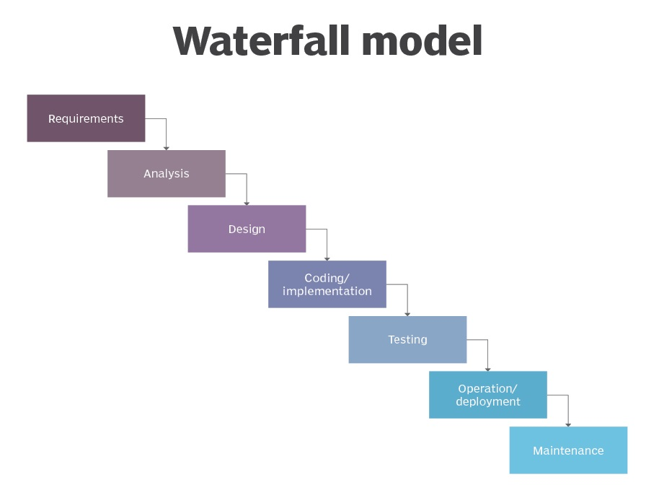
Waterfall Model
An implementation model for the SDLC in which each step is completed before moving to the next.
Pros:
  Clearly defined goals and timeline
  Less confusion regarding status of project completion
  Easier to implement
Cons:
  Not ideal for complex development projects
  Consumes a lot of time because each phase must be planned carefully and completed fully
  Since testing does not come until later, serious issues or complications may arise far into development.
Most Useful for:
  Projects where human life may be at stake
  Military programs
  Projects that have a high degree of oversight/accountability

Slide 13
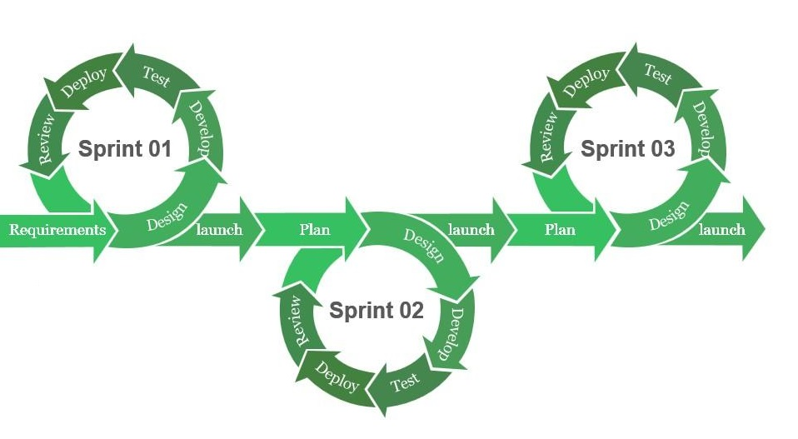
Agile Methodology
Methodology (work culture) which focuses on these core values:
  Individuals & Interactions over Processes and Tools
  Working software over comprehensive documentation
  Customer Collaboration over contract negotiations
  Responding to change over following a plan
Pros:
  Responsive approach to issues that arise
  Supports Cross-functional teamwork
  (Typically) Reduced scope for faster implementation
Cons:
  The final product depends on the customer, so it may shift. (moving target)
  It can be harder to integrate new members into workflow due to shifting workflow needs.
  May lead to inadequate documentation, which can cause confusion/misunderstanding
Useful for:
  Most modern software development

Slide 14
Scrum
Scrum
  A process framework used to manage the development of a product or software.
    Scrums are well suited for cross-functional teams to coordinate efforts.
    Work efforts for a scrum are split into individual “sprints” where some amount of nontrivial work is completed
Sprint
  An established timeframe (typically 2 weeks, should be less than month) during which a team produces potentially shippable* product.
    A single sprint may not produce the entire project, but should produce a useable piece of the project
    This means that after a sprint, a feature shouldn’t be dependent on a future release
See more terms at: https://www.agilealliance.org/agile101/agile-glossary/

Slide 15
Scrum Team - Leaders
Product Owner
  Responsible for maximizing value of the finished product
  Manages Product Backlog & provides clarity for any questions regarding Product Backlog items
  Typically, this is someone on the client-side or a BA who works closely with Client
Scrum Master
  Responsible for promoting Scrum & Upskilling new scrum teams
  Leads Stand-up Meetings
  Scrum Masters help those inside & outside a Scrum Team understand how to help with the Scrum process
  When a Development Team has matured, senior/experienced Scrum Masters may leave to nurture a new Scrum Team
  Anyone on a mature Development Team may become the new Scrum Master
See more terms at: https://www.agilealliance.org/agile101/agile-glossary/

Slide 16
Scrum Team – Development Team
Development Team
  Professionals who do the work of delivering a product.
  Dev Teams should be:
    self-organizing (no one tells the Development Team how to turn Product Backlog into potentially releasable functionality…)
    Cross-functional (all skills necessary to create the product should exist on the Scrum Development Team)
  There are no “sub-teams” in a development team (i.e. no “testing team”, “operations team”, etc…)
  Individual Team members may have specialized skills and areas of focus, but accountability belongs to the Development Team as a whole.
See more terms at: https://www.agilealliance.org/agile101/agile-glossary/

Slide 17
Scrum Ceremonies
Sprint Planning
  Review backlog and determine work to be completed in next sprint
Daily Stand-up
  Daily check-in meetings where teams discuss progress in brief
Sprint Review / Sprint Demo
  Review all work accomplished in the sprint
  Backlog is updated
  Preparation for next Sprint planning meeting
Sprint Retrospective
  Discuss opportunities for improvement in team workflow/processes to increase efficiency

Slide 18

Scrum Ceremonies – Stand Up
During a daily standup, the following questions are answered:
  What did you do yesterday?
  What problems are you facing?
  What are you planning to do today?
Team members should move any of their cards* from “To-do” to “Doing” to “Done” before the daily stand-up so that everyone is on the same page.
*Cards are typical with Kanban boards – but any ‘task tracking’ should be updated

Slide 19

Scrum Ceremonies – Review/Demo
Anyone from the scrum team can give a demonstration of the Product Backlog Items (PBIs) completed in the sprint
Demos are typically attended by the Product Owner (PO) and/or other business executives and impacted stakeholders
During a demo the PO validates the software developed meets expectations and matches user story specifications
  If yes, the PO confirms that a user story has been completed
  Typically, confirmation percentages are very high in Agile development teams

Slide 20
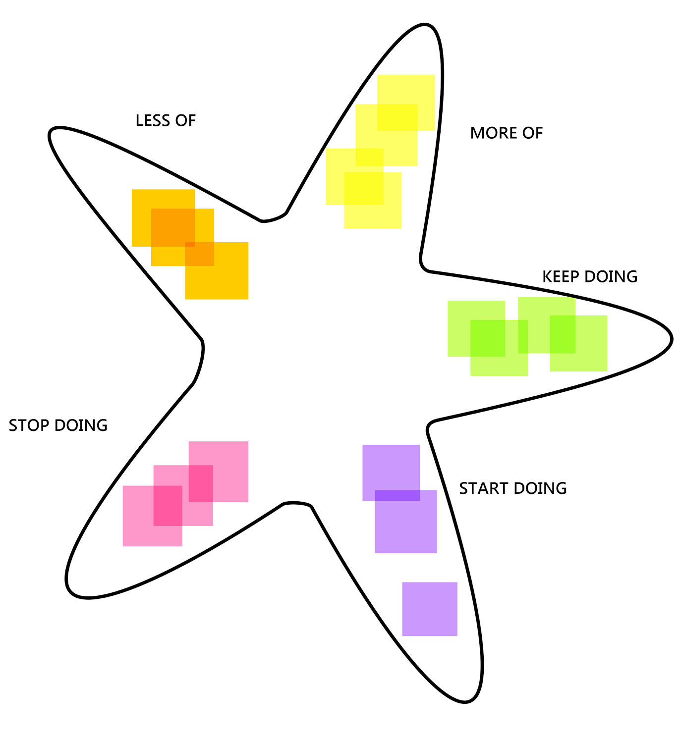
Scrum Ceremonies – Sprint Retrospective
Conducted after the Sprint Demo
All scrum members (except PO) participate in a discussion regarding:
  What went well during the sprint?
  What are the areas or improvement?
  What were the key challenges?
  Ideas that can be implemented in the next Sprint.
There are various techniques that are used during retrospectives:
  4Ls (Liked, Learned, Lacked, Longed for)
  Stop, Start, Continue
  Mad, Sad, Glad
  Star Method (pictured)
  Sailboat
  KALM (Keep, Add, Less, More)
Retrospectives help teams gather feedback and improve without pointing fingers

Slide 21
Scrum Artifacts | Managing Work in a Sprint
Product Backlog
  List of all new features, changes to existing features, bug fixes, etc… related to the product creation
  May contain Epics and User Stories
Sprint Backlog
  Subset of tasks from Product Backlog which establish work to be completed in current sprint
  Should only contain User Stories and other, discrete tasks associated with a story
Epic
  Large body of work that can be broken down into smaller, features/units of work (stories)
  Ex: User account Management
User Stories
  Functional unit of work which can be expected to yield an expected result when implemented.
  Typically, user stories are written using the following format:
    As a [user], I can [do something] so that I [value gained]
  Ex: As a new user, I want to update my profile details so that my account information can stay up-to-date.
  User stories are typically broken down further into individual tasks to be completed.

Slide 22
Planning a Sprint – Sizing Stories
The amount of “work” a User story requires is an abstract concept, as such a technique called “relative sizing” is used to categorize user stories.
How Large is the rectangle?
Extra Small
Small
Medium
Large
Extra Large

Slide 23
Planning a Sprint – Story Pointing
Story Points
  Assigning an arbitrary value to user stories based on it’s relative size.
  Allows a team to calculate their sprint velocity
  Fibonacci Series are commonly used
    i.e. 0, 1, 1, 2, 3, 5
User
Story
8
User
Story
11
User
Story
19
User
Story
21
User
Story
4
3
5
8
13
21

Slide 24
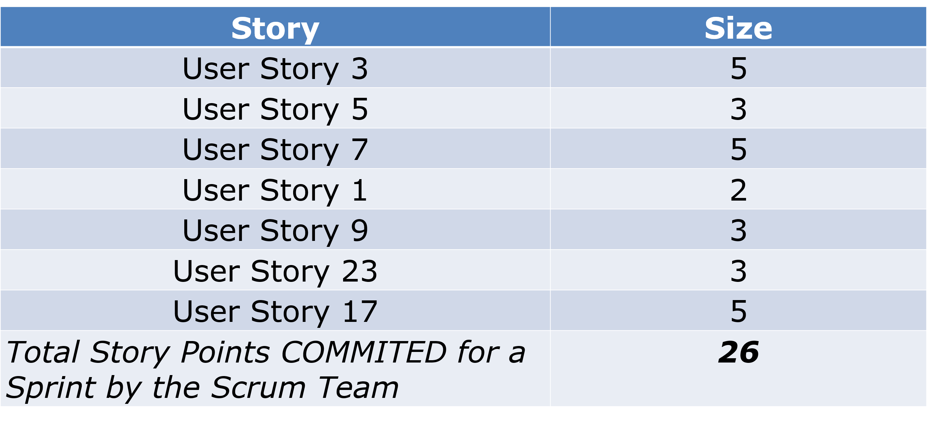
Planning a Sprint – Team Workload
The Sprint Backlog is created by selecting user stories from the Product Backlog.
User stories are picked based on priority and…
Based on the team’s capacity (amount of man hours available) and velocity (average amount of work the team can complete per sprint)

Slide 25
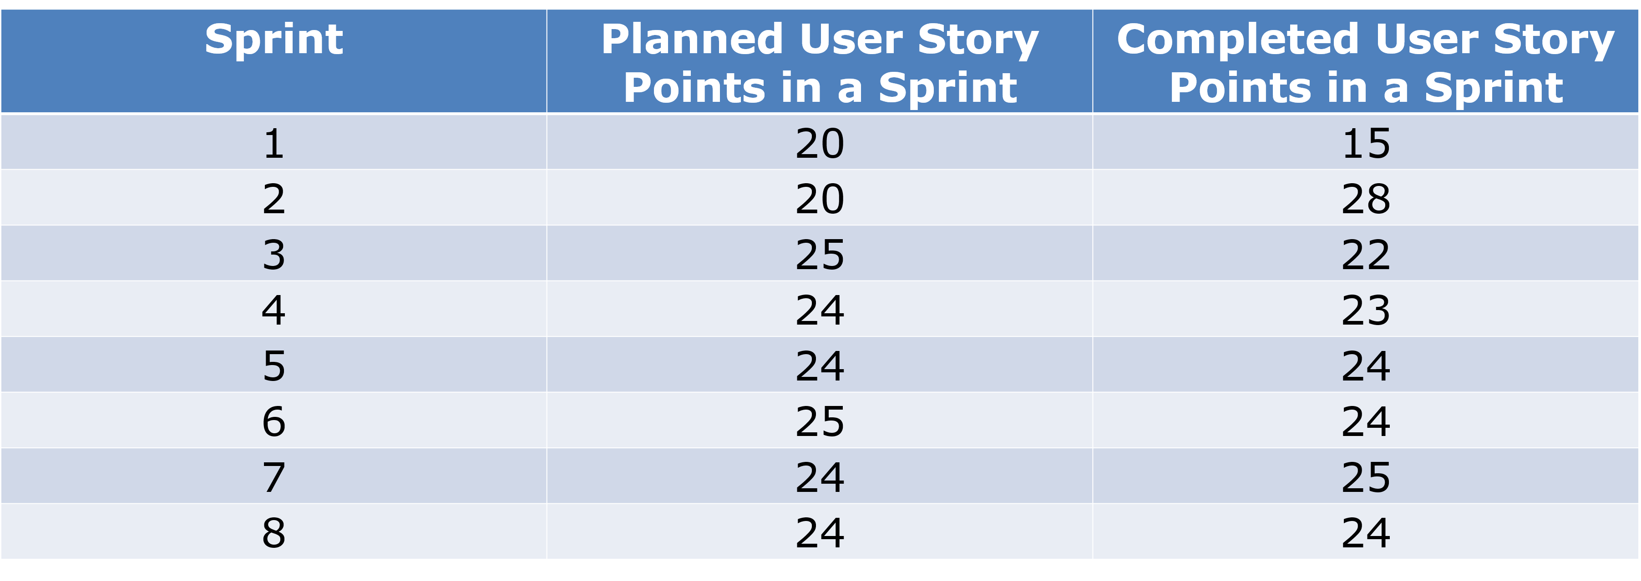
Planning a Sprint – Team Velocity
Software Team Capacity
  Rough calculation of the amount of man hours available to complete work.
  40 x 10 x 0.9 = 360
Scrum Team Velocity
  The Average number of Story points completed by the scrum team consistently.
  The initial few sprints are not as helpful in finding this figure…
Hours in a
work week
Count of
developers
Reduction to
account for
time off
Developer hours available per week

Slide 26
Planning a Sprint – Burndown Chart
Burndown charts are visual representations of work complete everyday and throughout a sprint.
They give a scrum team an idea about how much work is remaining to be done during the rest of the sprint
Burndown charts are created based on the movement of user stories on the spring backlog by the team members.
This is updated before daily standup meetings (when task status’ are updated)
Burndown charts can be maintained at a Sprint level or even a Release level.
Managed by a Scrum Master.

Slide 27
Kanban
Popular approach for managing the flow of work for an Agile-based Team.
Work (bugs, features, enhancements, etc…) move through a process as team members finish work in hand.
Work to be taken up is determined by the team member’s available capacity, not based on ad-hoc requests from the customer/client.
Work items are represented visually on a kanban board, allowing team members to see the state of every piece of work at any time

Slide 28
Kanban Board
Kanban boards are composed of columns with cards representing work to be done.
Backlog
To Do
In Progress
Done

Slide 29
Kanban – Key Principles
The key principles of a Kanban team are:
  Visualize the work
    The foundation of Kanban is a visual board that represents your workflow (“To-Do” -> “In Progress” -> “Done”)
    Each task should be represented by a card (digital or physical), that moves through states, represented through columns
    Visualization helps teams instantly see the status of all work, identify bottlenecks and promote accountability
  Limit Work in Progress
    Kanban encourages setting a maximum number of tasks that can be “in progress” at a given time
    This prevents multi-tasking overload, and ensures focus on finishing current work before starting new work
  Focus on Flow
    The goal of kanban is to achieve a smooth, predictable flow of work items across the board.
    Teams regularly review where cards pile up to resolve bottlenecks or inefficiencies, encouraging faster and consistent value for customer
  Make Policies Explicit
    Everyone should clearly understand the rules of how work moves from one stage to another.
    This includes definitions like: “What does ‘Done’ mean?”, “When is a task ‘Ready for Review’?”
  Continuous Improvement
    Regular meetings (daily standups, retrospectives, review sessions) provide opportunities to discuss flow, blockers and improvements
    Teams should use metrics to identify patterns and test small process changes
    Instead of overhauling processes, teams should evolve processes gradually.

Slide 30
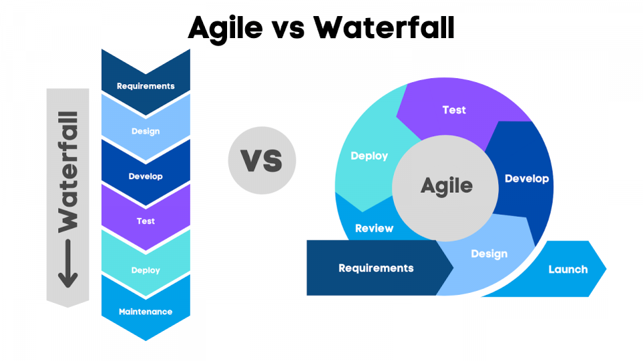
Agile vs Waterfall - Review
Waterfall | Agile
Requires less coordination due to clearly defined phases | Faster Feedback cycles and Response to issues
The cost of the project can be determined early in development | Higher potential for customer satisfaction
Better focus on documentation and design requirements | Better visibility and accountability during product development
Design phase is more methodical and structured | Time to market is drastically reduced
Works better with projects with high degree of oversight and scrutiny | Flexible prioritization and teams typically lead to better productivity

Slide 31
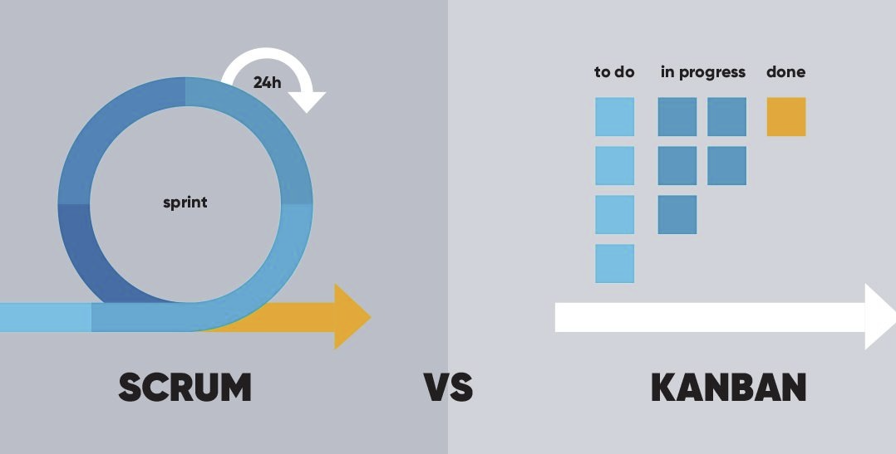
Scrum vs Kanban - Review
Scrum | Kanban
Focuses on helping teams manage their work through a set of values, principles and practices | Helps teams visualize tasks and manage workflows
Regular, fixed-length springs (i.e. 2-weeks) | Continuous flow of work completed
Scrum ceremonies: Sprint planning, sprint, daily stand-up, sprint demo, sprint retrospective | Kanban Board: visualize flow of work, limit work in progress, manage flow, continuous improvement
Product Owner & Scrum Masters who guide & facilitate the Development team | No roles required
Learn through experiences, self-organization, and reflect on wins/losses to improve | Use visuals to identify bottlenecks/inefficiencies and introduce gradual, metrics-driven improvements

