Slide 1
Biological data modelling
Use case: neoantigen representation in Neofox
Franziska Lang
Pablo Riesgo Ferreiro
22th September 2020

Slide 2
Motivation
Enforce data normalisation. The model acts as a base line representation, data validation is usually implemented on top of the models
Improved collaboration. Connect the low level technical data modelling with high level data knowledge enabling an easier interaction within a multidisciplinary team
Easier integration. Facilitate integration of different systems and technologies
Centralize data documentation and knowledge transfer
Enforce a robust software architecture with separation of concerns

Slide 3



Evolution of data modelling/serialization tools
Traditional approaches:
2001: XML Schema Definition (XSD)
2010: JSON schema https://json-schema.org/
Binary serialization approaches:
2009: Apache Avro http://avro.apache.org/
2008: Protocol Buffers https://developers.google.com/protocol-buffers (Google)
2007: Apache Thrift http://thrift.apache.org/ (Facebook)
Derived advantages:
Source code generation
Documentation
We compared neoantigen data modelling in both Apache Avro and Protocol Buffers.
Protocol buffers was chosen for Neofox due to its better user experience.

Slide 4
Who is modelling biological data using these tools?
Genomics Alliance 4 Genomics Health (GA4GH)
https://ga4gh-schemas.readthedocs.io/en/latest/appendix/proto_intro.html
https://phenopackets-schema.readthedocs.io/en/latest/
Genomics England
https://gelreportmodels.genomicsengland.co.uk/
GenomicsDB (used in GATK4) https://www.genomicsdb.org/
Weill Cornell Medical College
http://campagnelab.org/software/goby/
Campagne et al. Compression of structured high throughput sequencing data. https://doi.org/10.1371/journal.pone.0079871

Slide 5

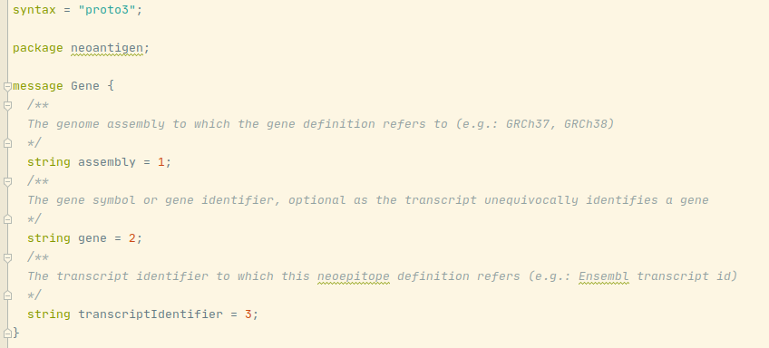

Protocol buffers
Multiple languages are supported effectively enabling multiple technologies
protoc compiler
The data modeller has to define the biological data determining field names and data types
The models are documented with the model itself and with the comments
betterproto: https://github.com/danielgtaylor/python-betterproto
Implementation available here: https://gitlab.rlp.net/tron/addannot/-/tree/v0.3.0/neofox/model

Slide 6

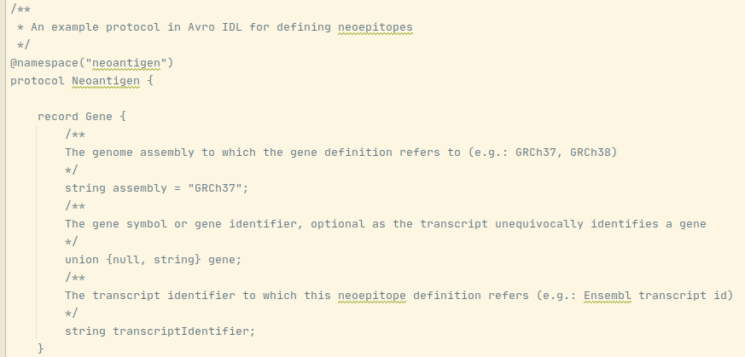
Apache Avro
AVSC
AVPR
Support for less languages + worst Python integration
avrotools
More complex compilation process due to intermediate formats
The data modelling is very similar to Protocol Buffers
The main difference is the ability to define required and optional fields
Documentation is similar
Implementation available here https://gitlab.rlp.net/tron/addannot/-/merge_requests/32/diffs

Slide 7
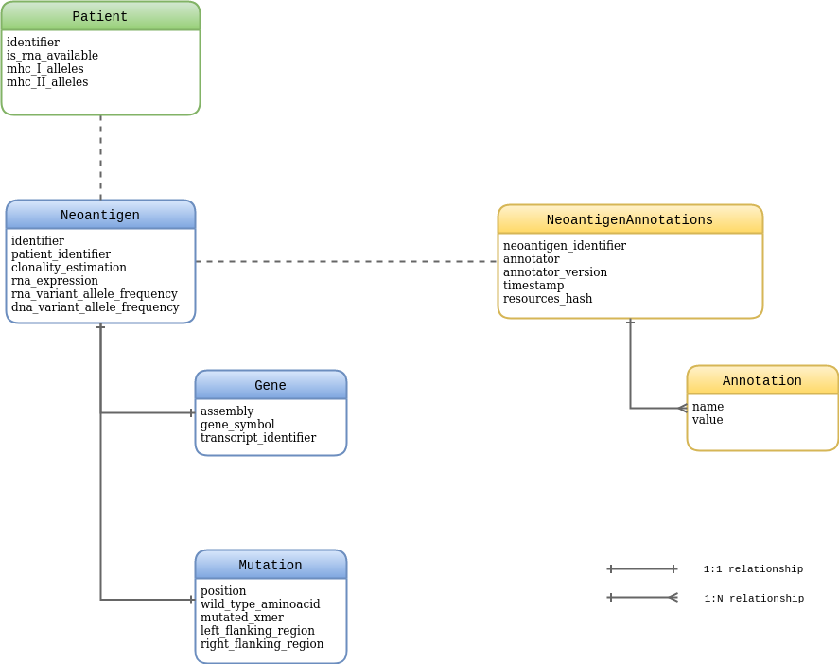
Neofox neoantigens model
We fully modelled Neofox input and output
Input data is parsed into these models and then validated ensuring consistency
Neofox internally works with model objects improving the decoupling of software components
Machine readability of the output is ensured by using models

Slide 8
Neofox Application Programming Interface (API)
# create a neoantigen
from neofox.model.neoantigen import Neoantigen, Patient, Gene, Mutation
gene = Gene(
assembly="hg19", gene="VCAN", transcript_identifier="uc003kii.3")
mutation = Mutation(
position=1007,
wild_type_aminoacid="I", mutated_aminoacid="T",
left_flanking_region="DEVLGEPSQDILV", right_flanking_region="DQTRLEATISPET")
neoantigen = Neoantigen(
gene=gene, mutation=mutation, patient_identifier="patient_123",
rna_expression=0.519506894, rna_variant_allele_frequency=0.857142857, dna_variant_allele_frequency=0.294573643)
patient = Patient(
identifier="patient_123", is_rna_available=True,
mhc_i_alleles=["HLA-A*03:01", … ,"HLA-C*12:03"],
mhc_i_i_alleles=["HLA-DRB1*11:04", … ,"HLA-DPB1*04:01"])
# validate data (eg: invalid aminoacids will fail validation)
from neofox.model.validation import ModelValidator
valid_neoantigen = ModelValidator.validate_neoantigen(neoantigen)
# run Neofox
from neofox.neofox import NeoFox
annotations = NeoFox(neoantigens=[valid_neoantigen], patients=[patient], patient_id="patient_123", num_cpus=2).get_annotations()

Slide 9
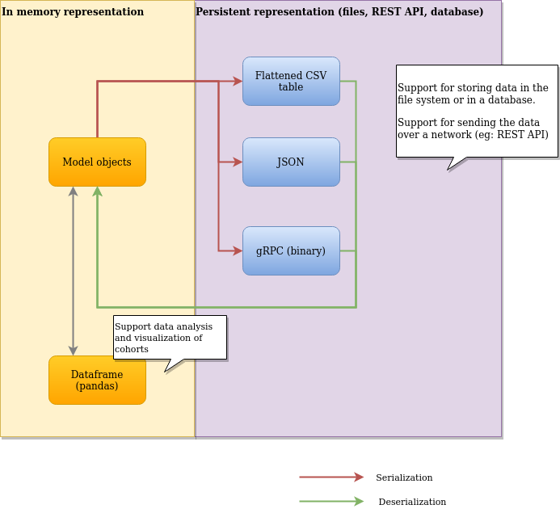
Data serialization

Slide 10
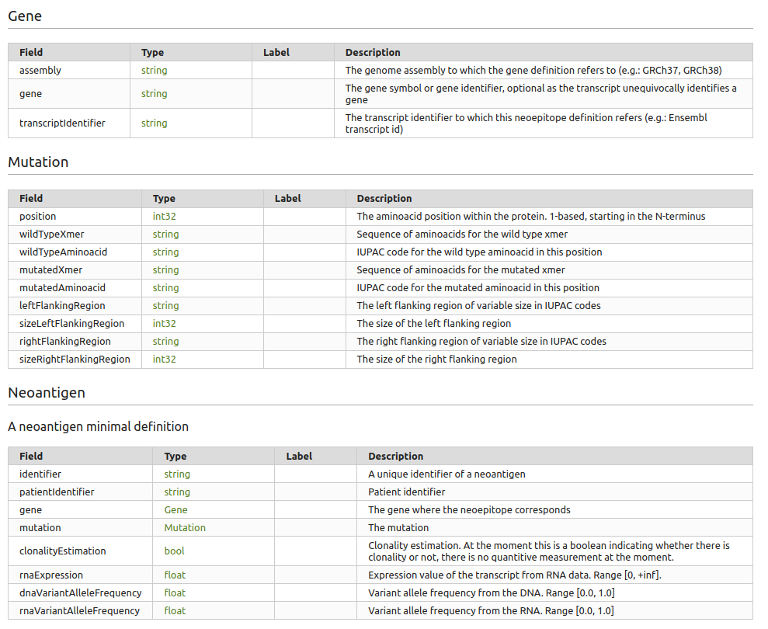
Documentation

