Slide 1
BPR
Study System
Siyu Xia 305554
Xuanyuan Cao 305557

Slide 2
Agenda
Introduction
Analysis
Design
Implementation
Tests
Results and Discussion
Conclusions
Project Future

Slide 3
Introduction (Siyu)
Flexibility in learning
Accessibility to resources
Personalized learning experiences
Notes:
Online courses became much more popular during the COVID-19 pandemic.
In 2016, there were over 6 million students in the U.S. who enrolled in at least one online course.
And in 2020, due to the impact of the COVID-19 pandemic, many schools and students were forced to switch to emergency remote teaching, which also further promoted the demand and development of online learning.
Online learning has many advantages, such as flexibility, accessibility. Online learning can allow students and teachers to arrange their learning and teaching according to their own time and place, without being limited by time and space.
The goal of this project is to provide a convenient and efficient video resource management platform for online learning students and teachers.

Slide 4
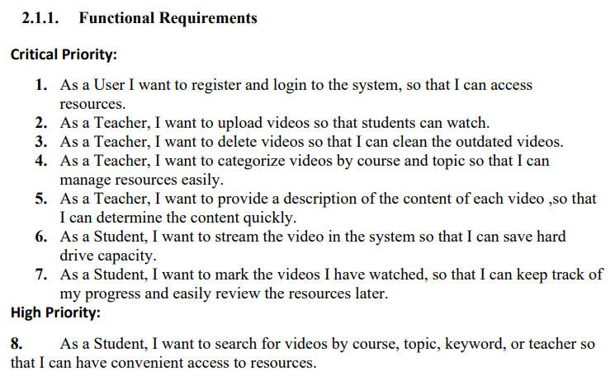
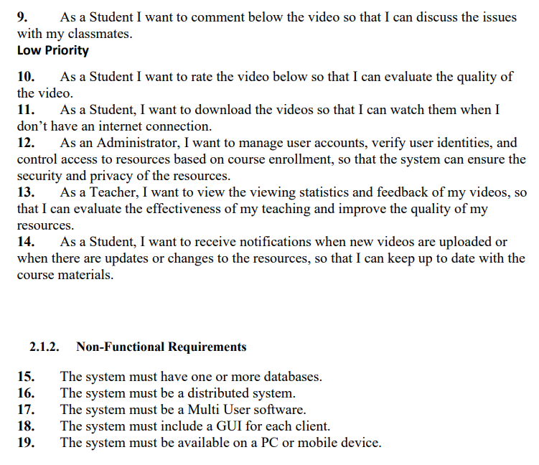

Analysis - Requirements (Siyu)
Notes:
The reason for choosing this topic is that we found that during the previous covid-19 pandemic, online courses became much more popular, and after we were finished, sometimes we would upload the recording to a third-party site, such as YouTube. Which leads to another problem, for example, YouTube doesn't use a VIA ID to log in, and even after we hide the video from the homepage, it can still be accessed by anyone who has a link to it. This makes the video not so private.
The second issue we noticed is that YouTube only allows you to like or dislike videos. This rating is too simple and is only split into positive and negative. We felt that for a learning video there needed to be a more refined rating to allow for different kinds of feedback.
The screen shows the requirements that we selected after analyzing and researching.

Slide 5
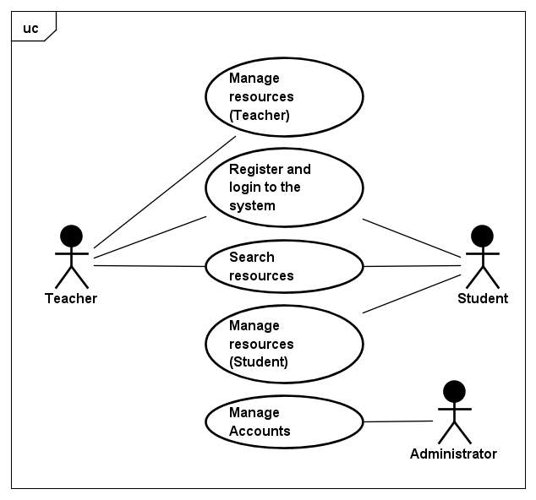
Analysis - Use Cases
Use case diagram
Use case description
Notes:
We have 5 use cases which are Mange resources for teacher, register and login, search resources, Manage resources for student and Manage accounts.
As well as 3 different users, the teacher, the student and the administrator.

Slide 6
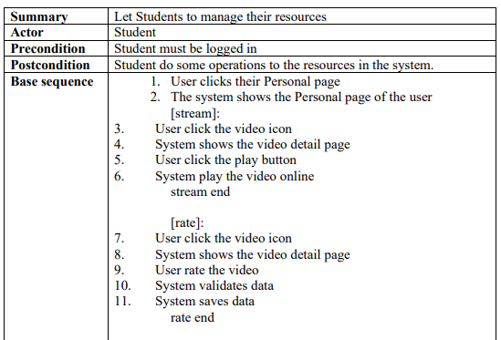
Use case description
Part of Use case table for
Manage resources
(Student)
Notes:
This is part of a use case description of for resources management for student.
As a student, he can watch videos online, rate videos, comment on videos, and download videos.

Slide 7
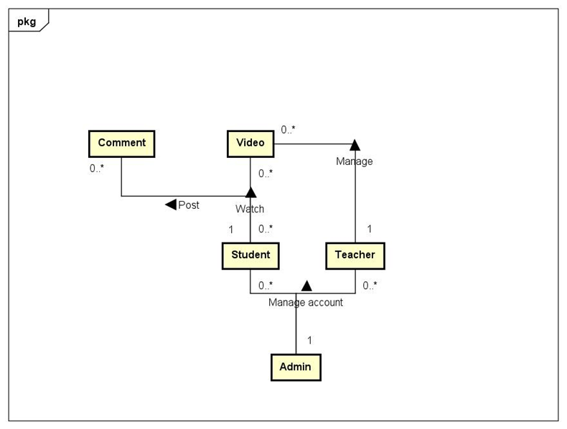
Analysis - Domain Model
Notes:
Here’s our domain model, it provides a clear and structured view of the project's scope. It also helps in identifying key functionalities and relationships between different components.

Slide 8
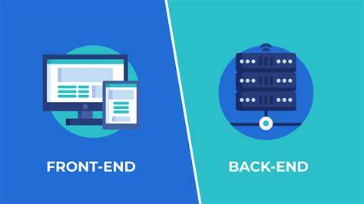
Design - General (Xuanyuan)
Front End
Back End

Slide 9
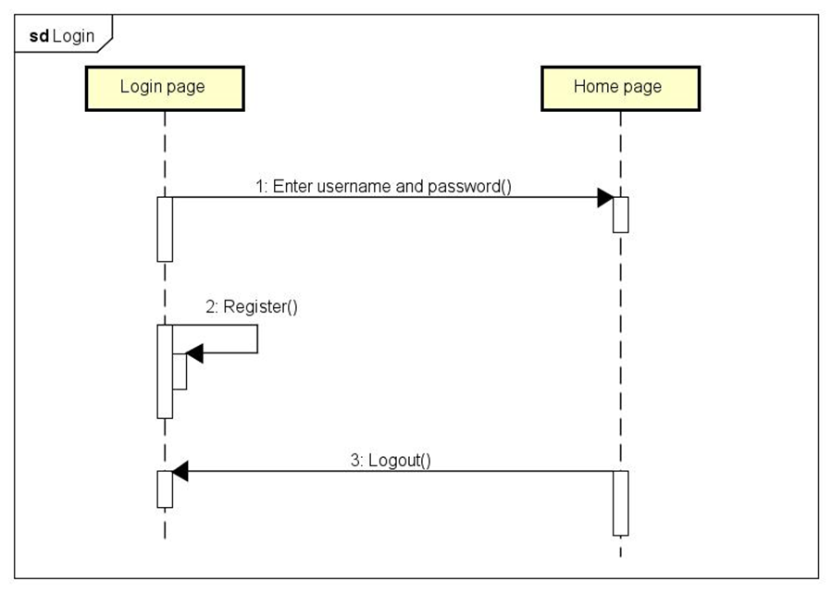
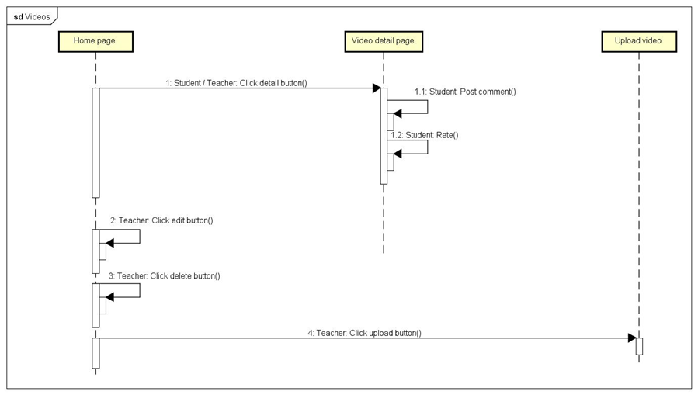
Design - Front End
Student, teacher
Login
Video

Slide 10
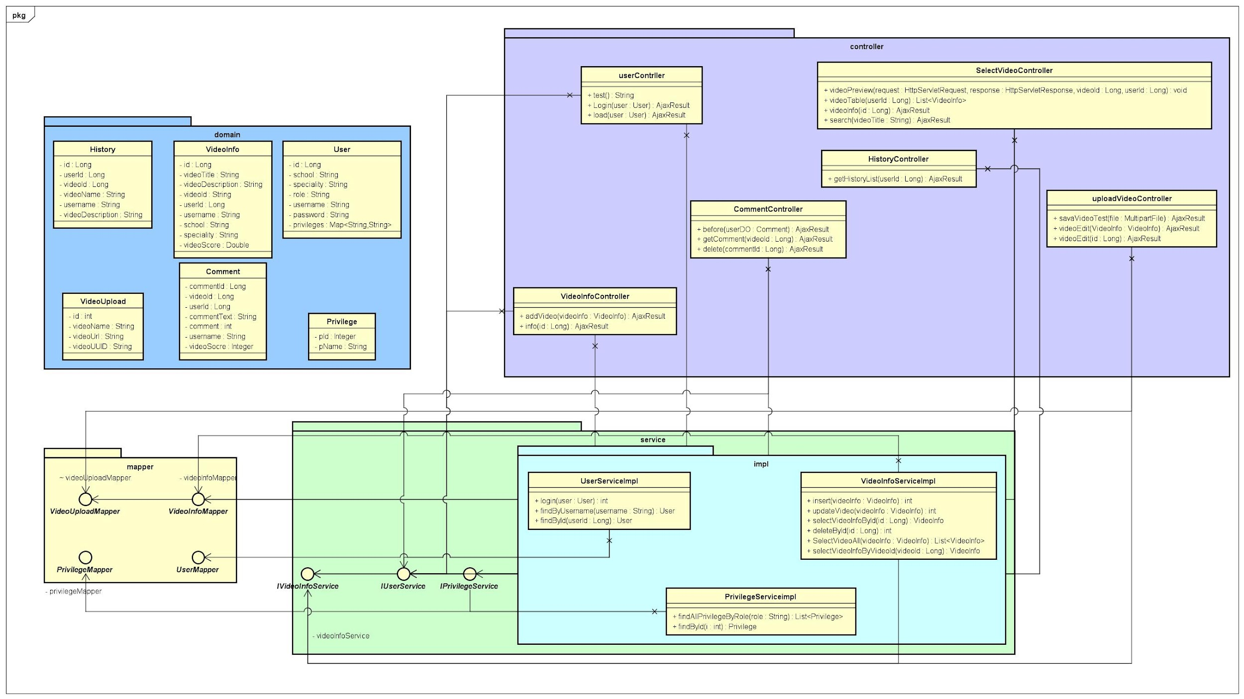
Design - Back End
Java
Spring boot
N-layer
WebSocket
Mybatis
Notes:
Controller layer is used for handle HTTP requests and responses, it can call service layer to do business logic and send back the response.
Service layer is mainly for doing business logic. It can call mapper layer to handle database and do business logic like some calculations so that controller can focus on HTTP requests. It is the layer between controller and mapper.
Mapper layer is designed for communicating with database and send data to service layer. In this project we use MyBatis as a tool to do this since MyBatis can enhance code readability and simplifying SQL operations.

Slide 11
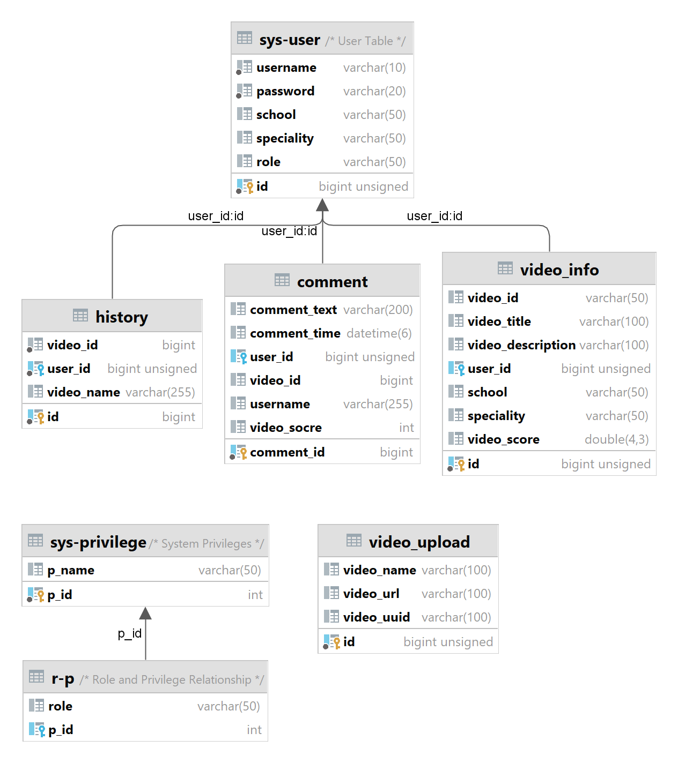
Design - Data (Siyu)
Notes:
So here’s our database design, we have 7 tables.
The user table handles all the data we need when they register to the system.
The history table is use to store every user’s watching history.
The comment table will store the time and user of each comment and which video it belongs to as well as their rating.
The video_info table is used to store the details of the video, such as the title and comments, as well as the school and major.
The rest is used to assign different privileges to different users, so that each user can only see or access the parts of the system that he is allowed to access.

Slide 12
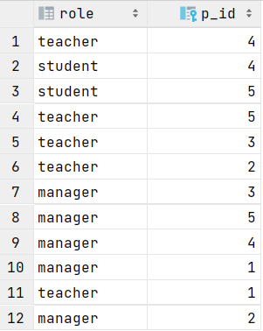
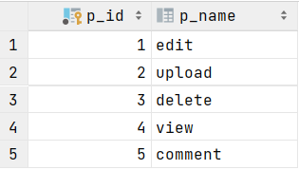
r-p
sys-privilege
Notes:
The sys-privilege table stores the privilege numbers corresponding to all the functions.
The r-p form is used to assign different privilege numbers to different roles.
The back-end sends the front-end user tokens with their privilege numbers, which the front-end uses to determine the visibility of elements to different users.

Slide 13
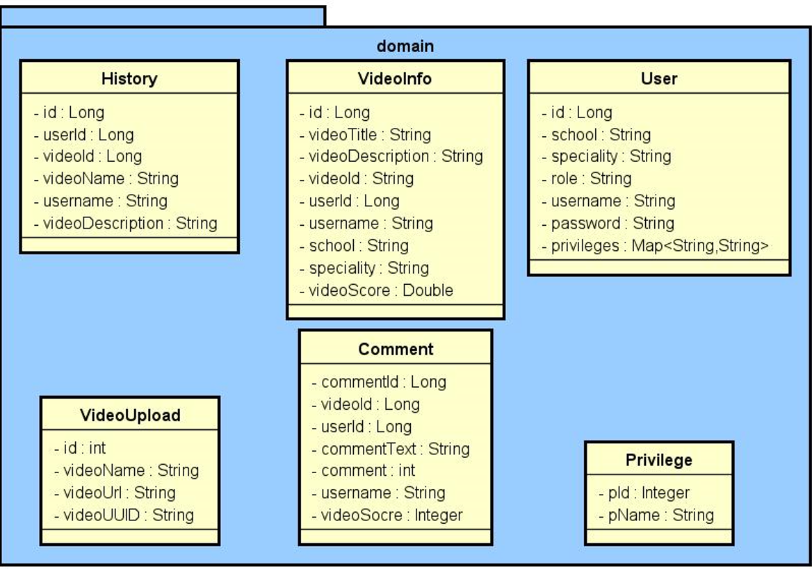
Design - Data
Notes:
This is the class diagram of our database

Slide 14
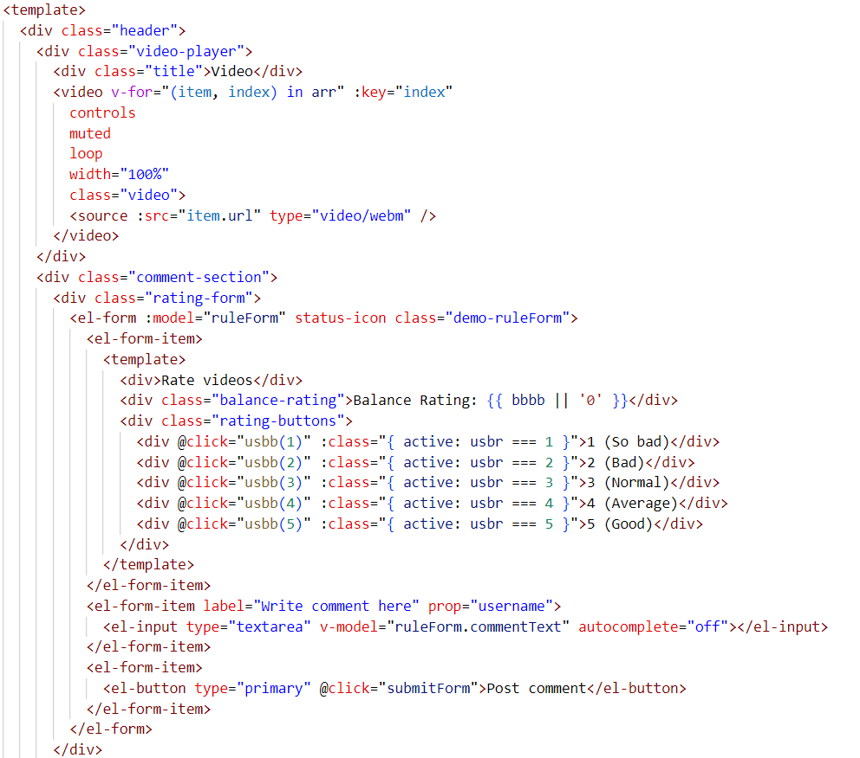
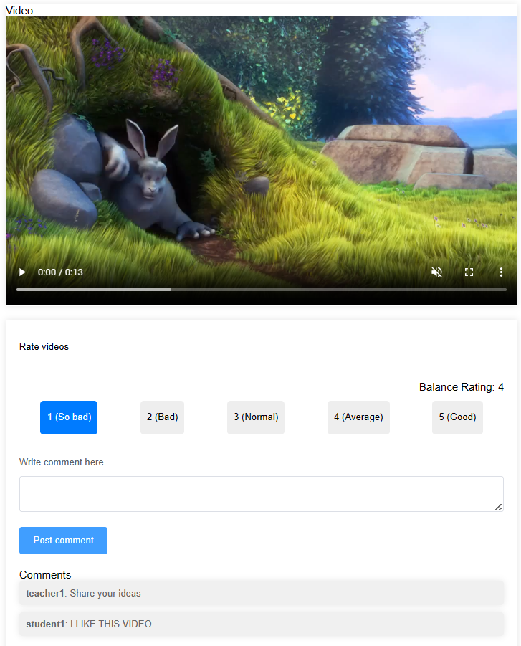
Implementation - Front End - Video Detail Page (Siyu)
Notes:
We use Vue.js to build the front end. Vue.js is a progressive JavaScript framework used for building user interfaces. It’s very suitable for single-page applications.
It provides a reactive and component-based structure, making the development process efficient. It means it can automatically updates the view when the code changes.
Here’s an example of our Video detail page. This code here defines the layout and components of the interface.
The page contains two sections, a video-player and a comment-section.

Slide 15
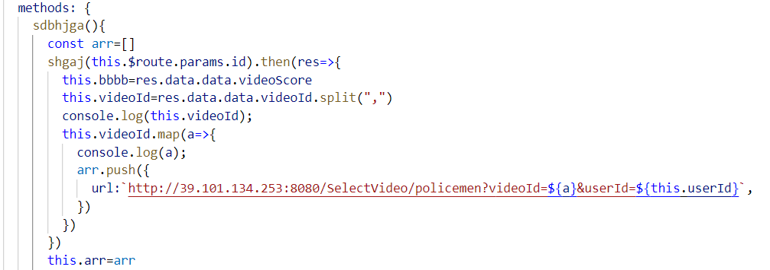
Notes:
And this one is a method used to pull the video from the backend

Slide 16
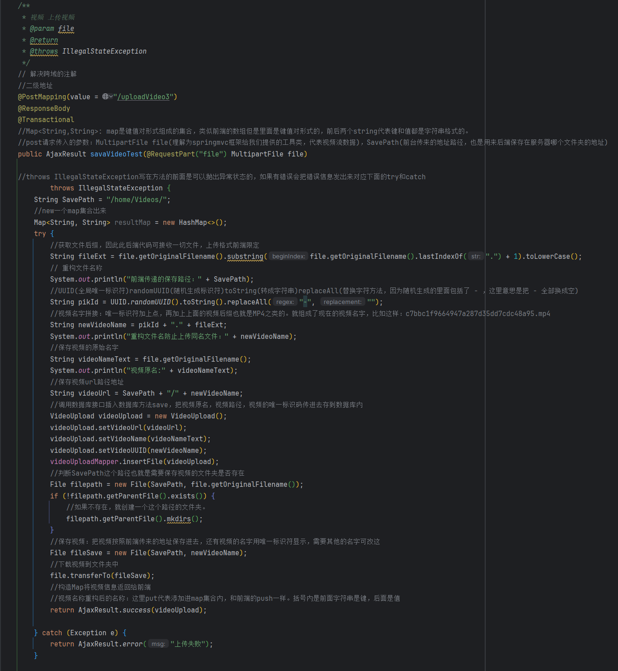
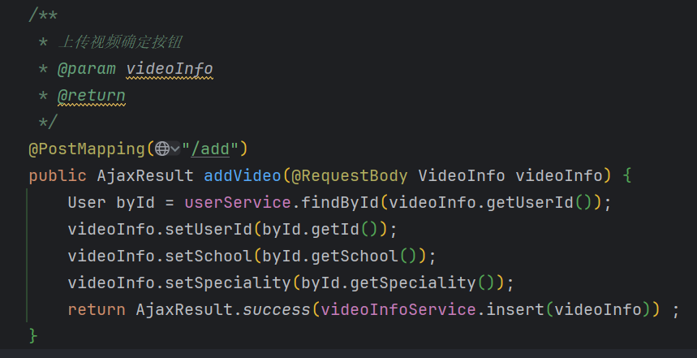
Implementation - Backend - Upload video Part (Xuanyuan)
Notes:
Since that we have two databases to store different information about videos, one for storing the path of the video file in the server, and one for storing information about the video description submitted by the user. We provides two controllers here to handle different video data.
Left: Generate a new path: to ensure that the file can be accurately saved on the server.
Generate a new name: This avoids having to save two copies of the same file name in the same directory.
Then download the video and save it to the specific directory.
Finally, return the results to the front end.

Slide 17
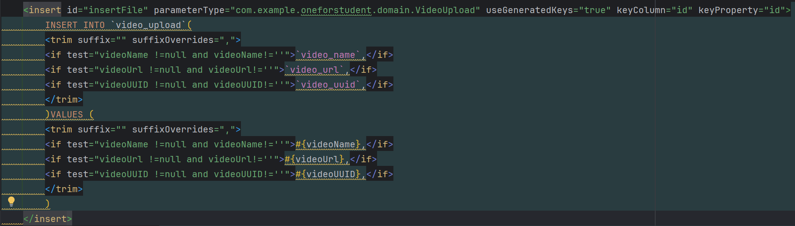
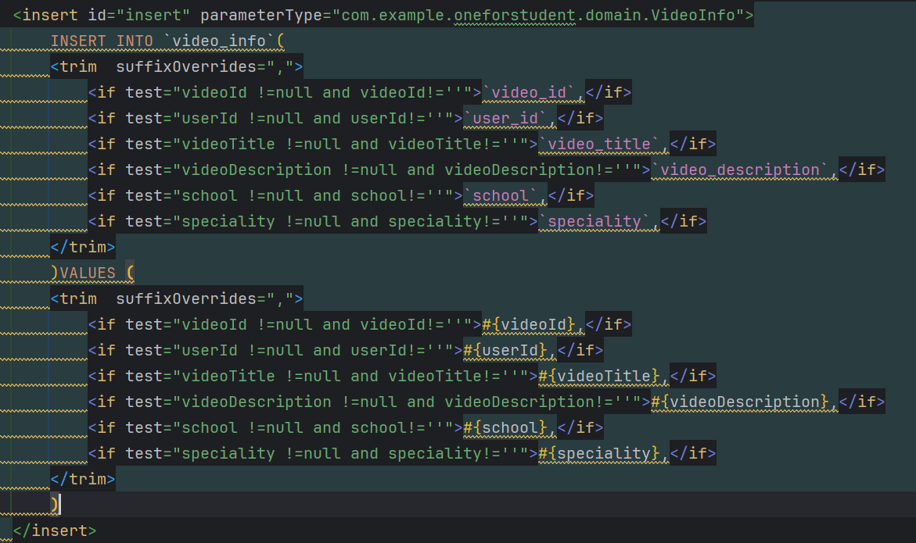

Notes:
Video_info: video info like title, userId, school
Video_upload: video path in server
Here are mappers, after receiving the data from controller the mapper will communicate with database and try to save the data into database. It will validate the value of each parameter at first, if there’re no empty values it will keep going to save data. Otherwise it will show an error and rollback all the operations since we have @Transactional in the controller.

Slide 18

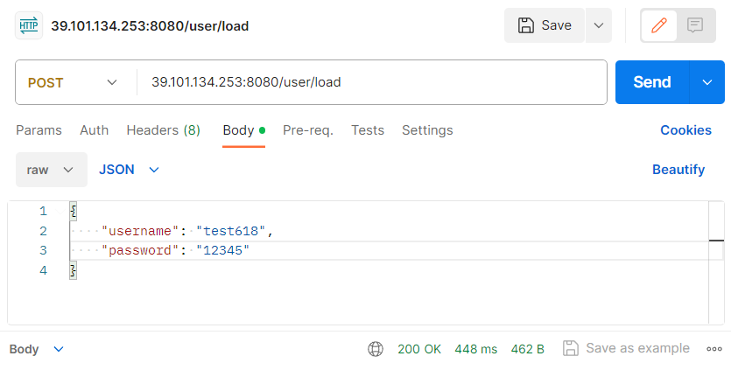
Tests - Back End (Siyu)
Postman
Black-box testing
Notes:
Regarding the testing part, we use Postman for black box testing and tested all the backend api functions.

Slide 19
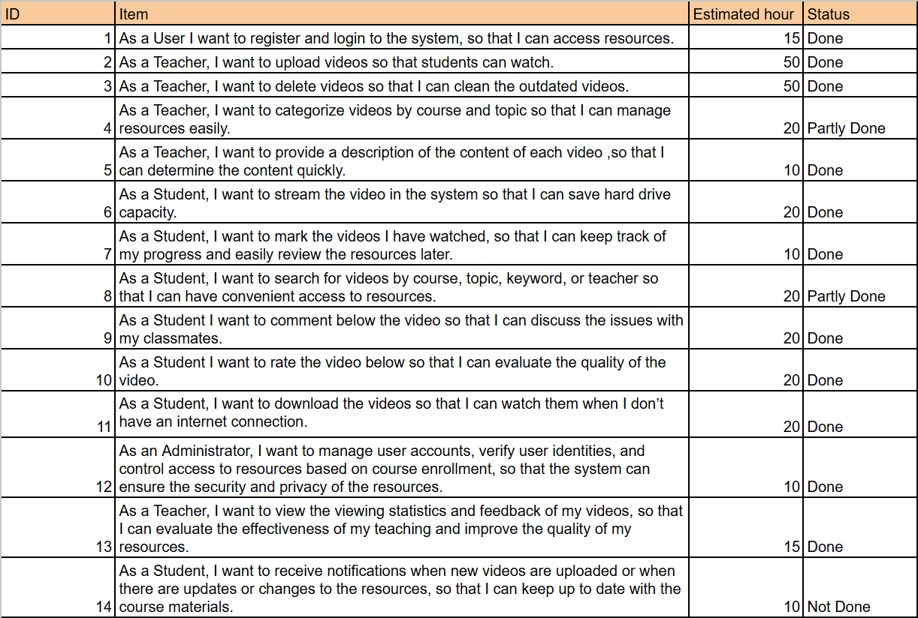
Results and Discussion (Xuanyuan)
85% of requirements implemented.
Critical requirements were implemented and the system is fully working: login and register, upload and stream video and rate and comment video.
Notes:
Discussion: As you can see, we still have some parts to go. For requirement No.4, Due to time constraints, we did not complete the part of having teachers manage resources according to topics. For No.8, the students can only search videos by keyword. No.11, student can download video but this feature is provided by the video player which means we needn’t to do anything more like make a download button. Since we are not familiar with Vue design, we spent too much time on main features like login, video upload and write comments. We didn’t have enough time to complete notification system and that’s why No.14 is not complete.

Slide 20
Conclusions (Xuanyuan)
High priority requirements
Main functionality of the system
Notes:
The goal of this system is to be a tool for an online study platform, to be a user-friendly app that allows students and teachers to access and manage various learning resources. We finished the high priority requirements and make sure the main function of system is fine and working. To achieve this, we made several decisions such as using Mybatis to communicate with database, using RESTful API to handle HTTP requests.

Slide 21

Project Future (Siyu)
Support for Diverse Learning Resource Formats
Allowing teachers to publish documents, compressed files, and code snippets
Enhanced Comment Functionality
Adding emoticons, pictures, and other non-text content to comments.
Displaying comments in a more interactive and attractive way.
Support for more platforms
Notes:
About the future. We plan to extend support for more formats of learning resources. This will allow teachers to publish not just videos, but also documents, compressed files, and code snippets.
We plan to enhance the comment functionality by allowing users to add emoticons, pictures, and other non-text content. This will enable more expressive and detailed feedback from users.
We also plan to support for more platforms. This will make our study system accessible on more devices and operating systems, enhancing usability for users.

Slide 22
Thank you !

