Slide 1

Company Profile
Percept Infosystem is a software development and IT Training provider and Consultants company based in Nagpur offering services in the area of application development, web development, Training in IT and Non- IT Languages and Outsourcing.

Slide 2
Services Offered :
Software Development
Recruitment Services
Payroll Services
Software Training Courses
Digital Marketing Services

Slide 3
Development :
Percept Infosystem work in PHP. We have smart Wordpress developers who can integrate the designs and create the custom functionality.
We offer complete PHP Development Services and web programming services. we develop custom php web application, portals, ecommerce solution, business processes using php, MYSQL, MVC framework, open source cms like word press, joomla, magneto, etc.

Slide 4
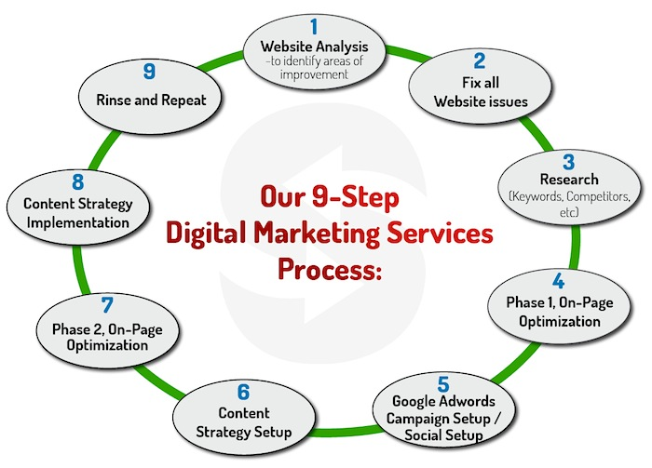
Digital Marketing

Slide 5
Training Courses are:-
PHP
.NET
Java
Software Testing
Digital Marketing
Web Designing
Graphic Designing
Android
Auto CAD
Catia
Python
HR Training

Slide 6
Placements:
Dedicated Placement Cell for Lifetime Placement Support with a Network with leading IT Companies.

Slide 7













Our Clients:

Slide 8














Slide 9
Payroll Services offered by Percept Infosystem
Employee Management
Salary Management
Leave Management
PF/ESIC/PT returns
Calculating Paychecks and Tax Obligations based on Employee Time Sheets.
Access to accurate and timely pay slips
Escalating cost due to in-house payroll maintenance
Security and confidentiality of payroll and employee data
Compliance with the latest laws and regulations

Slide 10
Access to accurate and timely pay slips
Escalating cost due to in-house payroll maintenance
Security and confidentiality of payroll and employee data
Compliance with the latest laws and regulations

Slide 11
Why Join Us
Organized pre-placement /training /Workshops/ Seminars for students.
We operate with the shared values of integrity, quality and accountability in everything we do.
We have well trained, reliable, Experienced professionals; with capacity to deliver on commitments, rapid responsiveness to resource needs and great sense of urgency there b resulting into cost effective pricing for our customer.

Slide 12



Get In Touch
20/2, Akar Builders, Opp – Dalal Nursing home, Near Byramji town, Sadar, Nagpur.
Website: www.perceptinfosystem.com
Email: hr@perceptinfosystem.com
Miss. Pooja Bhosle
8208970766/
7414977373
Contact Us

