Slide 1
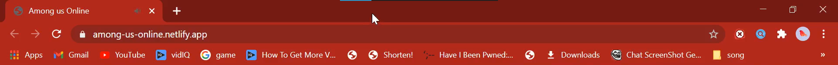

Slide 2

Online
Home Play Steam Settings Account
Sign in!
Username
Password
Play
You need to sign in to play
Don’t have an account? Sign up!

Slide 3
Online
Sign up
Username
Password
Email
Next
Have an account? Sign in!

Slide 4
Online
Please verify your email fakemanwhodoesnotexist@gmail.com
Resend email
Have an account? Sign in!
Home

