Slide 1
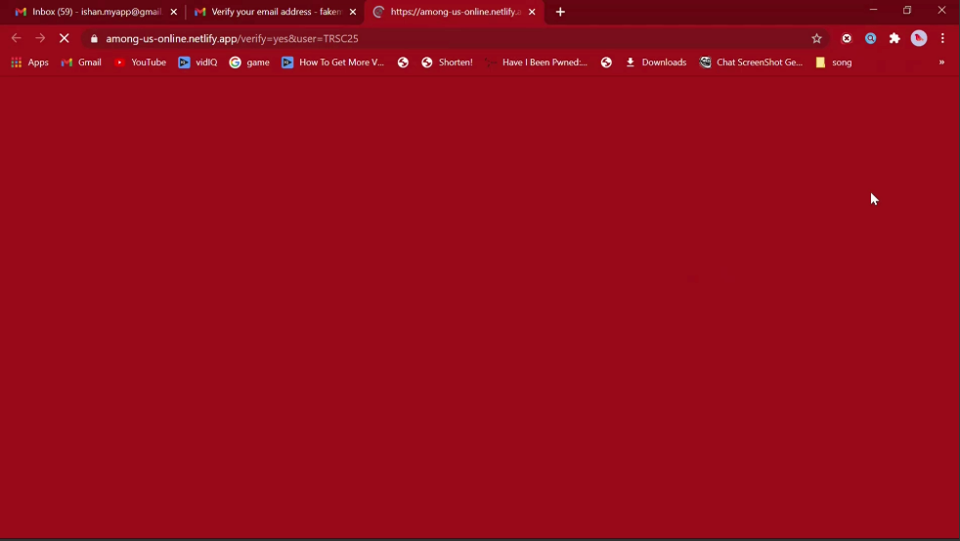

Slide 2
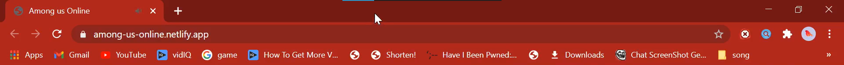
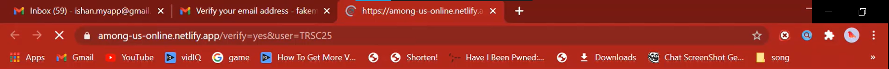
Redirecting to among-us-online.netlify.app

Slide 4

Online
Account verified successfully. Sign in to play.
Home Play Steam Settings Account
Sign in!
Username
Password
Play
You need to sign in to play
Don’t have an account? Sign up!

Slide 5
Online
Home Play Steam Settings Account
Sign in!
Username
Password
Play
You need to sign in to play
Sign in
Don’t have an account? Sign up!

Slide 6

Online
Home Play Steam Settings Account
Play
Welcome TRSC25!
Don’t have an account? Sign up!

Slide 8

/play=init&username=TRSC25&auth=done
Initializing
. . . . .

Slide 9
/play=init&username=TRSC25&auth=done
Entering fullscreen
. . . . .

Slide 10
Press F11 to exit full screen
Starting game
. . . . .

