Slide 1
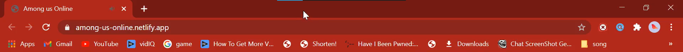

Saving game
. . . . .

Slide 2




Online
Saving game…..
Home Play Steam Settings Account
Play
Welcome TRSC25!

Slide 4
/play=init&username=TRSC25&auth=done
Initializing
. . . . .

Slide 5
/play=init&username=TRSC25&auth=done
Entering fullscreen
. . . . .

Slide 6
Press F11 to exit full screen
Starting game
. . . . .

