Slide 1
Editing STEP Schemas in VS Code
A user guide to the easyEXPRESS Viewers
Version 0.4.0 · May 2026
For schema authors and reviewers
Thomas Thurman

Slide 2
What this guide covers
Read schema descriptions without leaving the editor.
See math (stem:[…] / latexmath:[…]) rendered, not as raw text.
Click EXPRESS-G boxes to jump to the entity's source.
Type and live-preview AsciiMath in a popup.
Keep confidential schemas confidential — what to disable.

Slide 3
Before easyEXPRESS Viewers
Hovering on point shows the bare ENTITY declaration.
stem:[RR^m] in a description appears as raw text.
<<express:geometry_schema.cartesian_point>> is not clickable.
Opening an EXPRESS-G .svg shows XML.
To see what your schema looks like rendered: run Metanorma.

Slide 4
Install in 30 seconds
Get the .vsix file: easyexpress-0.4.0.vsix
Install:
  $ code --install-extension easyexpress-0.4.0.vsix
Reload VS Code (or just close + reopen).
That's it. The four viewer surfaces are now live in every .exp file.

Slide 5
Step 1 — Open your schema
Open VS Code on your wg12-step working tree.
Open any .exp file. For this tour: geometry_schema.exp.
You'll see the usual EXPRESS syntax highlighting.
Nothing visibly different yet — the viewers activate on demand.

Slide 6
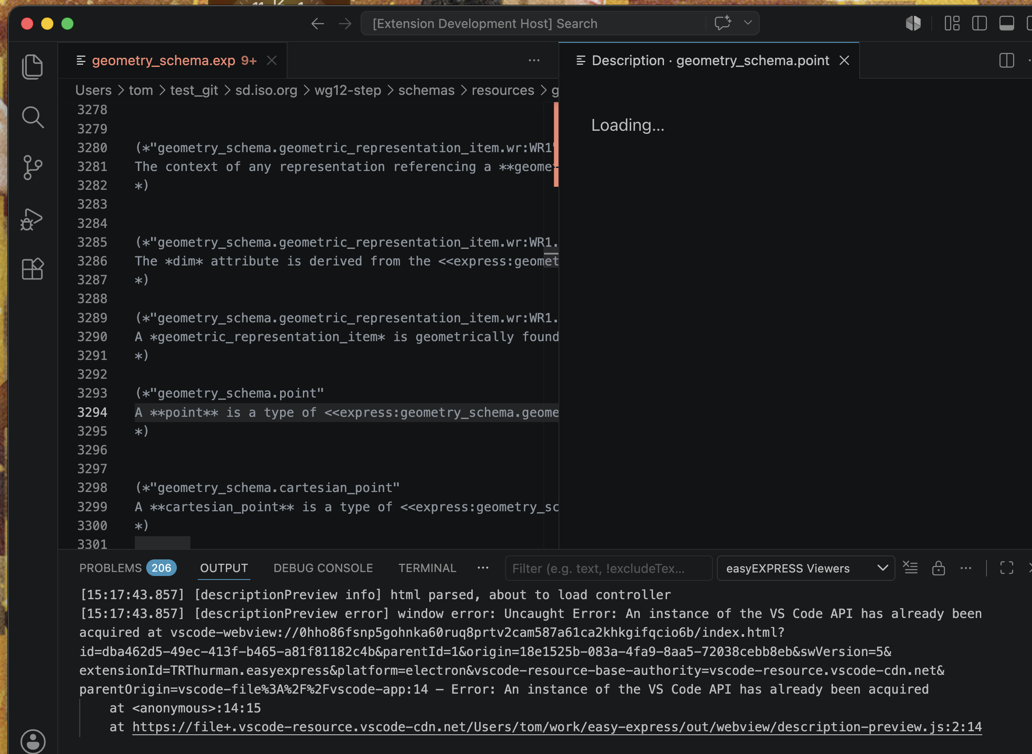
Step 2 — Hover any entity name
Hover over `point` (line 3294 in geometry_schema.exp). A tooltip appears with:
the description, clickable cross-references (blue underlined), and inline math (ℝᵐ here).

Slide 7
What the hover shows
Heading: the qualified path (geometry_schema.point).
Body: first ~360 chars of the description, transformed:
  stem:[…] becomes a rendered math glyph.
  <<express:…>> becomes a clickable link to that entity's description.
  *emphasis* becomes bold.
Click "Show full description" at the bottom for the rendered AsciiDoc.

Slide 8
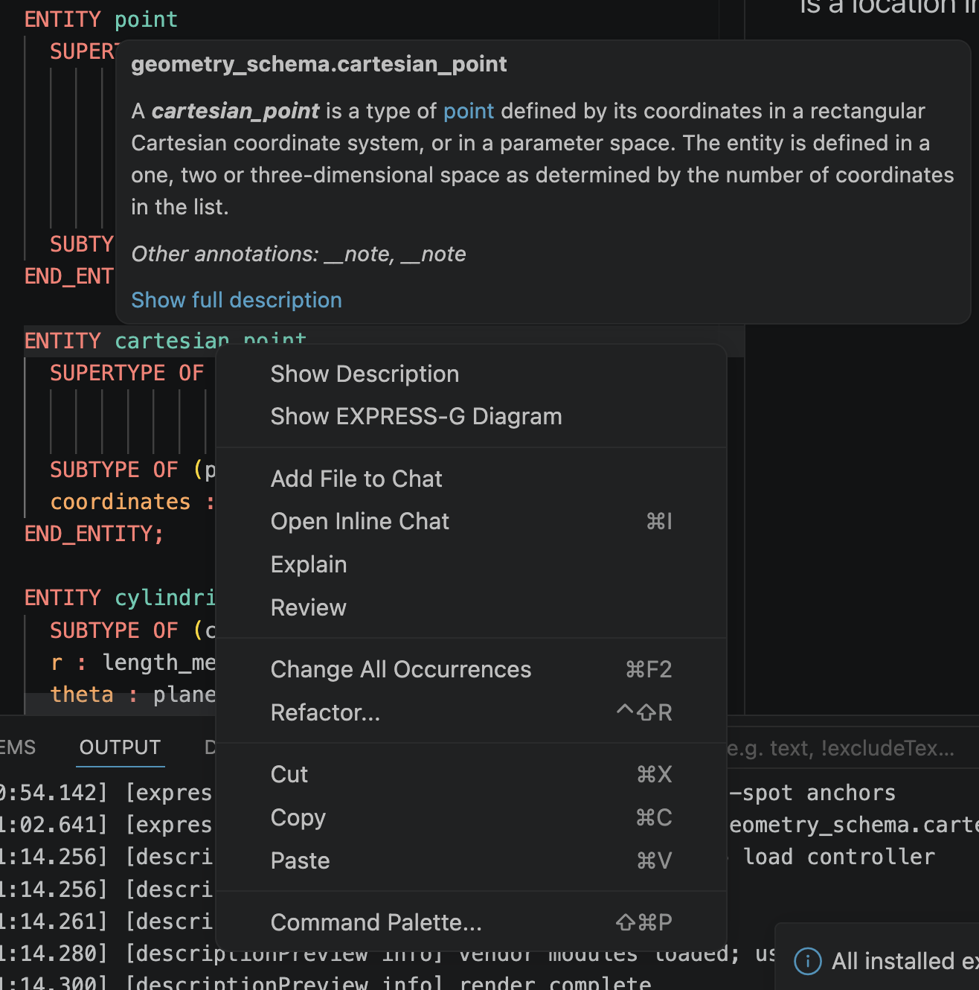
Right-clicking inside a .exp file adds two new entries near the top:
Show Description and Show EXPRESS-G Diagram.
Step 3 — Right-click for the new commands

Slide 9
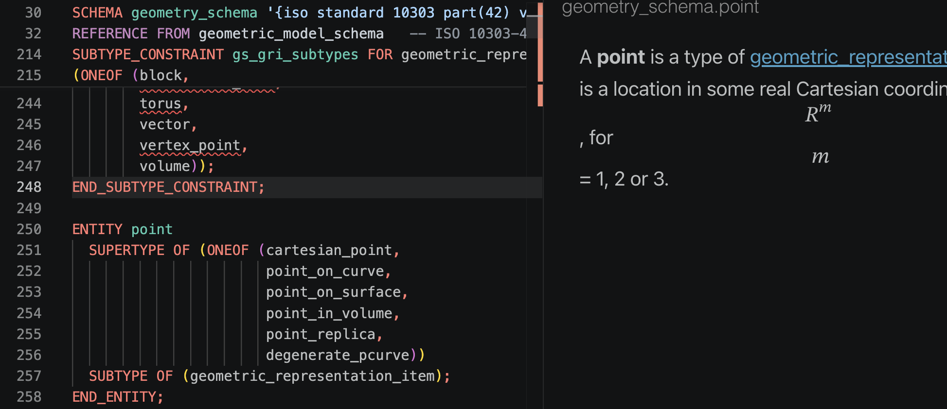
Step 4 — Show full description
A panel opens beside the editor with the rendered description:
headings, lists, tables, cross-refs, AND math typeset as MathML.
Same fidelity as Metanorma's published HTML.

Slide 10
About the description preview
Updates when you re-invoke the command — not auto-refresh.
stem:[…] renders via Plurimath (the same converter Metanorma uses).
latexmath:[…] also renders (Plurimath accepts both formats).
Math you write here will look identical to the published spec.
Click any cross-reference link to open that entity's description.

Slide 11
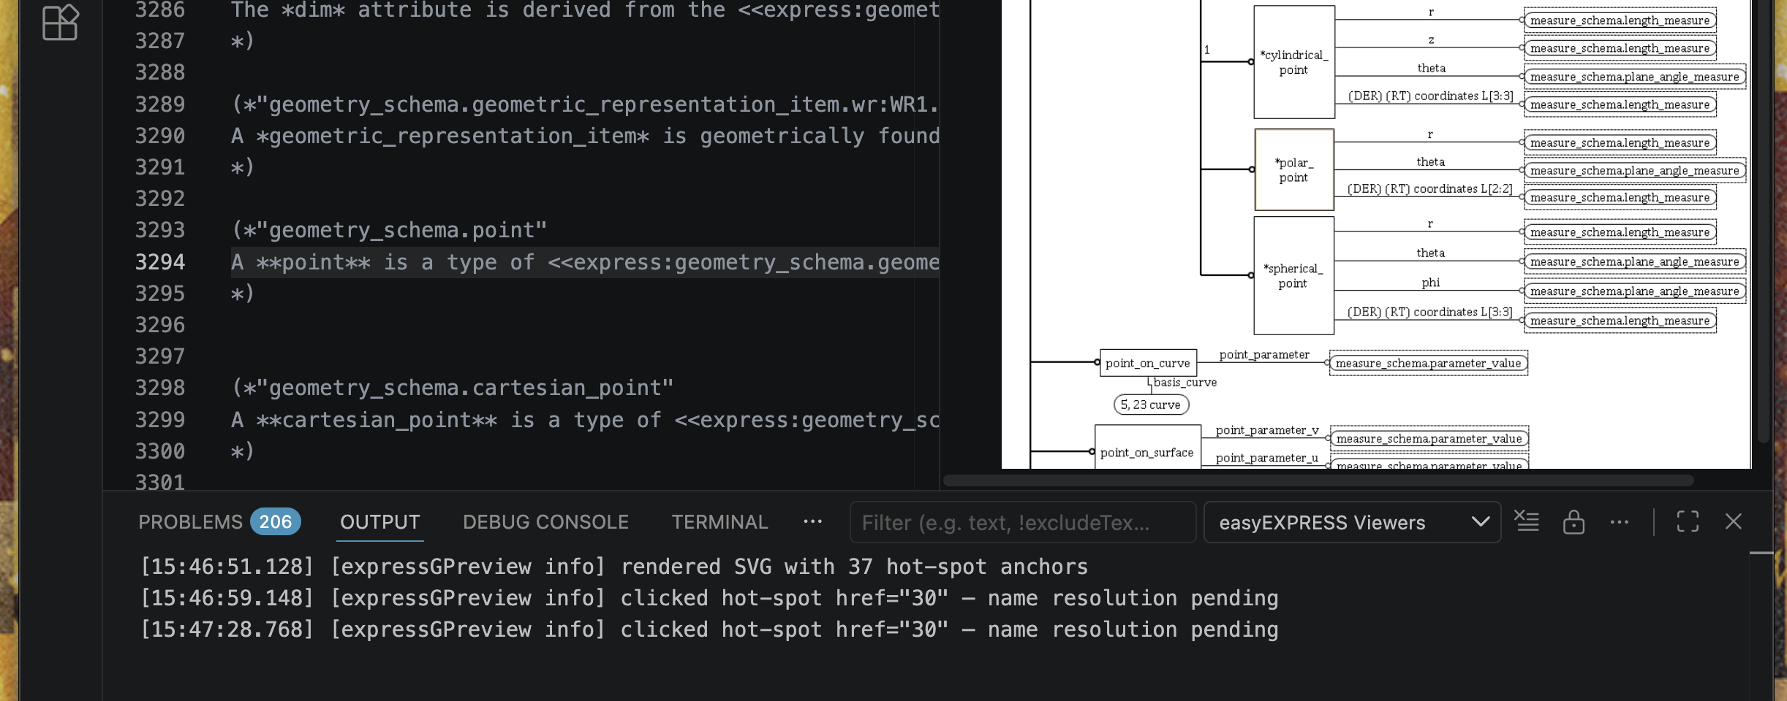
Step 5 — Show EXPRESS-G Diagram
The diagram opens. Hover-over an entity in the schema first — the picker auto-narrows
to just the diagrams that include that entity. Click any labeled box to navigate.

Slide 12
Click any box to jump to its source
Each labeled rectangle is a clickable hot-spot.
Click polar_point → editor jumps to ENTITY polar_point in the same schema.
Click cartesian_point → same: jumps to its definition.
Click an entity from another schema → cross-schema navigation works too.
If the target isn't in any open .exp, you'll see "no definition found".

Slide 13
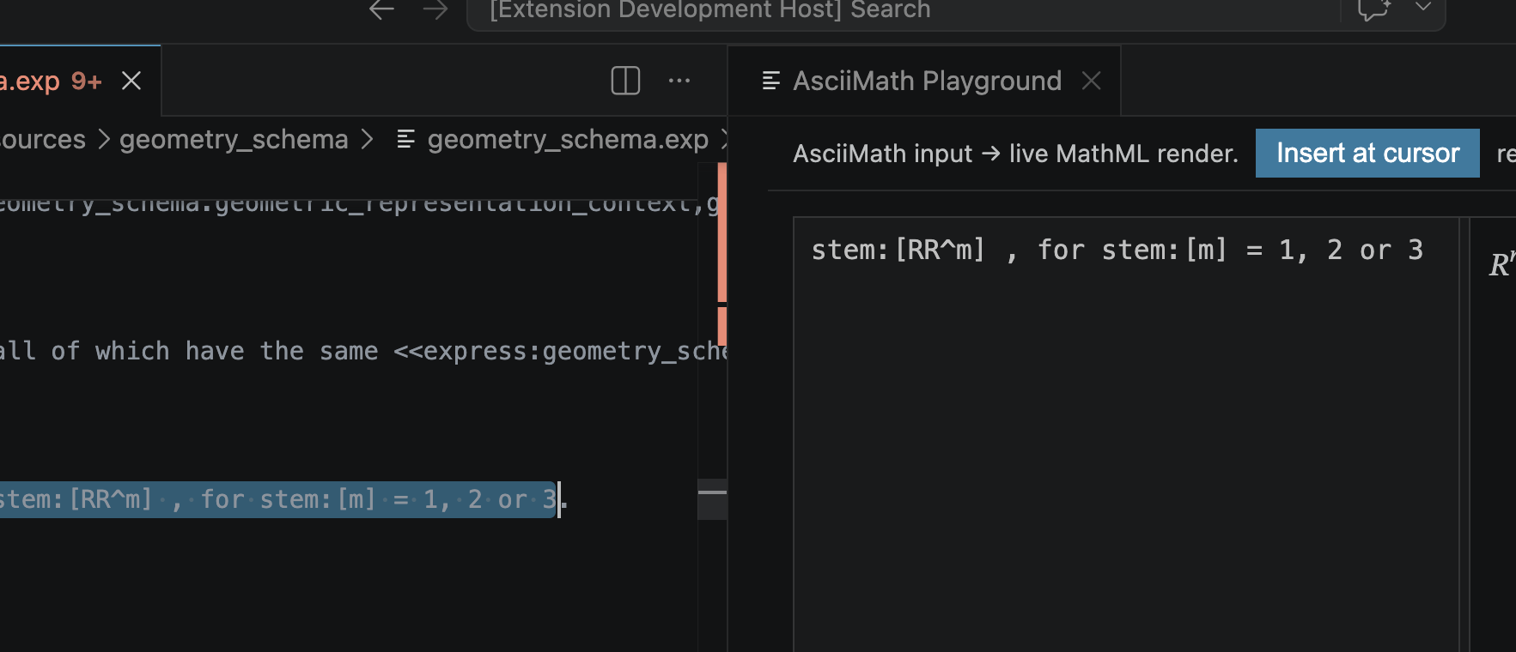
Step 6 — Open AsciiMath Playground
Cmd+Shift+P → "easyEXPRESS: Open AsciiMath Playground".
Two-pane editor: type AsciiMath on the left, select math, right click, select "send asciiMath to playground", see rendered math on the right.

Slide 14
Insert math into your schema
Type your AsciiMath in the left pane (live render on the right).
Place your editor cursor where you want the stem:[…] to go.
Click the "Insert at cursor" button.
Your text becomes stem:[<your math>] in the schema.
Save the file; Metanorma will render the same way the playground did.

Slide 15
Important — privacy for confidential schemas
easyEXPRESS Viewers itself sends NOTHING outside your machine.
But VS Code Insiders ships GitHub Copilot Chat as a built-in feature.
Disabling extensions does NOT remove it.
When you click Explain / Add File to Chat / Open Inline Chat / Review:
Cursor word, surrounding code, and snippets from other open editors
are sent to GitHub/Microsoft endpoints.
For NDA / pre-publication standards work this is a real concern.

Slide 16
Privacy — how to sign out of GitHub
Click the account icon at the bottom-left (silhouette) of the VS Code window.
Choose "Sign Out" from GitHub. Without auth, Copilot Chat cannot reach its API.
The menu items remain visible but clicking them errors locally with no outbound.

Slide 17
Privacy — alternative settings
If you'd rather keep the icons gone, in workspace settings (.vscode/settings.json):
"chat.disableAIFeatures": true
Recent VS Code releases honour this as a hard switch.
Best practice: a separate signed-out window for any sensitive standards work.
Re-sign-in is one click when you switch to non-confidential projects.

Slide 18
Recap — five things to remember
Hover over any entity to see its description with rendered math + clickable links.
Right-click → Show Description for the full rendered description panel.
Right-click → Show EXPRESS-G Diagram for clickable hot-spot navigation.
Cmd+Shift+P → AsciiMath Playground for live math editing.
For confidential schemas, sign out of GitHub OR set chat.disableAIFeatures.

Slide 19
Where to get help
Issue tracker: github.com/TRThurman/easy-express-mirror/issues
Maintainer: Thomas Thurman · thomas@trthurman.consulting
Smoke-test checklist: docs/smoke-test-checklist.md
Companion technical paper: docs/easyEXPRESS-viewers.adoc
Implementor deck: docs/easyEXPRESS-viewers.pptx

